Slide 1
IBM University Engagement Project Submission
“AI-Driven NSAP Scheme Predictor using IBM Watson Machine Learning”

Slide 2

Project Tile – AI-Driven NSAP Scheme Predictor using IBM Watson Machine Learning
Domain of Project – Government Welfare and Social Security
Student Name | Recent Passport Photo | Email ID | Mobile number [WhatsApp]
MANYA MISHRA |  | manyamishra303@gmail.com | 8318063102

Slide 3
Problem Statement -
Problem Statement : AI-Driven NSAP Scheme Predictor
The Challenge -
The National Social Assistance Programme (NSAP) provides financial assistance to elderly citizens, widows, persons with disabilities, and economically weaker sections through multiple welfare schemes. However, identifying the most appropriate scheme based on beneficiary demographic data can be a time-consuming and error-prone process.
Government officials often rely on manual analysis of population statistics and beneficiary records, which may lead to incorrect recommendations, delayed processing, and inefficient resource allocation. Without an intelligent, data-driven decision support system, selecting the right welfare scheme becomes difficult, especially when dealing with large datasets.
The Objective -
Build an AI-powered NSAP Scheme Predictor that delivers accurate and real-time welfare scheme predictions using demographic information. The solution should:
Beneficiary Data Analysis – Analyze demographic inputs such as Total Male, Total Female, Scheduled Caste (SC), and Scheduled Tribe (ST) population.
AI-Based Prediction – Utilize an IBM Watson Machine Learning model to predict the most suitable NSAP welfare scheme.
Real-Time Decision Support – Provide instant predictions through a simple and interactive web interface.
Secure Cloud Integration – Authenticate securely with IBM Cloud IAM and communicate with IBM Watson Machine Learning using REST APIs.
Automated Recommendation System – Reduce manual effort by automatically identifying the appropriate welfare scheme based on trained machine learning models.
Scalable Architecture – Support future integration with additional demographic, economic, and social parameters to improve prediction accuracy.
User-Friendly Interface – Enable government officials and administrators to easily enter beneficiary data and receive predictions without requiring technical expertise.
Fast & Reliable Predictions – Improve efficiency in welfare scheme identification, reducing processing time and enhancing decision-making.

Slide 4
Proposed Solution -
Proposed Solution: AI-Driven NSAP Scheme Predictor
The proposed solution is an AI-powered NSAP Scheme Predictor developed using IBM Watson Machine Learning, IBM Cloud, Node.js, Express.js, HTML, CSS, and JavaScript. The application predicts the most suitable National Social Assistance Programme (NSAP) scheme based on demographic inputs such as Total Male, Total Female, Scheduled Caste (SC), and Scheduled Tribe (ST) population.
The system securely communicates with a deployed IBM Watson Machine Learning model through REST APIs, where the trained model analyzes the input data and returns the predicted welfare scheme in real time.
The system consists of four key modules:
User Input Module allows users to enter beneficiary demographic details through a simple and interactive web interface.
Backend Processing Module validates the input, authenticates securely with IBM Cloud IAM, and forwards prediction requests to the deployed machine learning model.
IBM Watson Machine Learning Model processes the demographic data using a trained classification model and predicts the most suitable NSAP welfare scheme.
Prediction Display Module receives the response from IBM Watson Machine Learning and instantly displays the predicted scheme to the user.
The application features a responsive and user-friendly interface, ensuring a smooth experience across different devices. IBM Cloud provides secure and scalable model deployment, while IBM Watson Machine Learning enables accurate real-time predictions through cloud-based REST APIs.
Overall, this solution delivers an end-to-end intelligent welfare scheme prediction system that improves decision-making, reduces manual effort, increases prediction accuracy, and demonstrates the practical application of Artificial Intelligence and Machine Learning in government social welfare programs.

Slide 5
Technology Used
IBM watsonx.ai – Used to build, deploy, and host the machine learning model for predicting the most suitable NSAP welfare scheme.
IBM Cloud – Provides a secure cloud platform for deploying the AI model and managing authentication using IBM Cloud API Keys.
Node.js & Express.js – Used as the backend server to securely communicate between the frontend application and the deployed IBM watsonx.ai model.
HTML, CSS & JavaScript – Used to design a responsive and interactive web interface for collecting user inputs and displaying prediction results.
REST API (IBM Machine Learning Deployment API) – Used to send beneficiary details to the deployed model and retrieve real-time predictions.
Git & GitHub – Used for version control, project management, and hosting the complete source code.
ML Algorithm/ Model Used: IBM AutoAI Optimized Classification Model
Accuracy Obtained: 98.9
Enhancements and Hyperparameter tuning: Performed automatically using IBM AutoAI, including data preprocessing, feature engineering, algorithm selection, hyperparameter optimization, and pipeline ranking.

Slide 6
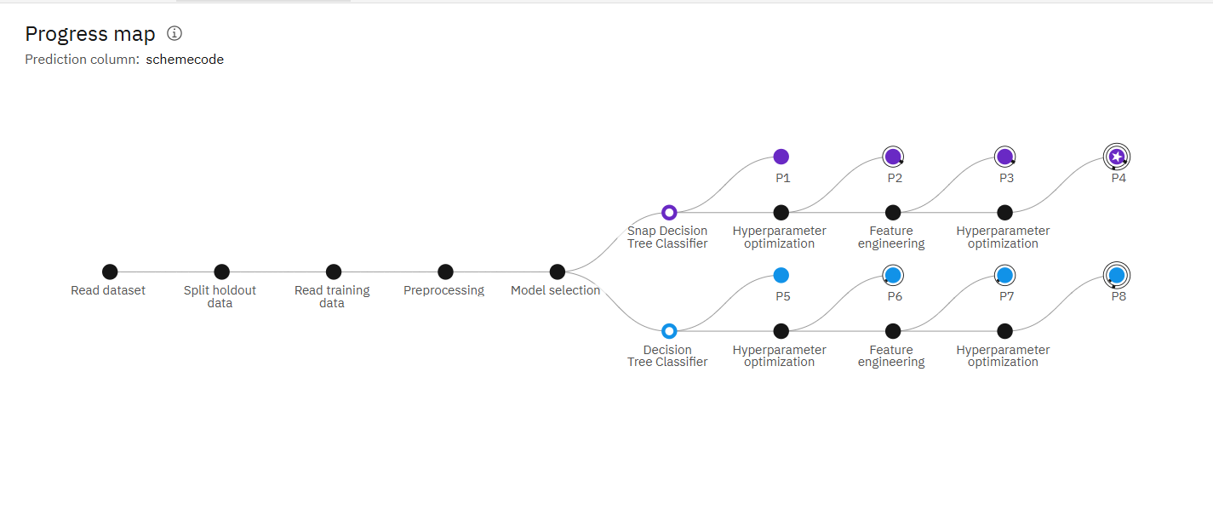
Training Screenshots-

Slide 7
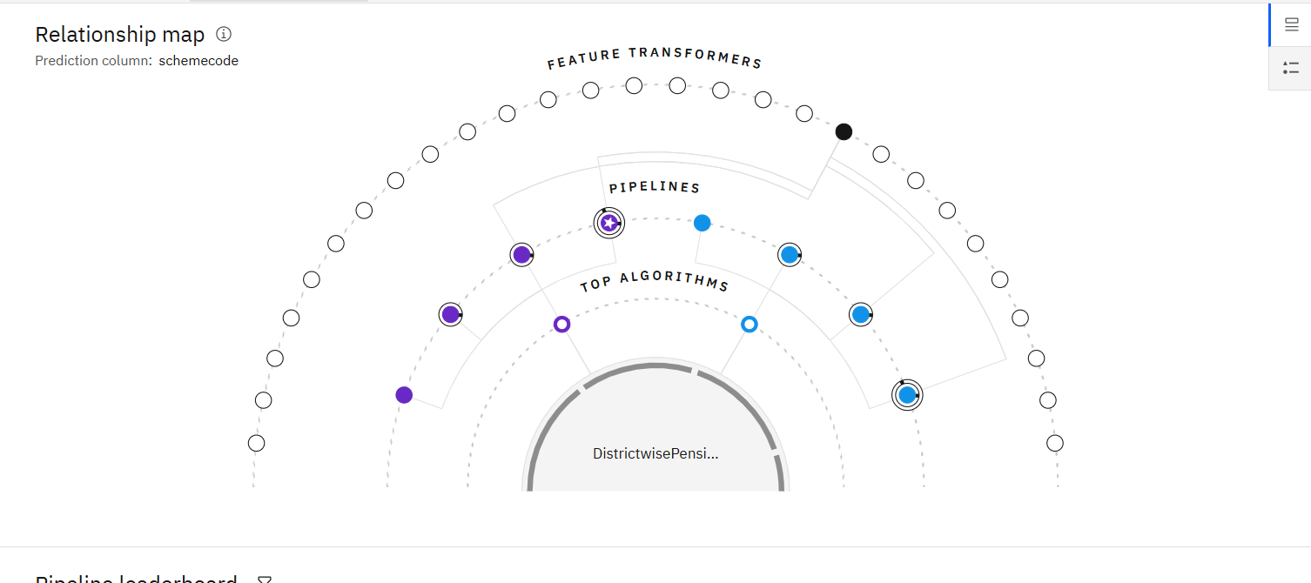

Slide 8
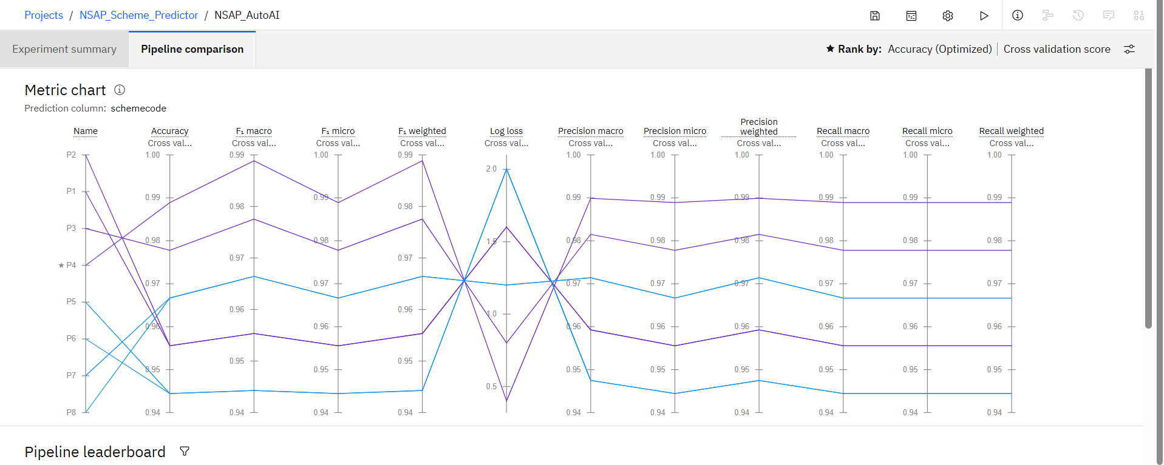

Slide 9
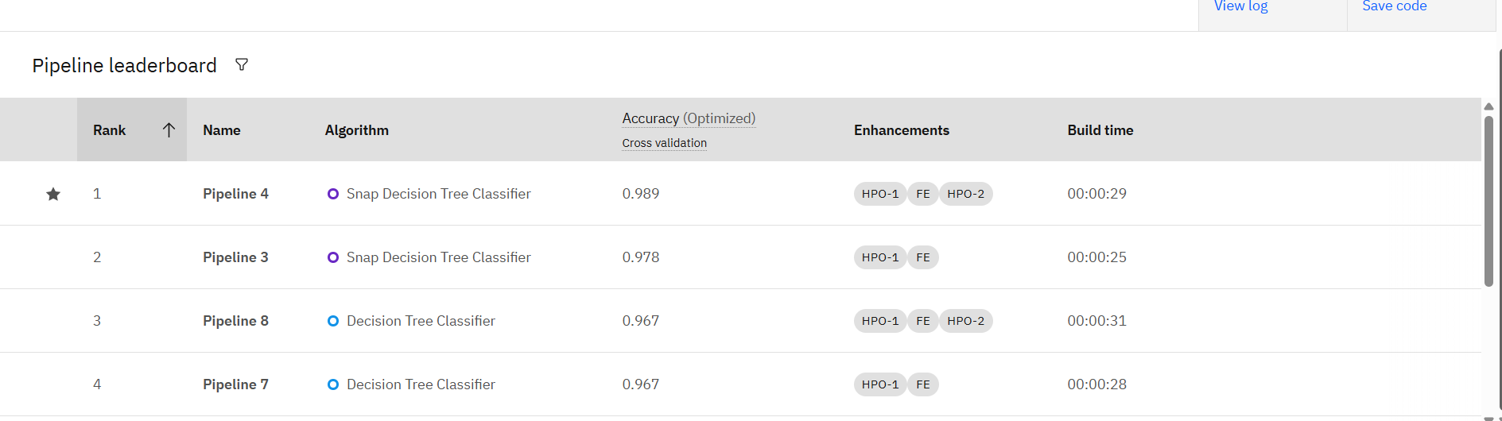
Best Model Screenshot:

Slide 10
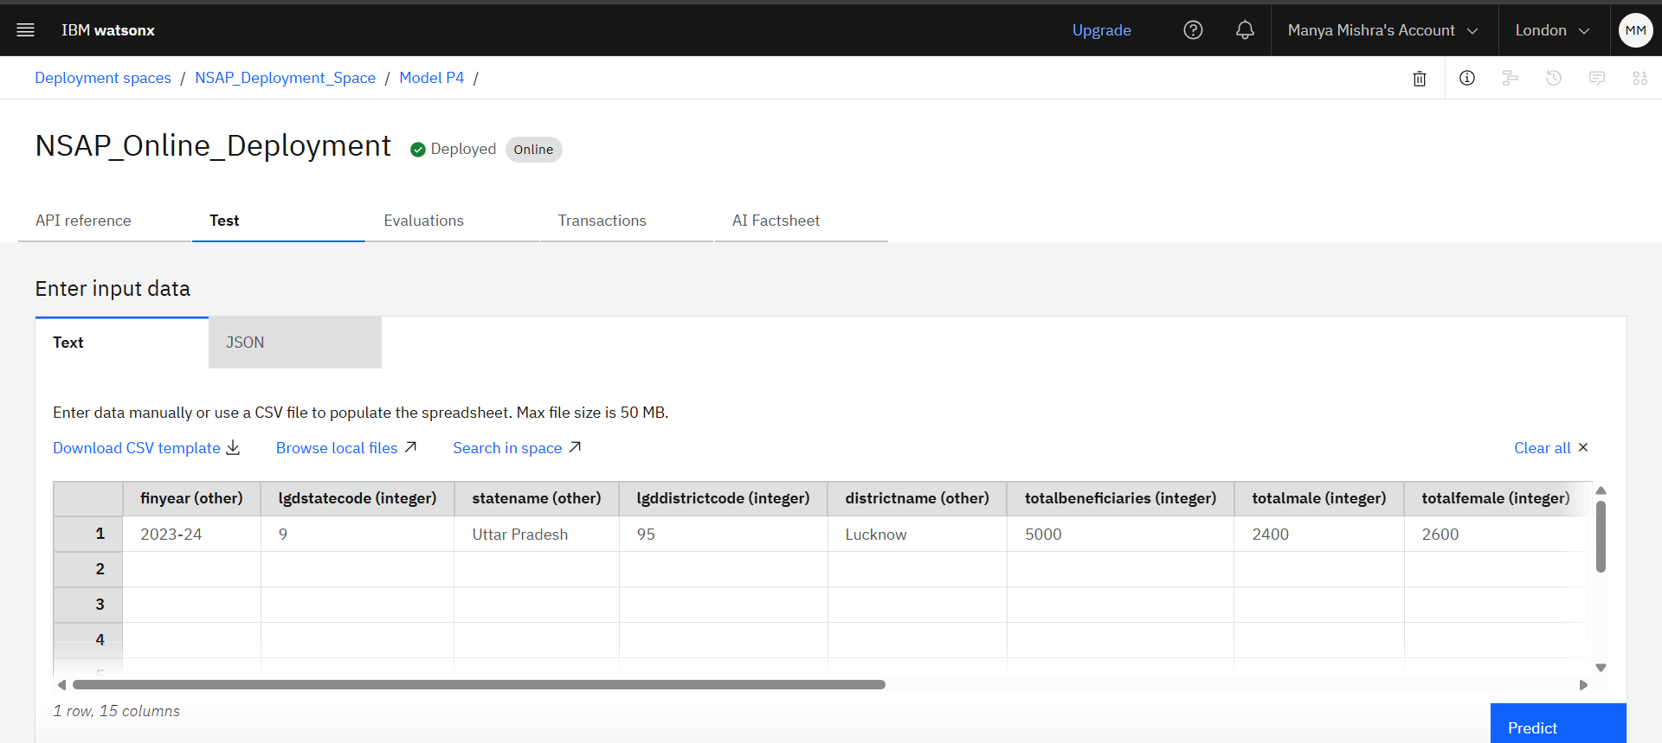
Testing Screenshot:

Slide 11
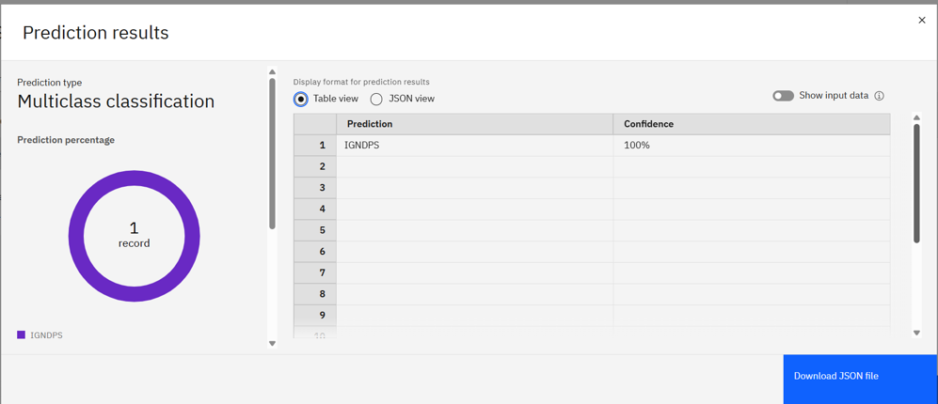
Testing Screenshot:

Slide 12
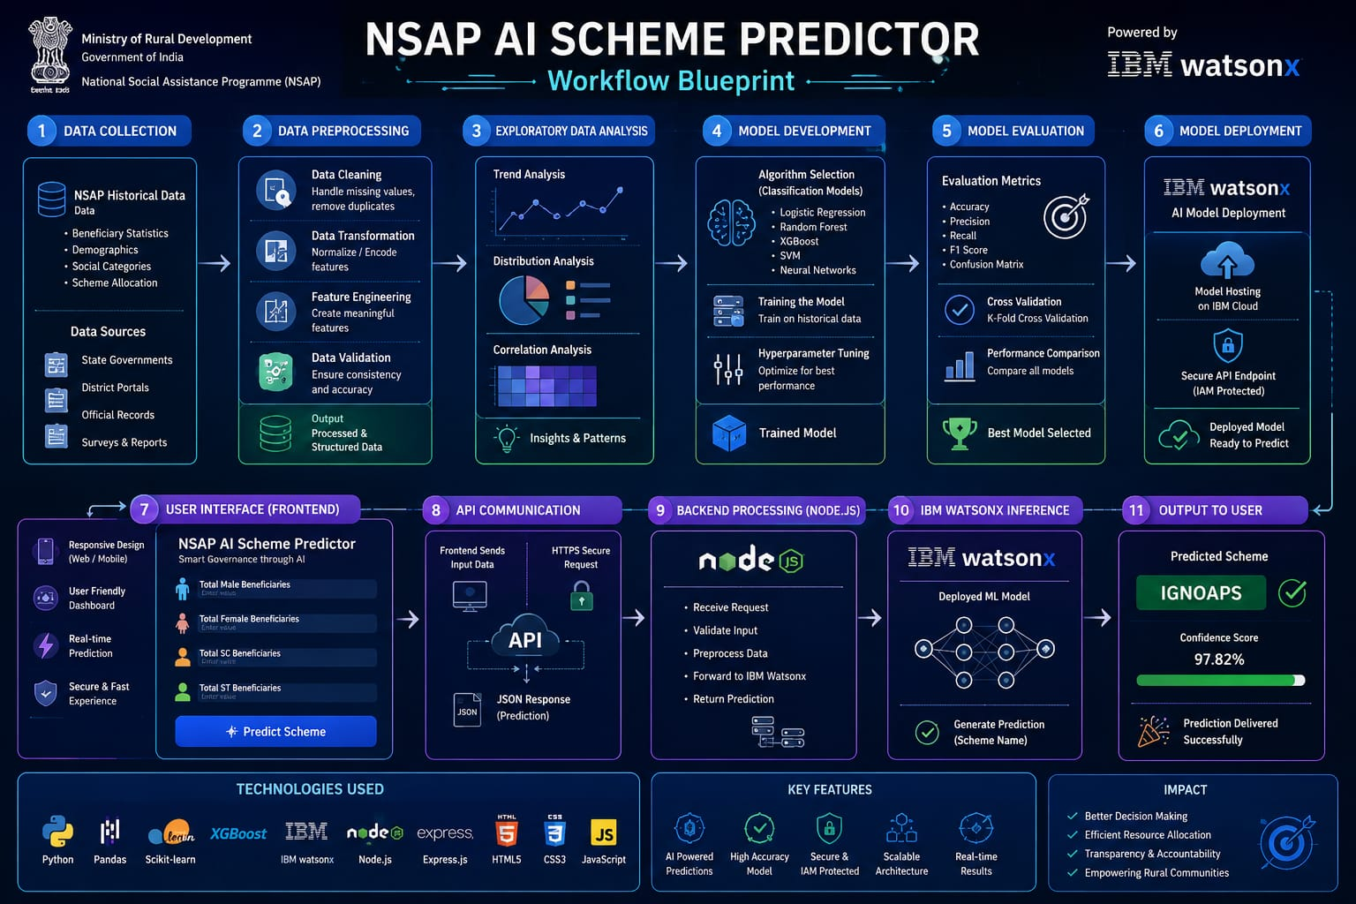
Architecture blueprint

Slide 13
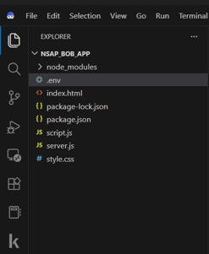
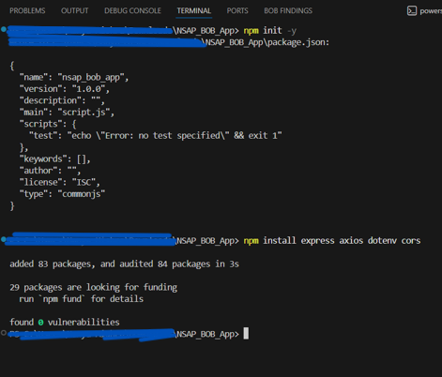
IBM BOB

Slide 14
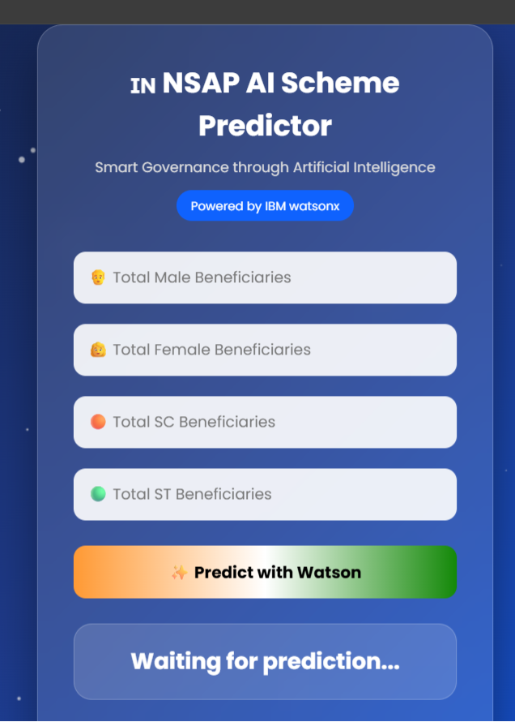
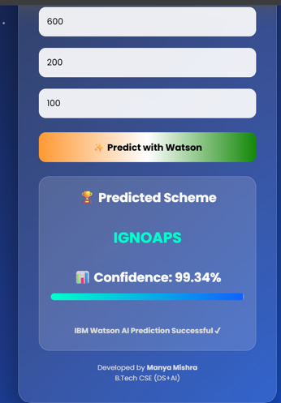
HOMEPAGE

Slide 15
Novelty and Uniqueness
The solution automates NSAP scheme prediction, reducing manual verification efforts and processing time.
It leverages IBM watsonx.ai AutoAI to automatically identify and deploy the best-performing machine learning model with minimal manual coding.
The system accurately classifies beneficiaries into appropriate National Social Assistance Programme (NSAP) schemes using demographic input data.
Automated data preprocessing, feature engineering, and model optimization improve prediction accuracy and uncover meaningful patterns in beneficiary data.
The deployed AI model provides real-time, consistent, and data-driven predictions, reducing human error and improving transparency in welfare scheme selection.
The solution is deployed as a web-based application, making AI-powered government scheme prediction easily accessible through an intuitive user interface.

Slide 16
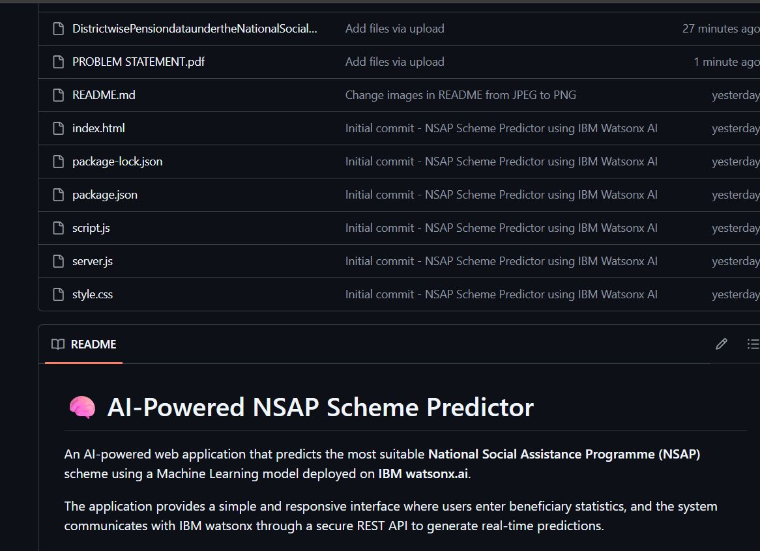
Git Hub Link
Github URL–https://github.com/MANYA303/AI-Driven-NSAP-Scheme-Predictor
·
·
·

Slide 17
Future Scope
Integrate the system with government portals to automate the end-to-end NSAP beneficiary verification and recommendation process.
Expand the platform to support additional government welfare schemes, creating a unified AI-based social assistance recommendation system.
Enable real-time integration with Aadhaar and other government databases (subject to authorization and privacy regulations) to improve eligibility verification and reduce fraudulent claims.
Continuously retrain and optimize the model using IBM watsonx.ai AutoAI as new beneficiary data becomes available, improving prediction accuracy over time.
Develop mobile and multilingual versions of the application to increase accessibility for citizens and field officers across India.
Implement analytics dashboards for government officials to monitor beneficiary trends, scheme distribution, and overall program effectiveness.
Scale the solution nationwide to support transparent, efficient, and data-driven welfare distribution across multiple social security programs.
·
·
·

Slide 18
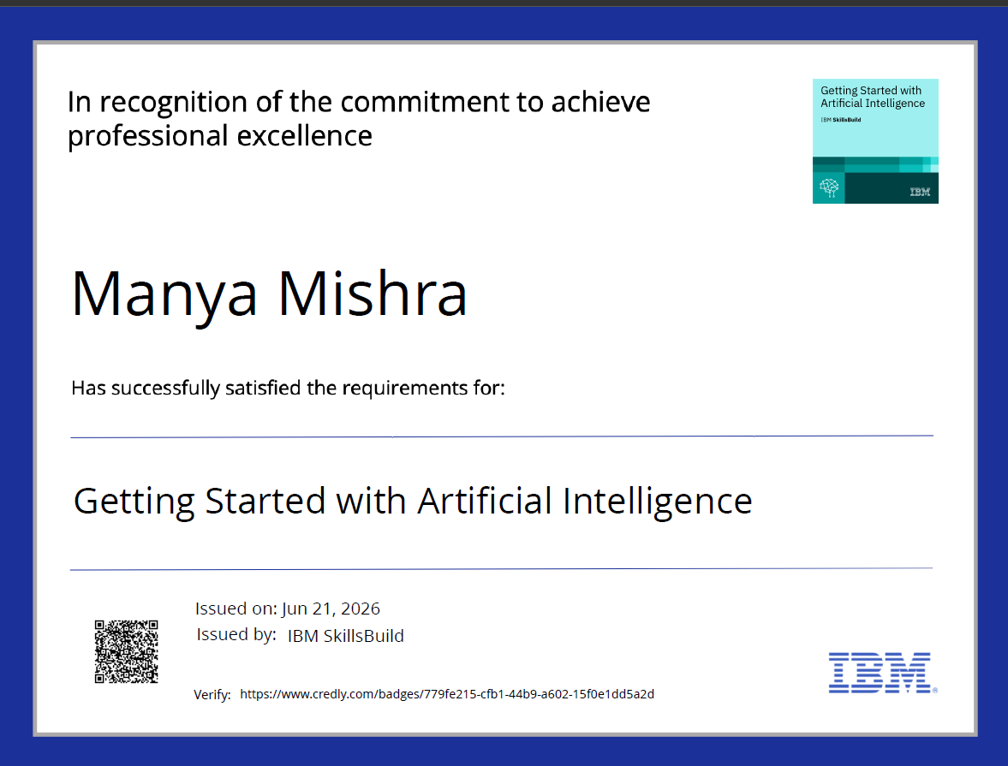
Certificates Earned:
Please add your credly certificate

Slide 19
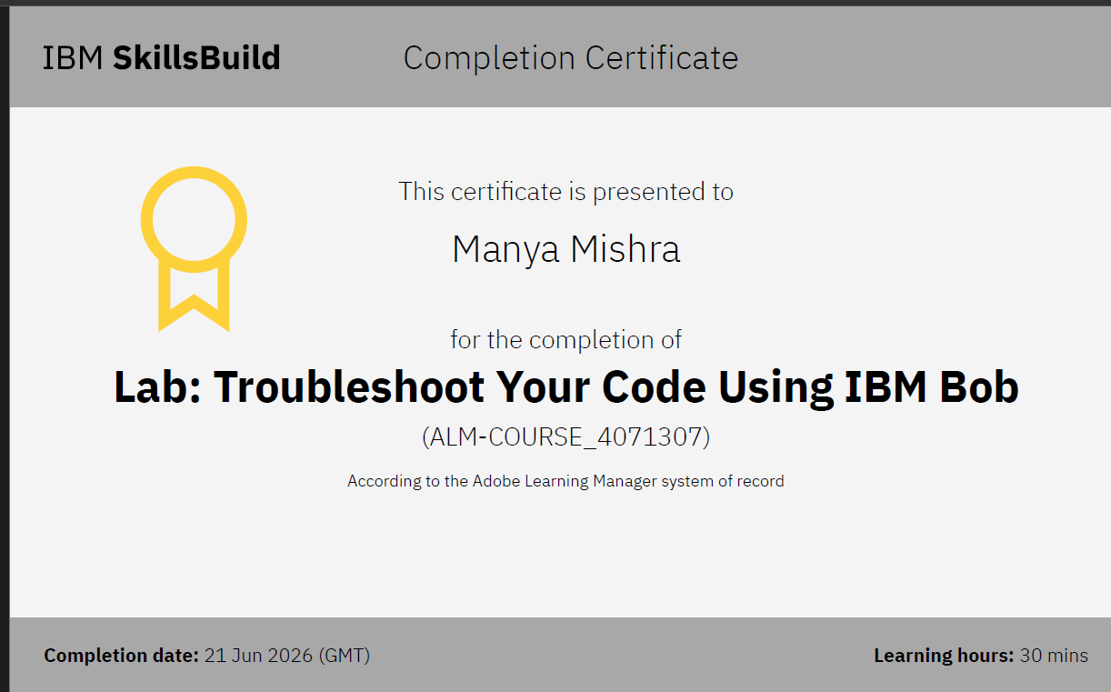
Certificates Earned:​
Add your IBM BOB Certificate

Slide 20


