Slide 1
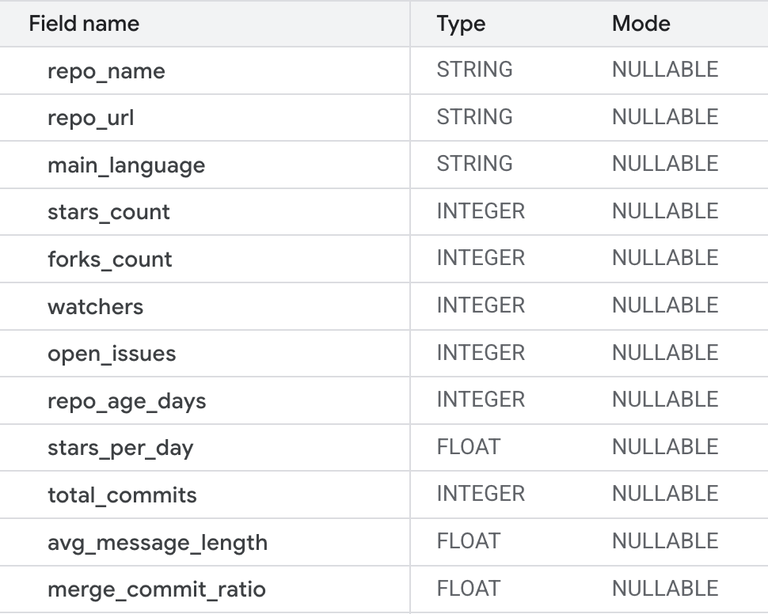
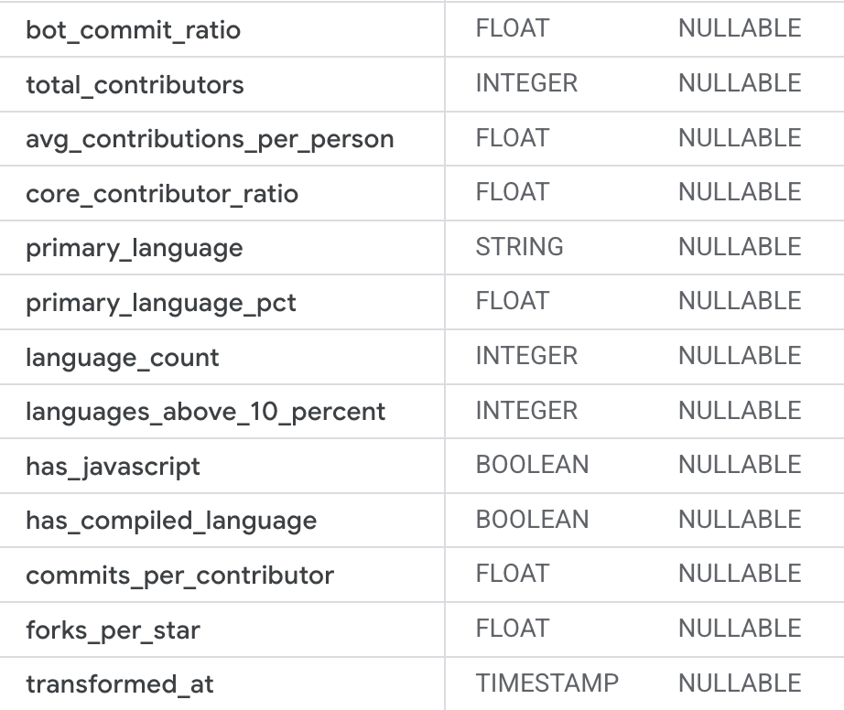
ML Dataset introduction
200 repos
300 repos
Repo_summary (13)
ML Dataset
Contributors_summary (12)
Commits_summary (17)
Language_summary (22)
repo_full_name | language_count
primary_language_pct | secondary_language
total_bytes | tertiary_language
tertiary_language_pct | top_5_language
…
New_table!

Slide 2
ML Dataset – LLM implemented
200 repos
300 repos
1
Get the link
ML Dataset
2
Go to readme files
3
Summarize the following contents
LLM new features
category
complexity
tech_stack
audience
use_case

Slide 3
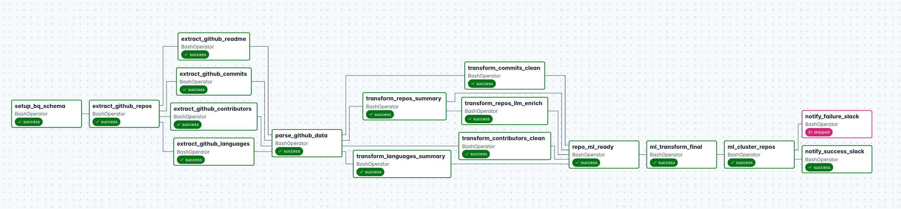

End-to-End Data Pipeline with LLM
Pipeline
Setting
Feature Selection
LLM
Enriched
Data Processing
Modeling
Analyzing
Notification
ML Table
Pick signals that describe repo popularity, activity, contributor structure, and language mix.
Filtering: drop rows missing important signals；
Imputation: fill NaNs with 0；
Scaling: StandardScaler
Embedding
Algorithm: Kmeans with clusters=4
Output: a cluster label (0–3) appended to each repo.
compute means/medians to create an interpretable “signature” per cluster.
Slack notification for success or fail
LLM generate 4 more features

Slide 4
Insights & Application
Clusters
Mature Ecosystem Projects
High-Complexity Community Hits
1
high stars, forks, and watchers
Stable growth; long repo age
Lower complexity score (LLM)
Simple tech stack
general users and sysadmins (LLM)
4
High stars and watchers; stronger forks-per-star growth rate
Highest complexity_score (~2.5+, LLM)
Rich, diverse tech stack
Broad Users (LLM)
web servers, devops, automation, deployment (LLM)
Engineering-Driven Projects
Multi-Language Innovation Projects
2
3
High stars with strong fork activity
Higher complexity_score (> 1.5, LLM)
Multi-language tech stack
Active contributors (~48)
backend engineers, security engineers, IT ops (LLM)
focus on monitoring, networking, deployment (LLM)
High stars but less intense commit activity
Large language diversity
High complexity_score (2.0–2.2, LLM)
Audience: researchers, ML engineers, advanced backend devs (LLM)
computer vision, graphics, ML, data processing (LLM)

Slide 5
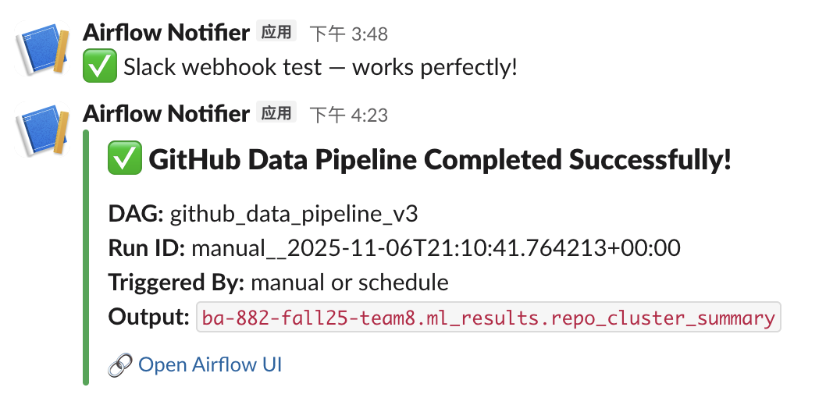
Insights & Application
Clusters
1
High Activity
4
Mature Repos
Extremely high stars
Very high forks
Moderate contributors
Fewer languages
High stars (8K)
Moderate contributors (~53)
Moderate language diversity (~7)
Lower forks-per-star ratio (0.13)
Slack Notification
2
Growing Projects
Mid-range stars (7.8K)
Moderate forks (10K)
Active contributors (~48)
Balanced language count (~4.8)
Moderate star growth (41/day)
3
Niche Projects
Lower stars (1K)
Very high language diversity
Smaller contributor base (~40)
ow forks per star (0.36)

Slide 6
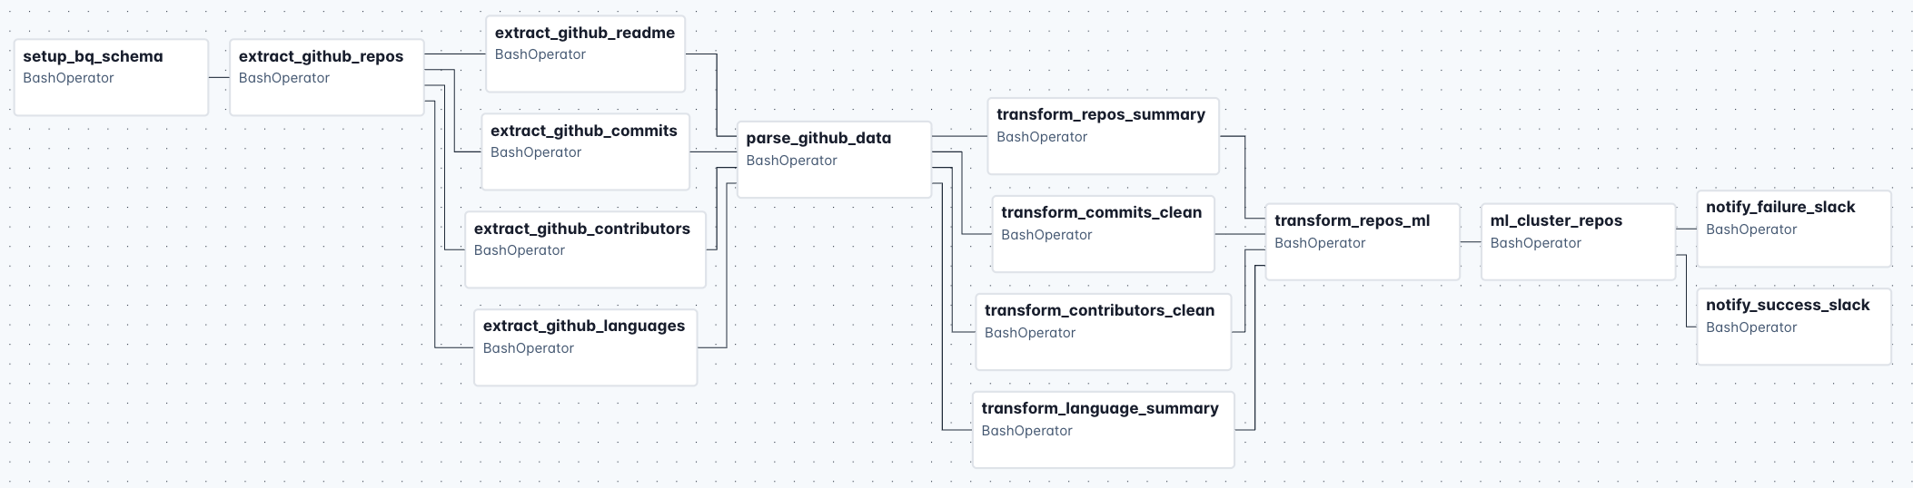
End-to-End Data Pipeline with LLM
Pipeline
Setting
Feature Selection
Data Processing
Modeling
Analyzing
Notification
ML Table
Filtering: drop rows missing important signals；
Imputation: fill NaNs with 0；
Scaling: StandardScaler
Algorithm: Kmeans with clusters=4
Output: a cluster label (0–3) appended to each repo.
Slack notification for success or fail
Pick signals that describe repo popularity, activity, contributor structure, and language mix.
compute means/medians to create an interpretable “signature” per cluster.

Slide 8










End-to-End Data Pipeline: Tools Workflow
Project Management: GitHub
Dev Environment: Cloud Shell
Data Collection
Data Parsing
Data Cleaning & Transformation
Workflow Automation
GitHub API
Access the dataset
Secret Manager
Cloud Function
Cloud Function
Astronomer
Store API token securely
Parse the raw data
Clean and Transform
Host and run our Airflow DAGs
Cloud Function
BigQuery
BigQuery
Airflow
Extract data
Load structured data
Save clean, analysis-ready tables
Track and automate weekly jobs
Cloud Storage
Load raw JSON
Visualization: Streamlit

Slide 9
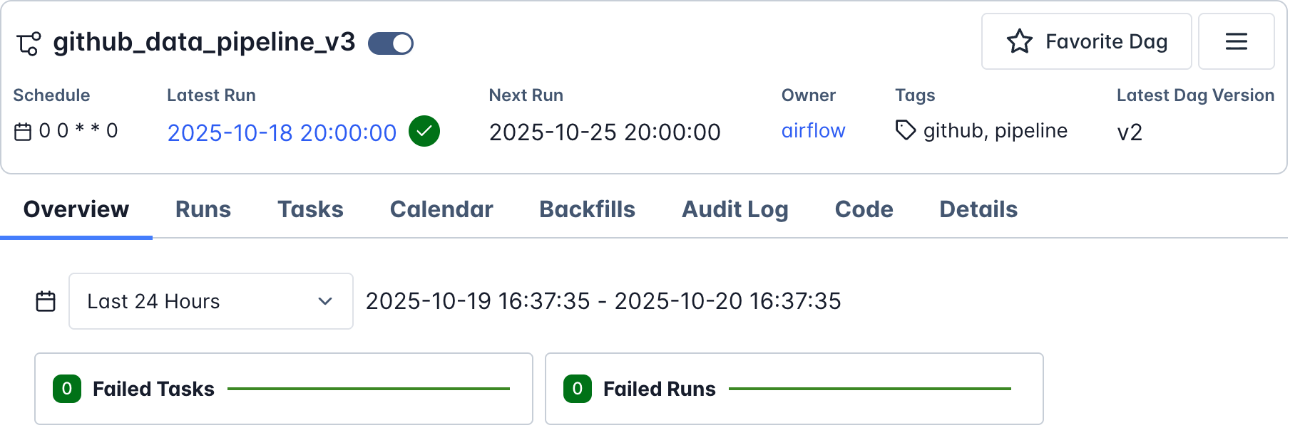
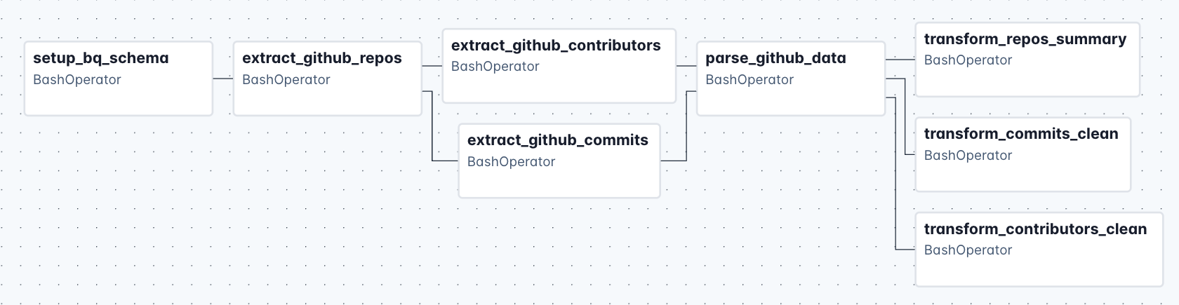
End-to-End Data Pipeline: Data Workflow
Pipeline
Setting
Scheduled DAG to run weekly on Saturday at 8 pm Boston time.
Pipeline Structure
——
Cloud
Function
01 Schema Setup
02 Data Extraction
03 Data Parsing
04 Data Transformation
Tasks are executed in the cloud, orchestrated by Airflow DAGs
Create raw tables in BigQuery
Convert & clean JSON files
Fetch raw data from GitHub
Generate clean, analysis-ready tables

