Slide 1
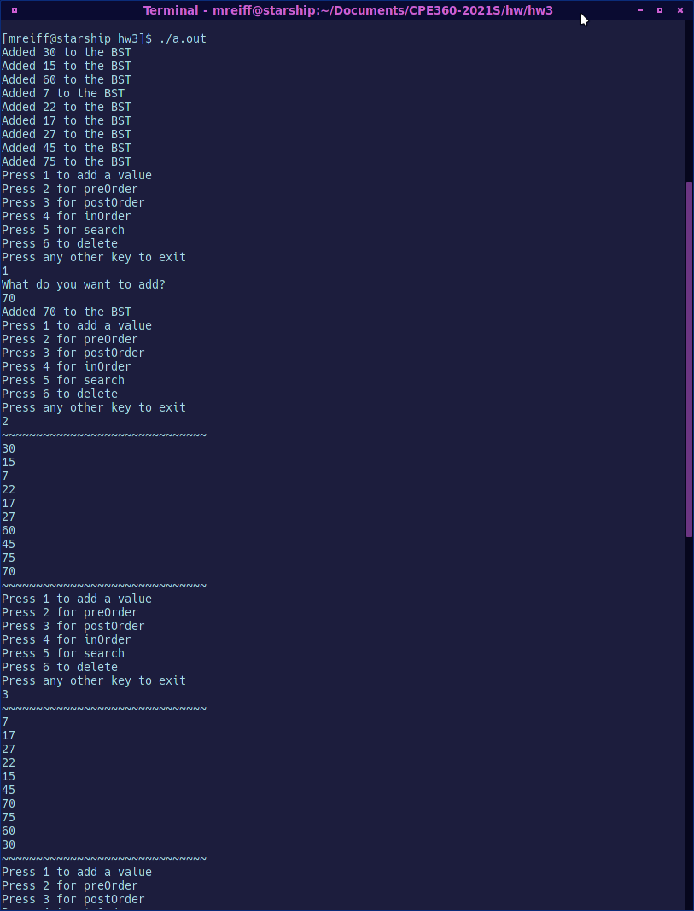
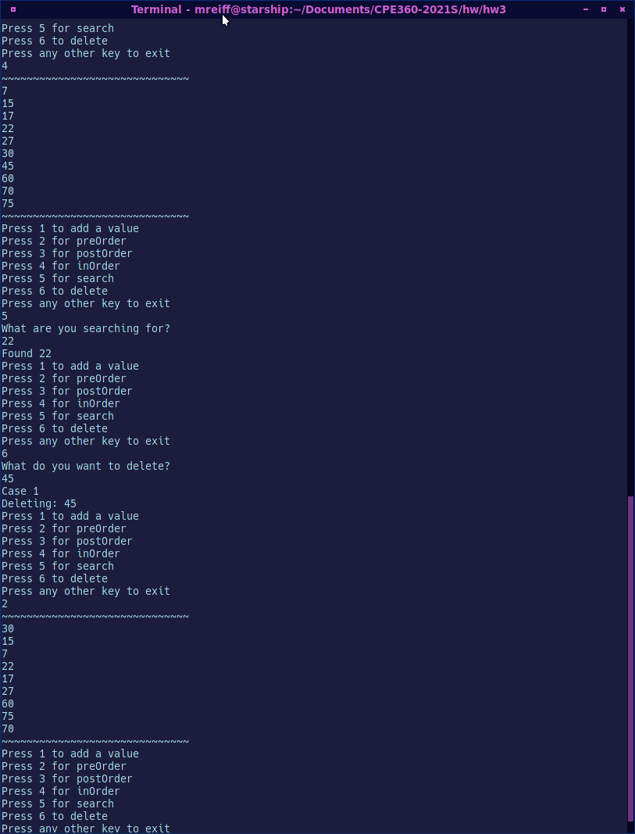
Could not fit it all into one long image without the text being too small so I put them side by side.

