Slide 1
Stroke Prediction
Team 6
Yue Liu, 001353606
Maqi Shi, 001057366

Slide 2
Introduction
According to the World Health Organization (WHO) stroke is the 2nd leading cause of death globally, responsible for approximately 11% of total deaths.
This project predicts whether a patient is likely to get stroke based on the health information.

Slide 3
Data Source
https://www.kaggle.com/lirilkumaramal/heart-stroke
This dataset is used to predict whether a patient is likely to get stroke based on the input parameters like gender, age, various diseases, and smoking status.
This dataset contains about 50000 rows, each row in the data provides related information about the patient.

Slide 4
Milestone
Week 1-2, data clean and learn spark
clean and break down the text of CSV format, eliminate errors and missing data, store them in the program or the database
Week 3 -4, build prediction model and train the model
Train multiple models, and get the result
Week 5, test model and build prediction app
use the test set to test models and find the best one, and build the prediction app, once the user inputs information, give the result

Slide 5
Methodology
Original data
Read csv file
dataframe
Clean data
Cleaned
dataframe
standardization
Standard
dataframe
Analyze data correlation
Final
dataframe
Use smote algorithm to generate minority data
Feature
dataframe
Choose high related column as feature
Correlation
Matrix
Train and Save model
Random Forest
Prediction App
User input
Load
model
Logistic Regression
Decision Tree
result

Slide 6
Use cases
User should input personal information by following the instructions
The predict model calculates whether user will get a stroke or not
user
Prediction APP
Will/Willn’t have stroke
Input
information

Slide 7
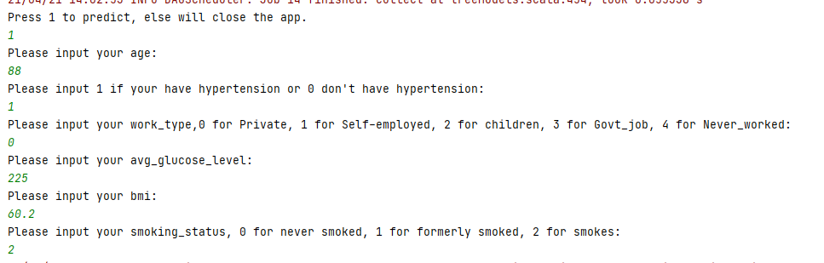

Use cases
User input:
Result:

Slide 8
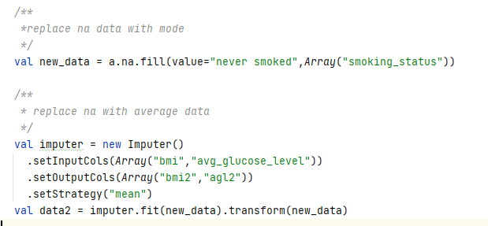
Cleaned Data

Slide 9
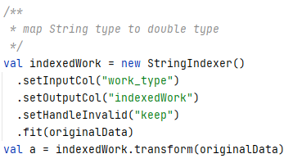
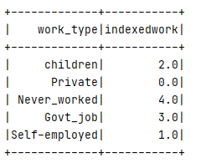
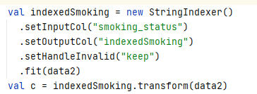
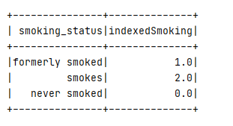
Standardization

Slide 10
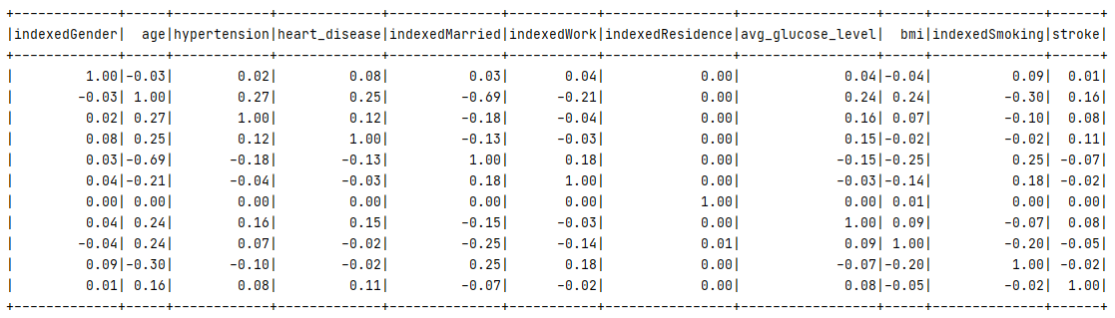
Correlation Matrix

Slide 11
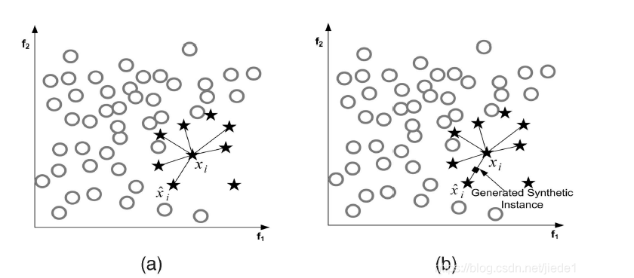
Smote

Slide 12
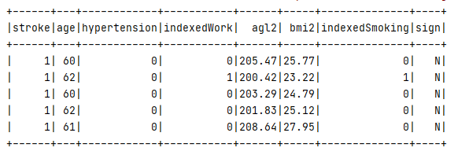
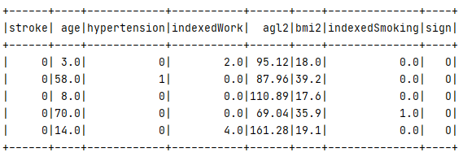
Smote
New data
Final data

Slide 13
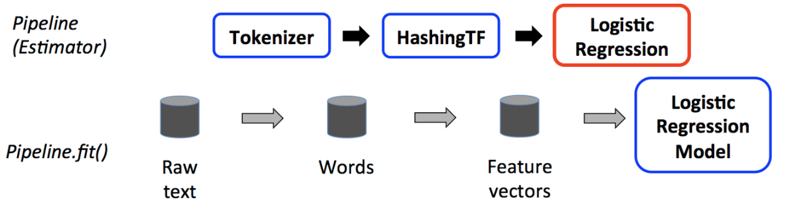
Model Choose
Logistic Regression Model
Logistic regression is a popular method to predict a categorical response. It is a special case of Generalized Linear models that predicts the probability of the outcomes.
Pipelines

Slide 14
Model Choose
Decision Tree Model
The decision tree is a greedy algorithm that performs a recursive binary partitioning of the feature space. The tree predicts the same label for each bottommost (leaf) partition. Each partition is chosen greedily by selecting the best split from a set of possible splits, in order to maximize the information gain at a tree node.

Slide 15
Model Choose
Random Forest Model
Random forests are ensembles of decision trees. Random forests combine many decision trees in order to reduce the risk of overfitting. The spark.ml implementation supports random forests for binary and multiclass classification and for regression, using both continuous and categorical features.

Slide 16


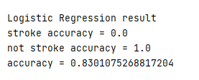

Model Accuracy Result
Before using Somte Algorithm:
After using Somte Algorithm:

Slide 17
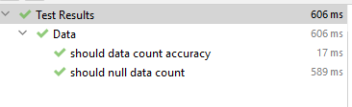
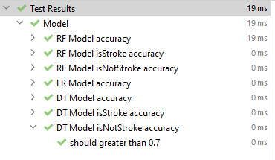
Testing Result

Slide 18

Acceptance criteria
Verify analysis results with test set(from dataset)
The accuracy should reach 70%
Response time < 2 Seconds
Meet the acceptance criteria

Slide 19
Program in scala
The implements of predict model
All the unit test
Extraction of data
Store the user information data
Repository
https://github.com/MAQI-SHI/CSYE-7200-Final-Project-Team-6

Slide 20
Goals of Project
Using scala to deal with big data
Build predict model to analysis the user's physical health and predict whether user will get a stroke
Learning the specific algorithm and the using of scala.

Slide 21
Thank you

