Slide 1
Stroke Prediction
Team 6
Yue Liu, 001353606
Maqi Shi, 001057366

Slide 2
Introduction
According to the World Health Organization (WHO) stroke is the 2nd leading cause of death globally, responsible for approximately 11% of total deaths.
This project predicts whether a patient is likely to get stroke based on the health information.

Slide 3
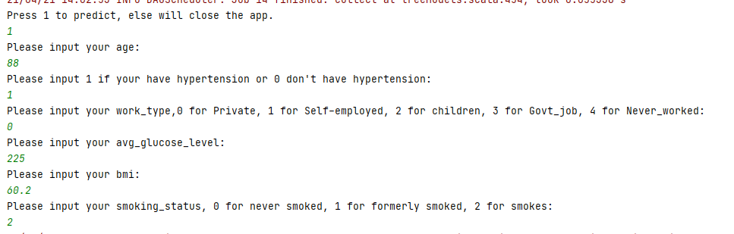
Use cases
User should input personal information by following the instructions
The predict model calculates whether user will get a stroke or not

Slide 4
Data Source
https://www.kaggle.com/fedesoriano/stroke-prediction-dataset
This dataset is used to predict whether a patient is likely to get stroke based on the input parameters like gender, age, various diseases, and smoking status.
This dataset contains 50000 rows, each row in the data provides relavant information about the patient.

Slide 5
Milestone
Week 1, data clean and learn spark
clean and break down the text of CSV format, eliminate errors and missing data, store them in the program or the database
Week 2 -3, build prediction model and train the model
Train multiple models, and get the result
Week 4, test model
use the test set to test models and find the best one

Slide 6
Methodology
Extract Stroke Prediction Dataset from kaggle dataset website (https://www.kaggle.com/lirilkumaramal/heart-stroke)
Clean and break down the text of CSV format
Replace null values with mode or average
For String type data, use mode
For Double type data, use average

Slide 7
Methodology
Map String type to Double type
Analyze the correlation of the data, and choose 6 feature: age, hypertension, work_type, avg_glucose_level, bmi, smoking_status
Use smote algorithm to do oversampling, generate minority data
Train the 3 models, and choose the best one.

Slide 8
Model Choose
Random Forest Model
Random forests are a popular family of classification and regression methods. More information about the spark.ml implementation can be found further in the section on random forests.

Slide 9
Model Choose
Logistic Regression Model
Logistic regression is a popular method to predict a categorical response. It is a special case of Generalized Linear models that predicts the probability of the outcomes. In spark.ml logistic regression can be used to predict a binary outcome by using binomial logistic regression, or it can be used to predict a multiclass outcome by using multinomial logistic regression. Use the family parameter to select between these two algorithms, or leave it unset and Spark will infer the correct variant.

Slide 10
Model Choose
Decision Tree Model
Random forests are a popular family of classification and regression methods. More information about the spark.ml implementation can be found further in the section on random forests.

Slide 11
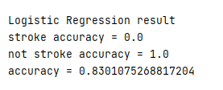


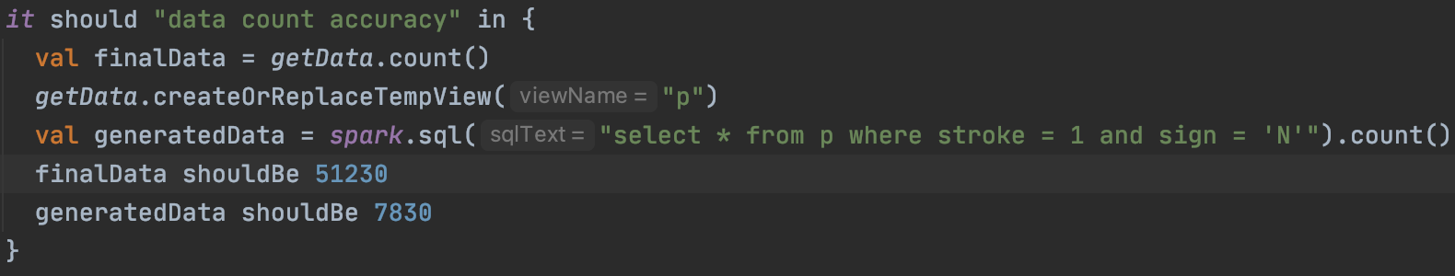
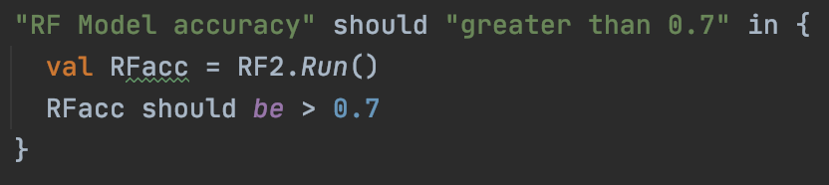
Result & Test
Check Data
Check Model

Slide 12

Acceptance criteria
Verify analysis results with test set(from dataset)
The accuracy should reach 70%
Response time < 2 Seconds

Slide 13
Program in scala
The implements of predict model
All the unit test
Extraction of data
Store the user information data
Repository
https://github.com/MAQI-SHI/CSYE-7200-Final-Project-Team-6

Slide 14
Goals of Project
Using scala to deal with big data
Build predict model to analysis the user's physical health and predict whether user will get a stroke
Learning the specific algorithm and the using of scala.

Slide 15
Thank you

