Slide 1
Stroke Prediction
Team 6
Yue Liu, 001353606
Maqi Shi, 001057366

Slide 2
Introduction
According to the World Health Organization (WHO) stroke is the 2nd leading cause of death globally, responsible for approximately 11% of total deaths.
This project predicts whether a patient is likely to get stroke based on the health information.

Slide 3
Use cases
User should input personal information by following the instructions
The predict model calculates whether user will get a stroke or not
user
Prediction APP
Will/Willn’t have stroke
Input
information

Slide 4
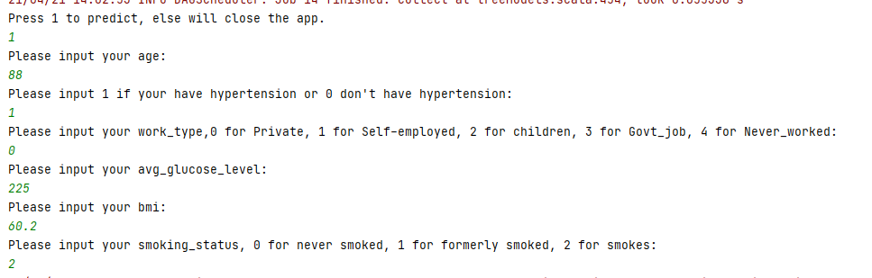

Use cases
User input:
Result:

Slide 5
Data Source
https://www.kaggle.com/lirilkumaramal/heart-stroke
This dataset is used to predict whether a patient is likely to get stroke based on the input parameters like gender, age, various diseases, and smoking status.
This dataset contains about 50000 rows, each row in the data provides related information about the patient.

Slide 6
Milestone
Week 1-2, data clean and learn spark
clean and break down the text of CSV format, eliminate errors and missing data, store them in the program or the database
Week 3 -4, build prediction model and train the model
Train multiple models, and get the result
Week 5, test model and build prediction app
use the test set to test models and find the best one, and build the prediction app, once the user inputs information, give the result

Slide 7
Methodology
Original data
Read csv file
dataframe
Clean data
Cleaned
dataframe
standardization
Standard
dataframe
Analyze data correlation
Final
dataframe
Use smote algorithm to generate minority data
Feature
dataframe
Choose high related column as feature
Correlation
Matrix
Train and save model
RandomForest
Prediction App
User input
Load
model
LogisticRegression
DecisionTree
result

Slide 8
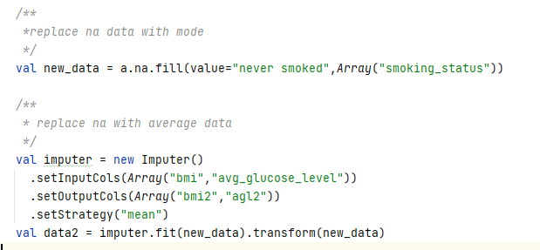
Cleaned Data

Slide 9
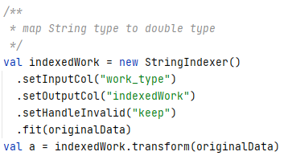
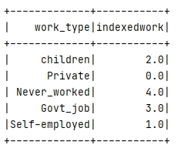
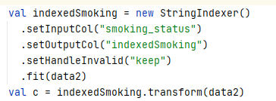
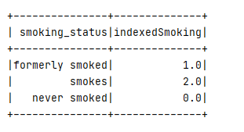
Standardization

Slide 10
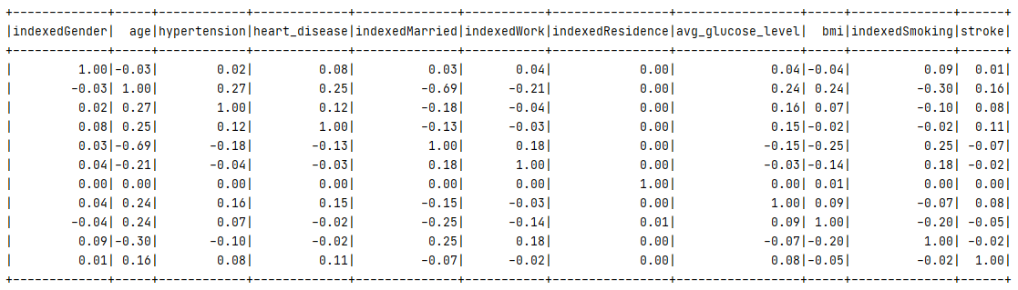
Correlation Matrix

Slide 11
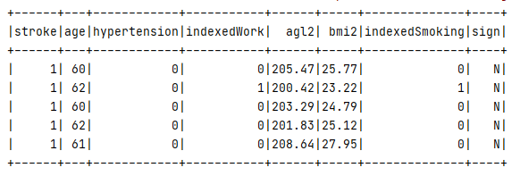
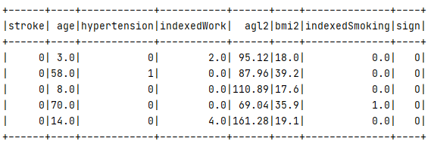
Smote
New data
Final data

Slide 12
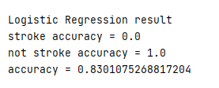


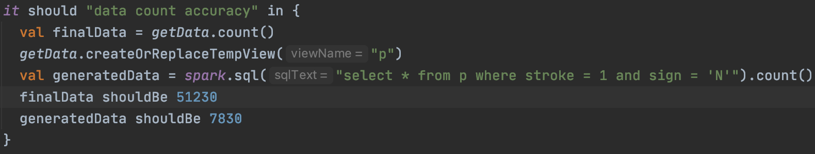
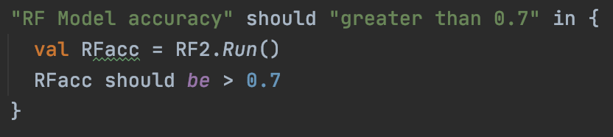
Result & Test
Check Data
Check Model

Slide 13
Model Choose
Random Forest Model
Random forests are a popular family of classification and regression methods. More information about the spark.ml implementation can be found further in the section on random forests.

Slide 14
Model Choose
Logistic Regression Model
Logistic regression is a popular method to predict a categorical response. It is a special case of Generalized Linear models that predicts the probability of the outcomes. In spark.ml logistic regression can be used to predict a binary outcome by using binomial logistic regression, or it can be used to predict a multiclass outcome by using multinomial logistic regression. Use the family parameter to select between these two algorithms, or leave it unset and Spark will infer the correct variant.

Slide 15
Model Choose
Decision Tree Model
Random forests are a popular family of classification and regression methods. More information about the spark.ml implementation can be found further in the section on random forests.

Slide 16

Acceptance criteria
Verify analysis results with test set(from dataset)
The accuracy should reach 70%
Response time < 2 Seconds

Slide 17
Program in scala
The implements of predict model
All the unit test
Extraction of data
Store the user information data
Repository
https://github.com/MAQI-SHI/CSYE-7200-Final-Project-Team-6

Slide 18
Goals of Project
Using scala to deal with big data
Build predict model to analysis the user's physical health and predict whether user will get a stroke
Learning the specific algorithm and the using of scala.

Slide 19
Thank you

