Slide 1
Credit Card
Fraud Detection
Python for data analysis
Group 2
LI SHIYU
MARCUS CHAN HUA RUI​
XU SHANGQING
YANG YINGTONG
ZHANG YANG

Slide 2
1
Data Description
2
Feature Engineering
3
Data Preprocessing
CONTENTS
4
Modeling
5
Results and Reflection
Description
Feature Engineering
Data Preprocessing
Modeling
Results and Reflection

Slide 3
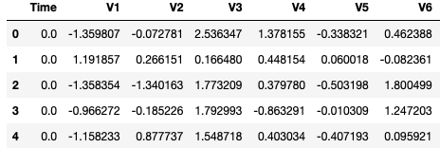
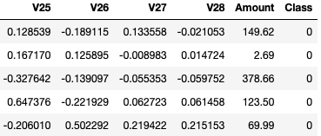
Data Description
Introduction to dataset
Dimension: 284807*31
Structure:
V1-V28: principal component after PCA (scaled)
Time: time duration between the first transaction and the
current data point (unit: second)
Amount: the amount of transaction (unit: dollar)
Class: response variable. 0 as normal, 1 as default.
Description
Feature Engineering
Data Preprocessing
Modeling
Results and Reflection

Slide 4
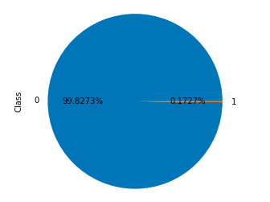
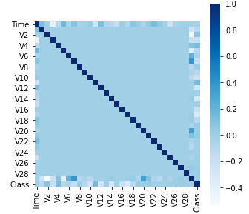
Data Description
Characteristics:
No missing data
V1-V28 uncorrelated
Response variable “Class” extremely unbalanced: 1 (0.1727%)
Insights:
Using resampling methods to deal with unbalanced problem
From correlation matrix, V2,V3,V4,V7,V10,V11,V12,V14,V16,V17,V18 have relatively high correlation with “Class”
Description
Feature Engineering
Data Preprocessing
Modeling
Results and Reflection

Slide 5
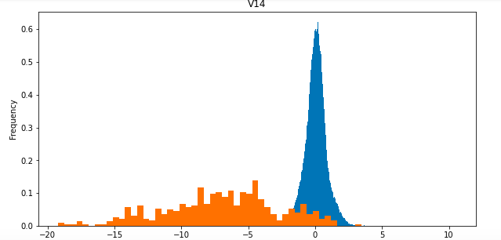
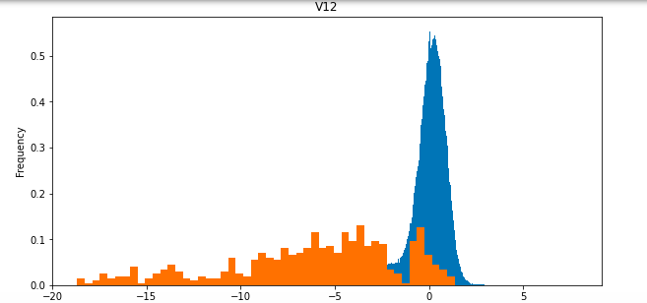
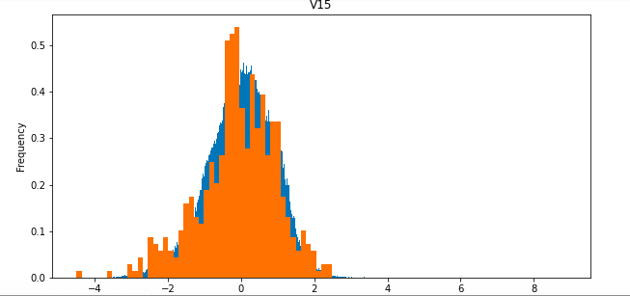
Feature Engineering
Feature Selection
Correlation: V2,V3,V4,V7,V10,V11,V12,V14,V16,V17,V18 should be important
Distribution:
By drawing distributions of variables in
different class 0 and 1, can see which
variables distributes differently in different
class.
Drop V8, V13, V15, V20, V21 , V22, V23,
V24, V25, V26, V27, V28
Description
Feature Engineering
Data Preprocessing
Modeling
Results and Reflection

Slide 6
Data Preprocessing
Split the dataset
Use stratified split to split the train (80%) and test (20%).
Scaling
V1-V28 are already been scaled. For some methods, scaling variable
“Time”, “Amount” to make sure the performance or improve the convergent speed.
Resampling
Five candidates SMOTE, ADASYN, SMOTETomek, SMOTEENN, RENN
Use the one that is suitable for specific classification method or make
Comparison of all of them.
Description
Feature Engineering
Data Preprocessing
Modeling
Results and Reflection

Slide 7
Modeling
Unsupervised
Outlier Detection
Isolated forest
OCSVM
Autoencoder
Model | Isolated forest (contamination = 0.03) |  | OCSVM (nu = 0.03, kernel = "rbf”) |  | Autoencoder
Confusion Matrix | 276198 | 8117 | 276176 | 8139 | 276718 | 7597
 | 64 | 428 | 68 | 424 | 82 | 410
Description
Feature Engineering
Data Preprocessing
Modeling
Results and Reflection

Slide 8
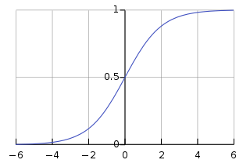
Logistic Regression
Introduction
Logistic regression is a statistical model that in its basic form uses a logistic function to model a binary dependent variable, although many more complex extensions exist. In regression analysis, logistic regression[1] (or logit regression) is estimating the parameters of a logistic model (a form of binary regression).
Description
Feature Engineering
Data Preprocessing
Modeling
Results and Reflection
Notes:
In machine learning, support-vector machines are supervised learning models with associated learning algorithms that analyze data used for classification and regression analysis. Given a set of training examples, each marked as belonging to one or the other of two categories, an SVM training algorithm builds a model that assigns new examples to one category or the other, making it a non-probabilistic binary linear classifier. An SVM model is a representation of the examples as points in space, mapped so that the examples of the separate categories are divided by a clear gap that is as wide as possible. New examples are then mapped into that same space and predicted to belong to a category based on the side of the gap on which they fall.

Slide 9
Logistic Regression
Preprocessing
Splitting
Scaling
Oversampling
Tunning Parameter
Split the data into training and testing datasets.
Do scaling to avoid extreme influence of one variable comparing with others.
Use 5 different oversampling methods to improve the imbalanced data set.
Use Grid Search to Tune the C value and penalty type.
Description
Feature Engineering
Data Preprocessing
Modeling
Results and Reflection

Slide 10
Logistic Regression
Results and Analysis
 | Accuracy Rate | Precision | Recall | F1-score | AUC | Tuning parameters
RENN | 1 | 0.93 | 0.78 | 0.84 | 0.972 | {'C': 0.001, 'penalty': 'l2'}
ENN(sot) | 0.98 | 0.53 | 0.93 | 0.55 | 0.9755 | {'C': 0.001, 'penalty': 'l2'}
SMOTE(sos) | 0.98 | 0.53 | 0.93 | 0.55 | 0.9751 | {'C': 0.001, 'penalty': 'l2'}
SMOTETomek(kos) | 0.98 | 0.53 | 0.93 | 0.55 | 0.9751 | {'C': 0.001, 'penalty': 'l2'}
ADASYN(aos) | 0.9 | 0.51 | 0.92 | 0.49 | 0.9751 | {'C': 0.001, 'penalty': 'l1'}
Description
Feature Engineering
Data Preprocessing
Modeling
Results and Reflection

Slide 11
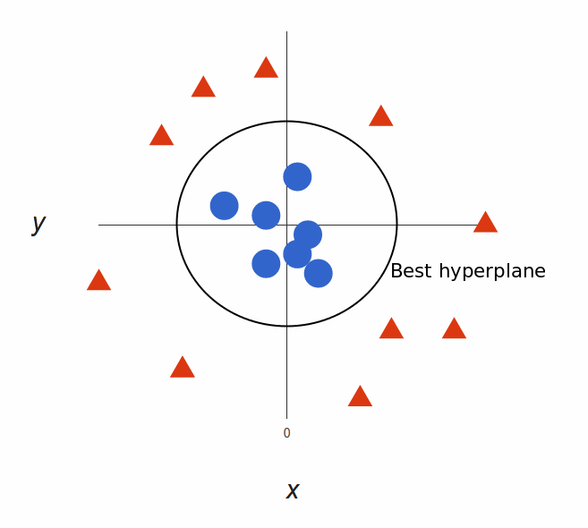
Support Vector Machine
Introduction
Assigns new examples to one category or the other, making it a non-probabilistic binary linear classifier.
An SVM model is a representation of the examples as points in space, mapped so that the examples of the separate categories are divided by a clear gap that is as wide as possible.
New examples are then mapped into that same space and predicted to belong to a category based on the side of the gap on which they fall.
Description
Feature Engineering
Data Preprocessing
Modeling
Results and Reflection
Notes:
In machine learning, support-vector machines are supervised learning models with associated learning algorithms that analyze data used for classification and regression analysis. Given a set of training examples, each marked as belonging to one or the other of two categories, an SVM training algorithm builds a model that assigns new examples to one category or the other, making it a non-probabilistic binary linear classifier. An SVM model is a representation of the examples as points in space, mapped so that the examples of the separate categories are divided by a clear gap that is as wide as possible. New examples are then mapped into that same space and predicted to belong to a category based on the side of the gap on which they fall.

Slide 12
Support Vector Machine
Preprocessing
Splitting
Scaling
Oversampling
Shrink to fit SVM
Split the data into training and testing datasets.
Do scaling to avoid extreme influence of one variable comparing with others.
Use 5 different oversampling methods to improve the imbalanced data set.
For SVM, the processing time is incredibly large. Use stratified sampling to shrink data sets to fit.
Description
Feature Engineering
Data Preprocessing
Modeling
Results and Reflection

Slide 13
Support Vector Machine
Tuning parameters
The C parameter trades off correct classification of training examples against maximization of the decision function’s margin.
Kernel
C
parameter
Gamma parameter
Linear, Polynomial and RBF kernel type to fit each sample data.
The gamma parameter defines how far the influence of a single training example reaches,
https://scikit-learn.org/stable/auto_examples/svm/plot_rbf_parameters.html
Description
Feature Engineering
Data Preprocessing
Modeling
Results and Reflection

Slide 14
Support Vector Machine
A complicated methods need a lot of time to process.
Not suitable for large data sets.
Description
Feature Engineering
Data Preprocessing
Modeling
Results and Reflection

Slide 15
Decision Tree
Pros:
The decision tree has no assumptions about distribution because of the non-parametric nature of the algorithm.
Its training time is faster compared to the neural network algorithm.
Decision trees can handle high dimensional data with good accuracy.
Cons:
It is highly sensitive as small change in the data can result in large change in the tree structure. (this data does not have noisy)
Single Decision tree is often a weak learner, so we require a bunch of decision tree for called random forest for better prediction.

Slide 16
Preprocess for Decision Tree
Figure out the realtionship between variance and target
Resampling the dataset (5methods)
Hyperparameter tuning with GridSearchCV
Calculate Accuracy, AUC, F1 score,Recall,Precision

Slide 17
Decision Tree
 | Accuracy Rate | Precision | Recall | F1-score | AUC
RENN | 99.9% | 99.9% | 99.9% | 77.2% | 89.8%
SMOTEENN | 99.8% | 99.8% | 99.7% | 52.3% | 89.7%
SMOTE | 99.7% | 99.9% | 99.9% | 48.2% | 88.1%
SMOTETomek | 99.7% | 99.8% | 99.7% | 47.2% | 87.1%
ADASYN | 99.8% | 99.9% | 99.8% | 55.7% | 88.7%

Slide 18
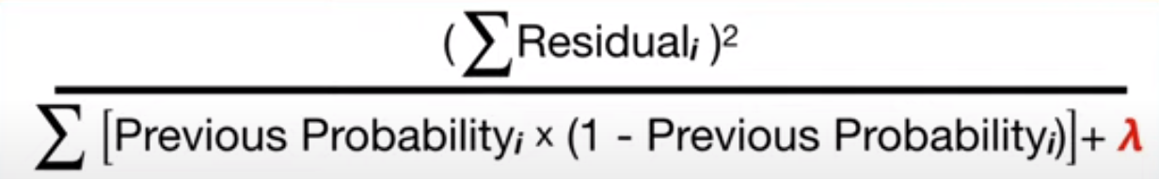
XGBoost Classifier – implementation of gradient boosting
XGBoost was designed for large complicated datasets
Performed moderately well on this dataset
Comprises tunable parameters such as:
Max depth
Regularisation
Gamma
Learning rate
Validation was conducted using 0.5 subsamples with 0.5 of the columns in a tree
Early stopping was also used
Notes:
XGBoost is one of the fastest implementations of gradient boosted trees.
gradient boosting considers all of the features and the possible splits, which is why it is slow to create a new branch (especially if you consider the case where there are thousands of features, and therefore thousands of possible splits). XGBoost tackles this inefficiency by
Use of sparse matrices with sparsity aware algorithms (looking at the distribution of features across all data points in a leaf and using this information to reduce the search space of possible feature splits.)
Improved data structures for better processor cache utilization which makes it faster.
Better support for multicore processing which reduces overall training time.
Although XGBoost implements a few regularization tricks, this speed up is by far the most useful feature of the library, allowing many hyperparameter settings to be investigated quickly. This is helpful because there are many, many hyperparameters to tune. Nearly all of them are designed to limit overfitting (no matter how simple your base models are, if you stick thousands of them together they will overfit).
Regularisation reduces similarity scores in a node, especially for less residuals in a node – which means the gains for next branches will be smaller – reduces overfitting due to less splits.
If the gain from a branch is larger than gamma, then it is accepted. Very high gamma means there is no pruning
Learning rate is similar to navigating while using the GPS – check more frequently means more accurate but slower.
Using 0.5 subsamples helps to speed up validation and help generalisation instead of memorisation.
Early stopping helps to save time and also prevent overfitting

Slide 19
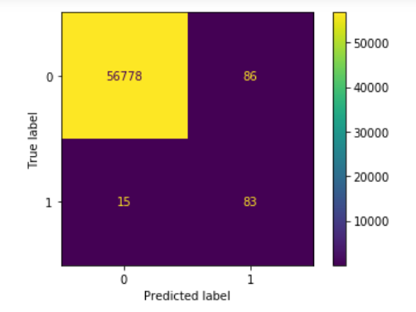
XGB results
Crossvalidation gave the following parameters:
{'gamma': 0.25, 'learning_rate': 0.1, 'max_depth': 5, 'reg_lambda': 0, 'scale_pos_weight': 350}
Accuracy Rate | Precision | Recall | F1-score | AUC
99.82% | 75% | 92% | 81% | 92.27%
Notes:
scale_pos_weight was cross validated to find the optimal value. And to start, it is typically the ratio of positive:negative classes or vice versa, thus 500 was the starting point, even though some sources say that sqrt 500 should be a more conservative approach
The approach is called cost sensitive, the idea is to force the model to take care of the rare event by increasing the loss if it fails to correctly predict them. It works much better than subsampling and co.
In most cases xgboost performs relatively well for classification problems as a starting model, and can be used to attain a baseline result

Slide 20
Random Forest Classifier
Random Forest Classifier is a machine learning method specifically designed for decision tree classifiers. Random forest is achieved by growing many classification trees.
Random Forest Classifier is easy to use and will obtain high performance for most cases. This method is also good at avoiding overfitting issue
Description
Feature Engineering
Data Preprocessing
Modeling
Results and Reflection

Slide 21
Random Forest Classifier
Preprocessing
Splitting
Scaling
Oversampling
Tunning Parameter
Split the data into training and testing datasets.
Random Forest method doesn’t require scaling for the data
Use 5 different oversampling methods to improve the imbalanced data set.
Use Grid Search tune hyper-parameters for random forest classifier
.
Description
Feature Engineering
Data Preprocessing
Modeling
Results and Reflection

Slide 22
Random Forest Classifier
Results and Analysis
 | Accuracy Rate | Precision | Recall | F1-score | AUC | Tuning parameters
RENN | 0.9992 | 0.92 | 0.86 | 0.89 | 0.9844 | {n_estimators=60, max_depth=11}
ENN(sot) | 0.9982 | 0.75 | 0.92 | 0.81 | 0.9873 | {n_estimators=60, max_depth=11}
SMOTE(sos) | 0.998 | 0.75 | 0.91 | 0.81 | 0.9796 | {n_estimators=50, max_depth=11}
SMOTETomek(kos) | 0.9984 | 0.76 | 0.92 | 0.82 | 0.9829 | {n_estimators=50, max_depth=11}
ADASYN(aos) | 0.9932 | 0.59 | 0.90 | 0.64 | 0.9699 | {n_estimators=60, max_depth=11}
Description
Feature Engineering
Data Preprocessing
Modeling
Results and Reflection

Slide 23
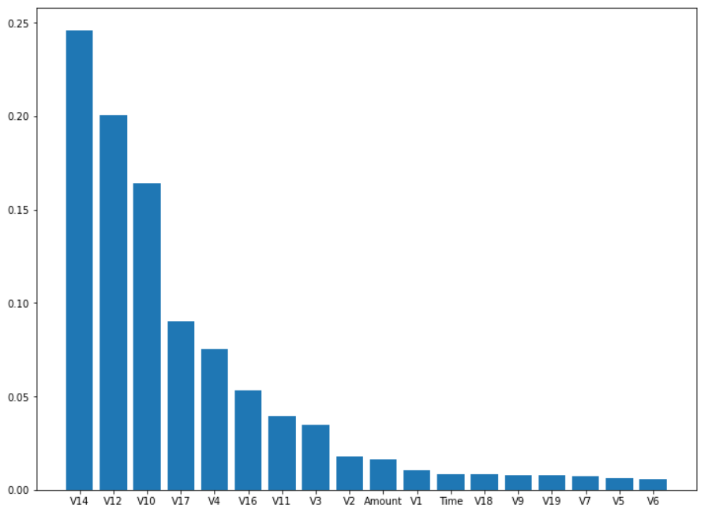
Random Forest Classifier Visualization of features importance
Description
Feature Engineering
Data Preprocessing
Modeling
Results and Reflection

Slide 24
Conclusion and Reflection
Based on AUC score , our best model is Random Forest Classifier with ENN resampling method(AUC:0.9873)
Confusion Matrix | Prediction(0) | (1)
Actual(0) | 56779 | 85
(1) | 16 | 82

Slide 25
Conclusion and Reflection
Future Improvement:
Consider data as time series
Improve resampling methods to avoid some noise of the dataset
Reflection:
Limited computational capacity
Try too many tree-based methods. We can try more fancy techniques such as deep learning

Slide 26
THANK YOU
Q&A

