Slide 1
MCI Study

Slide 2
Workflow
Install freesurfer
Install MRIcroGL
Run pre-processing

Slide 3
Inputs
10 MCI and 10 Cognitively normal subjects
Each sample comprises of 176 or 208 dicom files.
One MCI file comprised of 2 sets of dicom files. (037_S_4071)

Slide 4
Workflow: Download MRIcroGL https://www.youtube.com/watch?v=DMGWdi6Z73s&t=300s
Convert the dicom files into nifti files

Slide 5
Workflow: Download freesurfer https://surfer.nmr.mgh.harvard.edu/fswiki/rel7downloads
Ensure Xquartz is installed by running `xclock` on terminal
Latest 7.4 pkg for mac installation failed to run (freeview would not open)
Latest 7.4 tar for mac installation failed to run (freeview would not open)
Download 7.1.1 pkg installation for mac

Slide 6
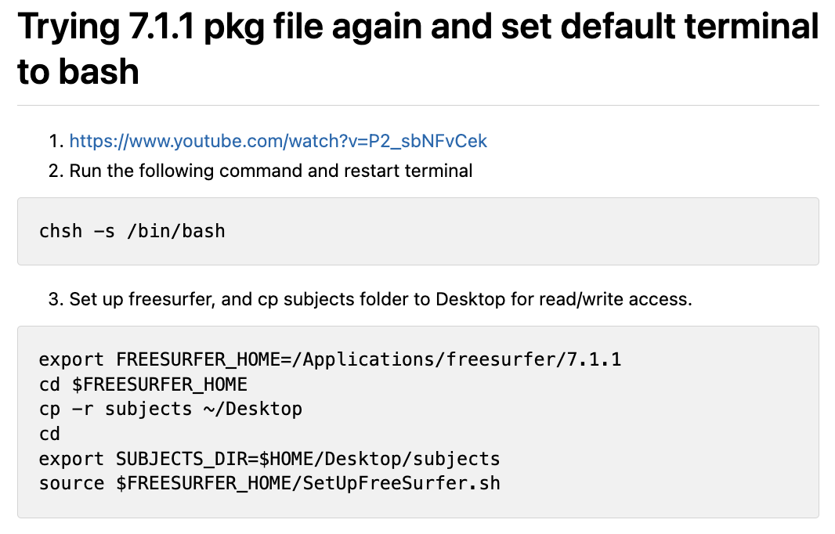
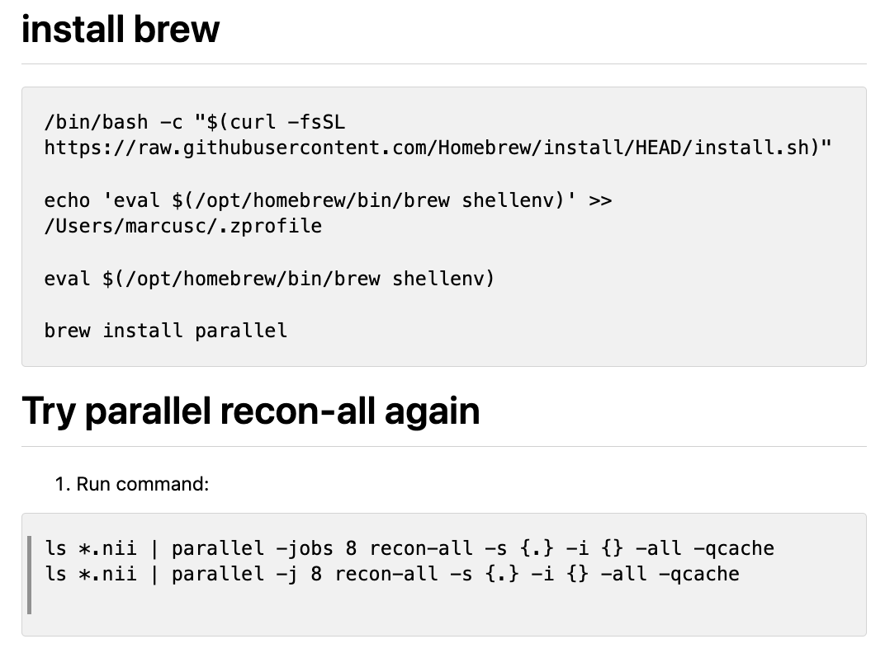
Workflow: freesurfer recon-all using 8 cores

Slide 7
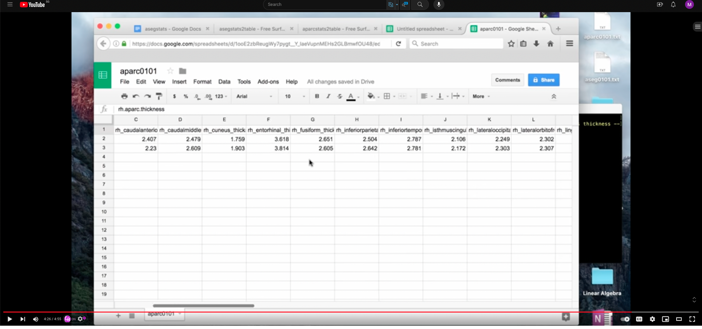
Workflow: Next steps
https://surfer.nmr.mgh.harvard.edu/fswiki/aparcstats2table
https://www.youtube.com/watch?v=E4lgb8t4x6I
aparcstats2table –subjects folder1 folder2 folder3 .. folder10--hemi rh --meas thickness --tablefile aparc_stats.txt
aparcstats2table –subjects folder1 folder2 folder3 .. folder10--hemi lh --meas thickness --tablefile aparc_stats.txt

Slide 8
Analysis
Calculate mean and standard deviation of the cortical thickness in different parcellations
Conduct Hypothesis testing using t-test.

Slide 9
Workflow: Next steps https://andysbrainbook.readthedocs.io/en/latest/FreeSurfer/FS_ShortCourse/FS_08_GroupAnalysis.html
Possible use of Group Analysis
Creating a group file with mris_preproc
Fitting the general linear model with mri_glmfit
Reviewing the Output

