Slide 1
Automated Event Detection, Scoring, and Analyst Review for Sprint Mechanics
Mridula Venkatasamy
Notes:
This project develops an automated and human-reviewable system for identifying sprint gait events, calculating SMAS metrics, and generating athlete reports from sprint video.

Slide 2
Project Goals
Goal 1: Automate SMAS analysis
  Detect gait cycles
  Predict the five SMAS event frames
  Calculate scoring metrics
  Generate visual annotations
  Produce an athlete report
Goal 2: Create a reusable research framework
  Support different keypoint-generation systems
  Compare event-detection algorithms
  Store intermediate features and predictions
  Allow future researchers to replace individual modules
  Preserve human review rather than forcing full automation

Slide 3
Stakeholders
Stakeholder 1: UTK Football Team
  Faster athlete evaluation
  Consistent frame selection
  Clear visual explanations
  The ability to review and correct results
  Reports that can support training decisions
Stakeholder 2: Computer-vision and biomechanics researchers
  A rapid research-and-development framework
  Reusable data-processing modules
  Standardized output formats
  Performance comparisons
  The ability to integrate improved pose models or detection algorithms

Slide 4
Sprint Evaluation Within Athletic Performance
UTK Football biomechanical analysts evaluate athletes using multiple drills and assessments.
Sprinting is one component of the broader athlete-evaluation process.
Sprint mechanics can provide information about:
  Movement quality
  Mechanical deficiencies
  Potential injury-related movement patterns
  Changes following training or rehabilitation

Slide 5
What Is SMAS?
SMAS stands for Sprint Mechanics Assessment Score.
Introduced by Dr. Christopher Bramah
It is a qualitative framework for evaluating sprint-running mechanics.
The original S-MAS contains 12 scoring criteria.
Each criterion receives:
  0: deficiency not observed
  1: deficiency observed
Scores are added to produce an overall score.
The objective is to achieve the lowest score possible:
  Lower score = fewer detected mechanical deficiencies
  Higher score = more detected mechanical deficiencies

Slide 6
The Five Sprint Positions
Each gait cycle is divided into five positions:
Toe-Off
The point immediately before the contralateral foot leaves the ground.
Maximum Vertical Projection (MVP)
The midpoint of flight when the pelvis is near its highest position.
Late Swing
The point of maximal knee extension during swing.
Touchdown
The first frame of ground contact.
Midstance
The point when the pelvis is positioned over the stance ankle.
Notes:
field-based screening tool for sprint mechanics associated with potential lower-limb and hamstring injury-related movement patterns

Slide 7
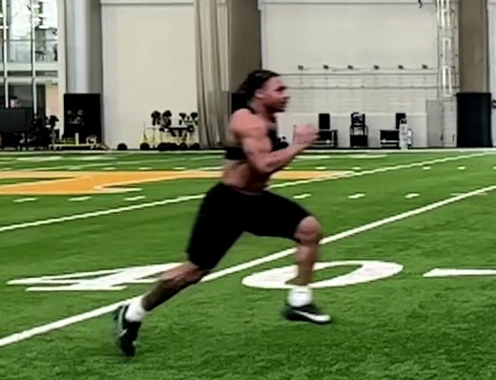
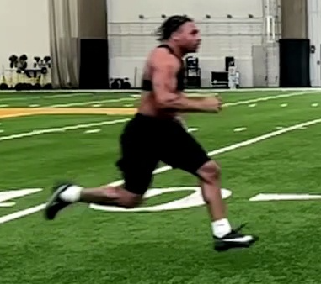
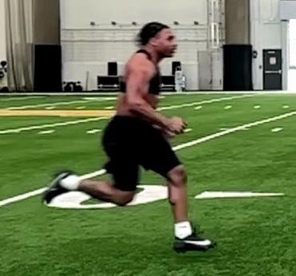
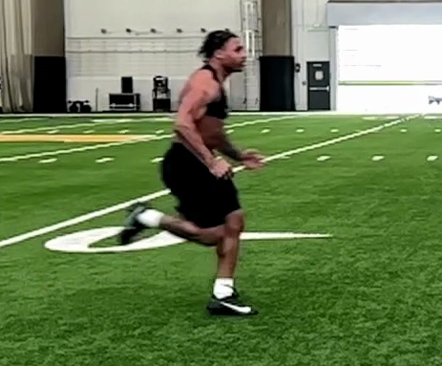
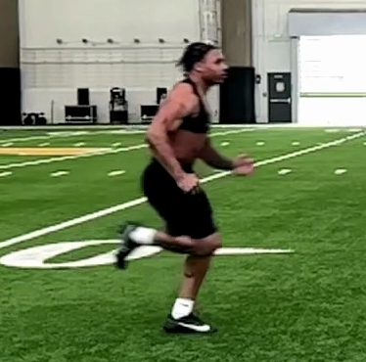
Toe off
MVP
Late Swing
Touchdown
Midstance
Notes:
Toe-Off
The point immediately before the contralateral foot leaves the ground.
Maximum Vertical Projection (MVP)
The midpoint of flight when the pelvis is near its highest position.
Late Swing
The point of maximal knee extension during swing.
Touchdown
The first frame of ground contact.
Midstance
The point when the pelvis is positioned over the stance ankle.

Slide 8
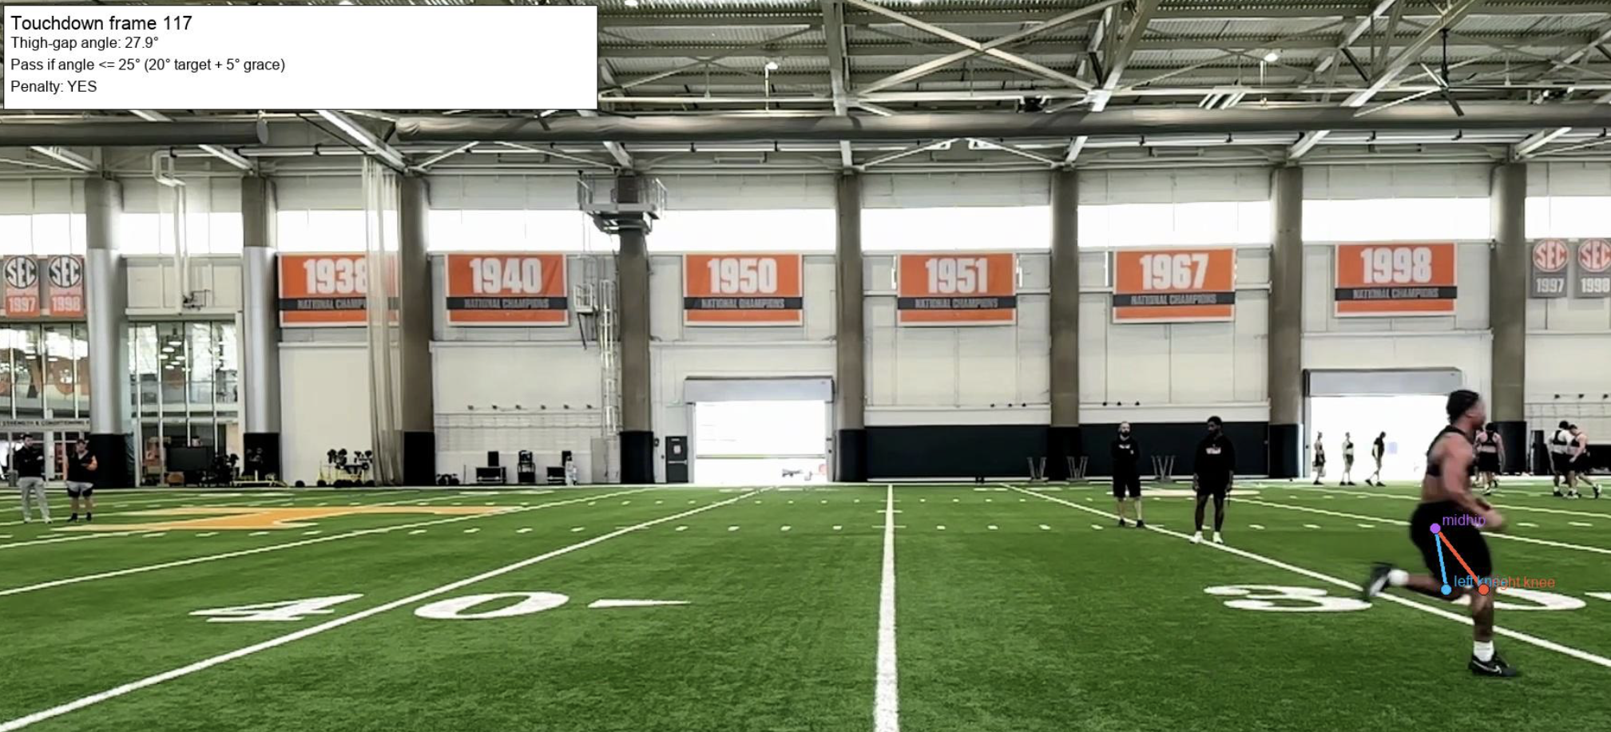
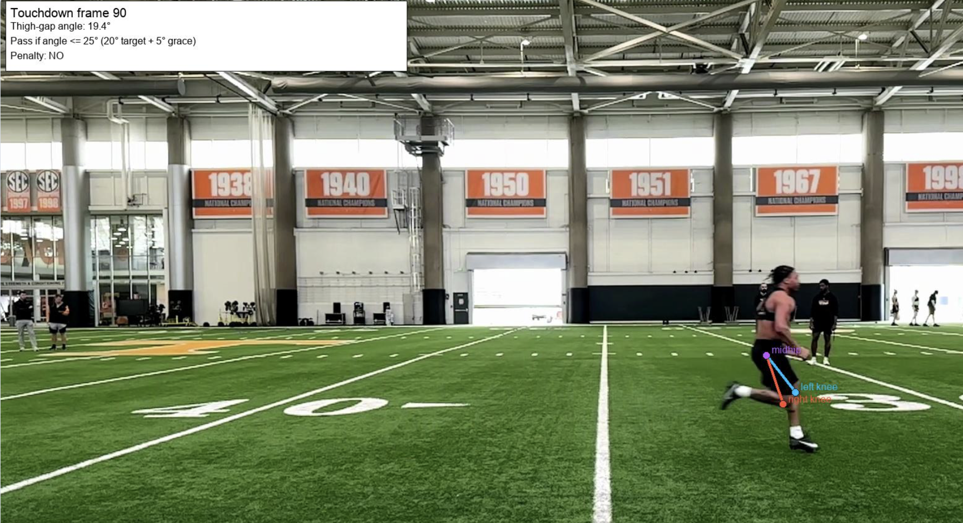
Scoring Assessment
  Appropriate trailing-limb position
  Controlled back-side mechanics
  Limited touchdown overstride
  Appropriate shin position
  Controlled midstance posture
  Excessive trailing-limb extension
  Excessive back kick
  Large thigh separation
  Foot too far ahead of the body
  Knee collapsing forward during midstance

Slide 9
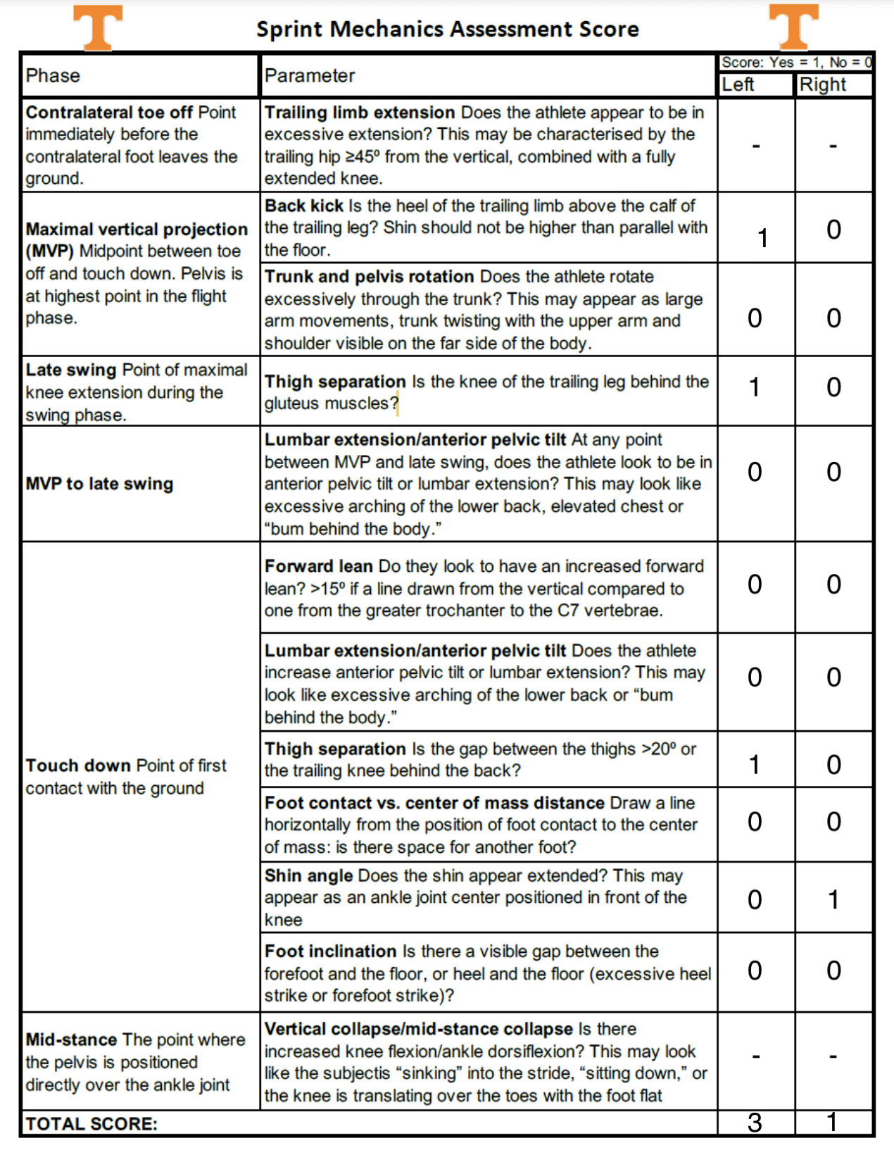
Notes:
SMAS evaluates several mechanical characteristics across the entire gait cycle rather than judging one isolated posture.

Slide 10
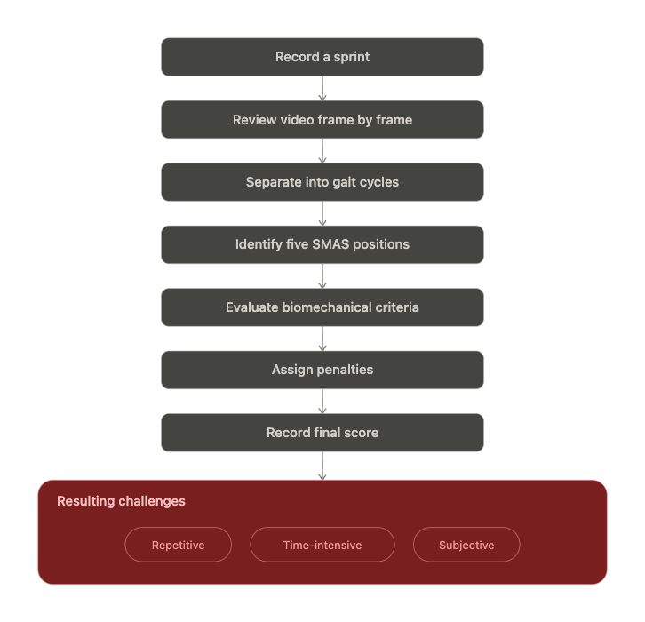
The Current Manual Workflow
Notes:
Frame selection may vary between analysts

Slide 11
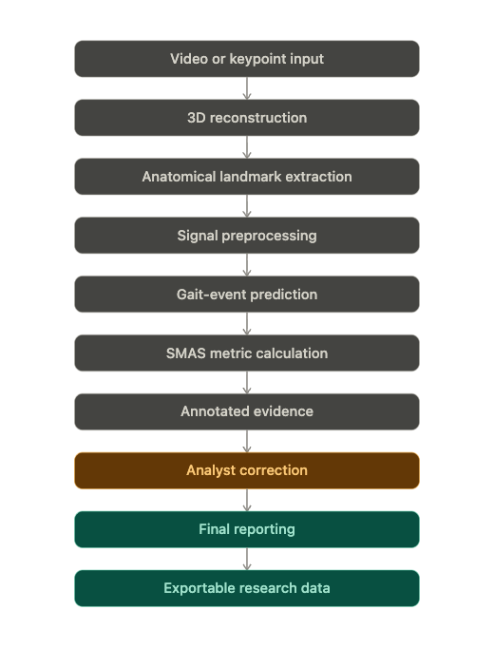
Why This Project Is Different
What makes it special
  It combines automation with expert review.
  Provides explanations for scores and allows analysts to override.
  Every score can be traced to a frame, measurement, threshold, and image.
  Individual modules can be replaced without rebuilding the complete system.

Slide 12
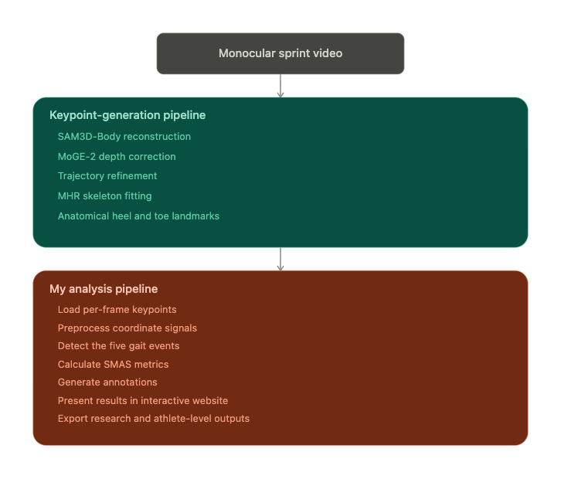
End-to-End System Architecture

Slide 13
Why Not Use Standard 2D Pose Estimation?
Pretrained 2D pose-estimation models are useful, but sprint analysis introduces specific challenges:
  Rapid limb movement
  Motion blur
  Self-occlusion
  Limbs crossing in the sagittal view
  Left/right label switching
  Standard skeletons may not include:
    Heel contact
    Heel tip
    Toe tip
    Detailed foot articulation
Notes:
chosen representation produces a temporally coherent 3D body reconstruction and derives anatomically meaningful foot landmarks required by several SMAS measurements. Nan’s module exports 21 joints at 30 fps, including left and right heel-contact, heel-tip, and toe-tip landmarks.

Slide 14
3D Reconstruction Module
Provided by Nan Xiao
3D human mesh recovery
  - SAM3D-Body reconstructs a full-body mesh.
  - MoGE-2 estimates focal length and improves depth scale.
Trajectory refinement
  - Estimates the floor and sprint direction.
  - Reduces jitter, drift, foot sliding, and lateral motion.
  - Applies physics-based trajectory constraints.
Keypoint extraction
  - Fits the MHR skeleton.
  Derives heel-contact, heel-tip, and toe-tip landmarks.
Notes:
The output is a per-frame JSON keypoint dataset used by the SMAS detector

Slide 15
Dataset
Ground truth Annotations:
  5 manually selected SMAS event frames per gait cycle
  Used Roboflow to manually annotated lower body keypoints for approx. 2000 frames
  Used to evaluate event-detection performance
  Used to compare predicted-frame scoring with ground-truth-frame scoring
Reconstruction Dataset:
  60 FPS
  2 JSON files per athlete
  Includes:
    Lower body joints
    Upper body joints
    Body-orientation vectors
Challenges:
  Manual keypoint annotation can be very noisy
  Adjacent frames can be visually and biomechanically very similar
Notes:
The output is a per-frame JSON keypoint dataset used by the SMAS detector

Slide 16
Establishing a Baseline
Before developing the current event detector, I needed a measurable baseline.
The baseline process:
  Use manually annotated frames as ground truth.
  Run an initial rule-based signal-processing detector.
  Compare predicted and ground-truth events.
  Identify which positions were consistently detected and which required new logic.
  Record:
    Detection rate
    Frame error
    Mean absolute error
    Tolerance-based accuracy
Notes:
The baseline was useful for discovering failure modes.
It was not the final system.
It showed that relying heavily on one primary event caused downstream error propagation.

Slide 17
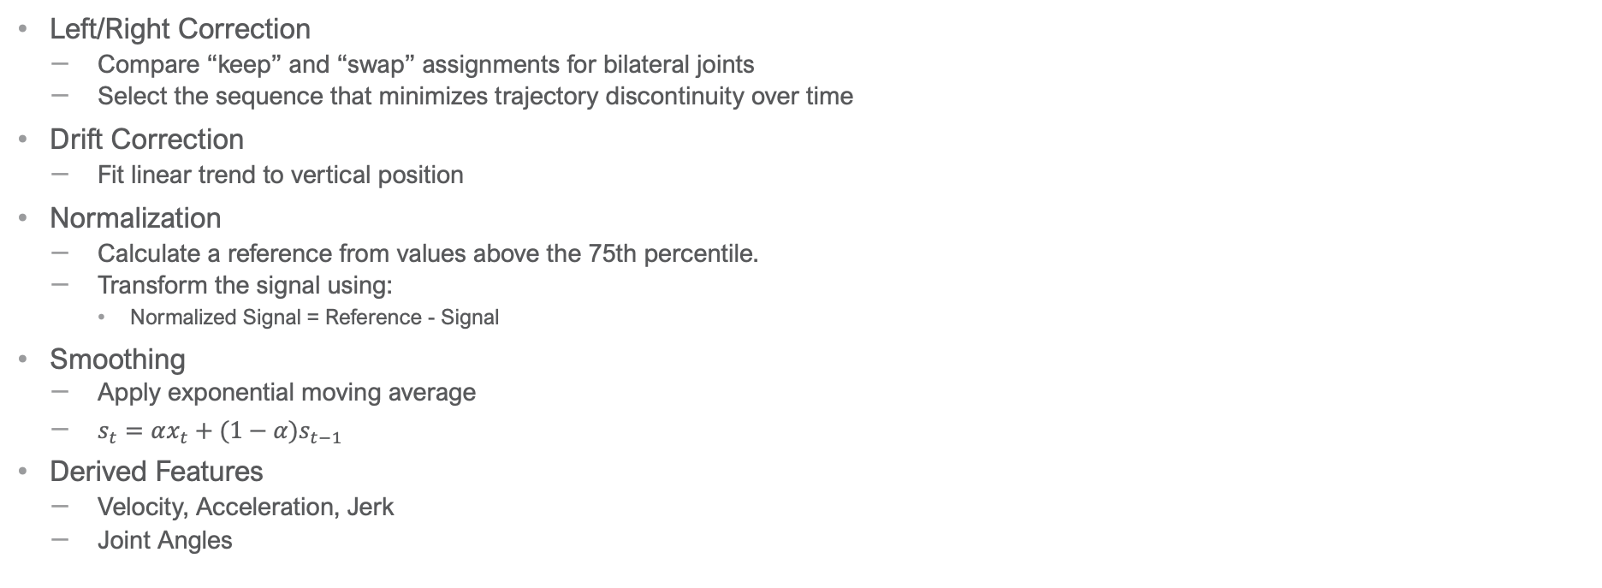
Signal Preprocessing
Left/Right Correction
  Compare “keep” and “swap” assignments for bilateral joints
  Select the sequence that minimizes trajectory discontinuity over time
Drift Correction
  Fit linear trend to vertical position
Normalization
  Calculate a reference from values above the 75th percentile.
  Transform the signal using:
    Normalized Signal = Reference - Signal
Smoothing
  Apply exponential moving average
  $s_{t}=αx_{t}+(1−α)s_{t−1}$
Derived Features
  Velocity, Acceleration, Jerk
  Joint Angles

Slide 18
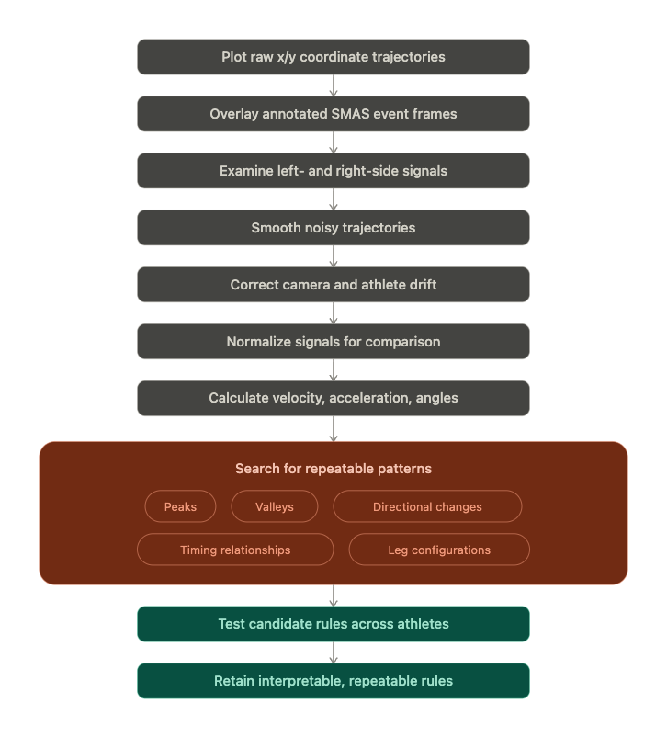
Algorithm Development
The algorithm was developed empirically through exploratory signal analysis.
Notes:
I did not begin by assuming which signal should represent each event. I transformed and visualized the available signals, aligned them with ground truth, and selected patterns that repeated across gait cycles.

Slide 19
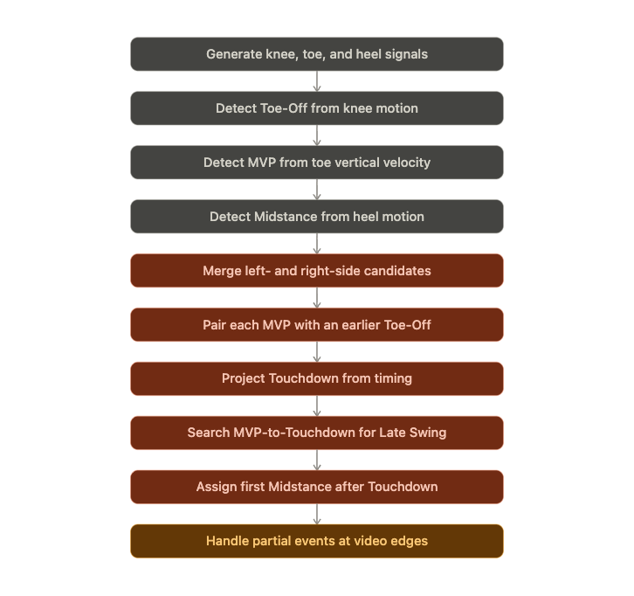
Event Detection Pipeline

Slide 20
Detecting MVP, Toe Off, and Midstance
Event | Signal | Detection method | Parameters
Toe-Off | Normalized, EMA-smoothed knee vertical trajectory | Prominent local maxima | Min prominence: 12% of range · Min separation: 10 frames
MVP | Toe vertical velocity | Prominent local maxima | Min prominence: 12% of range · Min separation: 10 frames
Midstance | Normalized, EMA-smoothed heel vertical trajectory | Prominent local maxima | First valid candidate after Touchdown, before next Toe-Off
Bilateral merging | Left/right candidates (any event) | Merge within 6-frame window | Retain higher-prominence candidate

Slide 21
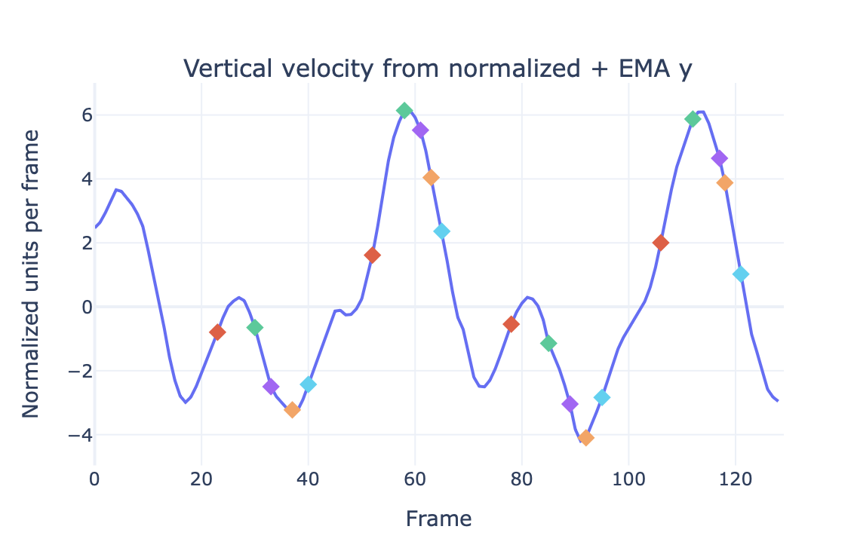
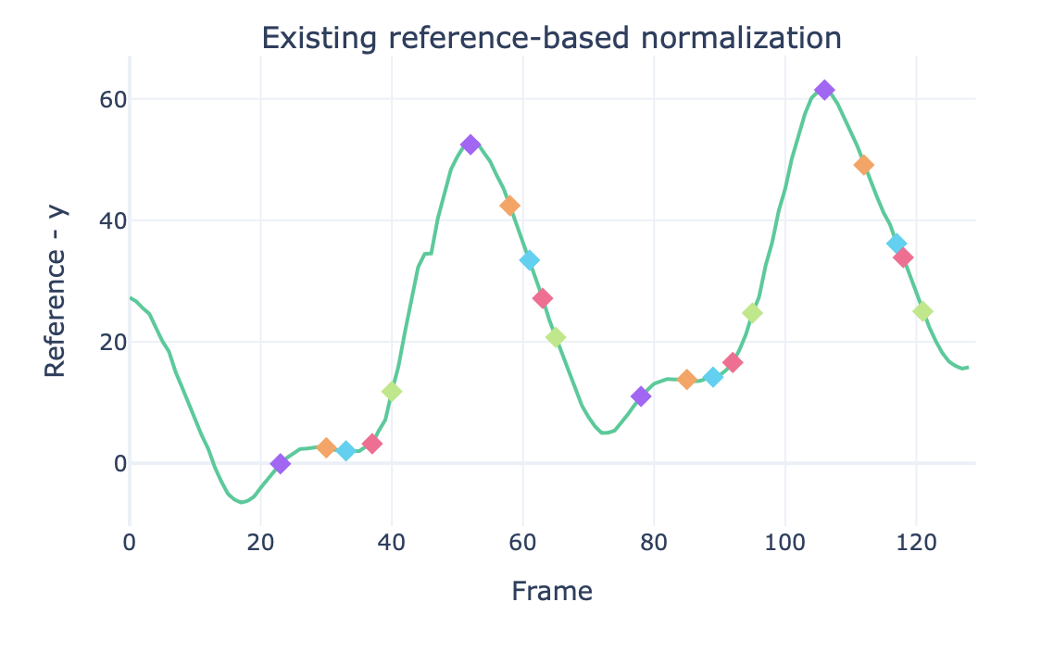
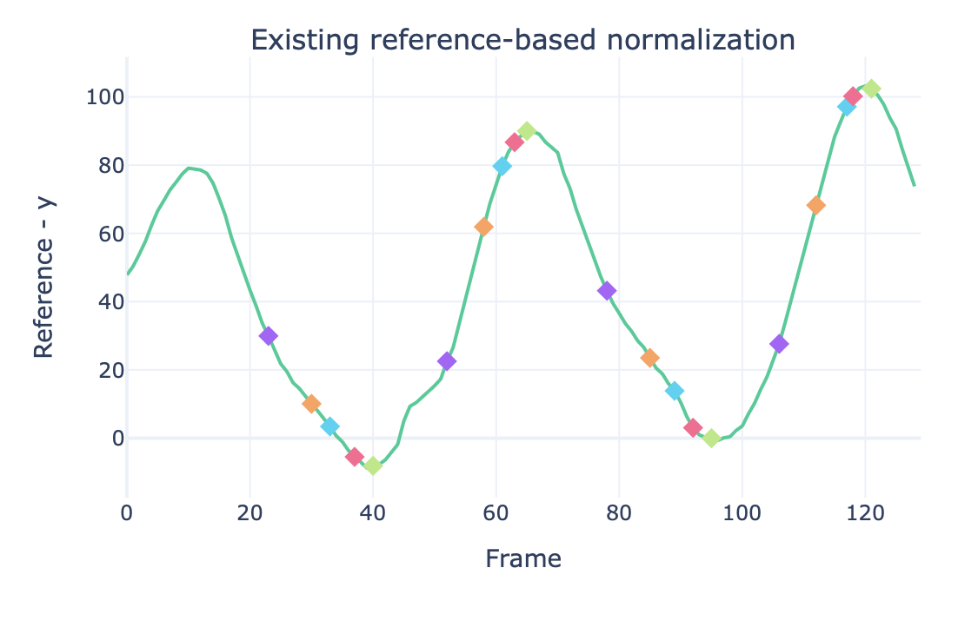
Left Toe Tip
MVP = Green
Late Swing = Purple
Toe-off = Red
Touchdown = Orange
Midstance = Blue
Toe-off = Purple
MVP = Orange
Late Swing = Blue
Touchdown = Red
Midstance = Green
Left Knee
Left Heel
Notes:
Vertical Velocity – left toe tip
Normalization – Knee
Normalization – Heel

Slide 22
Pairing Events and Completing the Gait Cycle
Toe-Off and MVP pairing
  For each MVP:
    Search for an unused earlier Toe-Off.
    Require a gap of 2 to 40 frames.
    Select the latest eligible Toe-Off.
    Prevent one Toe-Off from being assigned to multiple MVP events.
Late Swing
  Search between MVP and Touchdown.
  Calculate left- and right-leg angles.
  Retain the larger angle at each frame.
  Select the frame with the largest leg angle.
Touchdown
  Swing Interval = MVP – Toe-Off
  Touchdown = MVP + Swing Interval

Slide 23
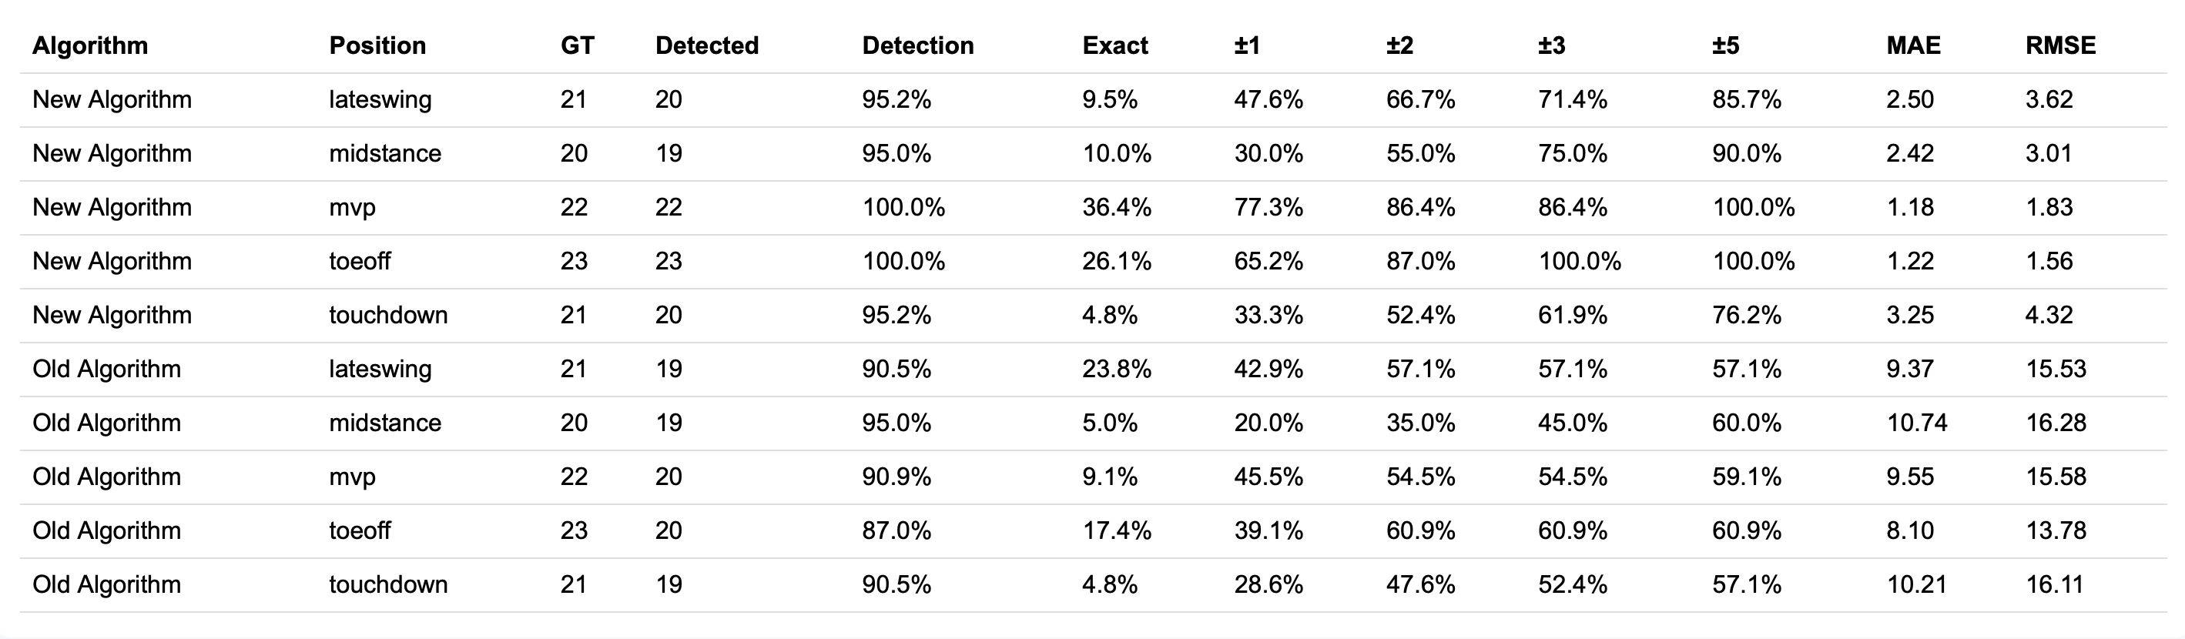
Performance Metrics

Slide 24
Position Analysis
Event | Criterion | Measurement | Threshold | Type
Toe-Off | Trailing heel–midhip angle | Midhip-to-heel angle relative to vertical | Target 45° · pass range 40°–50° | Automatic
MVP | Back kick | Trailing heel vs. trailing knee; shin rise above knee reference | Flagged if shin rises excessively | Automatic
MVP | Trunk and pelvic rotation | Chest orientation vs. sprint direction; pelvis orientation vs. sprint direction; chest-to-pelvis separation | |Chest-to-pelvis rotation| > 20° (provisional) | Automatic
Late Swing | Trailing-knee position | Knee position relative to hip/glute line | — | Automatic
Late Swing | Lumbar extension / anterior pelvic tilt | Signed trunk-curvature angle; trailing-hip position vs. pelvis; forward trunk lean | Review suggested if bend > 12° or trailing hip > 0.10 torso lengths behind pelvis | Analyst-reviewed
Touchdown | Forward lean | Pelvis-to-neck trunk angle relative to vertical | -2° ≤ forward lean ≤ 15° | Automatic
Touchdown | Lumbar extension / anterior pelvic tilt | Same procedure as Late Swing | Analyst confirms before any penalty | Analyst-reviewed
Touchdown | Thigh separation | Angle between the two midhip-to-knee vectors | Target 20° · pass ≤ 25° | Automatic
Touchdown | Shin position | Front ankle/foot distance ahead of front knee | Penalize excessive forward displacement | Automatic
Touchdown | Foot-to-center-of-mass distance | Front foot horizontal position vs. midhip, normalized by foot length | Penalize if > 1.25 foot lengths ahead | Automatic
Midstance | Knee-to-toe position | Stance knee horizontal position vs. toe-tip reference | Penalize excessive knee movement in front of toe | Automatic

Slide 25
Contributions & Limitations
Contributions
  Integrated 3D sprint reconstruction with SMAS analysis
  Developed an interpretable five-event detection algorithm
  Operationalized lower-body SMAS metrics
  Created annotated visual explanations
  Built an analyst-review interface
  Produced reusable CSV, JSON, image, and HTML outputs
  Created a framework in which future algorithms can be compared and replaced
Limitations
  Dependence on keypoint quality
  Subjective
  Occlusion and crossed limbs
  Scoring threshold requires additional validation
  Current 3D Reconstruction is not real time

Slide 26
Future Direction
Support manual keypoint correction
Automate the remaining trunk and pelvis metrics
Reduce reconstruction runtime
Replace event detection algorithm with a heuristics based approach
Store analyst corrections in a database and use reviewed corrections as training data
Allow new pose-estimation and event-detection modules to plug into the same pipeline
Notes:
This project transforms SMAS from a manual video-screening method into a transparent and extensible analysis platform. Its immediate value is saving analysts time, but its longer-term value is providing the infrastructure needed to develop, compare, validate, and deploy future computer-vision methods for sprint biomechanics.

Slide 27
Now…time for a live demo!

