Slide 1
SEI Executive KPI Report – High-Level Overview
Prepared for Executive Leadership
Prepared by Human resources

Slide 2
1. Industry Benchmark Intelligence
Technical / Junior Consultants: 75–85% utilization (non-billable dev time allowed)
Mid-Level Consultants / PMs: 75–90% (higher client responsibility, some internal work)
Senior Leaders / Partners: 40–75% (strategic & business development focus)
Firm Averages: 65–80% (balance revenue + growth)
Role-specific ranges increase transparency and employee buy-in
Goldilocks Zone (2025 benchmark): 70–80% chargeability

Slide 3
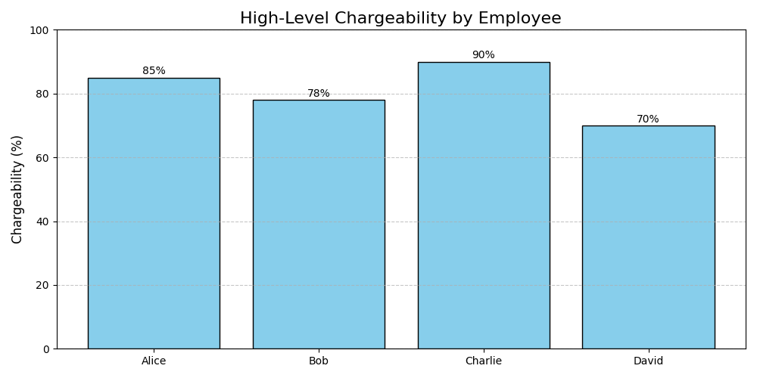
2. KPI Chargeability Overview

Slide 4
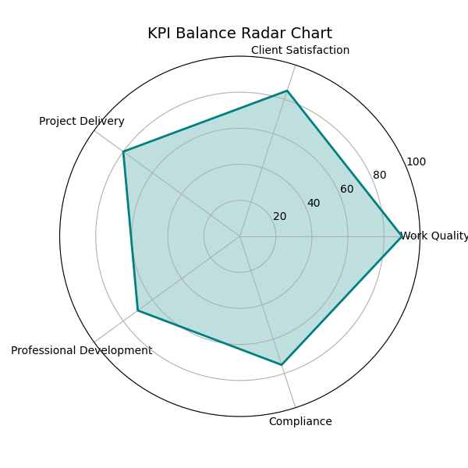
3. KPI Balance Radar Chart

Slide 5
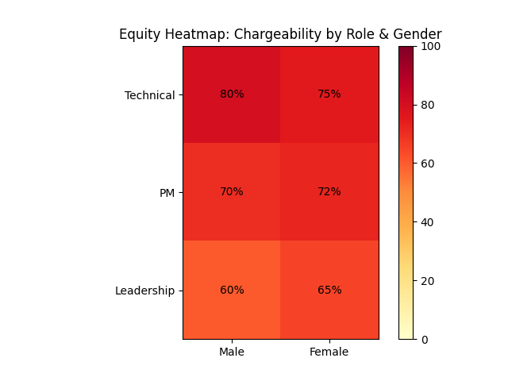
4. Equity Heatmap

Slide 6
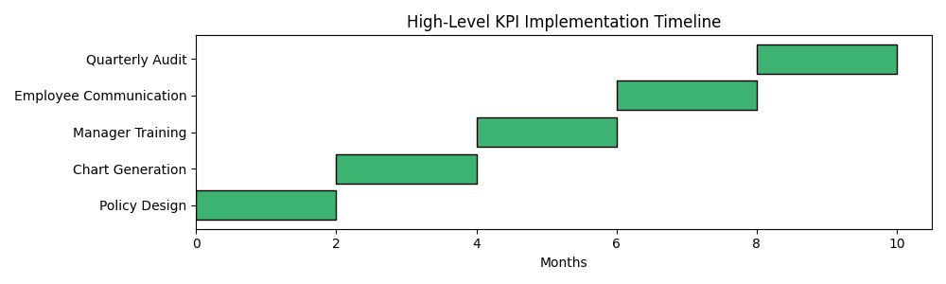
5. KPI Implementation Timeline

Slide 7
6. Executive Summary
✅ High-level KPI formula ensures fairness by adjusting for protected & company leaves
✅ Role-specific targets balance profitability & employee expectations
✅ Broader KPIs complement chargeability (e.g., project margin, realization rate)
✅ Equity & compliance audits mitigate risk and support defensible decision-making
✅ Time tracking and dashboards ensure transparency & actionable insights

