Slide 1
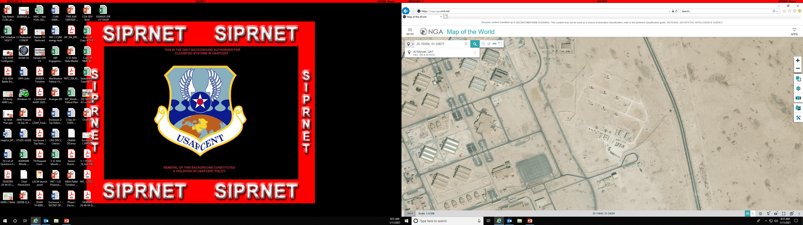
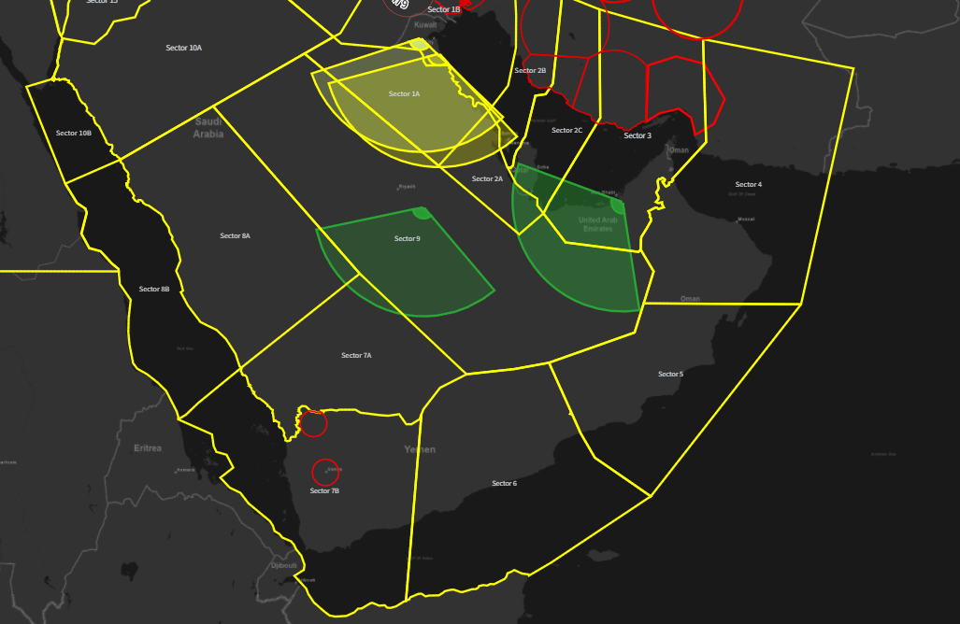
PAT XIV STORY BOARD
At 260700APR25 A 2-43 received a STO pushing the unit to Alert state of TWO. The TCO notified Hot Crew, and Hot Crew took of at a high rate of speed. The driver of the Hot Crew vehicle made a sharp turn, when he lost control, causing the vehicle to rollover. SM1 ejected from the vehicle. The vehicle rolled over the SM. The TC SM2 door flew open and slammed shut and crushed his right leg. Medics arrived at the accident site near LS2, and found SM1 deceased. SM2 was loaded in a FLA and transported to PSAB TMC.
Direction of travel
Rollover location

