Slide 1
THE NEED FOR THE MPU

Slide 2
What is MPU ?
Memory Protection Unit is a piece of hardware in modern MCUs
Prevents a process from accessing unallocated region
Allows privileged access to defined regions
Can be controlled with attributes
Monitors every transaction (including instruction fetch)
Violation triggers fault exception

Slide 3
Speculative Access
DMA Issues
Task Management

Slide 4
Speculative Access
Speculative access is like accessing in advance
What does it access ?
Types of Speculative Access (Read, Instruction, and cache)

Slide 5
Speculative READ
Speculative Read is reading the normal memory region in advance
The MCU might not need the data from the location
Increases the performance
Sometimes accesses the invalid location
Might cause errors, or system halt
For example, the external memories
MPU can be setup to prevent the access

Slide 6
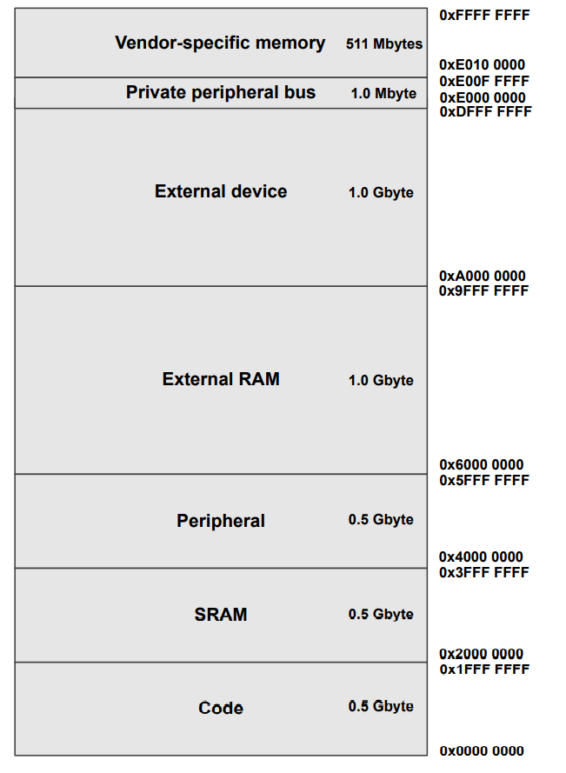

Slide 7
Speculative Instruction Fetch
Instruction is fetch regardless of whether it is needed
Sometimes it will not execute
Sometimes not even a valid instruction
Increases the performance

Slide 8
Speculative cache linefills
Takes place in cacheable regions
Sometimes even without any instruction

Slide 9
DMA ISSUES
Can’t work with cacheable regions
Needs data coherency
Coherency can be achieved using software also
Making region not cacheable works too
Detailed explanation during cache policies

Slide 10
Task Management
RTOS Tasks can be restricted in certain Regions
Prevent them from accessing system resources

