Slide 1
MEMORY TYPES and ATTRIBUTES

Slide 2
MEMORY TYPES in CORTEX M7
NORMAL MEMORY
DEVICE MEMORY
STRONGLY ORDERED MEMORY

Slide 3
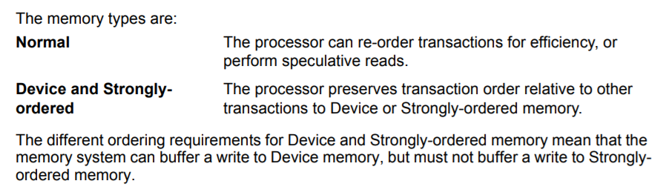
Normal memory is good for code execution
It allows the speculative access
No speculative access in strongly ordered and device memories
CPU waits for the end of instruction before performing another one
Each write needs to be visible for device, eg- external NAND
Device memory is used for microcontroller Registers

Slide 4
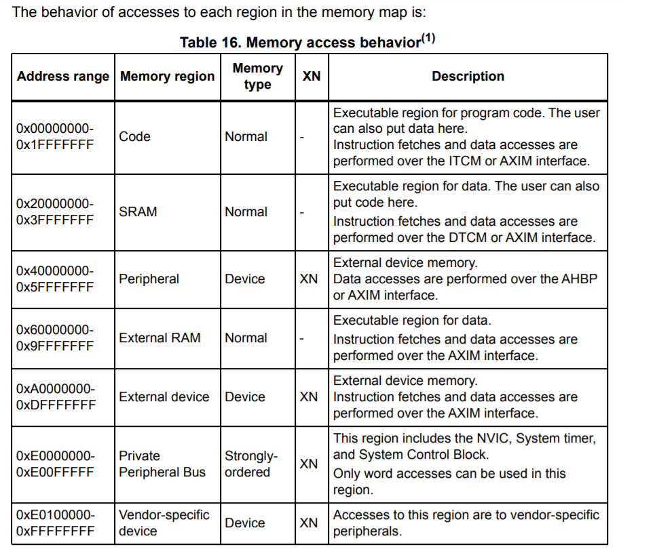

Slide 5
ATTRIBUTES
SHAREABILITY
CACHEABILITY
BUFFERABLILITY
EXECUTABLE NEVER (XN)

Slide 6
SHAREABLE REGION
Shareable Region means multiple masters can access the memory
For example, CPU and DMA accessing some region
Strongly ordered memory is always shareable
If some area Is cacheable and shareable, Data cache can’t be used
Instruction cache can be used though

Slide 7
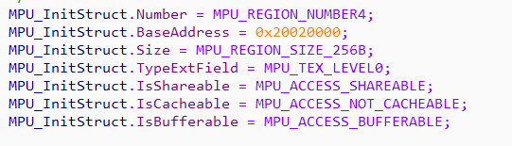
EXAMPLE for SHAREABLE REGION
Ethernet DMA Descriptors for Tx and Rx
256 Bytes of shareable region

Slide 8
CACHEABLE REGION
Where the cache can be used, i.e. instruction and data cache
Should be disabled for synchronisation between 2 masters
Will see more during the Cache policies

Slide 9
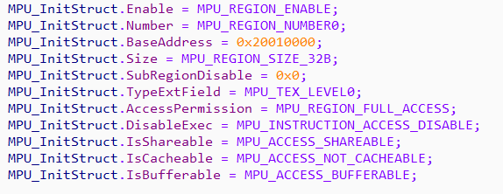
Example for Disabling Cache
Rx Buffer is at 0x20010000
DMA tries to copy data to RX Buffer
Disable Cacheability for data synchronisation

Slide 10
BUFFERABLE REGION
Instruction execution may continue before memory write is done
Memory write is then finished from a buffer

Slide 11
EXECUTABLE NEVER (XN)
Should be set where the instructions are not supposed to be executed from
If the instruction is executed from XN region, it causes hardfault
Speculative instruction fetch can be blocked

Slide 12
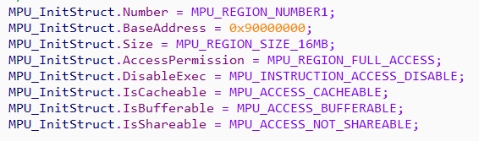
Prevent Speculative access
QSPI memory range
QSPI set as flash
Disabled instruction access

Slide 13
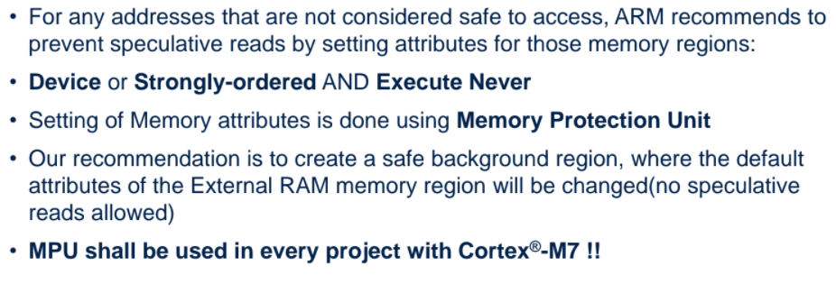
Things to remember

Slide 14
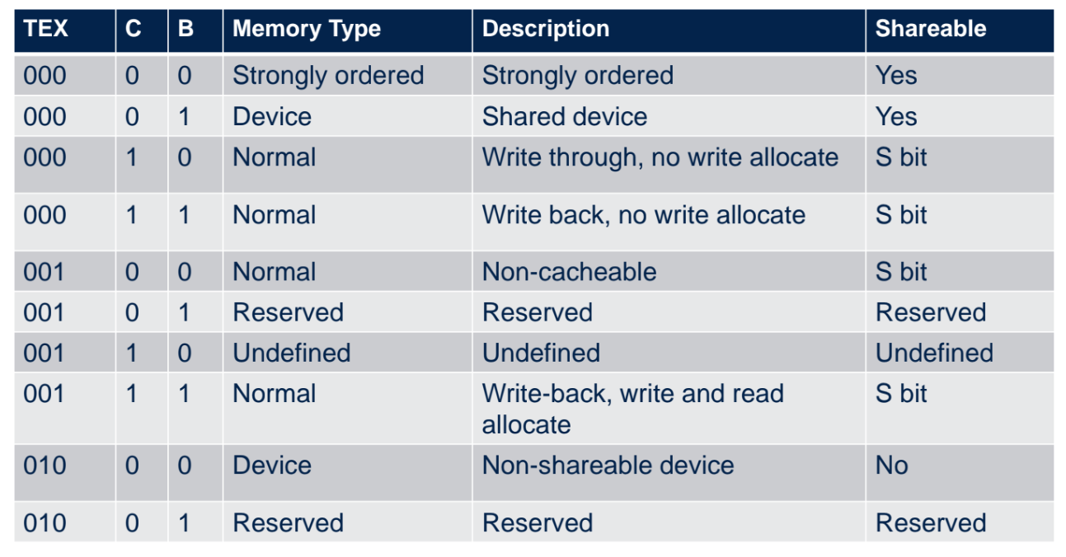
MPU configuration

