Slide 1
🚗
Car Price Prediction
Predicting the resale price of used cars with machine learning
EXPERT PETROLEUM SERVICES Internship Project
Model: Tuned XGBoost Regression Pipeline · Deployed with Streamlit
github.com/MAROUA871/EXPS_Car_Price_Prediction

Slide 2
Project Overview
Used car prices depend on multiple factors — original price, age, mileage, fuel type, transmission, and ownership history. This project builds a regression model that estimates a car's selling price from these characteristics, covering the complete ML workflow from raw data to an interactive web app.
PROJECT SCOPE
1
Data cleaning & preprocessing
2
Feature engineering
OBJECTIVE
3
Exploratory data analysis
Build a regression model that predicts the Selling Price of a used car.
4
Correlation analysis
5
Model training & comparison
6
Hyperparameter tuning
7
Model evaluation & serialization
8
Interactive prediction (Streamlit)

Slide 3
Dataset & Features
301 used-car records with vehicle characteristics and their sale prices.
Feature | Description
Car_Name | Name of the car
Year | Manufacturing year
Selling_Price | Target variable — selling price
Present_Price | Current / original market price
Kms_Driven | Kilometers driven
Fuel_Type | Petrol or Diesel
Seller_Type | Dealer or Individual
Transmission | Manual or Automatic
Owner | Number of previous owners
ENGINEERED FEATURE
Car_Age
Calculated from the manufacturing year, using 2018 as the reference year:
Car_Age = 2018 − Year
301
total car records
in the dataset

Slide 4
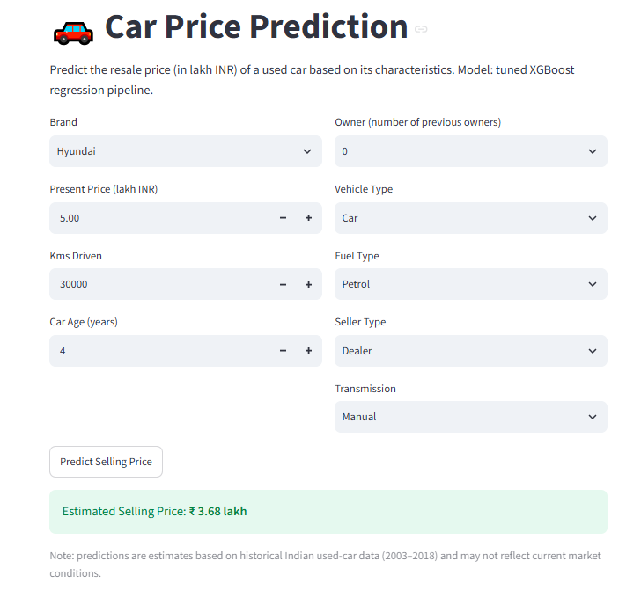
Interactive Streamlit App
Users enter a car's details and instantly get an estimated selling price.
INPUTS
Brand, present price, kms driven, car age, owner count, vehicle type, fuel type, seller type, transmission
OUTPUT
Estimated selling price in lakh INR, generated instantly on click
SCOPE NOTE
Trained on historical Indian used-car data (2003–2018)

Slide 5
Model & Tech Stack
Regression Modeling
Python & scikit-learn
Streamlit Deployment
Multiple models were trained and compared, with a tuned XGBoost pipeline selected as the final estimator.
Data cleaning, feature engineering, and model evaluation built with the standard Python data-science stack.
The final pipeline is serialized and served through an interactive Streamlit web app for live predictions.
Takeaway
This project walks the full ML lifecycle for a real-world regression problem — cleaning and engineering features from raw car listings, comparing regression models, tuning the best performer, and shipping it as a usable, interactive prediction tool.
github.com/MAROUA871/EXPS_Car_Price_Prediction

