Slide 1
📉
Unemployment Analysis with Python
Exploring U.S. unemployment trends, seasonality, and the COVID-19 shock (1976–2025)
EXPERT PETROLEUM SERVICES Internship Project
Data Cleaning · EDA · Time-Series · Seasonal & Geographic Analysis
github.com/MAROUA871/EXPS_Unemployment_Analysis

Slide 2
Project Overview
This project analyzes unemployment trends across U.S. states and selected geographic areas using Python. It covers data cleaning, validation, and exploratory analysis — examining historical trends, geographic differences, seasonal patterns, and the impact of the COVID-19 pandemic.
OBJECTIVES
Clean & validate a real-world dataset
Explore rate distribution & variation
FOCUS AREAS
Analyze historical trends over time
Data Cleaning · Data Validation · EDA · Visualization · Time-Series · Seasonal · Economic Trend Analysis
Investigate COVID-19 pandemic impact
Compare rates across geographies
PROJECT GOAL
Understand how unemployment has moved across time and geography — and what it reveals about major economic downturns and recoveries.
Identify seasonal patterns
Link labor-force participation & unemployment
Present findings with tables & visuals

Slide 3
Dataset & Data Cleaning
Unemployment in America Per US State.csv
53
1976–2025
31,747
11
geographic entities
years covered
observations
final columns
Fields include State/Area, Year, Month, civilian population, labor force, employment, unemployment, unemployment rate, and labor-force participation measures.
CLEANING & VALIDATION STEPS
Checked dataset structure & dimensions
Detected special missing-value codes
Standardized column names
Replaced special – values with NaN
Corrected data types
Checked for missing values & duplicates
Converted numeric strings to numeric values
Validated categorical, year & month values
Removed commas from numeric values
Converted variables to correct numeric formats

Slide 4
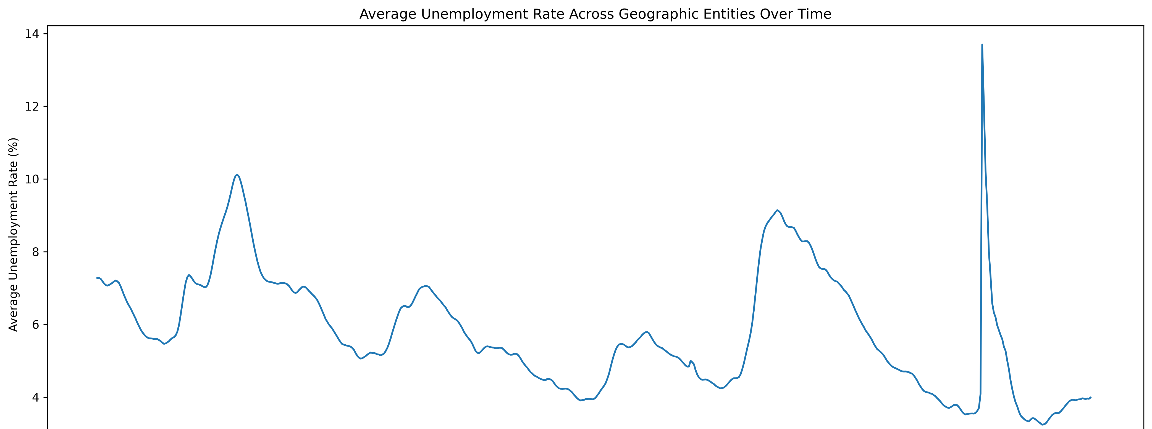
Historical Trends & the COVID-19 Shock
Average U.S. unemployment rate across geographic entities, 1976–2025
Early 1980s & 2009–10
2020
2022–2023
Recession peaks near 9–10%
COVID-19 spike to ~14% — the sharpest jump on record
Rapid recovery to historic lows near 3.5%

Slide 5
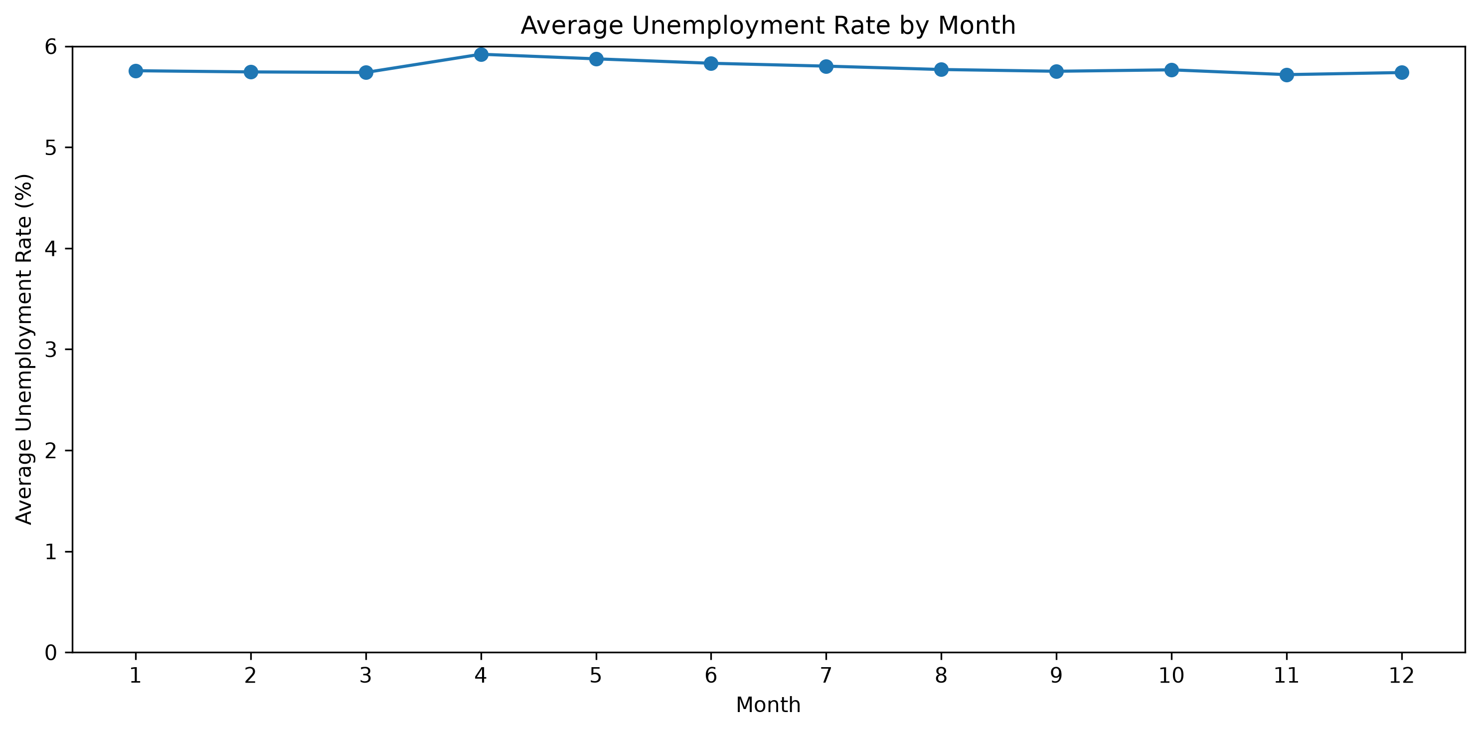
Seasonal & Geographic Patterns
SEASONAL PATTERNS
Unemployment stays fairly stable across the year, with a modest peak in spring (April–May) and the lowest points around November. Seasonal swings are small — well under 1 percentage point — and consistent across most years.
Average unemployment rate by calendar month
GEOGRAPHIC DIFFERENCES
Unemployment rates vary substantially across the 53 geographic entities
Some areas run consistently higher; others consistently lower
Entities respond differently in scale during major downturns

Slide 6
Key Findings & Tech Stack
KEY FINDINGS
TECHNOLOGIES
Unemployment varies considerably across historical periods
Python
COVID-19 produced an exceptional, sudden spike in 2020
Pandas
NumPy
Rates differ substantially between geographic entities
Matplotlib
Recurring monthly & seasonal patterns are present
Seaborn
Sharp increases mark major economic downturns
Jupyter Notebook
Subsequent decreases reflect periods of recovery
Internship: EXPERT PETROLEUM SERVICES
A full data-analysis lifecycle applied to 49 years of real-world labor data — from raw CSV to cleaned dataset to economic insight.
github.com/MAROUA871/EXPS_Unemployment_Analysis

