Slide 1
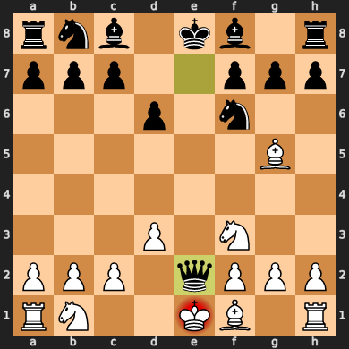
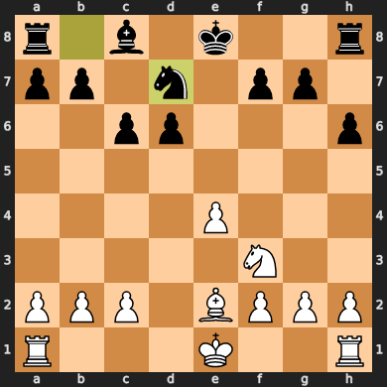
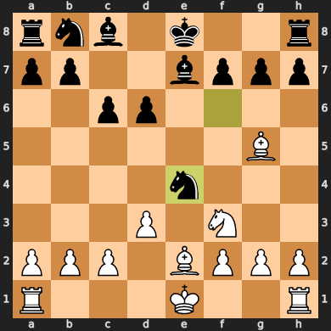
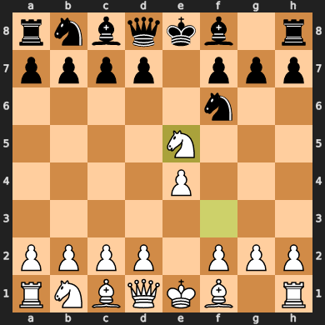
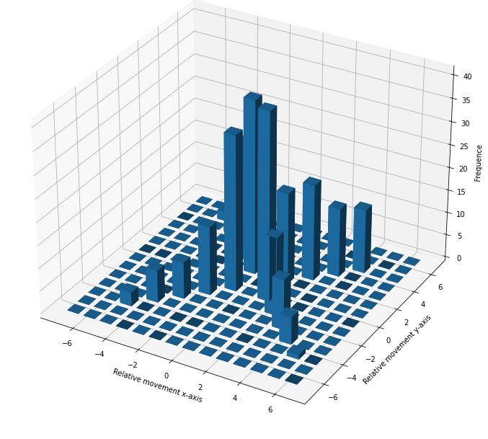
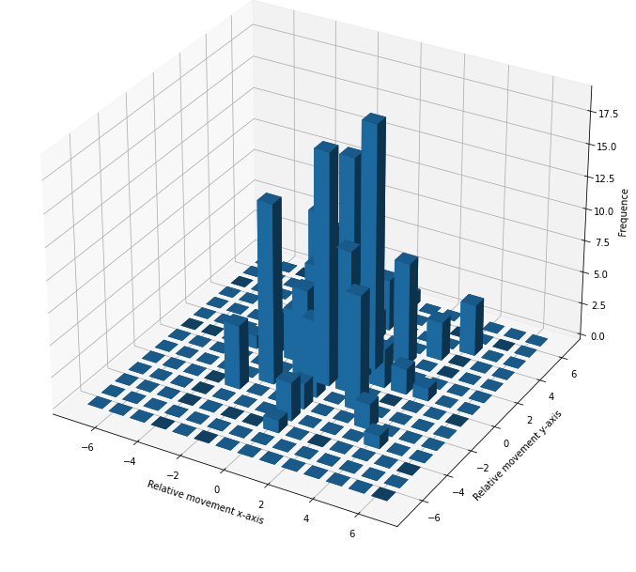
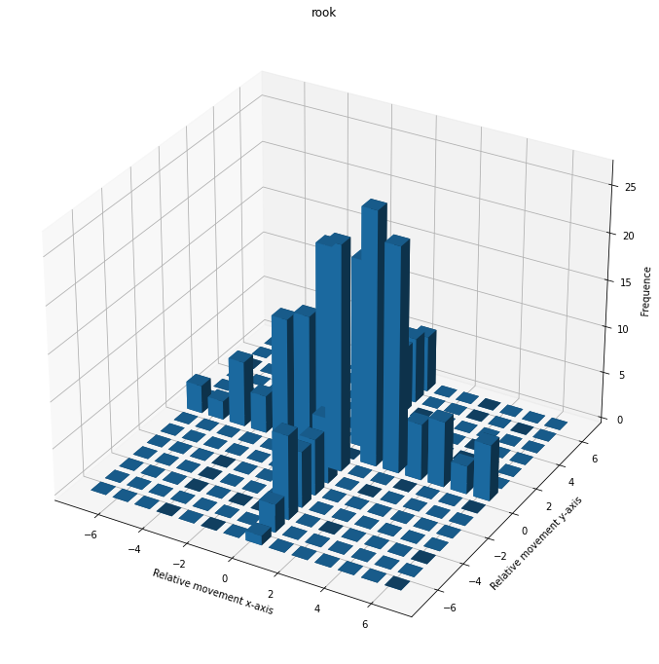
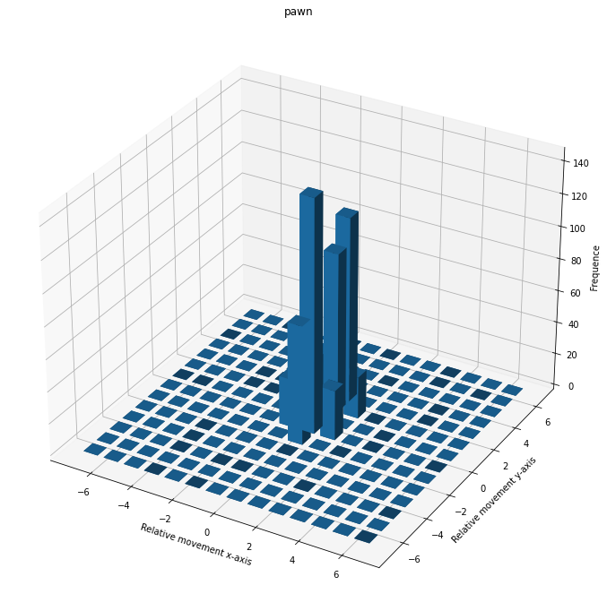
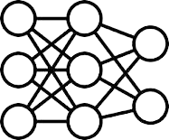
Dataset LichessAPI
Play games,
collect samples
Calculate Action space per piece thorugh a frequency distribution
Train local and global agents
Perform experiments for different setups
Setup each agent
[-1,2] – 60%
[1,2] – 10%
…
[-1,2]
[1,2] – 70%
[1,1] – 30%
[1,2]
Move Knight (R)
[-1,2]
[-1,1] – 50%
[-2,2] – 10%
…
[-1,1]

Slide 2
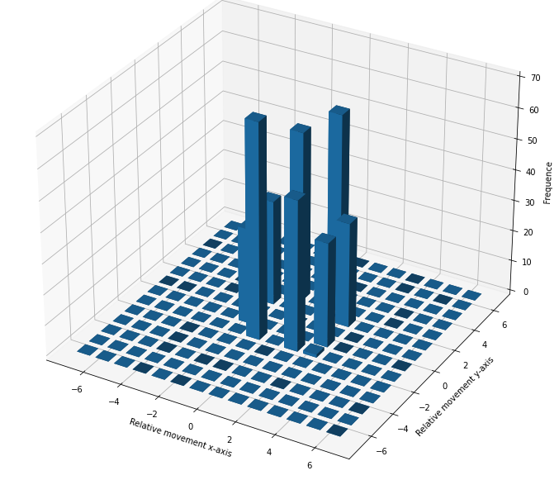
(Distributed/MAS) Reinforcement Learning,
In order to analyze and improve on pressing questions in RL an experiment setup is created. Chess serves as a fitting toy example, as it
Create a chess game as a experiment environment, because -> Multiple agents, that have varying action spaces, but the same long term goal, however serving different purposes thorughout the game ; Discrete action and large state space
Research Questions
Local vs. global learnings and decisions
Incorporating as little knowledge as possible into the training process
Knowledge transfer between local pieces
Neuroevolutive algorithms with dynamic observation and action spaces
Teaching and Hierarchical Learning on local and global level
Sparse Rewards and Reward Engineering with no knowledge inclusion
Competitive and cooperative acting in MAS
Play games,
collect samples
Dataset LichessAPI
Calculate Action space per piece thorugh a frequency distribution
Train local and global agents
Perform experiments for different setups
Setup each
agent
[-1,2] – 60%
[1,2] – 10%
…
[-1,2]
[1,2] – 70%
[1,1] – 30%
[1,2]
[-1,1] – 50%
[-2,2] – 10%
…
[-1,1]
Move Knight (R)
[-1,2]
Reinforcement Learning Multi-Agent Systems
Helen Haase (B.Sc.) Prof. Dr. Thomas Clemen
Helen.Haase@haw-hamburg.de Thomas.Clemen@haw.hamburg.de

Slide 3

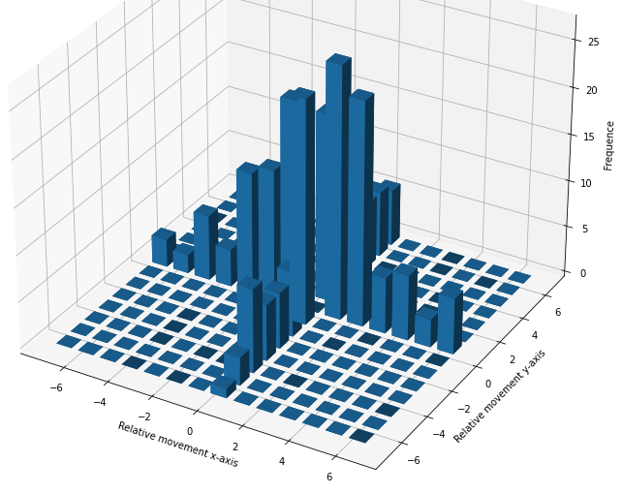
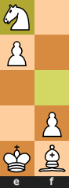
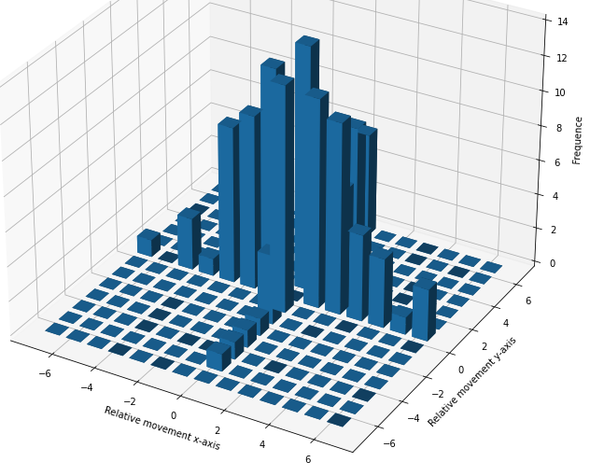
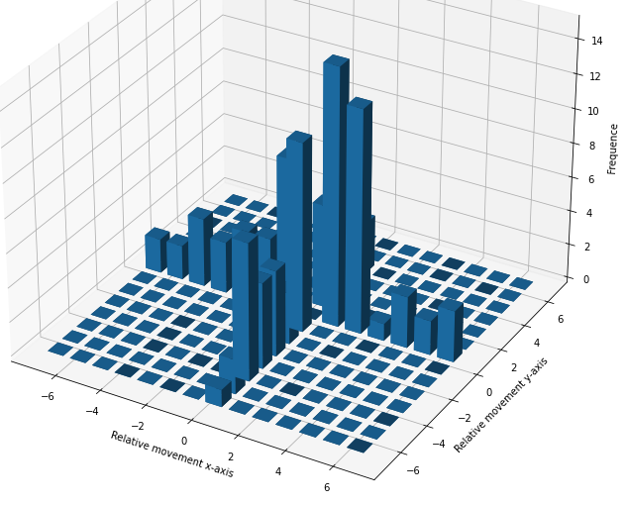
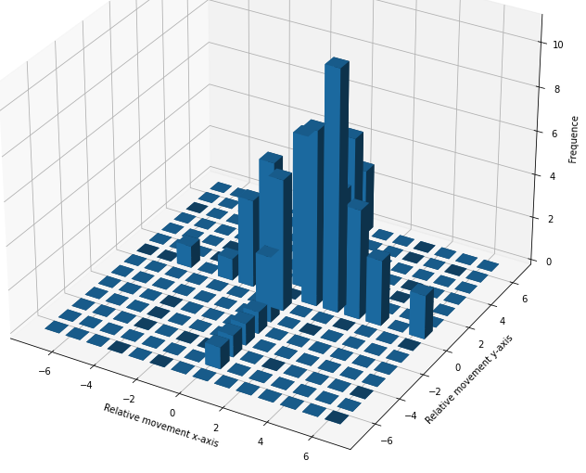
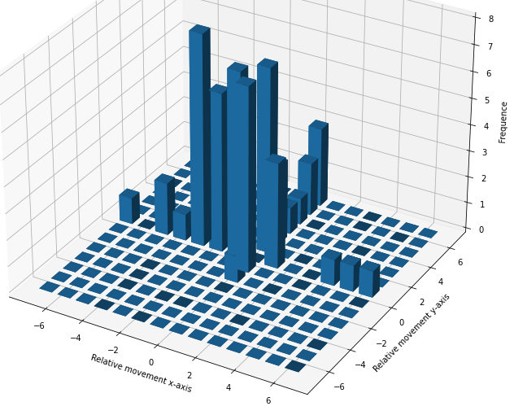
Deep Reinforcement Learning for Multi-Agent Systems on the Example of Chess
Train local and global agents
Perform experiments for different setups
Chess is a good example as it is possible to view the problem in a single and multiagent context, it is possible to define a strict action space but also learn the action space (rules based), the state space is enormous as it is in most realworld problem
Setup each
agent
Research Questions
Local vs. global learnings and decisions
Incorporating as little knowledge as possible into the training process
Knowledge transfer between local pieces
Neuroevolutive algorithms with dynamic observation and action spaces
Teaching and Hierarchical Learning on local and global level
Sparse Rewards and Reward Engineering with no knowledge inclusion
Competitive and cooperative acting in MAS
[-1,2] – 60%
[1,2] – 10%
…
[1,2] – 70%
[1,1] – 30%
[-1,1] – 50%
[-2,2] – 10%
…
[-1,2]
[1,2]
[-1,1]
Deep Reinforcement Learning (DRL) is a significant advancement in different fields including for example manufacturing process. Questions of how to train a robot to perform certain actions without being aware of which actions are possible perform, or without any understanding of the process itself are relevant and generalizable. How can I optimally train a new robot agent to learn without knowing the perfect strategy? How can a set of agents learn together to collectively solve problems? In order to investigate these questions a representative setup is built in chess, where multiple agents of varying capabilities cooperatively elaborate a solution.
Move Knight (R)
[-1,2]
Methods
Phase 1 – Approximating an action space through a frequency distribution
Take a dataset of thousands of played games from LichessAPI (cite?) and clean the dataset
Convert the algebraic notation of each game into action samples of each individual piece, calculate a frequency distribution + training samples
Use frequency distribution as a starting place of the action space of each piece
Results
Action space for each individual chess piece
Outlook
Local vs. global learnings and decisions
Incorporating as little knowledge as possible into the training process
Knowledge transfer between local pieces
Neuroevolutive algorithms with dynamic observation and action spaces
Teaching and Hierarchical Learning on local and global level
Sparse Rewards and Reward Engineering with no knowledge inclusion
Competitive and cooperative acting in MAS
References
Action space for each individual chess piece
[-1,2] – 60%
[2,1] – 10%
…
[-1,2]
[0,2] – 60%
[0,1] – 10%
…
[0,2]
[-1,2]
[-1,-1] – 60%
[1,1] – 10%
…
[-1,-1]
Collect sample games
[-1,2]
[0,2]
[-1,-1]
…
[-1,2] – 60%
[0,2] – 10%
[-1,-1] -10%
…
Dataset LichessAPI
Move Knight (R)
From F3 to E5
Calculate Action space per piece thorugh a frequency distribution
Reinforcement Learning Multi-Agent Systems
Helen Haase (B.Sc.) Prof. Dr. Thomas Clemen
Helen.Haase@haw-hamburg.de Thomas.Clemen@haw.hamburg.de

Slide 4

Deep Reinforcement Learning for Multi-Agent Systems on the Example of Chess
Train local and global agents
Perform experiments for different setups
Chess is a good example as it is possible to view the problem in a single and multiagent context, it is possible to define a strict action space but also learn the action space (rules based), the state space is enormous as it is in most realworld problem
Faculty of ENGINEERING AND COMPUTER SCIENCE
Department of Computer Science
Setup each
agent
Research Questions
Local vs. global learnings and decisions
Incorporating as little knowledge as possible into the training process
Knowledge transfer between local pieces
Neuroevolutive algorithms with dynamic observation and action spaces
Teaching and Hierarchical Learning on local and global level
Sparse Rewards and Reward Engineering with no knowledge inclusion
Competitive and cooperative acting in MAS
[-1,2] – 60%
[1,2] – 10%
…
[1,2] – 70%
[1,1] – 30%
[-1,1] – 50%
[-2,2] – 10%
…
[-1,2]
[1,2]
[-1,1]
Deep Reinforcement Learning (DRL) is a significant advancement in different fields including for example manufacturing process. Questions of how to train a robot to perform certain actions without being aware of which actions are possible perform, or without any understanding of the process itself are relevant and generalizable. How can I optimally train a new robot agent to learn without knowing the perfect strategy? How can a set of agents learn together to collectively solve problems? In order to investigate these questions a representative setup is built in chess, where multiple agents of varying capabilities cooperatively elaborate a solution.
Move Knight (R)
[-1,2]
[-1,2] – 60%
[2,1] – 10%
…
Methods
Phase 1 – Approximating an action space through a frequency distribution
Take a dataset of thousands of played games from LichessAPI and clean the dataset
Convert the algebraic notation of each game into action samples of each individual piece, calculate a frequency distribution + training samples
Use frequency distribution as a starting place of the action space of each piece
Results
After performing a small subset of 65 games the frequency distribution can be derived individually per color, piece type, and even for each individual piece
These distribution yielded a complete action space of each piece, while already incorporating strategic preferences of each piece
Outlook
Phase 2 – Looking into specific problems
Local vs. global learnings and decisions
Incorporating as little knowledge as possible into the training process
Knowledge transfer between local pieces
Neuroevolutive algorithms with dynamic observation and action spaces
Teaching and Hierarchical Learning on local and global level
Sparse Rewards and Reward Engineering with no knowledge inclusion
Competitive and cooperative acting in MAS
References
[-1,2]
[0,2] – 60%
[0,1] – 10%
…
[0,2]
[-1,2]
Apply distribution as action space of DRL
[-1,-1] – 60%
[1,1] – 10%
…
[-1,-1]
L
R
L
R
[-1,2]
[0,2]
[-1,-1]
…
[-1,2] – 60%
[0,2] – 10%
[-1,-1] -10%
…
Decision making process of a single move
Quelle: Helen Haase
Move Knight (R)
From F3 to E5
L
R
L
R
Collect sample games
L
R
Calculate actions and create frequency distribution and training data
Dataset LichessAPI
Process of the first phase
Quelle: Helen Haase
Examplary frequency distributions rooks
Quelle: Helen Haase
Reinforcement Learning Multi-Agent Systems
Helen Haase (B.Sc.) Prof. Dr. Thomas Clemen
Helen.Haase@haw-hamburg.de Thomas.Clemen@haw.hamburg.de

Slide 5
Deep Reinforcement Learning for Multi-Agent Systems on the Example of Chess
Faculty of ENGINEERING AND COMPUTER SCIENCE
Department of Computer Science
Deep Reinforcement Learning (DRL) is a significant advancement in for example the manufacturing process. Questions of how to train a robot to perform certain actions without being aware of which actions are possible to perform, or without any understanding of the process itself, are relevant and generalizable to various problems. How can I optimally train a new robot agent to learn without knowing the perfect strategy myself? How can a set of agents learn together to collectively solve problems? In order to investigate these questions a representative setup is built in chess, where multiple agents of varying capabilities cooperatively elaborate a solution.
[-1,2] – 60%
[2,1] – 10%
…
[-1,2]
[0,2] – 60%
[0,1] – 10%
…
[0,2]
[-1,2]
Methods
Phase 1 – Approximating an action space through a frequency distribution
Take a dataset of thousands of played games from LichessAPI and clean the dataset
Convert the algebraic notation of each game into action samples of each individual piece, calculate a frequency distribution + training samples
Use frequency distribution as a starting place of the action space of each piece
Results
After performing a small subset of 65 games the frequency distribution can be derived individually per color, piece type, and even for each individual piece
These distribution yielded a complete action space of each piece, while already incorporating strategic preferences of each piece
[-1,-1] – 60%
[1,1] – 10%
…
Apply distribution as action space of DRL
[-1,-1]
[-1,2]
[0,2]
[-1,-1]
…
[-1,2] – 60%
[0,2] – 10%
[-1,-1] -10%
…
L
R
L
Decision making process of a single move
Quelle: Helen Haase
Move Knight (R)
From F3 to E5
R
Outlook
Phase 2 – Experimenting with the Setup
Local vs. global learning and decision making
Incorporating as little knowledge as possible into the training process
Knowledge transfer between local pieces
Neuroevolutive algorithms with dynamic observation and action spaces
Teaching and Hierarchical Learning on local and global level
Sparse Rewards and Reward Engineering with no knowledge inclusion
Competitive and cooperative acting in MAS
References
[1] R.S. Sutton and A. G. Barto, Reinforcement learning: An introduction, MIT press, 2018.
L
R
L
R
Collect sample games
L
R
Calculate actions and create frequency distribution and training data
Examplary frequency distributions of rooks
Quelle: Helen Haase
Process of the first phase
Quelle: Helen Haase
Reinforcement Learning Multi-Agent Systems
Helen Haase (B.Sc.) Prof. Dr. Thomas Clemen
Helen.Haase@haw-hamburg.de Thomas.Clemen@haw.hamburg.de

