Slide 1


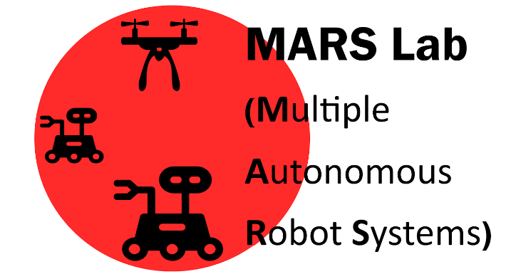
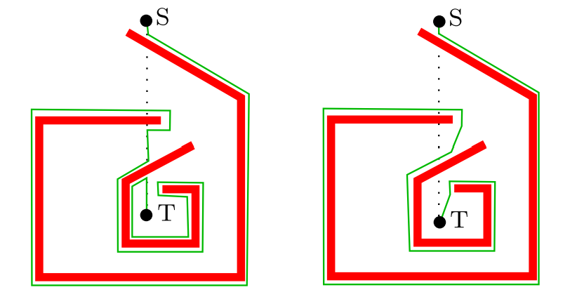
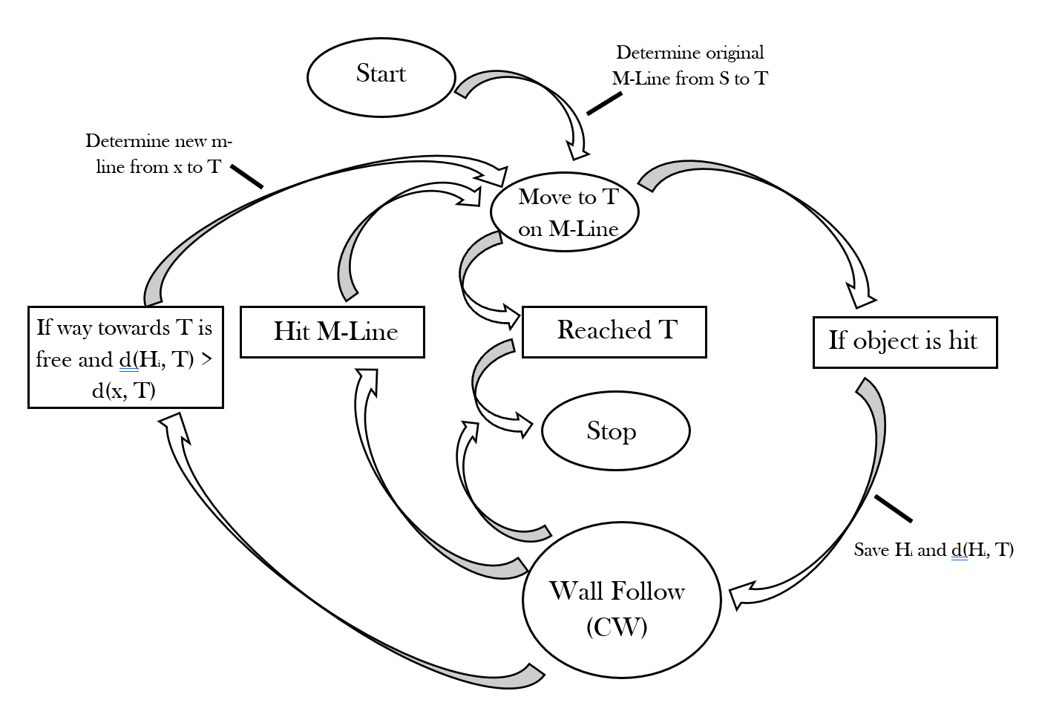
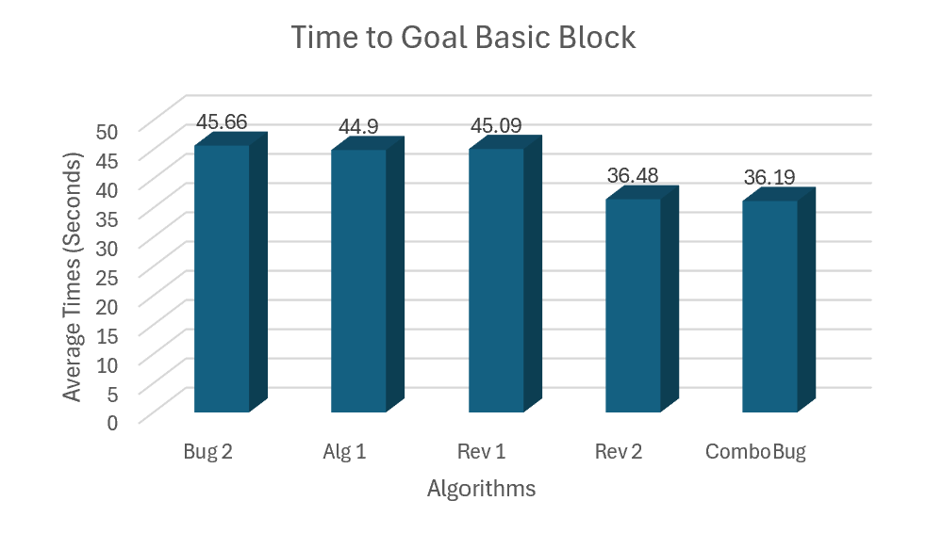
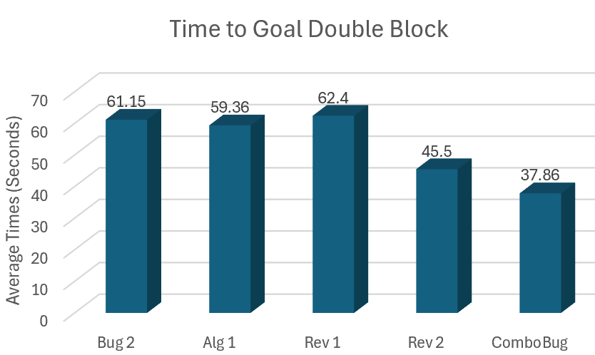
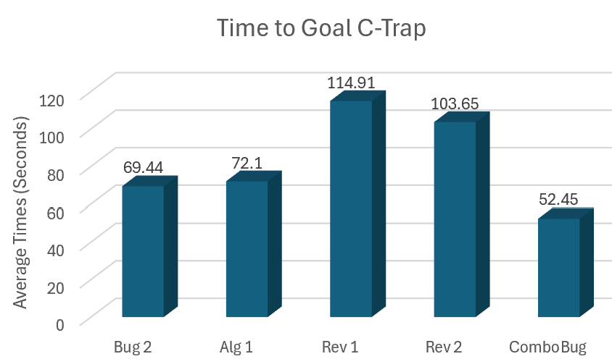
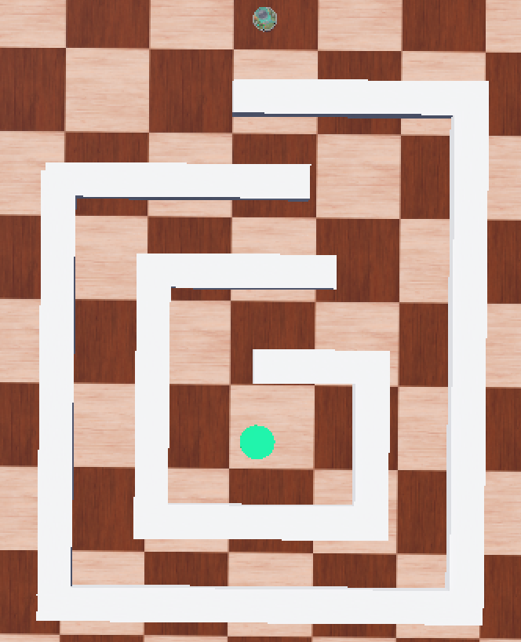
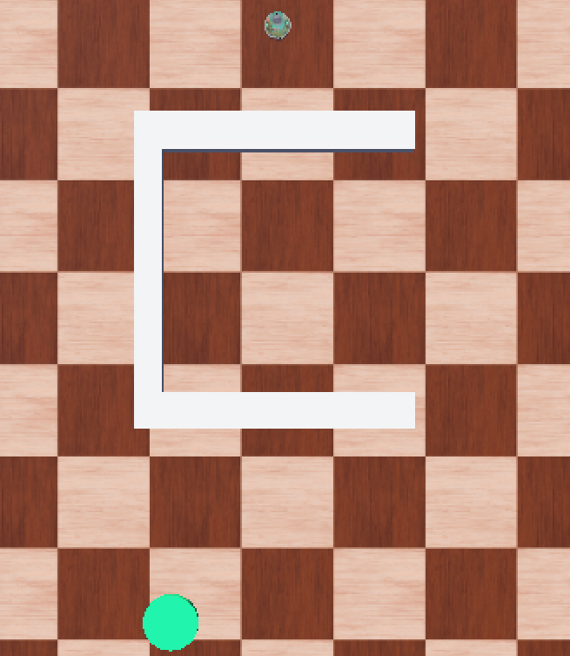
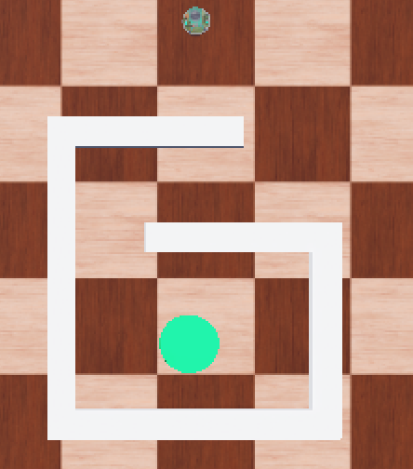
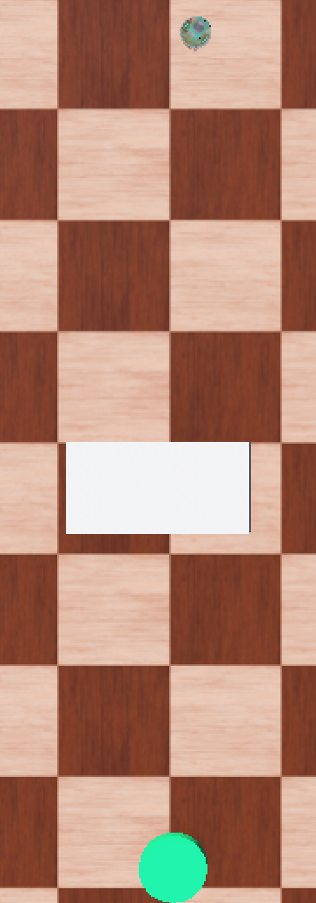
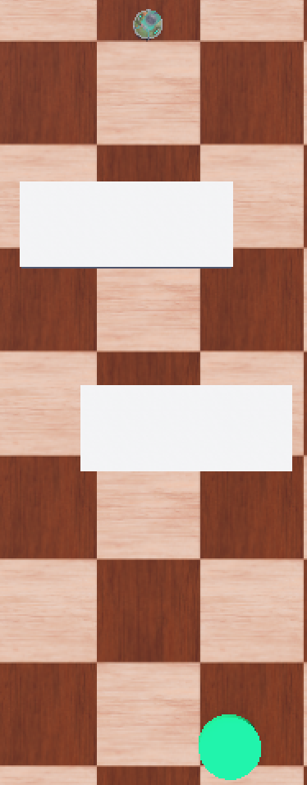
Multiple Autonomous Robot Systems Lab (MARS) – UTRGV Edinburg
Comparative Analysis and Enhancement of Bug Algorithms for Obstacle Avoidance
National Science Foundation
Izabella Valero and Qi Lu
Department of Computer Science
Abstract
Data and Results
Traditional Bug Algorithms for obstacle avoidance often struggle with inefficiency and entrapment in complex environments.
This research introduces a new algorithm that combines the qualities of existing algorithms.
The proposed approach shows promise in demonstrating shorter paths and reduced risk of entrapments in complex environments.
Data collection focuses on recording the navigation patterns and obstacle avoidance behaviors of the new algorithm against the existing within simulated environments in Webots.
The goal of the new bug is to combine features of the m-line and common-sense pattern to enhance its ability to optimize navigation. Figure 4 displays preliminary trials where ComboBug reaches the goal in a shorter time than existing algorithms.
Figure 1: Inefficient path of Rev 1 and Rev 2 [1].
Introduction & Background
Bug algorithms have low computational cost, relying on sensor data to guide the robot to its target.
They often struggle with longer paths and getting trapped in complex scenarios.
Improving these algorithms while maintaining low computational demands is a key challenge in robotics. Figure 1 displays some of the inefficiencies of existing algorithms.
The research presented proposes a new bug algorithm that enhances the existing strategies to enhance obstacle avoidance using only local sensor data.
Conclusions & Future Work
While the new algorithm has been demonstrated to be promising, further comparative testing is required to validate its advantages fully.
Continue focus on building new environments to trap the robot or delay its travel efficiency, like Figure 5.
There are plans to extend this research beyond simulations to physical robots, where more variable factors can challenge obstacle avoidance algorithms.
Figure 3: A state diagram of ComboBug
Methodology
Acknowledgments
Algorithm Analysis: Existing Bug Algorithms were analyzed using Webots simulations to identify strengths, limitations, and potential improvement, focusing on localization algorithms. Figure 2 demonstrates a simulation environment.
Algorithm Development: The proposed algorithm shown in Figure 3. The goal is to combine existing features to optimize the Bug performance. The algorithm tracks m-line movement like other algorithms, recording hit and leave points.
Current Development: The algorithm is currently being tested using Webots. The current comparative analysis is currently in progress.
The authors would like to acknowledge funding provided by the National Science Foundation CREST Center for Multidisciplinary Research Excellence in Cyber-Physical Infrastructure Systems (NSF Award No. 2112650) and the NSF Minority Serving Institute program (NSF Award No. 2318682).
References
[1] McGuire, K.N., G.C.H.E. de Croon, and K. Tuyls. "A Comparative Study of Bug Algorithms for Robot Navigation." Robotics and Autonomous Systems 121. (2019).
[2] Yufka, Alpaslan, and Osman Parlaktuna. "Performance Comparison of the BUG’s Algorithms for Mobile Robots." (2009)
[3] J. Antich, A. Ortiz and J. Mínguez, "A Bug-inspired algorithm for efficient anytime path planning," 2009 IEEE/RSJ International Conference on Intelligent Robots and System.s (2009).
Figure 5: Double Spiral
Figure 6: C-Trap
Figure 4: Preliminary Comparison of Average Time of Algorithms against ComboBug
Figure 7: Spiral Obstacle in Webots
Figure 8: Basic and Double Block
RGV STEM Education Consortium, South Padre Island, Texas, February 13-15, 2025
Affiliated Logos

