Slide 1

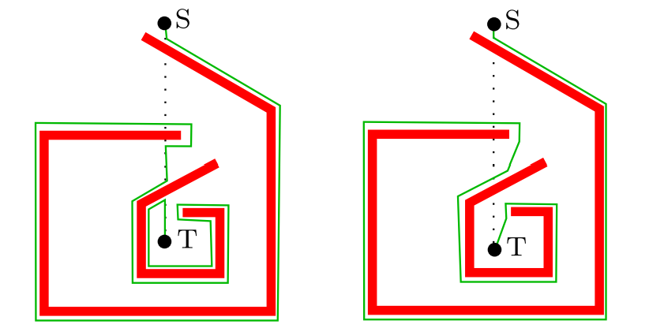
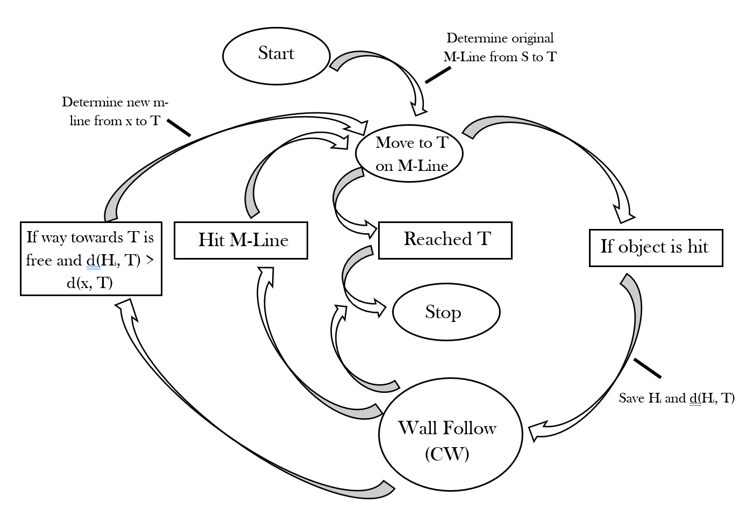
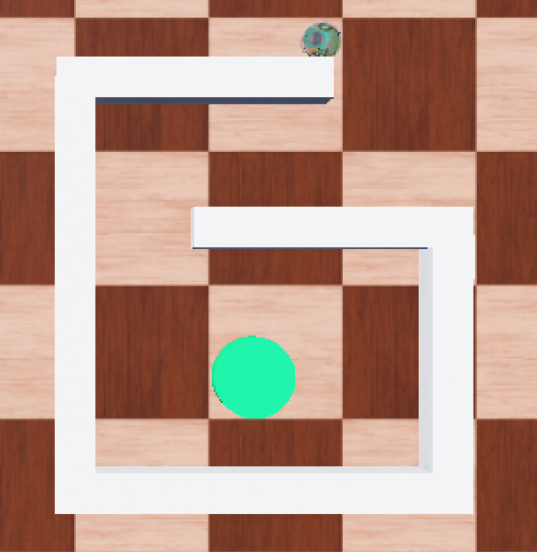

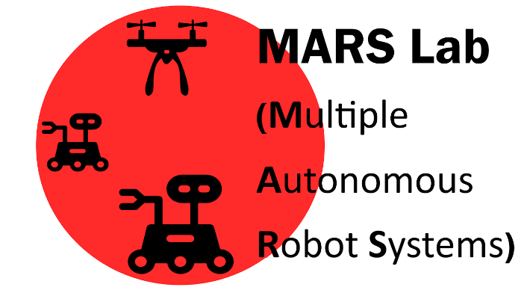
Multiple Autonomous Robot Systems Lab (MARS) – UTRGV Edinburg
Comparative Analysis and Enhancement of Bug Algorithms for Obstacle Avoidance
Izabella Valero and Qi Lu
Department of Computer Science
The University of Texas Rio Grande Valley
Abstract
Traditional Bug Algorithms for obstacle avoidance often struggle with inefficiency and entrapment in complex environments.
This research introduces a new algorithm that combines the qualities of existing algorithms.
The proposed approach shows promise in demonstrating shorter paths and reduced risk of entrapments in complex environments.
Introduction & Background
Figure 1: Rev 1 and Rev 2 respectively displaying an inefficient path [1].
Figure 3: A state diagram of the proposed algorithm.
Bug algorithms have low computational cost, relying on sensor data to guide the robot to its target.
They often struggle with longer paths and getting trapped in complex scenarios.
Improving these algorithms while maintaining low computational demands is a key challenge in robotics. Figure 1 displays some of the inefficiencies of existing algorithms.
The research presented proposes a new bug algorithm that enhances the existing strategies to enhance obstacle avoidance using only local sensor data.
Conclusions & Future Work
While the new algorithm has been demonstrated to be promising, further comparative testing is required to validate its advantages fully.
Future work will focus on building new environments meant to trap the robot or delay its travel efficiency.
There are plans to extend this research beyond simulations to physical robots, where more variable factors can challenge obstacle avoidance algorithms.
Full results of this project are expected to finish in 1-2 months.
Figure 2: A Webots simulation
Data and Results
Data collection focuses on recording the navigation patterns and obstacle avoidance behaviors of the new algorithm against the existing within simulated environments in Webots.
The goal of the new bug is to combine features pf the m-line and common-sense pattern to enhance its ability to optimize navigation.
The data currently being recorded is theoretical complexity time and time/distance used.
Once the comparative analysis is complete the effectiveness of this new approach relative to traditional bug algorithms will be more conclusively assessed. The current data results are displayed in Figure 4.
Methodology
Acknowledgments
Algorithm Analysis: Existing Bug Algorithms were analyzed using Webots simulations to identify strengths, limitations, and potential improvement, focusing on localization algorithms. Figure 2 demonstrates a simulation environment.
Algorithm Development: The proposed algorithm shown in Figure 3. The goal is to combine existing features to optimize the Bug performance. The algorithm tracks m-line movement like other algorithms, recording hit and leave points.
Current Development: The algorithm is currently being tested using Webots. The current comparative analysis is currently in progress.
The authors would like to acknowledge funding provided by the National Science Foundation CREST Center for Multidisciplinary Research Excellence in Cyber-Physical Infrastructure Systems (NSF Award No. 2112650) and the NSF Minority Serving Institute program (NSF Award No. 2318682).
References
[1] McGuire, K.N., G.C.H.E. de Croon, and K. Tuyls. "A Comparative Study of Bug Algorithms for Robot Navigation." Robotics and Autonomous Systems 121. (2019).
[2] Yufka, Alpaslan, and Osman Parlaktuna. "Performance Comparison of the BUG’s Algorithms for Mobile Robots." (2009)
[3] J. Antich, A. Ortiz and J. Mínguez, "A Bug-inspired algorithm for efficient anytime path planning," 2009 IEEE/RSJ International Conference on Intelligent Robots and System.s (2009).
National Science Foundation
RGV STEM Education Consortium, South Padre Island, Texas, February 13-15, 2025
Affiliated Logos

