Slide 1
Electronics and Communication Engineering Department
Sarvajanik College of Engineering and Technology, Surat.
BE IV Sem 8, Academic year 2019-2020
Machine learning based Mushroom Classification
Prepared By: Guide:
Anjali Jha (160420111020) Prof. Vandana Shah
Dhruvi Kapadia (160420111023)
Daizy Mandviwala (170423111004)
Arpita Patil (170423111008)
Digital Watermarking

Slide 2
COMMENTS
Comments | Justification
Dataset is not available | Found out Dataset
Work can’t be justified without proper dataset | Work accomplished with new dataset
Need to be discussed with committee | Discussed with committee and done accordingly

Slide 3
FLOW OF PRESENTATION
MOTIVATION
PROBLEM STATEMENT
OBJECTIVES
INTRODUCTION
LITERATURE SURVEY
FLOW DIAGRAM
SOFTWARE PLATFORMS
SVM(SUPPORT VECTOR MACHINES)
LABEL ENCODING
RESULTS
REFERENCES

Slide 4
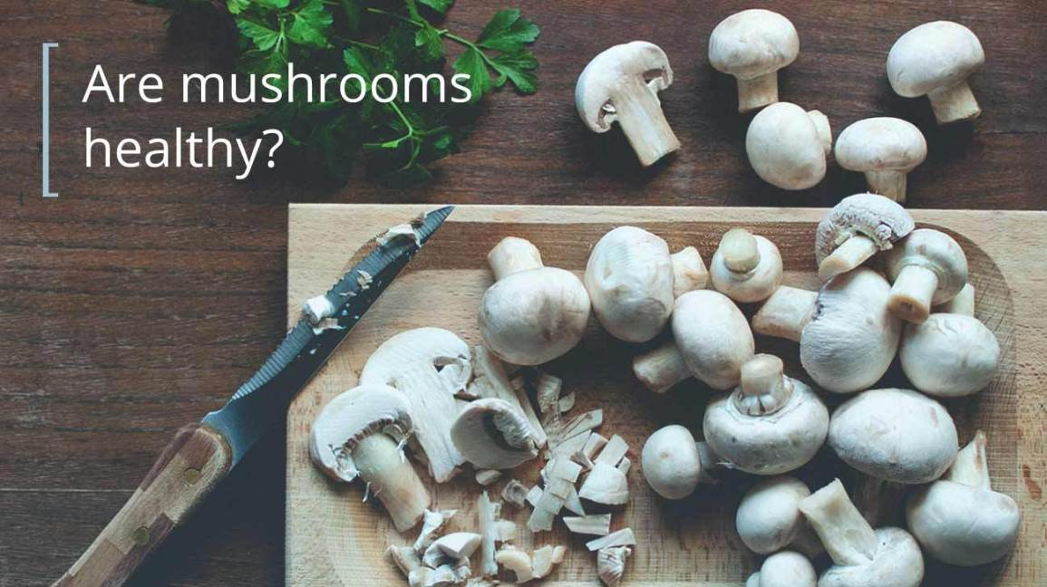
MOTIVATION
Mushroom is a great source of fibre, protein, and other nutrients. So it has very high demand and consumption rate. However, it can cause life threatening diseases and sometimes death too.
It would be great if we can detect poisonous mushrooms

Slide 5
PROBLEM STATEMENT
The purpose of this project is to apply a method to detect that the mushroom is fit for human consumption or not.

Slide 6
OBJECTIVES
To search for categorical data of Mushrooms.
To find research papers and study them in detail.
To study Support Vector Machines
To implement SVM example and understand
To implement SVM for Mushroom classification.
To train the SVM model.
To test the SVM model.

Slide 7
INTRODUCTION
As we know, Mushroom has become prominent fungi in the global market. Due to different varieties and characteristics, the utilization of mushrooms is proliferating day by day.
They come in lots of different shapes, sizes, and colors. For many years they’ve been used for their unique ability to add flavor in lots of different cultures’ cuisines.
Mushroom production can be used in medicinal purposes due to its vitamins and fibers.

Slide 8
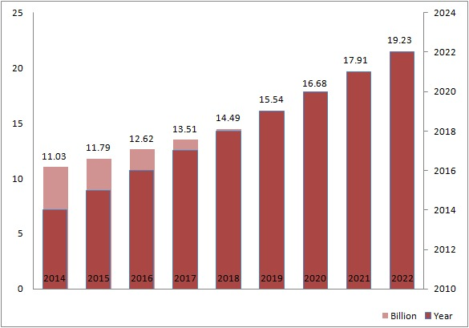
Global Button Mushroom Market 2017-2022 [5]
The global button mushroom market is likely to cross USD 19.23 Billion in 2022

Slide 9
MUSHROOM POISONING
The majority of mushroom poisonings occur due to misidentification as edible variety.
In India 15 cases of Amanita Phalloides poisoning with major clinical representation with nausea, vomiting, diarrhea, jaundice etc. were found.[6]
Another such case was found in rural hospital of Meghalaya, and the person had multiple episodes of vomiting.[7]

Slide 10
LITERATURE SURVEY
[1] Classification Algorithm for Edible Mushroom Identification (IEEE-2018)
This paper proposes a methodology to identify the mushroom type which lies under either edible or poisonous category. Mushroom dataset has been taken from “The Audubon Society Field Guide to North American Mushrooms”, in UCI machine learning repository. In which there are 8124 instances having 23 different attributes. Accuracy level of SVM is 100%. [1]

Slide 11
LITERATURE SURVEY [cntd]
[2] Development of Mushroom Expert System Based on SVM Classifier and Naive Bayes Classifier
This paper emphasize the system that is used to predict the type of mushroom, whether it is edible or not. Here, SVM and Naïve Bayes algorithms are implemented for the classification purpose. Mushroom Expert System is developed for classification of mushrooms and to predict the class of mushrooms on submission of characteristics of the mushrooms.[2]

Slide 12
LITERATURE SURVEY [cntd]
[4] Mushroom Classification Using Feature-Based Machine Learning Approach
This paper focuses on developing a method for classification of mushroom through image analysis, which is based on the machine learning approach. The performance of the proposed approach is 76.6% by using SVM classifier, which is found better with respect to the other classifiers like KNN, Logistic Regression, Linear Discriminant, Decision Tree, and Ensemble classifiers. After result analysis, it is observed that the overall performance of SVM classifier is better with respect to the other classifiers. [3] The Mushroom dataset is taken from the Mushroom world website.

Slide 13
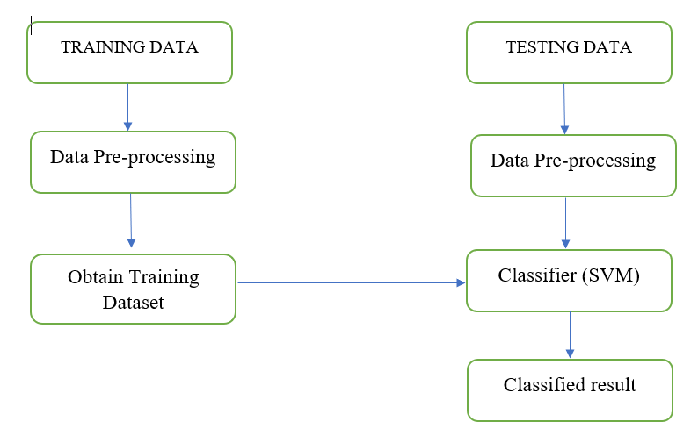
FLOW DIAGRAM

Slide 14
SOFTWARE PLATFORMS
Anaconda software IDE
Python used for Real time analysis of images
Python libraries used are:
NumPy
SciPy
Pandas
Seaborn
OpenCV
Scikit-learn
Pyplot
Matplotlib

Slide 15
DATASET
Characteristic | Class of Mushroom
Cap-shape is convex , cap-surface is smooth, cap-color is yellow, bruises are true, odor is almond, gill-attachment is free , gill-spacing is close, gill-size is broad, gill-color is black, stalk-shape is enlarging, stalk-root is club, stalk-surface-above-ring is smooth, stalk-surface-below-ring is smooth, stalk-color-above ring is white, stalk-color-below-ring is white, veil-type is partial, veil-color is white, ringnumber is one, ring-type is pendant , spore-print-color is brown, population is numerous and habitat is grasses | Edible
Cap-shape is convex , cap-surface is smooth, cap-color is brown, bruises are true, odor is pungent, gill-attachment is free , gill-spacing is close, gill-size is narrow, gill-color is black, stalk-shape is enlarging, stalk-root is equal, stalksurface-above-ring is smooth, stalk-surface-below-ring is smooth, stalk-color-above ring is white, stalk-color-below-ring is white, veil-type is partial, veil-color is white, ringnumber is one, ring-type is pendant , spore-print-color is black, population is scattered and habitat is urban | Poisonous

Slide 16
ATTRIBUTE INFORMATION
bell=b | conical=c | convex=x
flat=f | knobbed=k | sunken=s
Cap Shape
Cap Surface
Cap Color
Gill size
Gill Spacing
fibrous=f | grooves=g
scaly=y | smooth=s
brown= n | buff=b | cinnamon=c | gray=g
green=r | red=e | white=w | purple=u
enlarging=e | tapering=t
broad=b | narrow=n

Slide 17
ATTRIBUTE INFORMATION
Veil type
Veil Color
Stalk color
partial=p | universal=u
brown=n | orange=o
white=w | yellow=y
brown=n, | ,buff=b, | cinnamon=c | gray=g
orange=o | pink=p | red=e | yellow=y

Slide 18
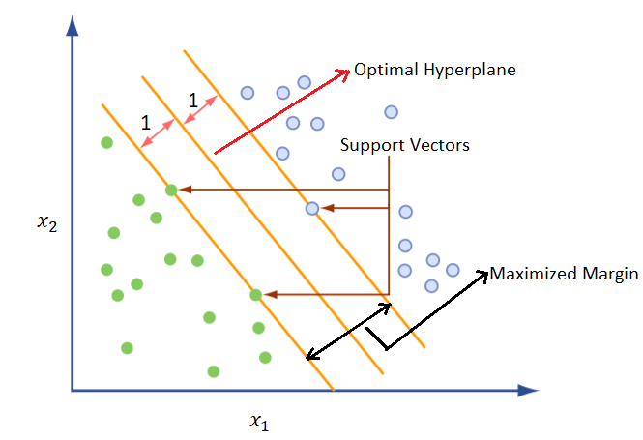
SVM- SUPPORT VECTOR MACHINES
OBJECTIVE
Support Vector Machine is responsible for finding the decision boundary to separate different classes and maximize the margin.

Slide 19
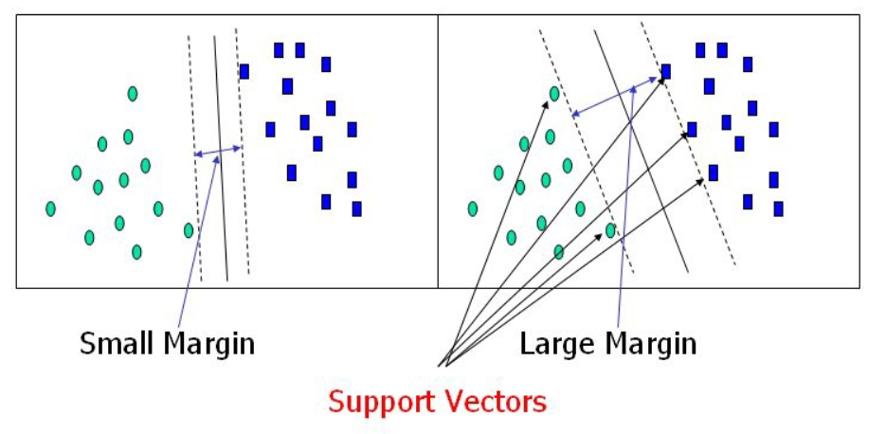

Slide 20
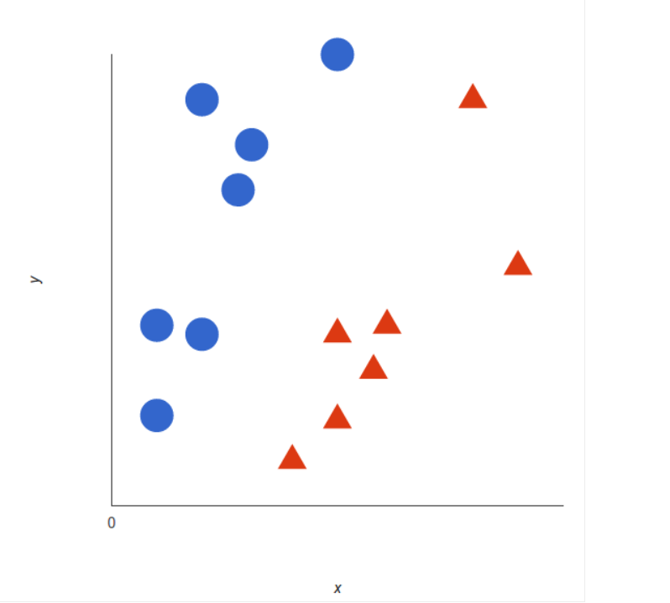
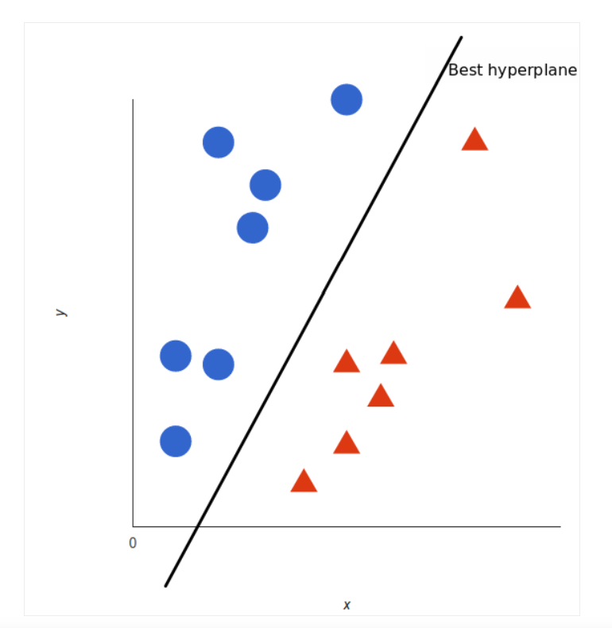
HOW SVM WORKS?
The basics of Support Vector Machine and how it works is best understood by example.

Slide 21
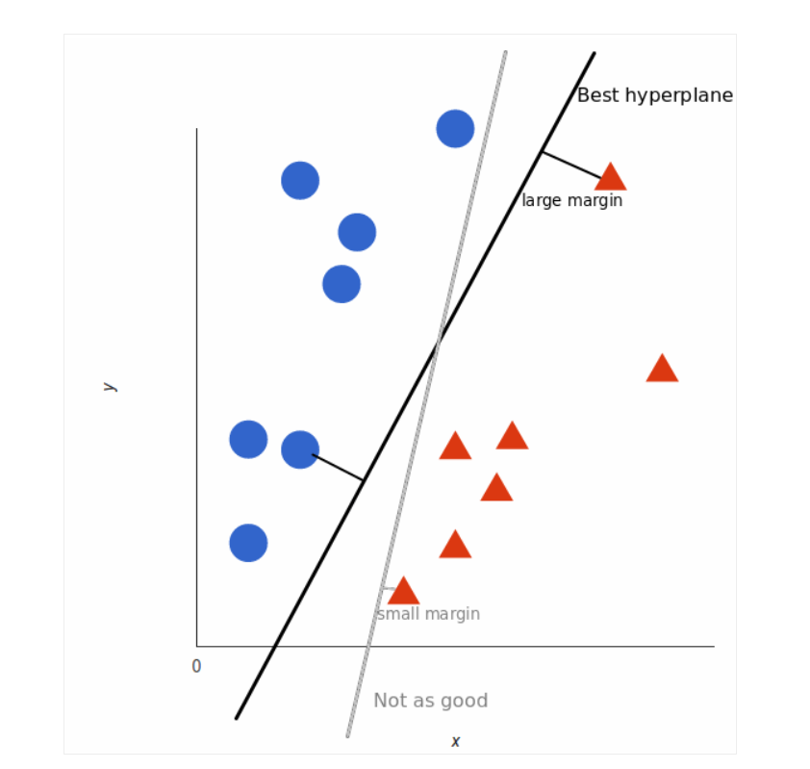

Slide 22
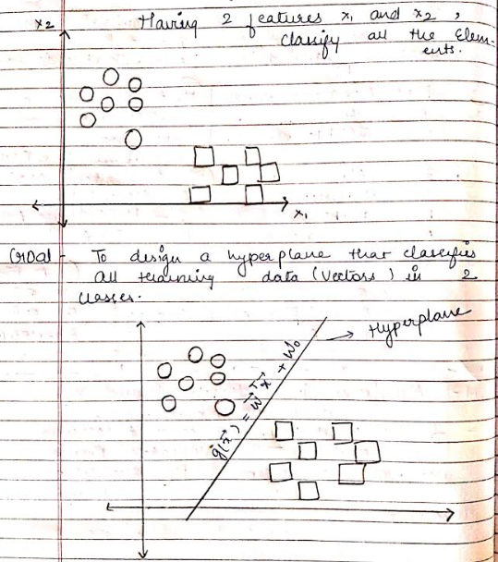
Example- SVM Linearly Separable

Slide 23
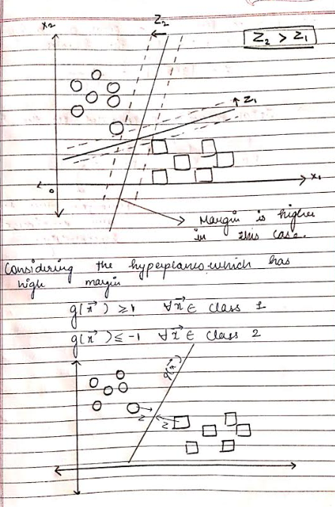

Slide 24
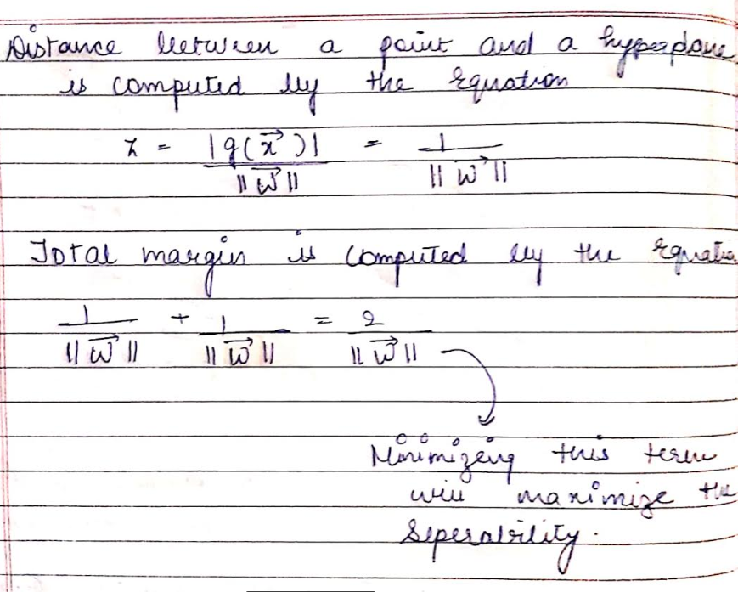

Slide 25
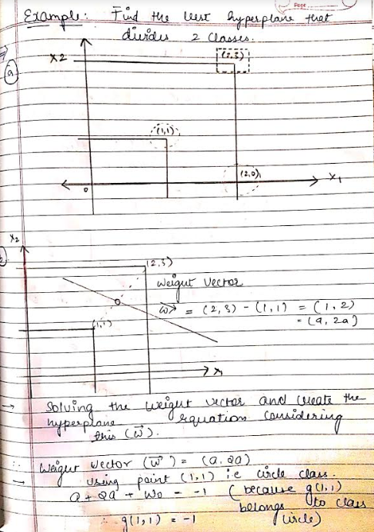

Slide 26


Slide 27
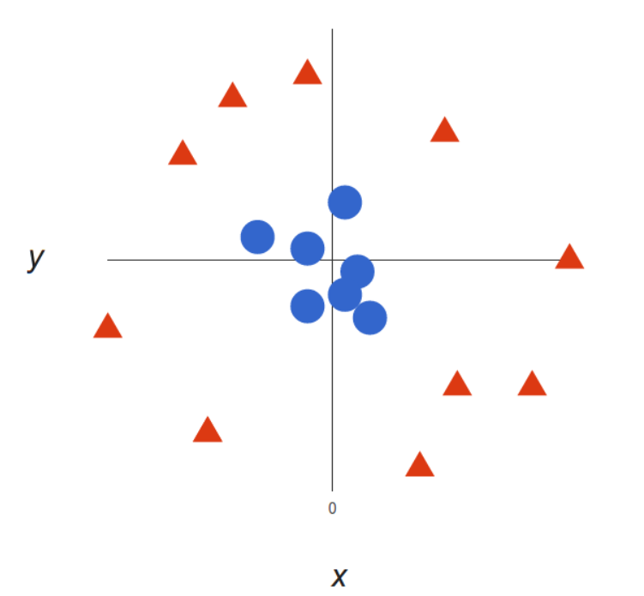
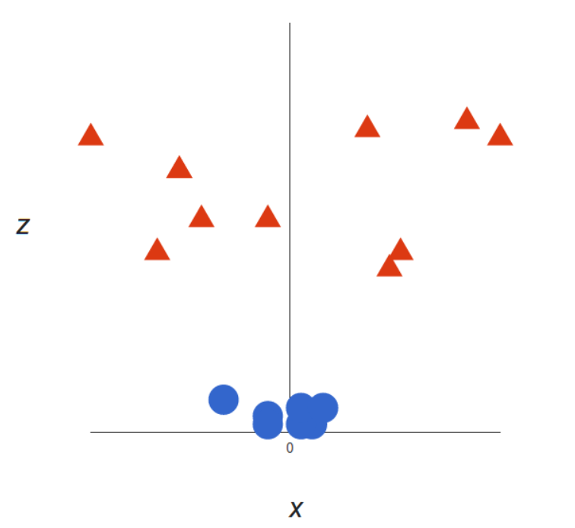
SVM- Non linear data
Figure A
Figure B

Slide 28
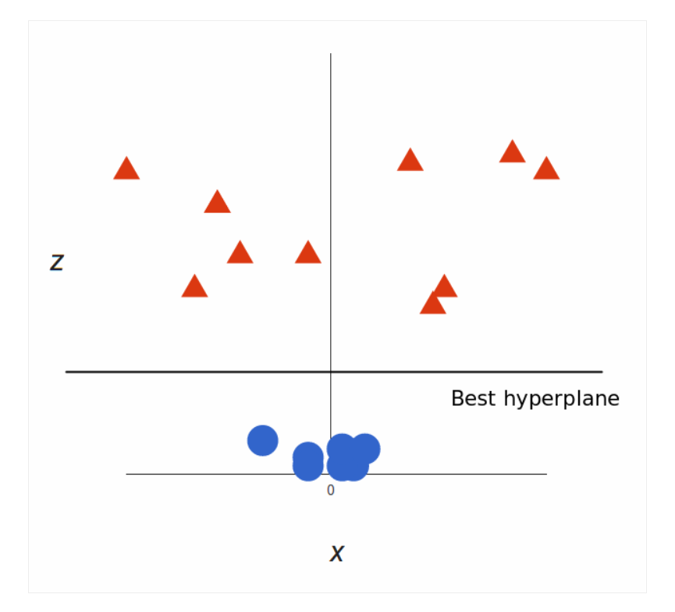
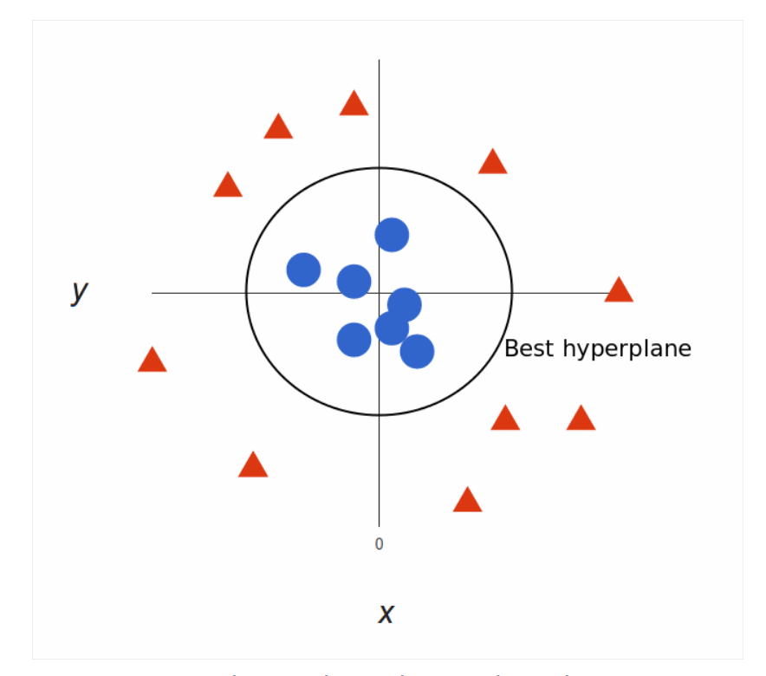

Slide 29
TUNING PARAMETERS
One can tune the SVM by changing the tuning parameters of SVM algorithm that are mentioned below:
Kernel
Regularization
Gamma
Margin

Slide 30
KERNEL
In machine learning a Kernel is usually referred to the Kernel Trick, a method of using a linear classifier to solve a non-linear problem.
Kernels helps us do certain calculation faster which otherwise would involve computations in higher dimensional space.
Mathematically kernel is represented as K(x, y) = <f(x), f(y)>

Slide 31

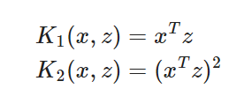

TYPES OF KERNEL
Polynomial Kernel
There are two types of Polynomial Kernels:
➔Homogeneous
Homogeneous is defined as
The most typical cases are linear and quadratic
Non homogeneous
In non homogeneous kernel is defined as:

Slide 32
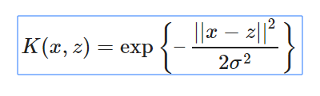
TYPES OF KERNEL
Gaussian Kernel
Gaussian Kernel is also called as Gaussian Radial Basis Function ( RBF ) and one of the most popular and powerful Kernel.
The Gaussian Kernel is defined as,

Slide 33
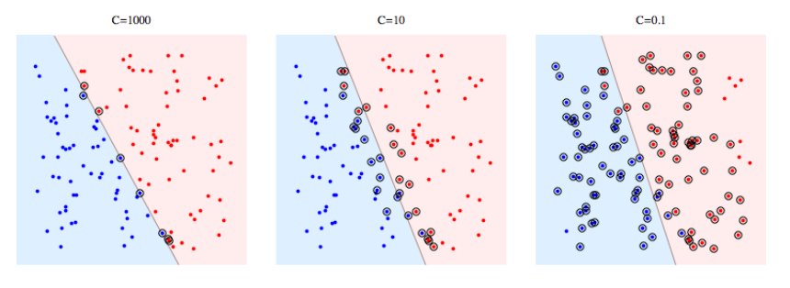
REGULARIZATION
C is the penalty parameter, which represents misclassification or error term.
The misclassification or error term tells the SVM optimization how much error is bearable. This is the way to control the trade-off between decision boundary and misclassification term.

Slide 34
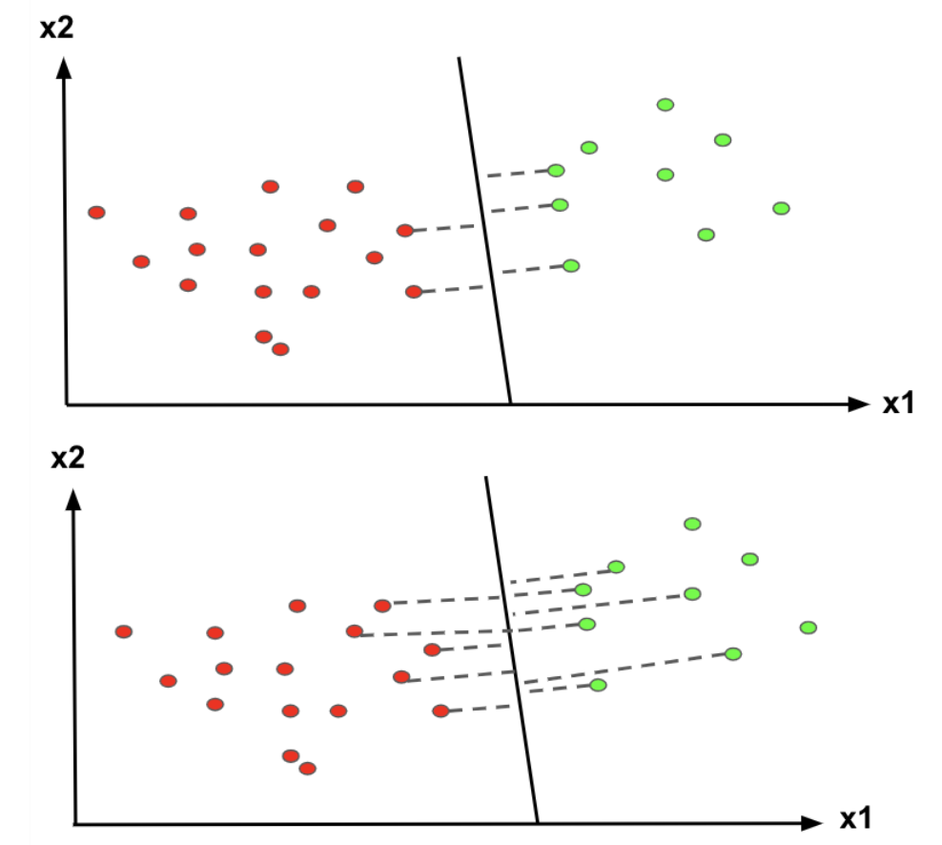
GAMMA
The gamma parameter defines how far the influence of a single training example reaches.
High Gamma
Low Gamma

Slide 35
MARGIN
A margin is a separation of line to the closest class points. A good margin is one where this separation is larger for both the classes.
Images below gives to visual example of good and bad margin.
A good margin allows the points to be in their respective classes without crossing to other class.

Slide 36
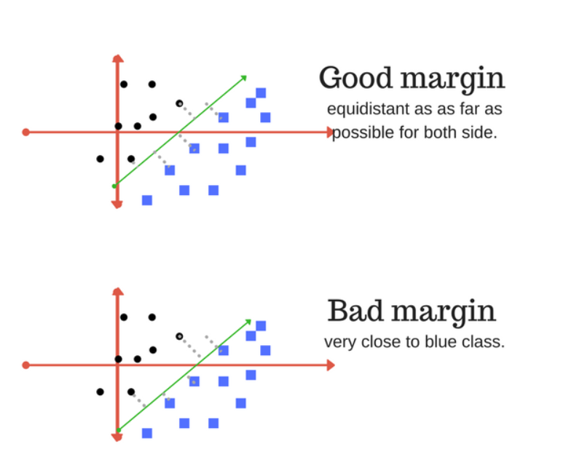

Slide 37
CONFUSION MATRIX
A confusion matrix is a tabular summary of the number of correct and incorrect predictions made by a classifier. It is used to measure the performance of a classification model.
In the domain of Machine learning and especially the problem of statistical classification, a confusion matrix is a precise table design allowing visualization of the performance of an algorithm, in supervised learning.
Each row of the matrix depicts the instances in a predicted class while each column outlines the occurrences in an actual class (or vice versa).

Slide 38
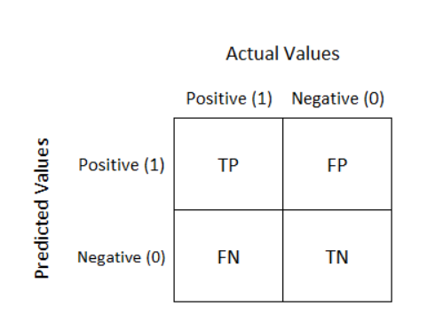

Slide 39
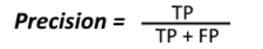

TERMS RELATED TO CONFUSION MATRIX
Precision
The precision metric shows the accuracy of the positive class. It measures how likely the prediction of the positive class is correct.
Mathematical Expression:
Recall
It states how much we predicted correctly out of all positive classes. It should be as high as possible.
Mathematical Expression:

Slide 40


TERMS RELATED TO CONFUSION MATRIX
Accuracy
Accuracy shows out of the all classes how much we predicted correctly.
Mathematical Expression:
F-measure
F-score helps to measure Recall and Precision at the same time.
Mathematical Expression:

Slide 41
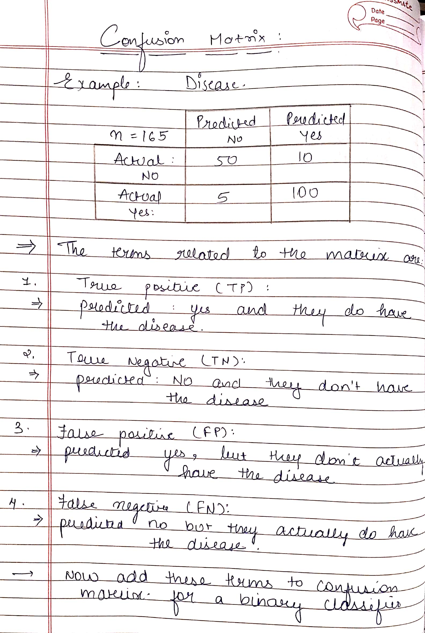
EXAMPLE

Slide 42
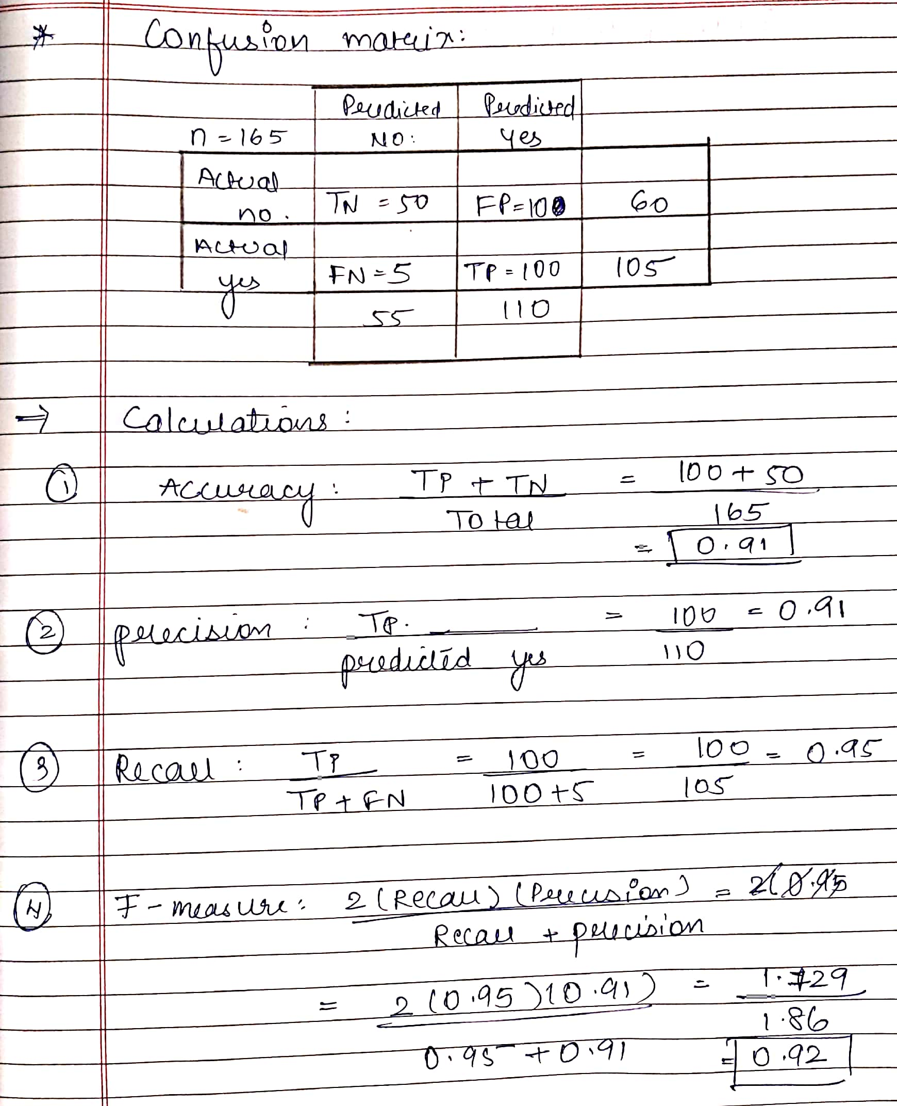

Slide 43
LABEL ENCODING
Label Encoding is a popular encoding technique for handling categorical variables. In this technique, each label is assigned a unique integer based on alphabetical ordering.
We apply Label Encoding when:
The categorical feature is ordinal (like Jr. kg, Sr. kg, Primary school, high school)
The number of categories is quite large as one-hot encoding can lead to high memory consumption

Slide 44
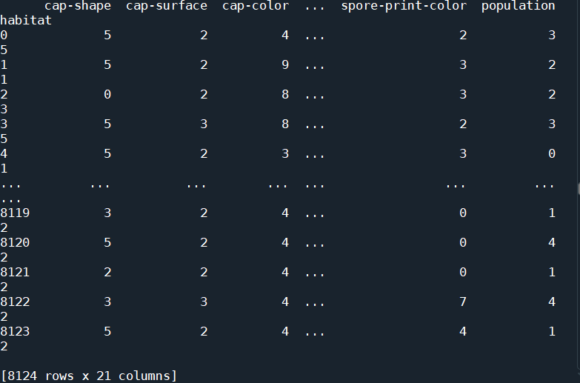
LABELED DATA

Slide 45
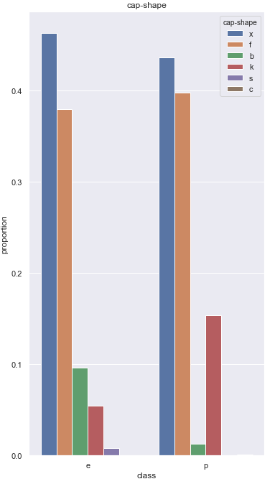
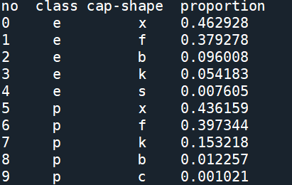
PROPORTION LEVEL

Slide 46
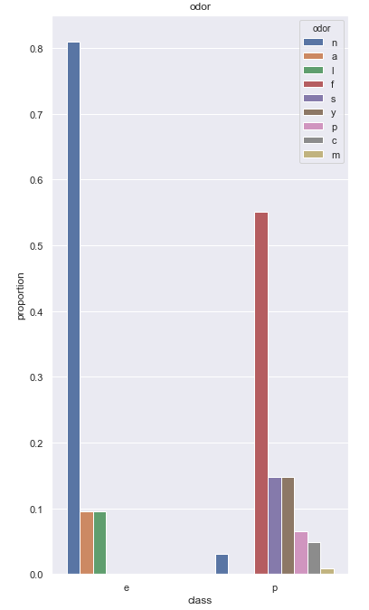
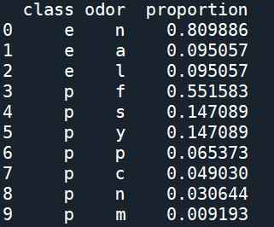
PROPORTION LEVEL

Slide 47
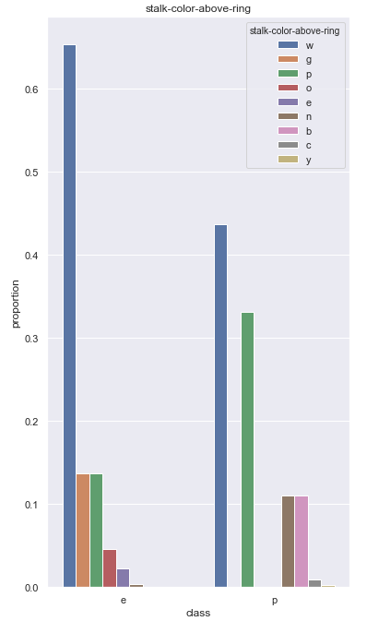
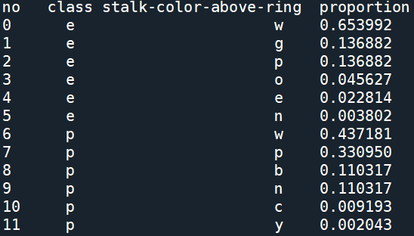
PROPORTION LEVEL

Slide 48
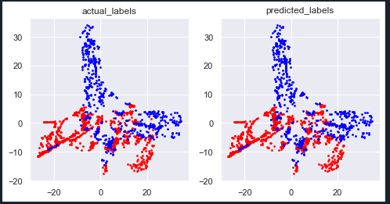
PREDICTED OUTCOME

Slide 49
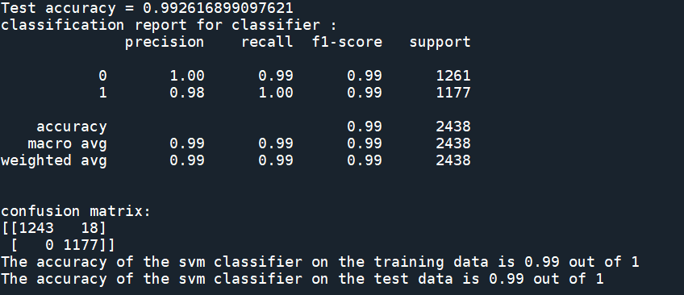
CLASSIFICATION REPORT

Slide 50
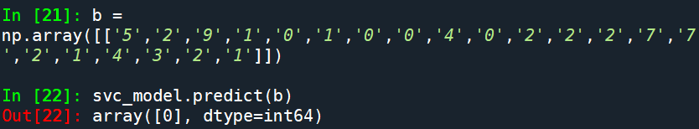
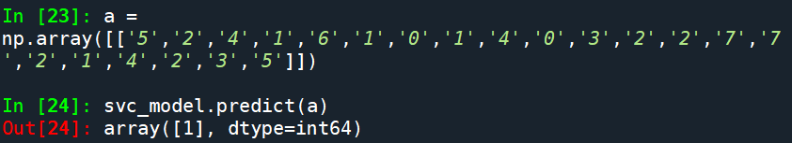
OUTPUT

Slide 51
TIME PLAN OF WORK FOR ODD SEM
Sr.no | Time span | Objectives
1. | June-July | Studied Research papers and collected database
2. | August | Learnt python and image pre processing operations
3. | September | Image Segmentation And image processing algorithms
4. | October | Feature Extraction
5. | November | Understanding unsupervised and Supervised machine learning algorithm .

Slide 52
TIME PLAN OF WORK FOR EVEN SEM
Sr.no | Time span | Objectives
1. | December | To study Support Vector Machines(SVM)
2. | January | To start implementation of SVM
3. | February | To finish it thoroughly
4. | March | Test your machine whether it gives predicted results or not. Based on that do necessary corrections

Slide 53
REFERENCES
Agung Wibowo, ,Yuri Rahayu, Andi Riyanto, Taufik Hidayatulloh “Classification Algorithm for Edible Mushroom Identification”, IEEE conference 2018 International Conference on Information and Communication Technology.
Prof. M.S. Prasad Babu, Rajani Thommandru, K.Swapna, E.Nilima “Development of Mushroom Expert System based on SVM classifier and Naïve Bayes Classifier”, IJCSMC -2014
Hilmy Assodiky, Achmad Basuki, Fadilah Fahrul Hardiansyah, “Macro-sized Basidiomycota Species Recognition Using Shape and Color Features”, IEEE conference 2016 International Electronics Symposium (IES)
Bhupen Barman, Synrang Batngen Warjri “Amanita Nephrotoxic Syndrome: First case report in India “, Indian Journal of Nephrology- March 2018
Nipun Verma, Susheel Kumar, “Wild Mushroom Poisoning in north India”, Jounal of Clinical and experimental hepatology – December 2014

Slide 54
THANK YOU

