Slide 1


Digital Upskilling for Employment Opportunities in Africa
Presentation by: Mary Addai
Employment and Livelihoods Development

Slide 2

INTRODUCTION
In the ever-changing landscape of Sub-Saharan Africa, the rise of digitalization and technological advancements is paving the way for a revolutionary era in the realm of work. Projections suggest that in the next decade, around 230 million jobs in the region will require digital skills, creating a remarkable opportunity for the growing youth population (Kuteyi & Winkler, 2022) . However, there are significant obstacles that hinder the acquisition of these crucial skills, especially for young Africans.
This introduction sets the stage for a comprehensive exploration of entrepreneurship and the nurturing of Micro, Small, and Medium Enterprises (MSMEs), a holistic approach to skills development, the positive impact of digital upskilling on livelihoods, the direct correlation between digital upskilling and economic empowerment, the importance of financial literacy and individual empowerment.

Slide 3
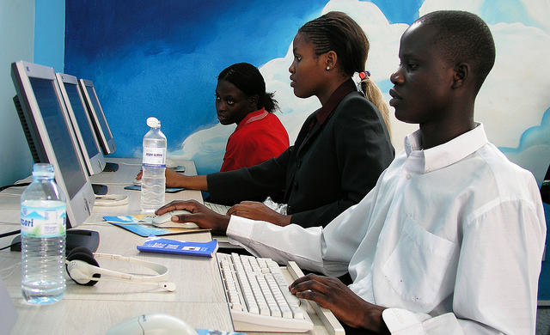
PROJECT OVERVIEW
Objective : Our primary goal is to empower the young generation in Sub-Saharan Africa by tackling obstacles and embracing the possibilities brought about by digitalization. We aim to equip them with vital digital skills that will prepare them for the future job market.
Focus Area : The focus area of this project is to collaboratively develop and implement digital skills training programs in Sub-Saharan Africa, aiming to equip the youth with essential skills, foster employability, entrepreneurship, and partnerships with businesses, ultimately contributing to the economic vitality and innovation of the African continent.
Market Demand : The market demand in this context refers to the increasing need for digital skills in Sub-Saharan Africa. Projections indicate that around 230 million jobs in the region will require digital skills by 2030, creating a substantial demand for a workforce proficient in technology.

Slide 4
PROJECT OVERVIEW Continued
Key Players : Project Team, Local Community Leaders, International Organizations, Educational Institutions, Corporate Partners, Technology Partners, Media and Communication Partners and Community Members.
Digital Evolution: Enhanced Digital Literacy, Entrepreneurial Mindset, MSME Growth, Advanced Skills Development , Rural Livelihood Improvement, employability and Job Opportunities.
Success Factors : Community Engagement, Government Support, Accessible Training Programs, Partnership and Collaborations, Monitoring & Evaluations, Technology Infrastructure, Financial Inclusion, Mentorship & Support, Marketing.
Potential Impact : Community Upliftment, Global Recognition, Increased Employment Opportunities.

Slide 5
ENTREPRENEURSHIP & MSME
In our quest to foster entrepreneurship and support Micro, Small, and Medium Enterprises (MSMEs) in Africa, our approach to digital upskilling involves the meticulous design and implementation of a variety of training programs. These initiatives consist of comprehensive workshops and courses that are carefully tailored to enhance participants' digital literacy and skills. The curriculum covers a wide range of relevant topics, such as digital marketing strategies, effective utilization of e-commerce platforms, integration of financial management tools, and the seamless incorporation of technology into daily business operations. To ensure accessible and practical learning experiences, we utilize dynamic online learning platforms, engaging workshops, and mentorship programs. We collaborate with esteemed educational institutions, industry experts, and technology firms to ensure that our content remains up-to-date and relevant. Additionally, we form strategic partnerships with governmental bodies, non-governmental organizations (NGOs), and international entities to access the necessary resources and infrastructure for scaling these initiatives effectively. Through targeted training, mentorship, and collaborative partnerships, our digital upskilling efforts aim to empower entrepreneurs and MSMEs, equipping them with the skills to navigate the digital landscape, tap into global markets, and make significant contributions to economic growth and job creation throughout Africa (Elsayary, 2023).

Slide 6
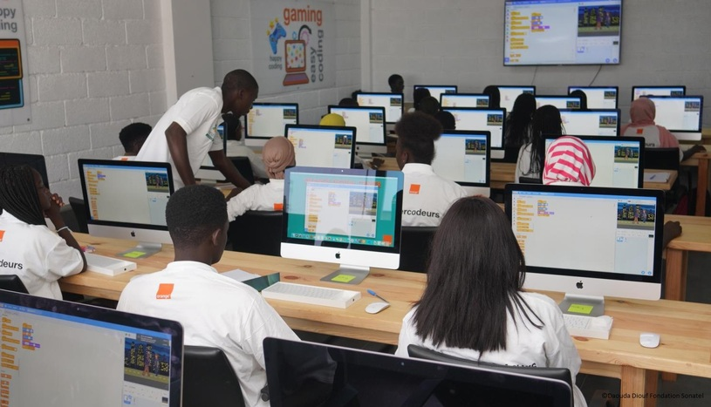
SKILLS DEVELOPMENT AND TRAINING
The carefully curated skills development and training programs provide a comprehensive learning experience that seamlessly combines theoretical knowledge with practical application. These programs cover a wide range of skills, including digital skills, technical expertise, soft skills, and industry-recognized certifications. Participants engage in hands-on training, workshops, and real-world case studies to enhance their digital literacy and technical capabilities. The programs offer flexibility and accessibility through various delivery methods, such as in-person workshops and online courses. Collaborations with educational institutions and industry partners enrich the learning journey, while continuous monitoring and evaluation ensure participant progress.
These programs not only equip participants with skills during the sessions but also foster a commitment to lifelong learning for sustained professional growth. By emphasizing accessibility
and inclusivity, these programs aim to reach diverse audiences and underserved communities.
These dynamic and industry-relevant programs empower participants in Africa with a versatile
skill set, preparing them for success in the modern workforce and creating opportunities for digital employment
(Ackermann, 2023)

Slide 7
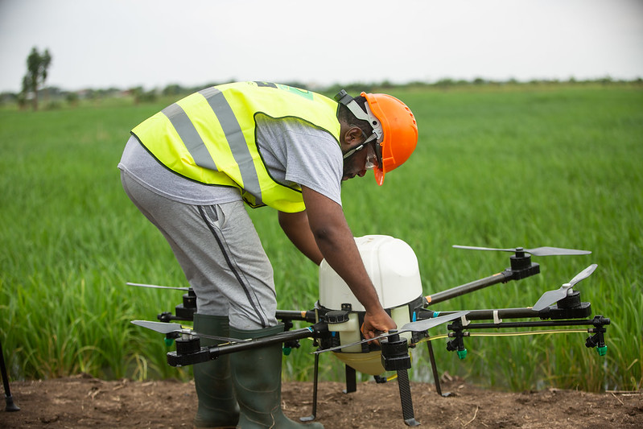
RURAL LIVELIHOOD DEVELOPMENT
The Digital Upskilling for Employment Opportunities in Africa project aims to significantly impact Rural Livelihood Development by addressing specific challenges faced in rural communities. Through targeted digital upskilling programs, the project intends to empower individuals in rural areas with the skills necessary for online work, entrepreneurship, and participation in the digital economy. The focus includes agricultural technology training, financial inclusion, and the establishment of community hubs. Collaborations with local entities ensure cultural sensitivity, while robust monitoring and evaluation mechanisms assess the impact and allow for adaptive strategies. The project envisions fostering comprehensive rural development by leveraging digital skills to create sustainable opportunities and contribute to economic growth in African rural communities.

Slide 8
ECONOMIC EMPOWERMENT
For this project, the Economic Empowerment initiative involves teaming up with various partners such as governments, private sector organizations, NGOs, and international entities to bring about positive change. Together, they are pooling their resources and expertise to implement this strategic project that will boost the economy. The focus is on improving digital infrastructure, advocating for simplified regulations, and supporting efficient e-commerce operations. By providing customized digital literacy programs, individuals are equipped with essential skills and given access to global markets, fostering entrepreneurship. Continuous monitoring and evaluation ensure that the programs remain relevant and adaptable. Additionally, initiatives supporting entrepreneurship, enhancing payment systems, and building consumer trust contribute to sustainable economic opportunities and job creation across Africa. The goal is to empower individuals through digital skills, creating a lasting and positive impact on economic prosperity in the region.

Slide 9
FINANCIAL INCLUSION AND EMPLOYMENT
The project initiative is dedicated to bridging the digital skills gap and promoting financial inclusion, with a special emphasis on utilizing microfinance initiatives to enhance accessibility. The comprehensive curriculum covers both basic digital literacy and advanced technical skills, providing individuals with the necessary tools for the digital era. By combining online resources and workshops, the program aims to empower participants with practical skills. Additionally, efforts are being made to expand digital infrastructure in remote areas and promote mobile banking, specifically targeting support for microfinance initiatives. These initiatives are vital in promoting financial inclusion and ensuring that individuals, especially those excluded from formal finance, can actively participate in the digital economy. Ongoing assessments guide the project's evolution and potential expansion across different regions in Africa.

Slide 10
REAL – WORLD IMPACT
The outlined initiative has the potential to generate significant real-world impact across various dimensions:
Youth Enrichment through Digital Skills: Equipping the youth with digital skills prepares them for the job market, fostering employability and entrepreneurship to contribute to Sub-Saharan Africa's economic development.
Addressing Market Demands and Enhancing Workforce Readiness: Meeting the increasing demand for digital skills aligns the workforce with market needs, enhancing their readiness for evolving industries.
Nurturing Entrepreneurship and Supporting MSMEs: Focusing on Micro, Small, and Medium Enterprises (MSMEs) with digital skills promotes economic vitality by enabling entrepreneurs to navigate global markets and foster business growth.
Digital Empowerment for Rural Livelihoods: Targeting rural areas with digital upskilling programs empowers individuals in agriculture and other sectors, leading to increased productivity and overall rural development.
Economic Empowerment through Infrastructure Enhancement: Collaborating to boost digital infrastructure and advocate for simplified regulations opens economic opportunities, fostering entrepreneurship and job creation.
Promoting Financial Inclusion with Microfinance Initiatives: Emphasizing microfinance initiatives and expanding digital infrastructure in remote areas supports financial inclusion and economic activities, particularly for those excluded from formal finance.

Slide 11
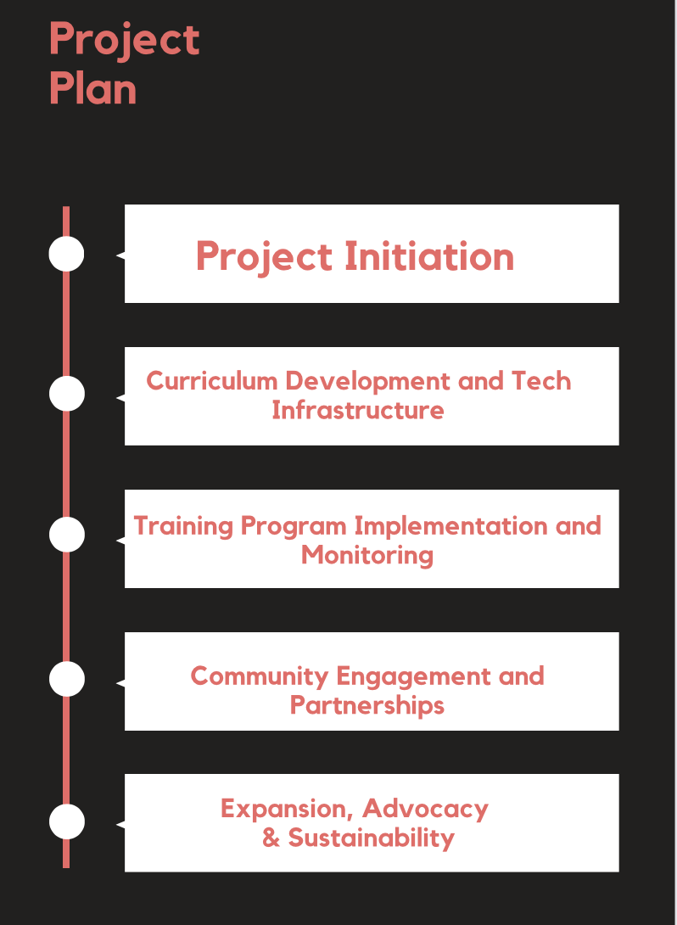
NEXT STEPS
Creating a detailed project plan involves breaking down the initiative into specific tasks, assigning responsibilities, setting timelines, and defining key milestones.
Project Initiation: Define project goals, engage stakeholders, and establish a charter to align interests and kickstart the initiative.
Curriculum Development and Tech Infrastructure: Form a team, collaborate on curriculum design with industry experts, and set up a secure online learning environment.
Training Program Implementation and Monitoring: Launch diverse training methods, including pilot programs, and implement monitoring systems to assess progress and impact.
Community Engagement and Partnerships: Connect with communities, raise awareness through campaigns, and forge partnerships for resources and support.
Expansion, Advocacy, and Sustainability: Assess the success of pilot programs, strategize for scalable implementations, and champion policies conducive to fostering digital upskilling initiatives.

Slide 12
CONCLUSION
In conclusion, the Digital Empowerment for Sub-Saharan Africa project presents a comprehensive and strategic approach to addressing the evolving needs of the region. By focusing on youth empowerment, market demands, entrepreneurship, and rural livelihood development, the initiative aims to bridge the digital skills gap and contribute to economic vitality. Through collaborative efforts, dynamic curriculum development, and community engagement, the project sets out to empower individuals, particularly in rural areas, with essential skills for the digital era. As the initiative progresses, continuous monitoring, adaptive strategies, and advocacy for supportive policies will be crucial for ensuring the project's success and lasting impact. By fostering strategic partnerships, leveraging technology, and prioritizing sustainability, the project aims to not only equip individuals with digital skills but also to create a ripple effect that positively influences economic growth and innovation throughout Sub-Saharan Africa.

Slide 13
References
Kuteyi, D., & Winkler, H. (2022). Logistics Challenges in Sub-Saharan Africa and Opportunities for Digitalization. Sustainability.
Elsayary, A. (2023). The impact of a professional upskilling training programme on developing teachers' digital competence. Journal of Computer Assisted Learning.
Ackermann, N. (2023). Community Research Fellows Training Program: Evaluation of a COVID-19-Precipitated Virtual Adaptation. International Journal of Environmental Research and Public Health, 20.

Slide 14
THANK YOU !!

