Slide 1
XML Database

Slide 2
Outline
Structured, Semi-structured, and Unstructured Data
Introduction to XML
XML Data Model
XML Instance Storage
XML Languages

Slide 3
Structured, Semistructured, and Unstructured Data
Structured data
Represented in a strict format
Example: information stored in databases
Semistructured data
Has a certain structure
Not all information collected will have identical structure
Schema information mixed in with data values
Self-describing data

Slide 4
Structured, Semistructured, and Unstructured Data (cont.)
Unstructured data
Limited indication of the of data document that contains information embedded within it
HTML tag
Text that appears between angled brackets: <...>
End tag
Tag with a slash: </...>

Slide 5
Structured, Semistructured, and Unstructured Data (cont.)
HTML uses a large number of predefined tags
HTML documents
Do not include schema information about type of data
Static HTML page
All information to be displayed explicitly spelled out as fixed text in HTML file

Slide 6
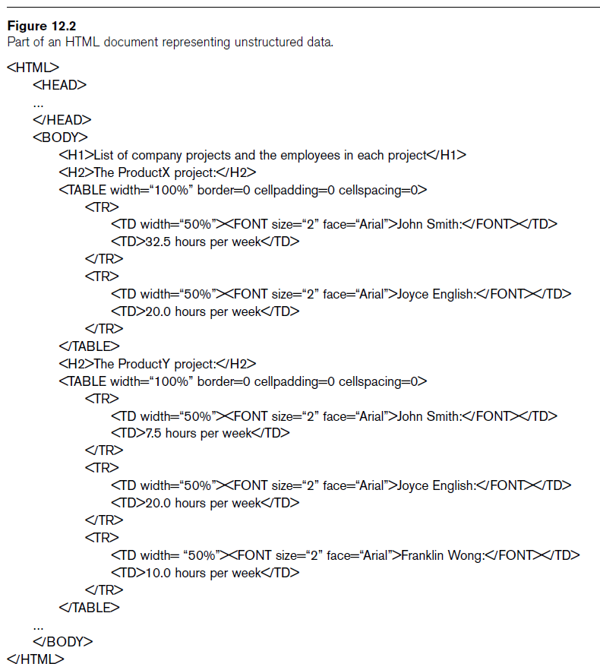

Slide 7
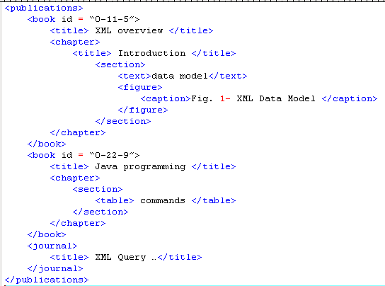
An Example of XML Document
<element>
“attribute”
text
Notes:
Tree Structured
Well-formedness
Every XML document has a root element
Matching opening-closing tags; properly nested
For example, line 3 in Figure 1.1 identifies that the title for the book with id ‘0-11-5’ is ‘XML Overview’. In each XML document, there exists only one root element. In this example, publications is the root. Under publications, there are three subelements: two books and a journal. Under the first book element, there are two subelements: title and chapter and so forth

Slide 8
XML Document Components
Declaration <?xml version=‘1.0’ encoding=‘UTF-8’?>
Start and end tags <book> </book>
Attributes id=“0-11-5”
Data XML Overview
Elements (nodes) <title></title>
Comments < ! - - a comment - - >
Notes:
Declaration specifies the encoding scheme.
XML parser can read, store in Unicode.

Slide 9
XML Data Model
XML documents can be modeled as a rooted (one that is the parent of all other elements) , nested (can contain sub elements, text and attributes) , ordered (is the order in which nodes appear in the XML document)
node-labeled data tree
edge-labeled data tree (a.k.a OEM –Object Exchanged Model)
Differ in terms of placement of labels.

Slide 10
XML Data Model – Node Labeled
Notes:
In a node-labeled data tree, there are two main objects, namely, nodes and edges. Nodes can be further classified into (1) Element Node, (2) Attribute Node and (3) Value Node. Element Nodes correspond to the tags in the XML document, such as book, title, chapter and so on while the Attribute Nodes and Value Nodes each correspond to attributes and data values in the XML document, such as attributes ‘id’ under the book element and values ‘XML Overview’, ‘Introduction’, etc, respectively.

Slide 11
XML Data Model – Edge Labeled
Notes:
Conversely, in an edge-labeled data tree, we assume that no element has attributes other than the attribute ID and IDREF (Bray, Paoli and Sperberg-McQueen, 1998). Thus, it may need restructuring if there is any attribute other than ID and IDREF for easier maintenance and reading. We replace the other attribute as child element of the respective element. For example, referring to Figure 1.2, the attribute id will be replaced by a child element id of the element book.

Slide 12
Simple Way to Design XML – Example
Example
Telephone Directory Listing
Name: | John A. Doe
Address: | 123 Main Street
City: | Plesantville
State: | Maryland
Zip code: | 12345
Telephone: | (999)555-1234

Slide 13
Simple Way to Design XML – Example (cont.)
Example
<Telephone_Directory_Listing>
<Name>John A. Doe</Name> <Address>123 Main Street</Address> <City>Plesantville</City> <State>Maryland</State> <Zip_Code>12345</Zip_Code> <Telephone>(999)555-1234</Telephone>
</Telephone_Directory_Listing>
Notes:
To use the components as individual query terms, serviced with direct lookup.

Slide 14
Simple Way to Design XML – Example (cont.)
Example
<Telephone_Directory_Listing>
<Name>
<First>John</First>
<MI>A.</MI> <Last>Doe</Last>
</Name> <Address>
<Street>123 Main Street</Street> <City>Plesantville</City> <State>Maryland</State> <Zip_Code>12345</Zip_Code>
</Address> <Telephone>
<Area_Code>999</Area_Code>
<Number>555-1234</Number> </Telephone>
</Telephone_Directory_Listing>
Notes:
To use the components as individual query terms, serviced with direct lookup.

Slide 15
XML INSTANCE STORAGE
(1) XML-ENABLED DATABASE (XED)
(Relational Database, Object-oriented database, object-relational database, etc)
(2) NATIVE XML DATABASE (NXD)
(Building specialized data manager)
(3) Hybrid System
(Storing both relational (structured) and XML (semi-structured)
data)
Notes:
Xml enable db : Store the XML data in other formats such as tabular data, spreadsheet, object and so on, other than the XML format itself. These technologies usually provide a means to shred XML into their underlying format.

Slide 16
XML-Enabled Database
Store the XML data in other formats such as tabular data, spreadsheet, object and so on, other than the XML format itself.
These technologies usually provide a means to shred/map XML into their underlying format.

Slide 17
Relational Database – The DTD Approach
Example
involves shared-inlining method (Deutsch et al., 1999)
DTD or XML schema is necessary – provide information where inlining is possible
* 0 or more occurrences (M)
+ 1 or more occurrences (M)
? 0 or 1 (1)
Notes:
Figure 1.6(a) shows the DTD graph based on the Publications XML data in Figure 1.2(b). The ‘*’ symbol associated with an element implies that this element can have multiple copies under its parent while the ‘+’ symbol implies that this element must occur at least once. Some other notations are depicted in Table 1.1. For example, a publications element might have zero or multiple journal sub-elements but must have at least one book sub-element.
From the DTD graph, we need to transform it into relational schema, by deciding what kind of relations to create. Relations are created for all elements in the DTD graph whose nodes have an in-degree greater than one. Nodes with an in-degree of one are inlined. Element nodes having an in-degree of zero are also made separate relations, because they are not reachable from any other node. In contrast, all sub-elements with one-to-many relationships cannot be inlined and have to be stored in separate table. An ID is assigned to each tuple in a table and a ParentID column is included to identify its parent. If an element can only appear once in its parent, it is inlined as one of the column in the table representing its parent. When a cycle exists in a DTD graph, a separate table must be used to break the cycle. Figure 1.6(b) shows the transformed relational schema from the DTD.

Slide 18
Native XML Database (NXD)
Basically means building a specialized data manager.
Fundamental unit of logical model: XML - stored and retrieved in their original structure.
Work best especially on scalability, data retrieval and handling of huge amounts of data.
Example : LORE (McHugh et al., 1997), TIMBER (Jagadish et al., 2002), XBase (Lu et al., 2002), Tamino (Software AG, 2002), eXist (Sourceforge, 2004) and Natix (Brantner et al., 2005)
Notes:
no mapping process required

Slide 19
Managing XML in DB2 – Example
Example
CREATE DATABASE sample;
CREATE TABLE clients(
id int primary key not null,
name varchar(50),
status varchar(10),
contactinfo xml
);

Slide 20
Managing XML in DB2 – Example (cont.)
Example
INSERT INTO clients VALUES
(
77, 'John Smith', 'Gold',
'<client>
<address>
<street>541 Julio Ave</street>
<city>San Jose</city>
<state>CA</state>
<zip>95116</zip>
</address>
<email>John@yahoo.com</email>
</client>'
);

Slide 21
Managing XML in DB2 – Example (cont.)
Example
select * from clients;
select id, name, contactinfo
from clients
where status = 'Gold';
Notes:
'only retrieve value in “name” column of “clients” table
'invoke the XMLExists function,
'specify an XPath expression that prompts DB2 to navigate to the “zip” element and check for a value of 95116
'using data accessible from node “$c”
'the value of “$c”: it's the “contactinfo” column of the “clients” table

Slide 22

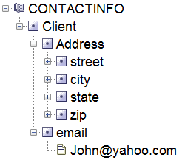
Managing XML in DB2 – Example (cont.)

Slide 23
XML Languages
Two query language standards
XPath
Specify path expressions to identify certain nodes (elements) or attributes within an XML document that match specific patterns
XQuery
Uses XPath expressions but has additional constructs

Slide 24
XPath: Specifying Path Expressions in XML
XPath expression
Returns a sequence of items that satisfy a certain pattern as specified by the expression
Qualifier conditions
Further restrict nodes that satisfy pattern
Separators used when specifying a path:
Single slash (/) and double slash (//)

Slide 25
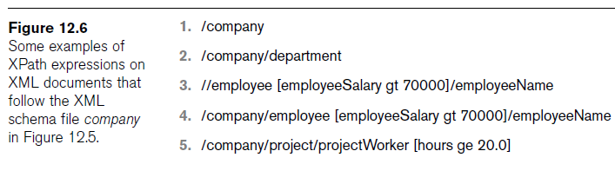
XPath: Specifying Path Expressions in XML (cont.)

Slide 26
XPath: Specifying Path Expressions in XML (cont.)
Attribute name prefixed by the @ symbol
Wildcard symbol *
Stands for any element
Example: /company/*

Slide 27
XQuery: Specifying Queries in XML
XQuery FLWR expression
Four main clauses of XQuery
Form:
FOR <variable bindings to individual nodes (elements)>
LET <variable bindings to collections of nodes (elements)>
WHERE <qualifier conditions>
RETURN <query result specification>
Zero or more instances of FOR and LET clauses

Slide 28
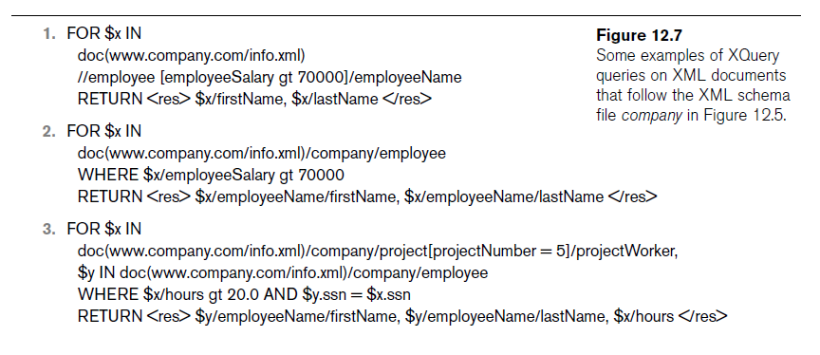

Slide 29
XQuery embedded in SQL/XML
Convenient for SQL programmers
incorporate XQueries into SELECT lists
extract fragments of XML documents into result sets
select name,
xmlquery('for $e in $c/client/email[1] return $e'
passing contactinfo as "c")
from clients
where status = 'Gold' ;
Notes:
Line 1: customer names will be included in the result set.
Line 2: output from the XMLQuery function will be included in the result set.
The first “email” sub-element of the “Client” element is to be returned.
Line 3: Source of our XML data – the “contactinfo” column.
Line 5: condition “Gold” customers are of interest to us.

Slide 30
XQuery embedded in SQL/XML (cont.)
SQL/XML – return clause of XQuery enables to transform XML output as needed.
select xmlquery('for $e in $c/client/email[1]
return <p>{$e}</p>'
passing contactinfo as "c")
from clients
where status = 'Gold';
Notes:
Line 1: customer names will be included in the result set.
Line 2: output from the XMLQuery function will be included in the result set.
The first “email” sub-element of the “Client” element is to be returned.
Line 3: Source of our XML data – the “contactinfo” column.
Line 5: condition “Gold” customers are of interest to us.

Slide 31

Querying with SQL/XML
Example
select name
from clients
where xmlexists('$c/client/address [zip="95116"]'
passing clients.contactinfo as "c");
Notes:
XMLExists and XMLQuery functions enable incorporate Xquery into SQL.
'only retrieve value in “name” column of “clients” table
'invoke the XMLExists function,
'specify an XPath expression that prompts DB2 to navigate to the “zip” element and check for a value of 95116 “$c/Client/Address” indicates the path in the XML document hierarchy
'using data accessible from node “$c”
'the value of “$c”: it's the “contactinfo” column of the “clients” table

Slide 32

Querying with SQL/XML
Example
XML values in returned result set
select xmlquery('$c/Client/email'
passing contactinfo as "c")
from clients
where status = 'Gold';

Slide 33
Summary
Three main types of data: structured, semi-structured, and unstructured
XML standard
Tree-structured (hierarchical) data model
XML documents and the languages for specifying the structure of these documents
XPath and XQuery languages
Query XML data

