Slide 1
Special-Purpose Database Systems
Notes:
Jan Chomicki & David Toman.
Handbook of Temporal Reasoning in Artificial Intelligence
Sarocco, Nicola, Gandhi.
A matter of time: Temporal data management in DB2 10, IBM 2012

Slide 2
Outline
Temporal Database
Multimedia Database

Slide 3
Specialized Database
Pre-programmed for specific data storage and retrieval purposes
Examples:
Temporal
Multimedia
Spatial
Notes:
Vendor: Db2, Oracle
QueryExtender
Store and query data that represents objects defined in a geometric space. Common database that can be connected to by a mobile device, or database which is actually stored by the mobile device - list of contacts, price information, distance travelled. Store text, graphics, images, animation, video and audio.

Slide 4

Temporal Database
It is a matter of time
Track and query
historical
current
future conditions
DB2 10 – temporal data management
Implement time-aware applications
Includes differences between system time and business time
Notes:
Handbook of Temporal Reasoning in Artificial Intelligence By Jan Chomicki & David Toman

Slide 5
Temporal Database Applications
Auditing and compliance initiatives
Pinpoint and correct human errors
Automatically manage multiple versions of data
Business intelligence
GPS location-based applications
Notes:
Handbook of Temporal Reasoning in Artificial Intelligence By Jan Chomicki & David Toman

Slide 6
Temporal Database Applications – Examples
A financial audit on MyBank requires reporting of changes made to a client's records during the past five years.
A pending lawsuit prompts a hospital to reassess its knowledge of a patient's medical condition just before a new treatment was ordered.
Online travel agency wants to detect inconsistency in customers itineraries.
Eg; books a hotel in Rome for eight days and reserves a car in New York for three of those days,
flag warning

Slide 7
Basic Concepts – Temporal Attributes
Transaction time (System time)
tracking when changes are made to the state of a table
E.g. when an insurance policy is modified or a loan is created.
Valid time (business time or application time)
tracking the effective dates of certain business conditions
E.g. the terms of an insurance policy or the interest rate of a loan.
Some organizations need to track both types of temporal data in one table; such tables would be considered bitemporal

Slide 8
Bitemporal Attributes
Bitemporal – indicate both the valid time and transaction time of the data
Represented by four extra table-columns
StartVT
EndVT
StartTT
EndTT

Slide 9
Temporal Attribute
Single-dimensional
temporal relations were allowed only a single temporal attribute
Multiple-dimensional
with each tuple in a relation there can be more than one temporal attribute

Slide 10
Example of Valid Time: Scenario (1/2)
HealthFirst Hospital stores their patient history as follows. Patients, identified by PatID visit the hospital to seek treatment from the respective doctor-in-charge, identified by a DocID. Consider the following visits during October 2014:
On 3rd of Oct, patient P101 seeks treatment from D1234 for 3 days
On 5th of Oct, patient P102 seeks treatment from D1245 for 3 days
From 10th to 12th of Oct, and again from 15th to 18th of Oct, patient P102 seeks treatment from D1234

Slide 11
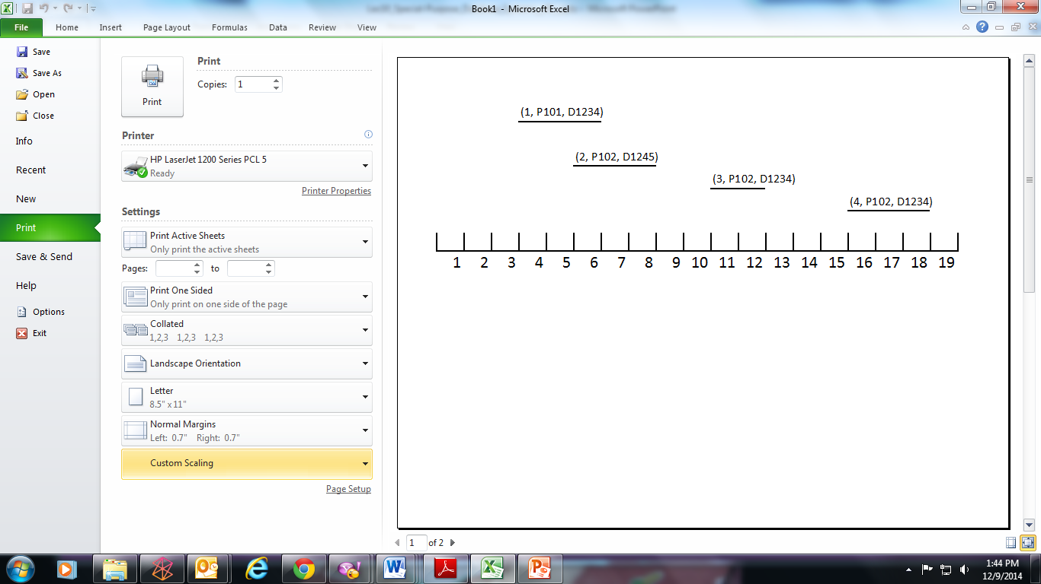
Example of Valid Time: Scenario (2/2)

Slide 12
Managing Data Versions with Transaction Time
DB2 for transaction/system time enables to automatically track and manage multiple versions of data
Instruct DB2 to automatically capture changes made to the state the table and to save "old" rows in a history table
History table
a separate table with the same structure as your current table

Slide 13
Managing Data Versions with Transaction Time (cont.)
Temporal queries referencing current table
DB2 transparently access history table
Work with historical data easily
Avoid need for complex WHERE clauses with various timestamp and join conditions

Slide 14
Create a Base Table
Example
Create base table for current data
CREATE TABLE policy (
id INT primary key not null,
vin VARCHAR(10),
annual_mileage INT,
rental_car CHAR(1),
coverage_amt INT,
sys_start TIMESTAMP(12) GENERATED ALWAYS AS ROW BEGIN NOT NULL,
sys_end TIMESTAMP(12) GENERATED ALWAYS AS ROW END NOT NULL,
PERIOD SYSTEM_TIME (sys_start, sys_end)
);
Notes:
Include three TIMESTAMP(12) columns
two for the start/end points of the system time
one for the transaction start time.
DB2 generates appropriate TIMESTAMP(12) values for system time columns and transaction start time.
DB2 uses the transaction start time column to track when the transaction first executed a statement that changes the table's data.
Define all three TIMESTAMP columns as GENERATED ALWAYS so DB2 will automatically generate these values on INSERT, UPDATE, and DELETE.
Avoid specifying values for these columns when writing to the database to ensures that the timestamps are accurate.
IMPLICITLY HIDDEN - won't show up in SELECT statements.

Slide 15
Create an Associated History Table
Create associated history table
CREATE TABLE policy_history LIKE policy;
Enable versioning
ALTER TABLE policy ADD VERSIONING USE HISTORY TABLE policy_history;
Notes:
History table—structure is identical to the table containing the current data.
Create using a CREATE TABLE . . . LIKE statement.
Alter the current table to enable versioning and identify the history table

Slide 16
Insert into Base Table
INSERT INTO policy(id, vin, annual_mileage, rental_car, coverage_amt)
VALUES(1111, 'A1111', 10000, 'Y', 500000);
INSERT INTO policy(id, vin, annual_mileage, rental_car, coverage_amt)
VALUES(1414, ‘B7777', 14000, 'Y', 750000);

Slide 17
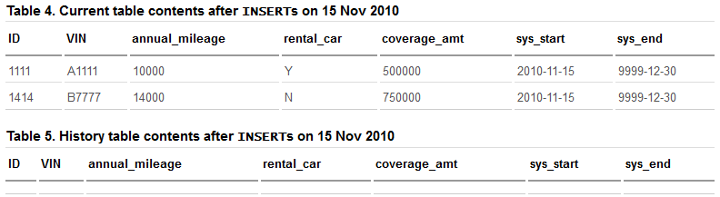
Contents of the POLICY and POLICY_HISTORY Tables
The SYS_START values in the POLICY table reflect when the rows were inserted (on 15 Nov 2010)
The SYSTEM_END values are set to 30 Dec 9999 to indicate that these rows have not expired (i.e., the rows contain current data).
Notes:
The SYS_START values in the POLICY table reflect when the rows were inserted (on 15 Nov 2010 in our example). The SYSTEM_END values are set to 30 Dec 9999 to indicate that these rows have not expired (i.e., the rows contain current data).

Slide 18
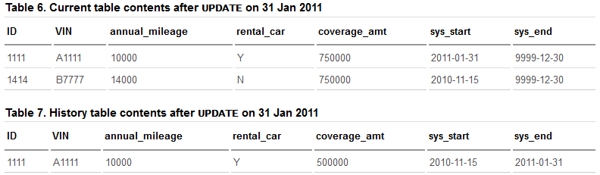
Contents of the POLICY and POLICY_HISTORY Tables (cont.)
UPDATE policy
SET coverage_amt = 750000
WHERE id = 1111;
Notes:
UPDATE policy SET coverage_amt = 750000 WHERE id = 1111

Slide 19
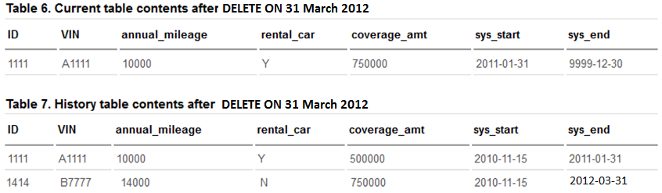
Delete from Base Table
DELETE FROM policy WHERE id = 1414; - - on 31 March 2012

Slide 20
Querying Table with System Time
Work with older versions of data
Supported period specifications in the FROM clause:
FOR SYSTEM_TIME AS OF
query data as of a certain point in time
FOR SYSTEM_TIME FROM ... TO ...
query data from a certain time to a certain time

Slide 21
Querying Table with System Time – Examples
SELECT coverage_amt FROM policy WHERE id = 1111;
SELECT coverage_amt FROM policy FOR SYSTEM_TIME AS OF '2010-12-01' WHERE id = 1111;
DB2 transparently accesses data in the history table to retrieve the correct information, i.e. 500000
No need to reference the history table in the query
The FOR SYSTEM_TIME period specification causes DB2 to automatically access the history table as appropriate.
SELECT count(*) FROM policy FOR SYSTEM_TIME FROM '2011-11-30' TO '9999-12-30' WHERE vin = 'A1111';
Notes:
SELECT coverage_amt FROM policy WHERE id = 1111;
SELECT coverage_amt FROM policy FOR SYSTEM_TIME AS OF '2010-12-01' WHERE id = 1111;
To resolve this query, DB2 transparently accesses data in the history table to retrieve the correct information (to return a value of 500000 for this query). Note that you didn't need to reference the history table in your query. The FOR SYSTEM_TIME period specification causes DB2 to automatically access the history table as appropriate.
SELECT count(*) FROM policy FOR SYSTEM_TIME FROM '2011-11-30' TO '9999-12-30' WHERE vin = 'A1111';

Slide 22
Multimedia Database
Multimedia data refers to a range of different types of media from
text, usually in the form of documents,
image,
audio, or
video
Multimedia database implies the ability to manage, store and retrieve multimedia data
Notes:
Principles of Multimedia Database Systems. V.S. Subrahmanian, 1998

Slide 23
Multimedia Data Application
Consider a crime investigation. The investigation may generate the following types of data:
Video data captured by surveillance cameras that record the activities at various locations.
Audio data captured by legal telephone wiretaps.
Image data consisting of still photographs.
Document data seized by the investigators.
Structured relational data containing background information, back records, etc.
Geographical location data of relevant locations.
Notes:
Principles of Multimedia Database Systems. V.S. Subrahmanian, 1998

Slide 24
Challenges of Multimedia Data
1st challenge: Size
Data size will affect the storage, retrieval and transmission of multimedia data
A single good quality colored image could require up to 6MB
A video object that consists of a sequence of such images (frames)
With 30 frames / second, a 5-minute video could required 54GB!
A typical sequence of audio may occupy 8Kb for each second

Slide 25
Challenges of Multimedia Data (cont.)
2nd challenge: time
Continuous periodic media:
Audio
Video - The frames of the video must run in the correct sequence and at an acceptable rate
Example: a movie must include audio and image that must be synchronized together
The effect of time is often regarded as real-time challenge

Slide 26

Challenges of Multimedia Data (cont.)
3rd challenge: semantic nature of multimedia data
More complex than traditional data types
Difficult to identify components within the media that could be used for retrieval
Simple solution:
Add a description in words of the content of the image
Drawback – different people interpret the image differently

Slide 27
Metadata
Any data that is required to interpret other data as meaningful information
Used for retrieving and manipulating the data
In traditional DBMS
Metadata describes the structure of the database, the tables, etc
In the case of MMDBMS
Metadata deals with the content, structure and semantic of the multimedia data

Slide 28
Metadata (cont.)
Metadata can be in the form of multimedia indexes and linguistic annotation added for specific attributes
Objective:
To allow the media to be queried and manipulated by querying the metadata first and then retrieving the actual result set
Notes:
Automatically-generated metadata – RGB values, time and date when picture is captured, etc.

Slide 29
Multimedia DBMS
Supported by object-relational DBMS
Provide convenient facilities for the storage and manipulation of unstructured data objects
ORDBMS market leaders IBM’s DB2 , Oracle, Microsoft SQL Server
User defined types (UDTs)
Processing and manipulation of large object types (LOB) and their extensions
Creating, inserting, and updating objects
Notes:
Principles of Multimedia Database Systems. V.S. Subrahmanian, 1998

Slide 30
Large Object Data Types
Store entire image or document
Large object (LOB) refers to the following data types:
CLOB – character large object
DBCLOB – double-byte character large object
BLOB – binary large object
Notes:
Principles of Multimedia Database Systems. V.S. Subrahmanian, 1998

Slide 31
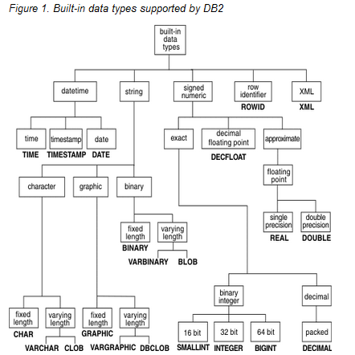
Notes:
Principles of Multimedia Database Systems. V.S. Subrahmanian, 1998

Slide 32
Single-Byte (SBCS) vs. Double-Byte (DBCS)
Single-byte – one byte to distinguish every possible character set
One byte has ability to represent 256 characters
Example: differentiating punctuation marks, and special characters using one byte per character.
Double-byte – two bytes to distinguish every possible character set
Two byte has ability to represent 65,536 characters.
Notes:
Principles of Multimedia Database Systems. V.S. Subrahmanian, 1998

Slide 33
Using LOB
CLOB - store large SBCS data or mixed data, such as lengthy documents that contain single character set.
DBCLOB – store large DBCS data, such as documents that use a DBCS data.
BLOB – store non-traditional noncharacter data such as pictures, voice, and mixed media.
Notes:
Reference: Principles of Multimedia Database Systems. V.S. Subrahmanian, 1998
Handling Unstructured Data Type in DB2 and Oracle A.P. Pons & H. Aljifri, Communications of the International Information Management Association, 3(2).

Slide 34
Creating Multimedia Database
Typical ways of creating MMDB
Binary large objects (BLOBs) stored within the local database that could contain text documents, audio, video or image data
Separate files or large objects stored as BFILEs, stored within the operating system file system
Streaming audio or video data stored on specialized media servers
URLs containing audio, image or video data stored on any HTTP server, e.g. Apache HTTPD, Oracle Application Server, Microsoft Internet Information Server, etc.
Method 2 – 4 store pointer in the database and media data is stored externally

Slide 35
Querying Multimedia Database
Instead of the exact match, it is more likely that the query will take the form of similarity matching:
Does the model match the given model within a certain tolerance?
The system returns a label and a confidence level that represents how likely the label is to be correct
Objective:
To create systems which require fewer assumptions to be made and have fewer constraints on the domain

Slide 36
Querying Multimedia Data (cont.)
Process of querying multimedia data can be in two ways:
What information can be retrieved?
How the information can be retrieved?

Slide 37
Querying Multimedia Data (cont’)
The “how” can be classified on the basis of whether the information is retrieved by:
Attribute-based systems
Text-based systems
Content-based systems
These three retrieval approaches use different indexing and searching methods

Slide 38
Attribute-based Retrieval (ABR)
Use a set of structured attributes, like traditional DBMSs
Example of specifying a table definition for ABR system:
CREATE TABLE Song
( cdref CHAR(6),
songid CHAR(6),
artist VARCHAR(30),
title VARCHAR(30),
script CLOB,
writer VARCHAR(30),
duration INTEGER,
audio_source BLOB,
PRIMARY KEY (cdref, songid)
)

Slide 39
Text-based Retrieval (TBR)
Add annotations, usually brief descriptions combined with some structured data
Disadvantage of TBR:
Difficult in practice as annotations must be added manually
Resource intensive and costly
Some images, such as abstract art are hard to describe in text
To successfully retrieve, user must use the same descriptive terms as the annotator

Slide 40

Content-based Retrieval (CBR)
Developed to attempt to overcome some of the difficulties of TBR
CBR implies the ability to search based on the user’s association and impression of an image
Setting up a mapping from the user’s ideas and concepts to both the raw image data and image characteristics
User’s ideas and concepts
Image characteristics
Image

Slide 41
Retrieval Strategies and Techniques
Nature of Retrieval | Techniques Employed
Attribute-based | Fixed set of structured attributes, with indexing based on B+ trees and inverted files
Text-based | Text descriptions and structure fields Indexing by full text – scanning, inversion files, signature file methods
Content-based | Content features automatically extracted

Slide 42
Summary
To design, implement and develop a temporal or multimedia database involves the integration of skills and knowledge based in many different disciplines
Database design and implementation
SQL coding on single-dimensional and multi-dimensional data
Image processing, computer vision, temporal data processing
Information retrieval
Human-computer interaction

