Slide 1
Object Oriented Database

Slide 2
Outline
Object Concept
Type Construct
Class Hierarchies
Inheritance
Method Overriding
Object-Relational Database

Slide 3
Object Orientation
Object orientation is a modeling and development methodology based on object-oriented (OO) concepts.
A set of design and development principles based on conceptually autonomous computer structures known as objects.

Slide 4
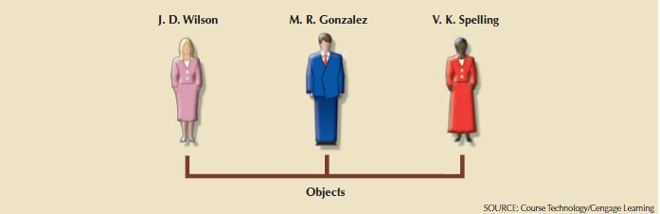
Object
An object can be defined as an abstract representation of a real-world entity that has a unique identity, embedded properties, and the ability to interact with other objects and act upon itself.

Slide 5
Object Characteristics
Object ID (OID) –
Unique to object
Not a primary key
System generated.
Attributes – Called instance variables.
Object state – Object values at any given time.
Methods –
Code that performs operation on object’s data.
Has name and body

Slide 6
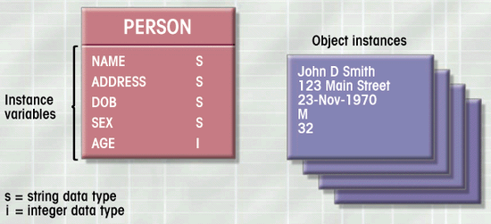
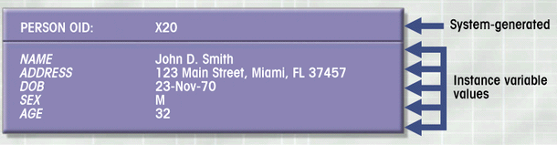
Object and Class
Notes:
Not a physical address.

Slide 7
Object and Class
Class is a collection of objects belonging to the same type
A class is defined by its name and the collection of objects included in the class
Notes:
Behavior! Distinguish from rel. Only way to access.
OID never changed.

Slide 8
Data Type
Primitive type – atomic, such as integers, numbers, character strings, booleans
Collection type – list, array,..
Based on other objects
Abstract type – user-defined class

Slide 9
Class – Examples
Example
class Employee {
String name;
Date birthdate;
Department dept;
//methods
}
class Department {
String name;
Float budget;
Employee manager;
// methods
}

Slide 10
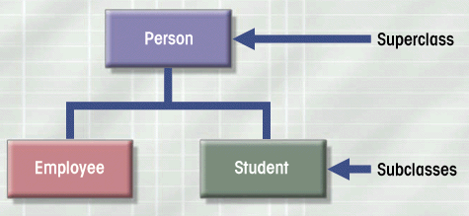
Class Hierarchies

Slide 11
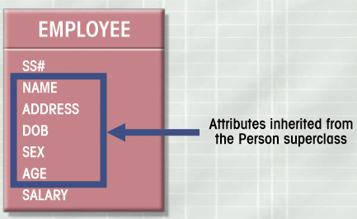
Inheritance

Slide 12
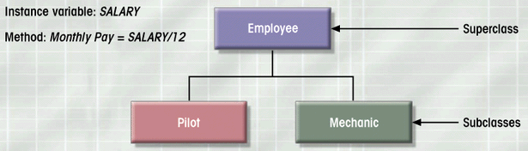
Inheritance (cont.)
Ability of object to inherit the data structure and behavior of classes above it
Single inheritance – Class has one immediate superclass

Slide 13
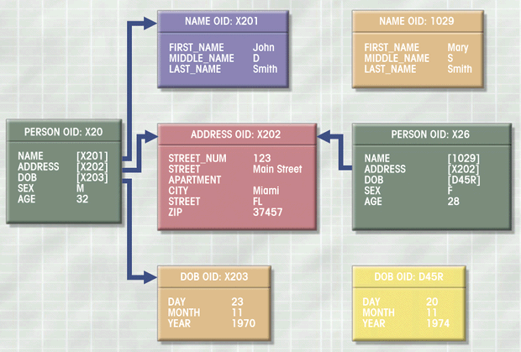
Object Space Representation

Slide 14
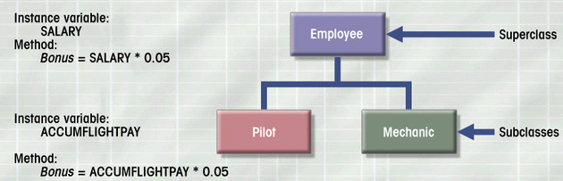
Method Overiding
Method redefined at subclass level

Slide 15
Method Overriding – Example
Example
Employee e = new Employee();
e.getBonus();
Pilot p = new Pilot();
p.getBonus();

Slide 16
Inter-objects Relationship
Object’s attribute references another object
Relationship representation in OO Model
Related classes enclosed in boxes
Double line on right side indicates mandatory
Connectivity indicated by labeling each box – 1:M , M:N with an intersection class

Slide 17
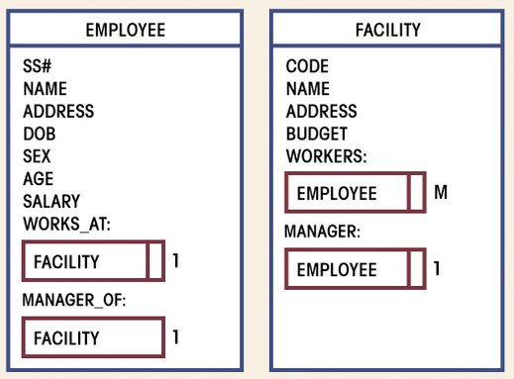
1:M connectivity

Slide 18
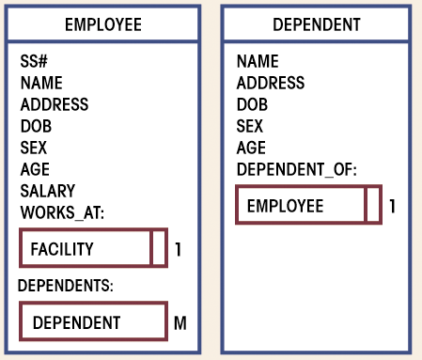
1:M connectivity

Slide 19
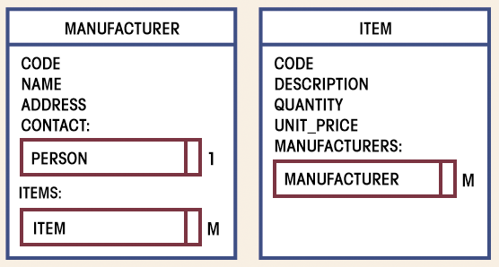
M:N connectivity

Slide 20
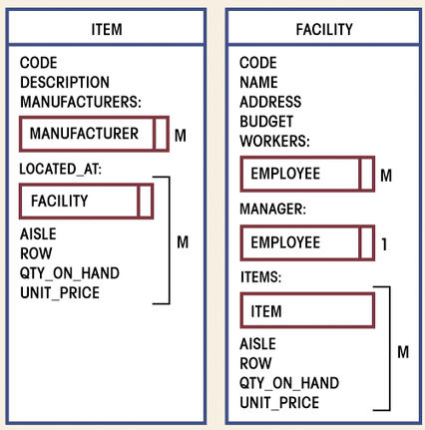
Detailed representation with properties for M:N connectivity
Associated properties
Associated properties

Slide 21
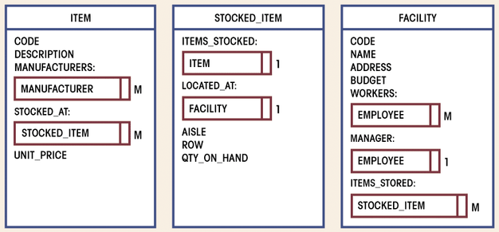
M:N connectivity with intersection class
Similar concept of omposite entity

Slide 22
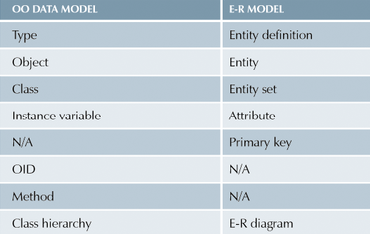
Comparing Data Model

Slide 23
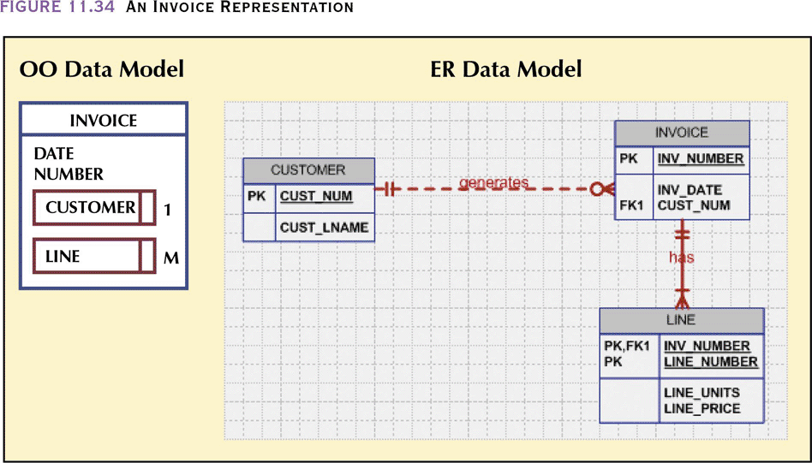
Comparing Data Model
Draw also object CUSTOMER and LINE.

Slide 24
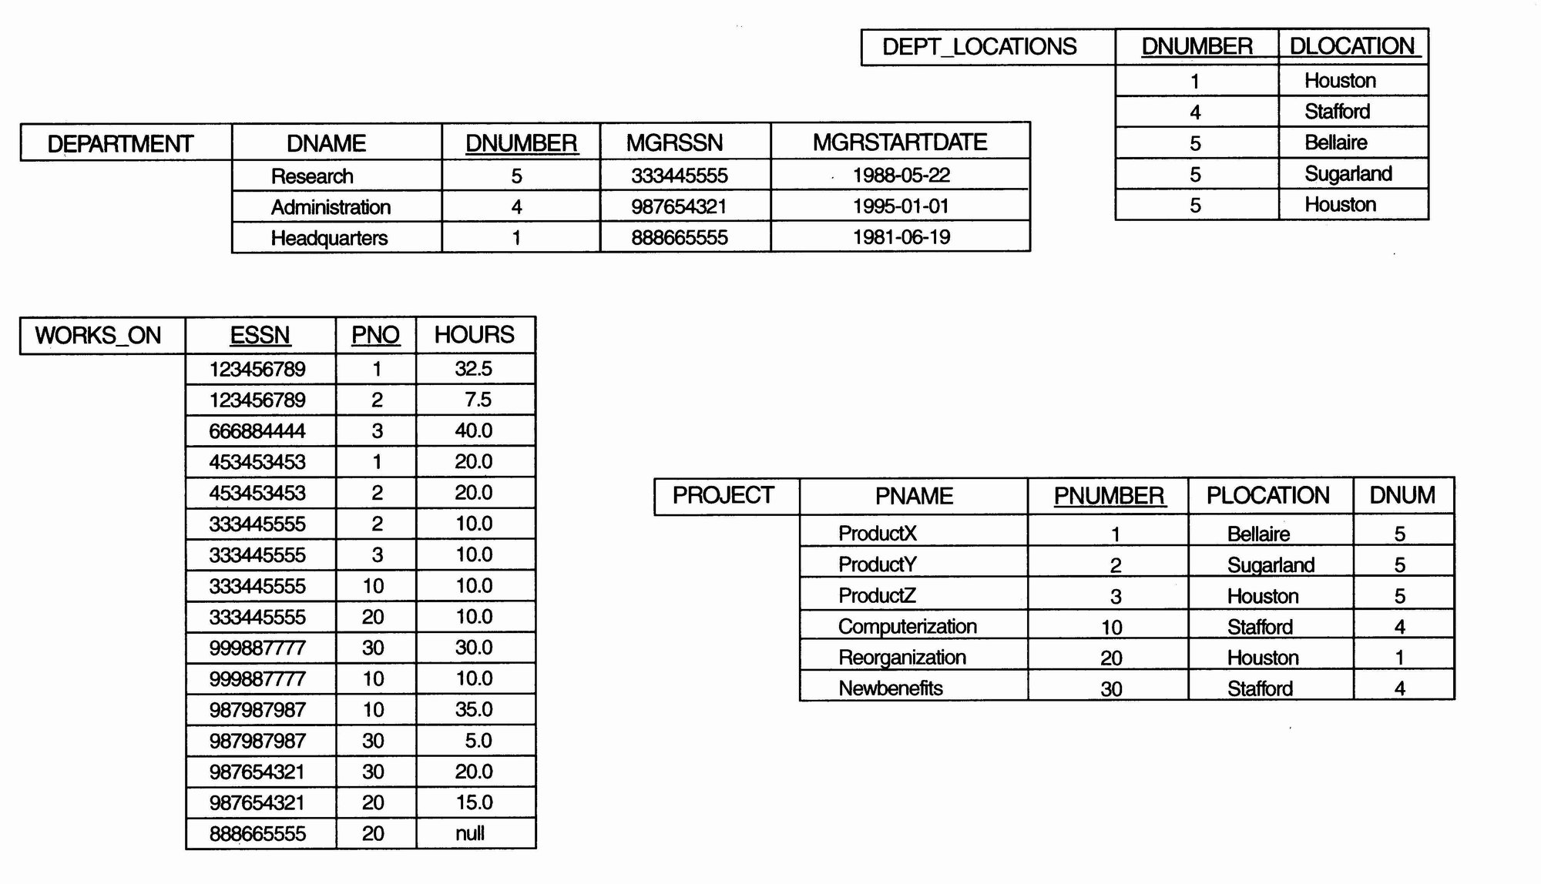
Specifying Object Types – Example (cont.)

Slide 25
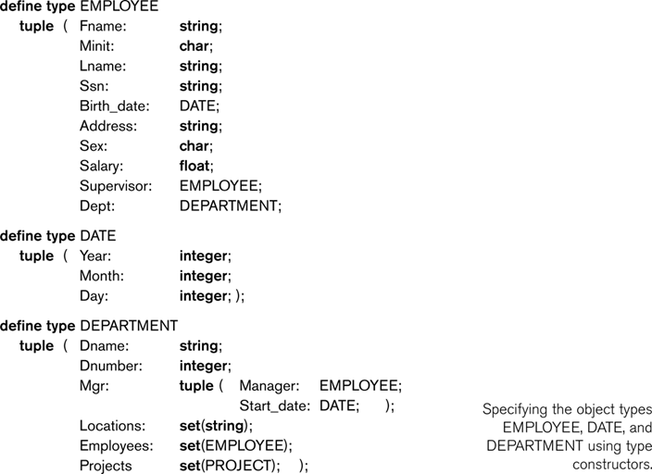
Specifying Object Types – Example (cont.)

Slide 26
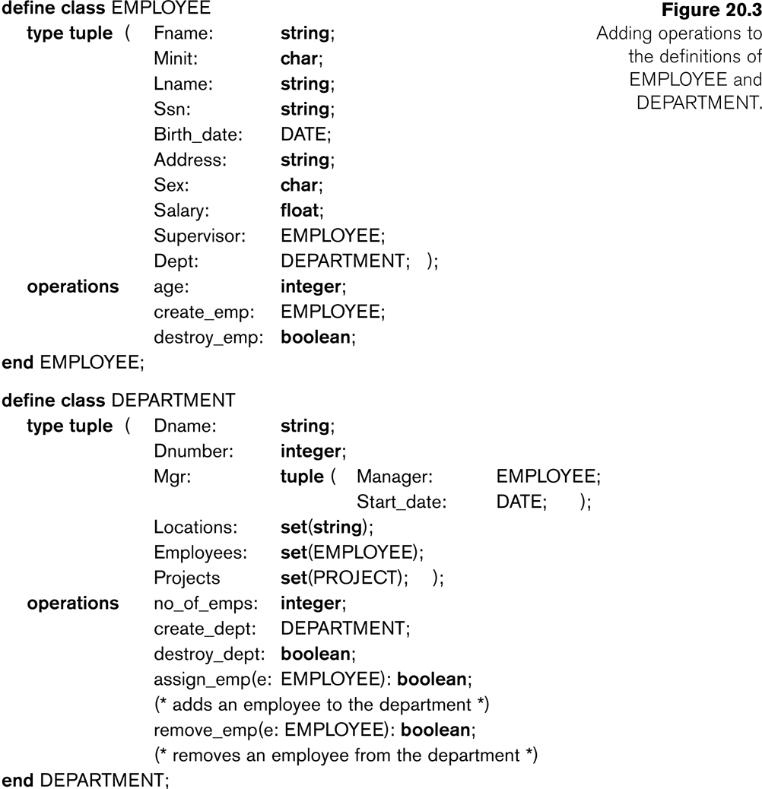
Defining Classes – Example

Slide 27
Advantages of OO Database
More semantic information
Support for complex objects
Extensibility of data types
Reusability
Inheritance speeds development and application

Slide 28
OODB Management Systems
InterSystems Caché®
Versant
Objectivity
ObjectStore

Slide 29
Object Relational Database
Support object-oriented database model: objects, classes and inheritance in database schemas and in query language.
User-defined structured types and other object-oriented features such as inheritance, methods, object identifiers, navigation by reference, and dynamic dispatch of methods (polymorphism).

Slide 30
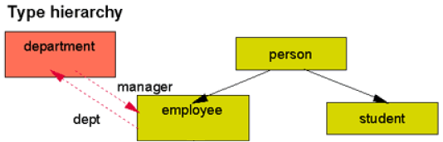
Object Relational Database (cont.)

Slide 31
Object Relational Database – Example
CREATE TYPE person AS
(name varchar(20),
birthyear INTEGER,
address varchar(40))
MODE DB2SQL;
CREATE TYPE employee UNDER person AS
(salary (8,2))
MODE DB2SQL;
CREATE TYPE department AS
(ID INTEGER,
manager REF(employee),
Budget (10,2))
MODE DB2SQL;
ALTER TYPE employee
ADD ATTRIBUTE dept REF(department)

Slide 32
Object Relational Database – Example
CREATE TABLE person_table OF person
(REF IS oid USER GENERATED,
name WITH OPTIONS NOT NULL);
CREATE TABLE employee_table OF employee
UNDER person_table
INHERIT SELECT PRIVILEGES;
CREATE TABLE dept_table OF department
(REF IS oid USER GENERATED,
manager WITH OPTIONS SCOPE employee_table);

Slide 33
Object Relational Database – Example
INSERT INTO dept_table (oid, ID, Budget)
VALUES (department('1'), 100, 50000);
INSERT INTO employee_table (oid, Name, Birthyear, Address, Salary, Dept)
VALUES (
employee('6'), Jennifer T', 1990, '25 Cyberjaya', 28000,
(SELECT oid FROM Dept_table WHERE ID=100)
);

Slide 34
Object Relational Database - Example
Rich query capabilities
SELECT P.* FROM
Person_table P;

Slide 35
OODBMS Disadvantage
OODB market growing very slowly these days.
Complexity: Object databases are tightly coupled to object-oriented languages, making them harder to integrate with other systems.
Relational DBs dominate: SQL-based relational databases (like PostgreSQL, MySQL, Oracle) are standardized, mature, and extremely well-supported.

