Slide 1
Distributed Database

Slide 2
Outline
Introduction to Distributed Database
Distributed Database Management Systems (DDBMSs)
Data and Process Distribution
Transactions in Distributed Database Environment
Data partitioning and Replication
Distributed Database Design

Slide 3
Factors Driven DDBMS
Business operations become decentralized – Each unit has authority to create own IS have control over local data
Data sharing – User at location A can access and update data at location B
Data communication costs – High cost of shipping large quantities of data across network
More economical to locate data and applications close to where they are needed
Database recovery – Data is replicated on separate computers. Users can have access to data while primary site is restored

Slide 4
Distributed Database
Distributed Database Management Systems (DDBMS)
Governs storage and processing of logically related data over interconnected computer systems in which both data and processing functions are distributed among several sites.

Slide 5
Centralized Database
Centralized database require data be stored in a single central site
Dynamic business environment
Centralized database shortcomings
Applications demand data access from different sources at multiple locations

Slide 6
Decentralized Database
A collection of independent databases on non-networked computers
The computers on multiple locations cannot share data

Slide 7
Distributed vs Decentralized
A single logical database that is spread physically across computers in multiple locations that are connected by a data communications link
Centrally administered
Sites can be over large area (a country or worldwide) or small area (a building or campus)
Requires multiple DBMSs at each remote site

Slide 8
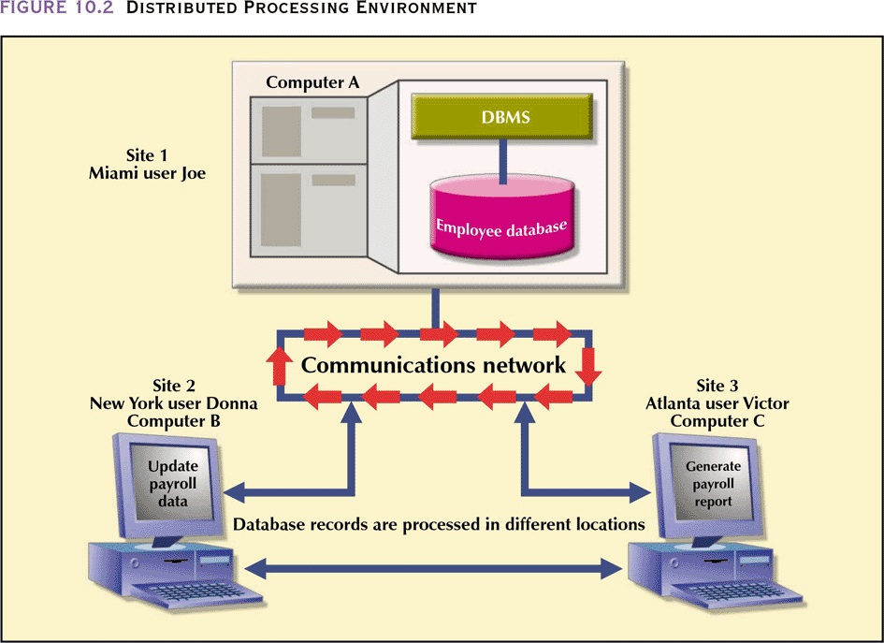
Distributed Processing

Slide 9
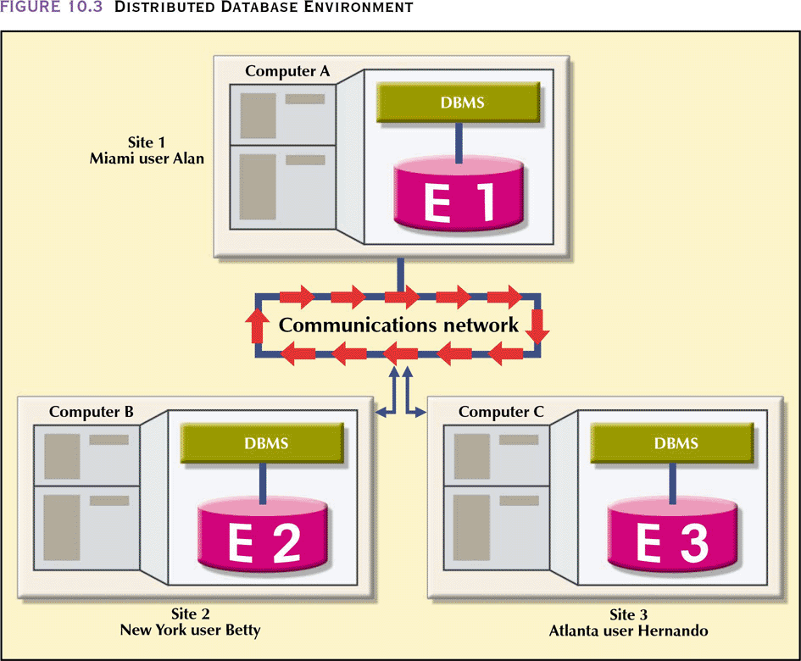
Distributed Database

Slide 10
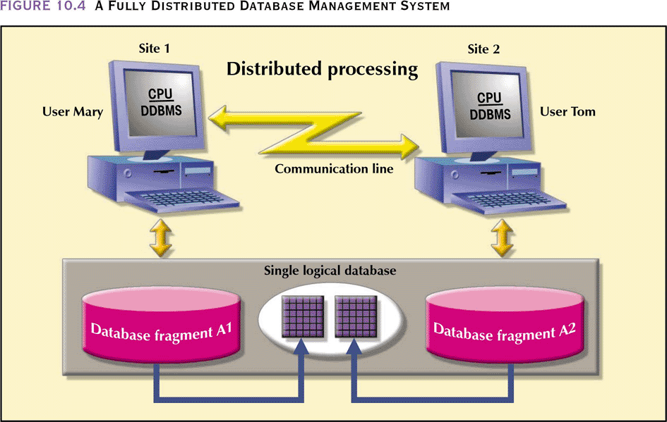
Fully Distributed Database Management System

Slide 11
Characteristics of DDBMS
Perform all the functions of a centralized DBMS
Handle all necessary functions imposed by the distribution of data and processing
Perform these additional functions transparently to the end user

Slide 12
DDBMS Components
Computer workstations
Network hardware and software
Communications media
Transaction processor TP (application processor, transaction manager ) – Software in each computer that requests data
Data processor DP (data manager) – Software in each computer that stores and retrieves data located at the site

Slide 13
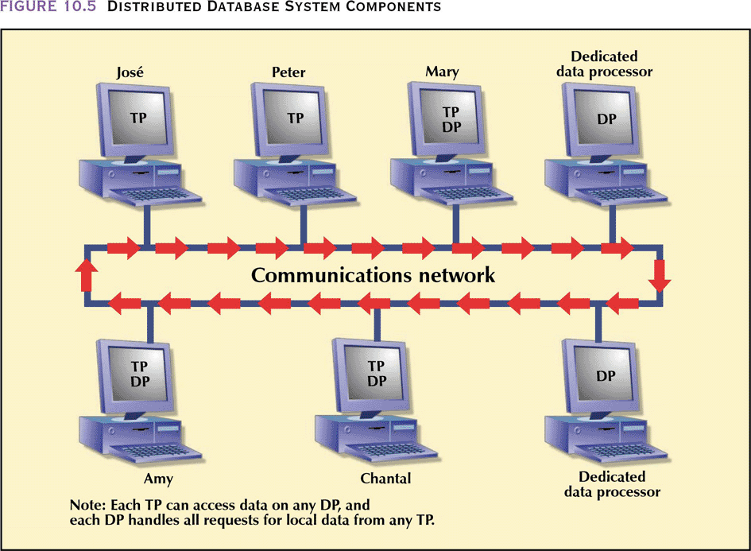
DDBMS Components

Slide 14
Process and Data Distribution
Could processing be on single site?
Could processing be on several sites ?
Could data be on single site?
Could data be on several sites?

Slide 15
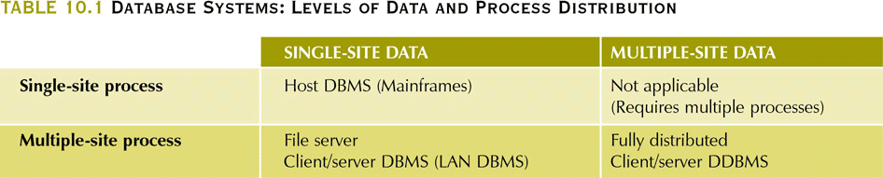
Data and Process Distribution

Slide 16
Single-Site Processing, Single-Site Data (SPSD)
All processing is done on single CPU or host computer (mainframe, midrange, or PC)
All data are stored on host computer’s local disk
Processing cannot be done on end user’s side of the system
Typical of most mainframe and midrange computer DBMSs
DBMS is located on the host computer, which is accessed by dumb terminals connected to it
Also typical of the first generation of single-user microcomputer databases

Slide 17
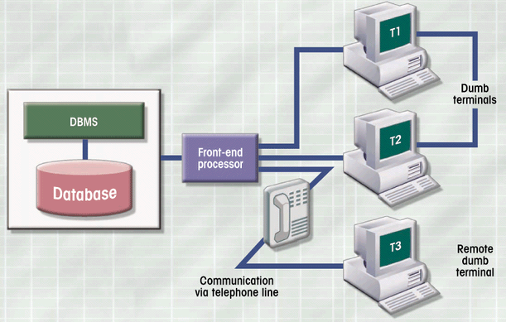
SPSD

Slide 18
Multiple-Site Processing, Single-Site Data (MPSD)
Multiple processes run on different computers sharing a single data repository
MPSD scenario requires a network file server running conventional applications that are accessed through a LAN
Many multi-user accounting applications, running under a personal computer network, fit such a description

Slide 19
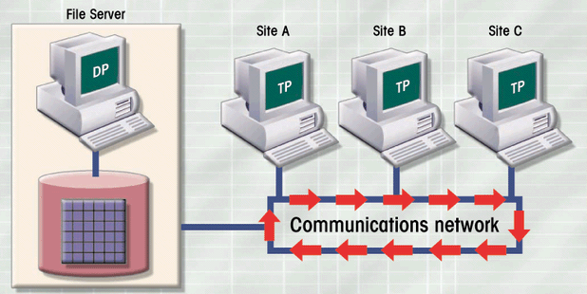
MPSD

Slide 20
Multiple-Site Processing, Multiple-Site Data (MPMD)
Fully distributed database management system with support for multiple data processors and transaction processors at multiple sites
Classified as either homogeneous or heterogeneous

Slide 21
Homogeneous MPMD DDBMS
Integrate only one type of centralized DBMS over a network
Data is distributed across all the nodes
Same DBMS at each node
All data is managed by the distributed DBMS
All access is through one global schema
The global schema is the union of all the local schema

Slide 22
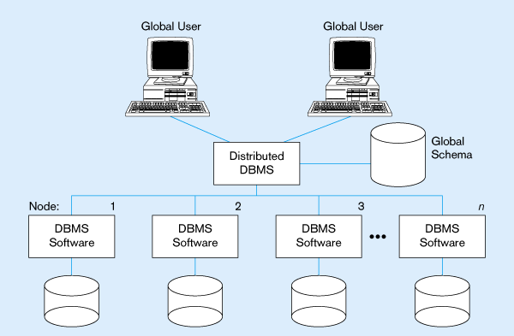
Homogeneous MPMD DDBMS

Slide 23
Heterogeneous MPMD DDBMS
Integrate different types of centralized DBMSs over a network
Support different DBMSs that may even support different data models (relational, hierarchical, or network) running under different computer systems, such as mainframes and microcomputers
Data distributed across all the nodes
Different DBMSs may be used at each node
Local access is done using the local DBMS and schema
Remote access is done using the global schema

Slide 24
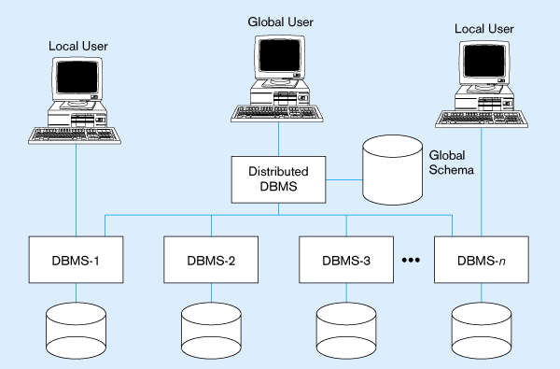
Heterogeneous MPMD DDBMS

Slide 25
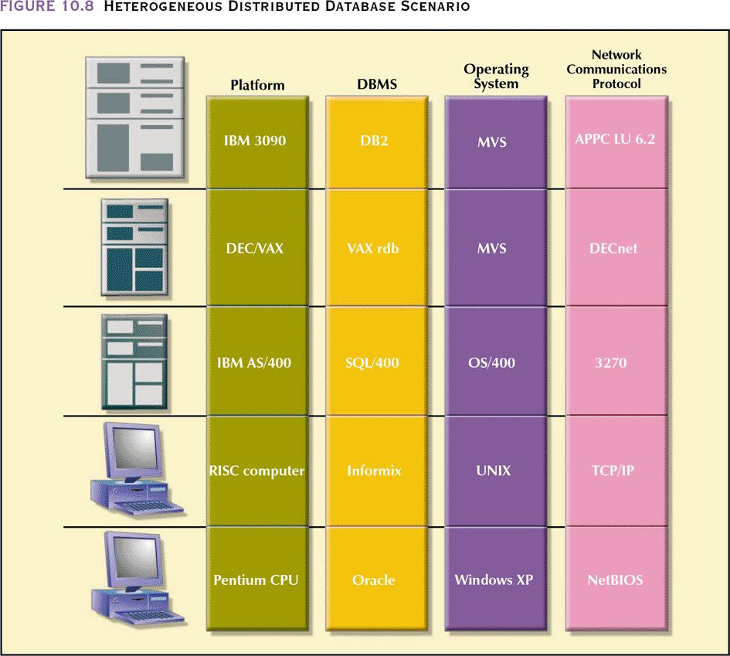
Heterogeneous DDBMS

Slide 26
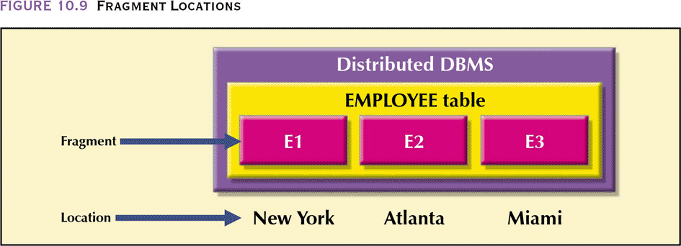
Transparency of Distributed Database
User sees right through database, sees the database as if it were centralized and as if the only user

Slide 27
Request and Transaction on DDBMS
Remote request – A single SQL statement access data to be processed by a single remote database processor (DP)
Remote transaction – A transaction access data at a single remote DP site
Distributed request – A single SQL statement reference data located at several different local or remote DP sites
Distributed transaction – A transaction reference several different (local or remote) DP sites

Slide 28
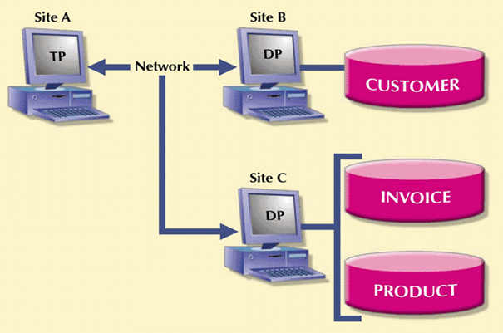
Example

Slide 29
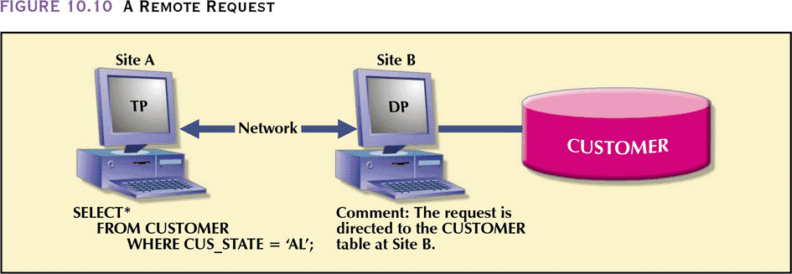
Remote Request

Slide 30
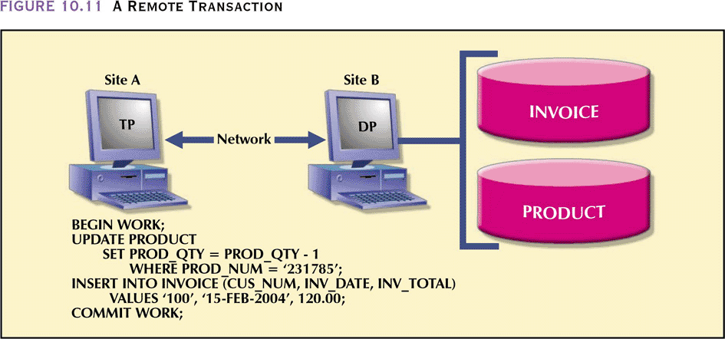
Remote Transaction

Slide 31
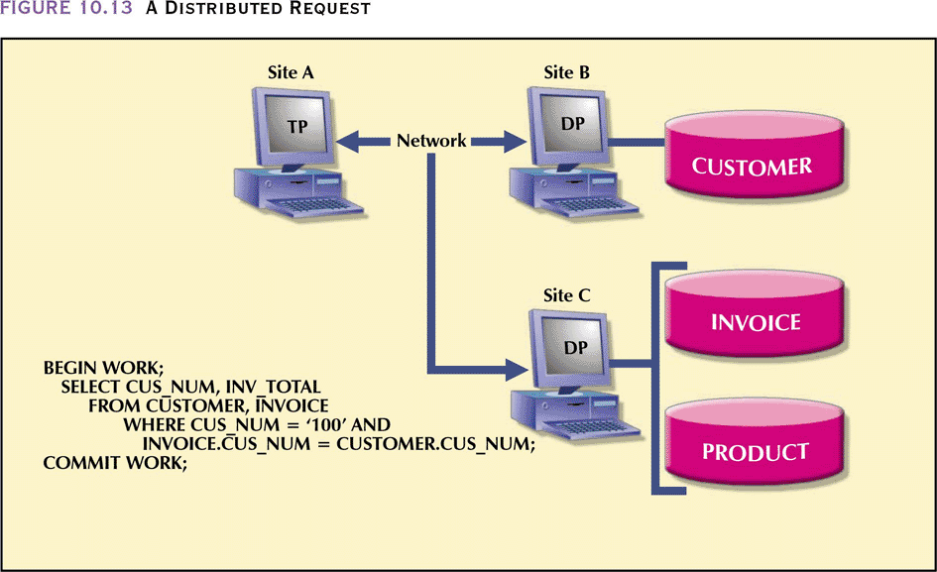
Distributed Request

Slide 32
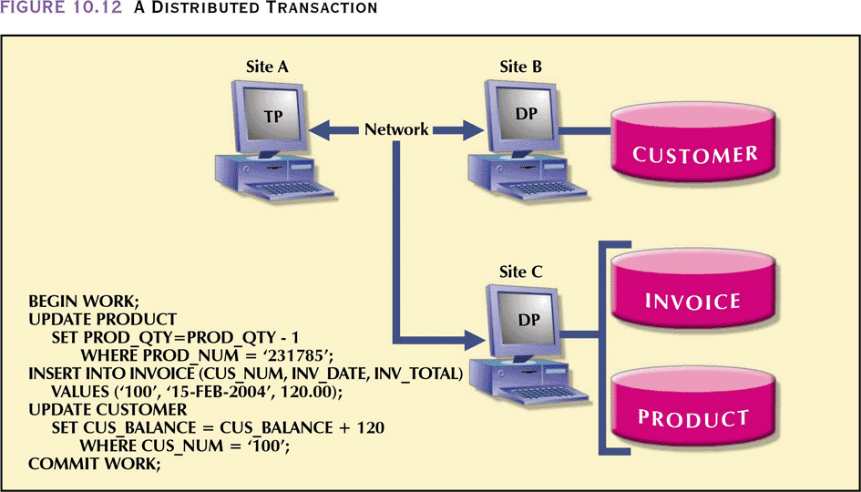
Distributed Transaction

Slide 33
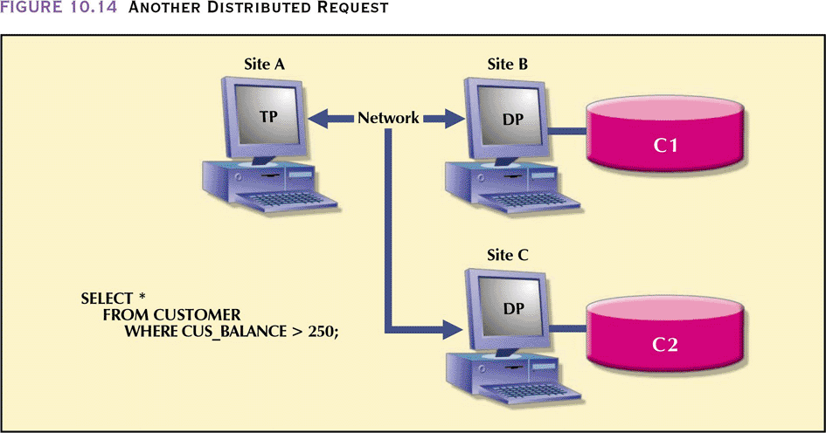
Another Example of Distributed Request

Slide 34
Distributed Database Design
Data fragmentation – HOW to partition the database into fragments?
Data replication – WHICH fragments to replicate?
Data allocation – WHERE to locate those fragments and replicas?

Slide 35
Data Fragmentation
Breaks single object into two or more segments or fragments
Each fragment can be stored at any site over a computer network
Information about data fragmentation is stored in the distributed data catalog (DDC), from which it is accessed by the TP to process user requests

Slide 36
Data Fragmentation
Horizontal fragmentation – Division of a relation into subsets (fragments) of tuples (rows)
Vertical fragmentation – Division of a relation into attribute (column) subsets
Mixed fragmentation – Combination of horizontal and vertical strategies

Slide 37
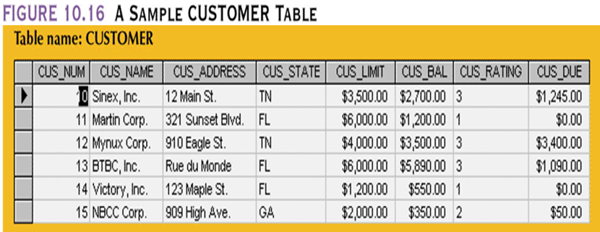
Example

Slide 38
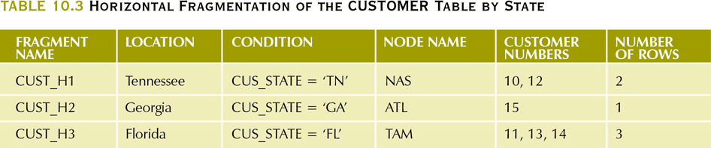
Example
Distributed Data Catalog

Slide 39
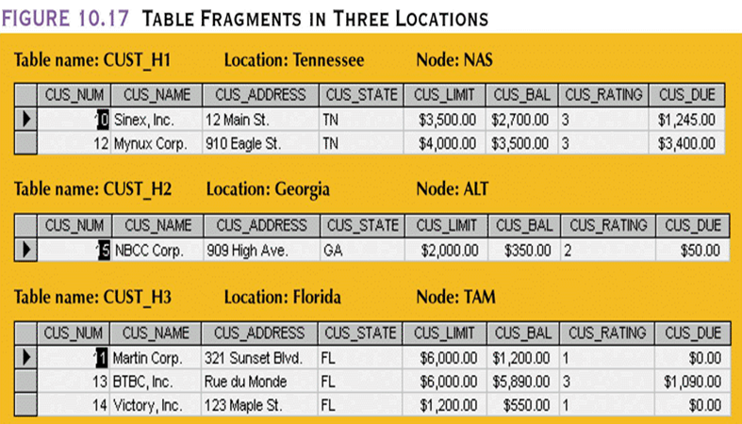
Example
Table contents

Slide 40
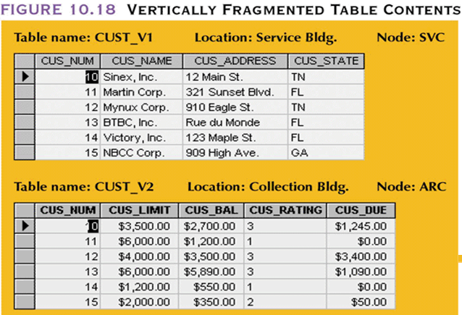
Example
Table contents

Slide 41
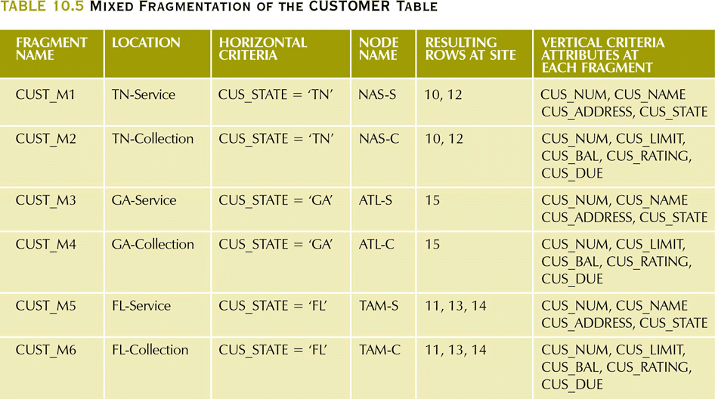
Example
Distributed Data Catalog

Slide 42
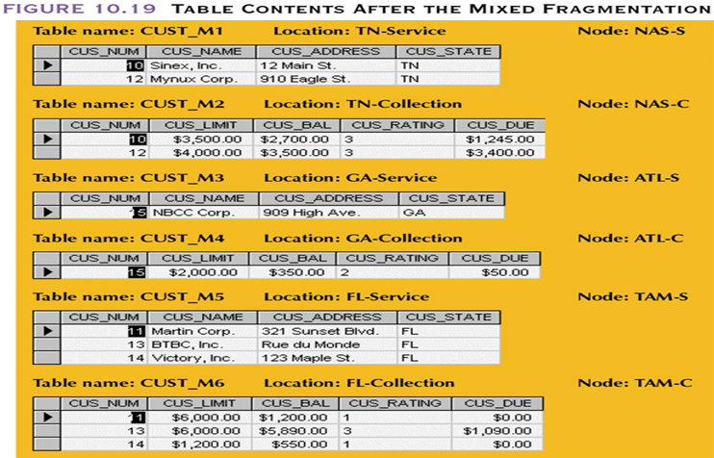
Example

Slide 43
Data Replication
Storage of data copies at multiple sites served by a computer network
Fragment copies can be stored at several sites to serve specific information requirements
Can enhance data availability and response time
Can help to reduce communication and total query costs

Slide 44
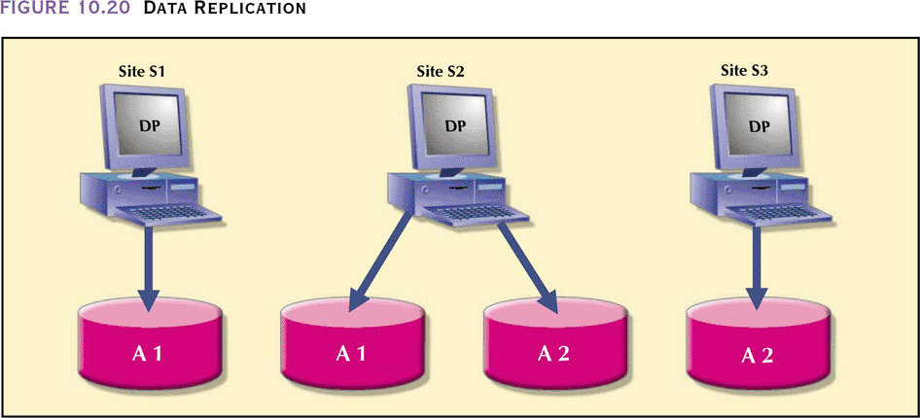
Data Replication

Slide 45
Data Replication
Mutual Consistency Rule
Replicated data are subject to the mutual consistency rule, which requires that all copies of data fragments be identical
DDBMS must ensure that a database update is performed at all sites where replicas exist.

Slide 46
Data Allocation
Centralized data allocation – Entire database is stored at one site
Partitioned data allocation – Database is divided into several disjointed parts (fragments) and stored at several sites
Replicated data allocation – Copies of one or more database fragments are stored at several sites

Slide 47
Why DDBMS ?
Data are located near “greatest demand” site
Faster data access
Faster data processing
Growth facilitation
Improved communications
Reduced operating costs
User-friendly interface
Less danger of a single-point failure
Processor independence

Slide 48
Exercises
1) What is the primary advantage of data replication in a DDBMS?
A. It ensures only one site needs to be updated during changes B. It improves data consistency without additional overhead C. It enhances data availability and response time D. It reduces the need for network hardware and software

Slide 49
Exercises
2) In a distributed database system, a user executes an SQL query that pulls product information from Site A and customer orders from Site B in one statement. What kind of request is this?
A. Remote Request B. Remote Transaction C. Distributed Request D. Distributed Transaction

Slide 50
Case Study
Your company is expanding globally; therefore, the regional offices need quick access to customer information and sales reports. As a database designer, how would you use data fragmentation, replication, and allocation to design a distributed database that would guarantee performance, and arability? Justify your choices.

Slide 51
Case Study - Answer
Fragmentation:
Horizontally fragment the customer database and sales data by region so that each office has its own set of customers and their corresponding sales.
Replication:
Create duplicate summary sales reports and customer contact information for all regions so that every office can quickly respond to international inquiries or service requests.
Allocation:
Place critical pieces of data (such as active customer information) closer to where they are most utilized, which is at the local office. Data used less frequently can stay on central servers.

