Slide 1
S&DAI
P2P electric prosumers and MAS
Lorenzo Foschi

Slide 2
Creative
Hard

Slide 3
The proposal seeks to integrate MAS (Multi-Agent System) knowledge into an existing scholarship research project focused on an energy prosumers network tool, namely STONKSpp. It aims to achieve a real BDI (Belief-Desire-Intention) approach in this context through three key directions:
- Theoretical Exploration of BDI Architecture for Prosumers: develop a theoretical model, potentially supported by code mockups, for extending prosumer agent design towards a real BDI architecture.
- Implementation of BDI Prosumers:
Implement BDI prosumers based on the model from point 1, using necessary simplifications to meet the project's 7-10 day timeline, utilize the Python-Agentspeak framework and compare implementations with the Jason framework.
- Integration of Mango agents into the paper (trial)

Slide 4
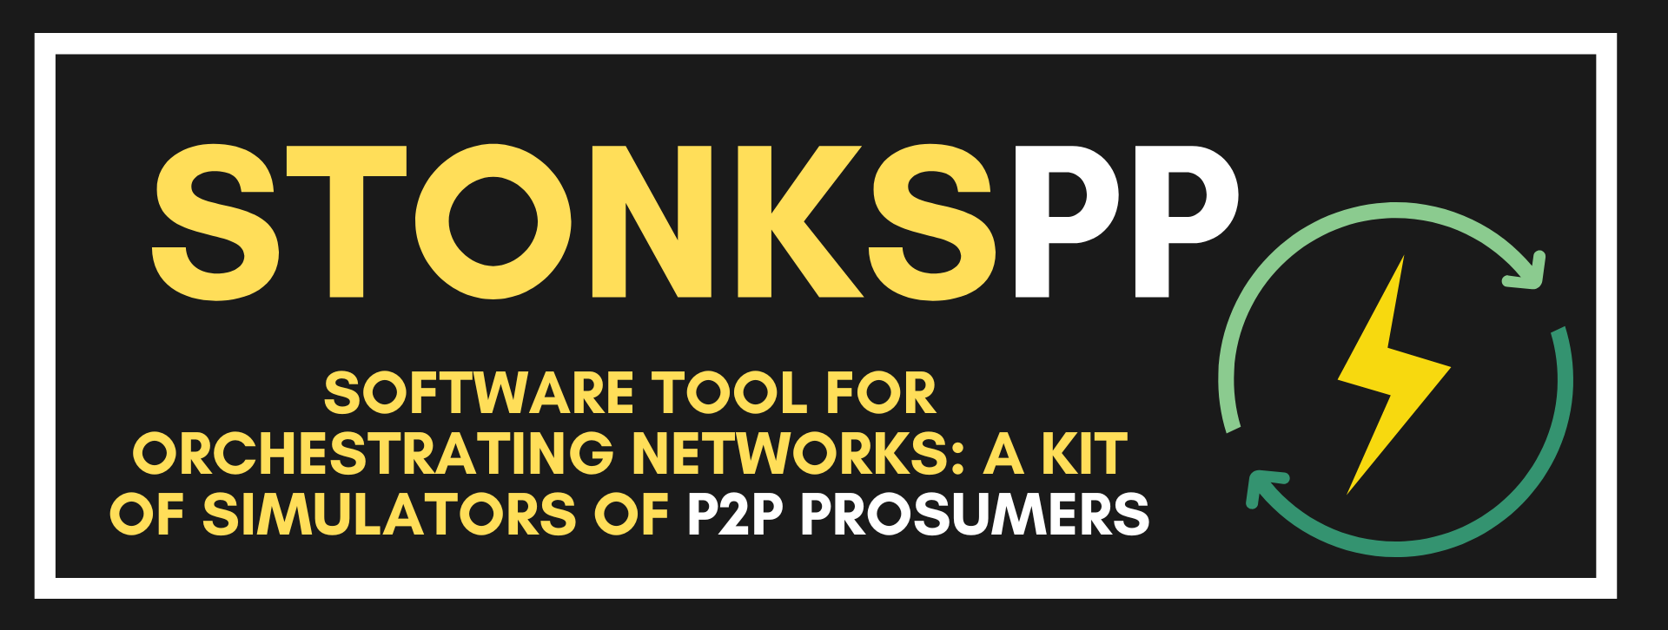
Motivation of the project
Prosumer’s smart grids are one of the most prominent multi-agent-related fields:
  As cited in CETINA’s seminars on Research in Artificial Intelligence for the Energy and Infrastructure Sector (held by S&DAI prof. V.Mascardi), intelligent agents have demonstrated their value in peer-to-peer energy trading and managing dynamic scenarios, highlighting their ability to adapt to rapidly changing environments.
  In my research paper I already implicitly made some steps towards MAS, moving to a decentralized approach with real-message passing among multiple independent entities.

Slide 5
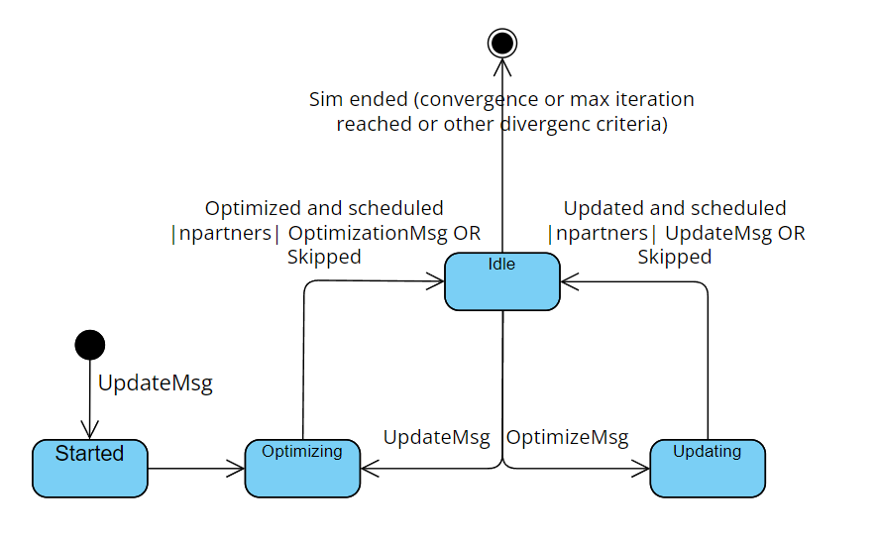
Message-passing paradigm
First step made in STONKSpp paper for transitioning from a fully centralized approach to a discrete event simulation: the initial implementation of Baroche’s prosumer markets assumed a perfect network with no message loss or delays, where nodes received all messages synchronously and processed them in nested loops.

Slide 6
Extensibility towards BDI approach (1)
  Enviromental definition - Given that the environment is currently scattered across multiple entities we should first identify these and consequently study an ideal extraction of the environment with the following capabilities:
    Storing global states (e.g. network topology, global time, and external constraints).
    Providing environment-related services for agents (e.g., query/obtain the neighbor set, get network latencies, or check resource constraints).

Slide 7
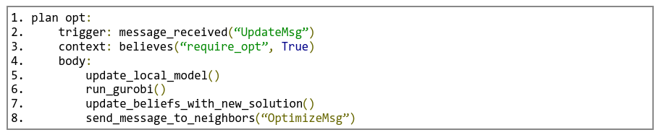
Extensibility towards BDI approach (2)
Prosumer def | Currently | With BDI
Beliefs | Trades, partner list, a/b cost function parameters, rho penalty factor, estimated electricity demand, observed electricity usage, local/global prices | Set of beliefs that must be true
Desires | Minimizing costs, maximizing social welfare, achieving local constraints (e.g local conspumption <= production + battery), cooperate with neighbors | Body of the plan to execute
Intentions | Performing local optimization, sending trade proposals to neighbor X with a certain quantity, receiving a trade proposal | Triggering event due to message received & send message to neighbors

Slide 8
Extensibility towards BDI approach (3)
  Neighbors Awareness
  In a BDI setup, an agent’s knowledge about its neighbors can definitely be dynamic, as it may discover new neighbors or lose existing ones due to changing environmental conditions or reconfiguration events.
  Additionally, an optional advanced extension involves incorporating social awareness and trust, allowing agents to track the reliability or trustworthiness of their neighbors.
  Communication Protocols
  Inform: “I inform you that my new supply is X kW”
  Request: “I request you to send me an updated price”
  Propose: “I propose an exchange of Y kW at price P” → Accept/Reject

Slide 9
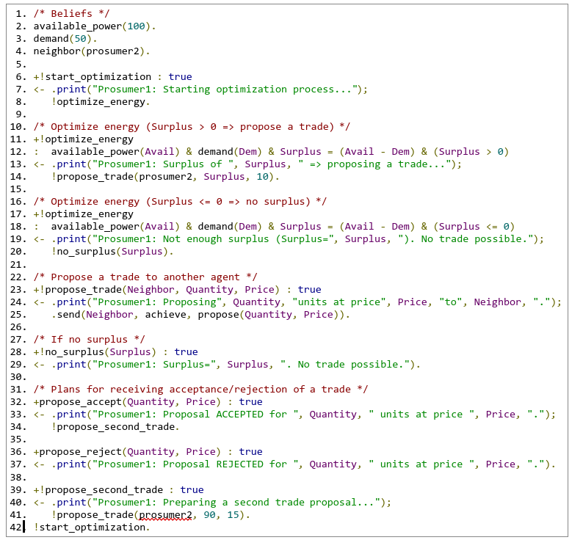
Python-agentspeak implementation (1)
Agentspeak file of one of the two implemented Prosumer, in its first version (static neighbors and without introduced randomness)

Slide 10
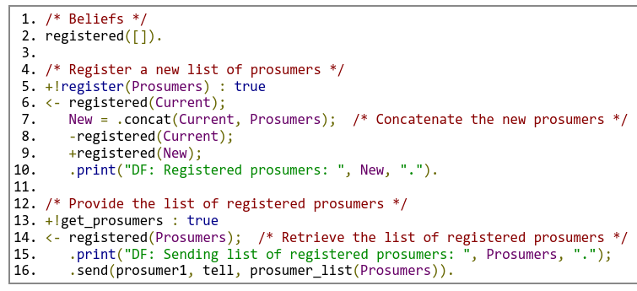
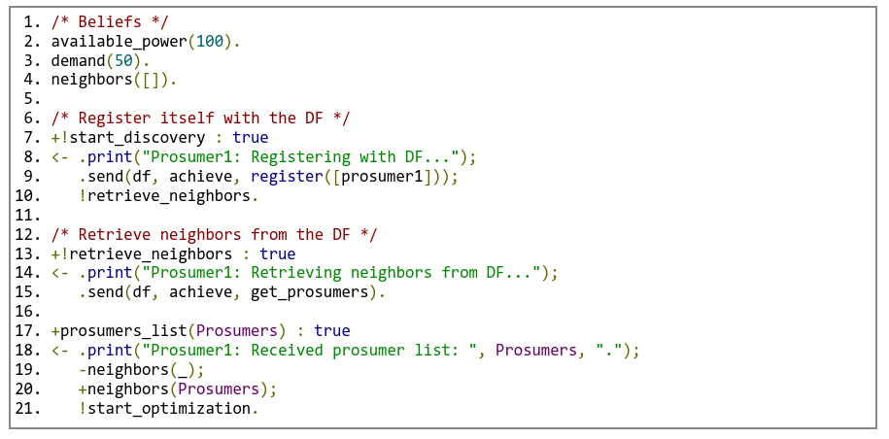
Python-agentspeak implementation (2)
Adding neighbor discovery to the equation

Slide 11
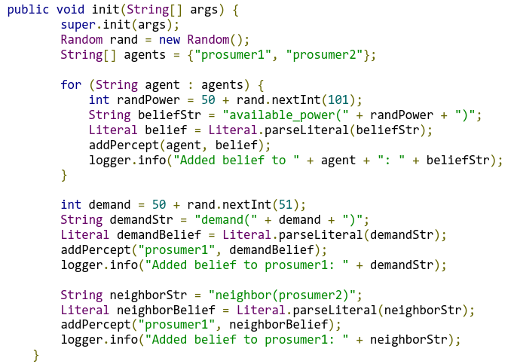
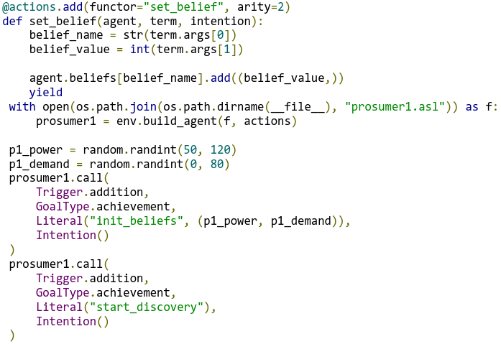
Python-as and Jason… are equivalent!
Jason
Python-agentspeak
Deeply inside, Python-agentspeak is a set of lexer/AST/parser classes which allow to use agentspeak syntax in a python environment. Basically, it’s like having Jason but with a Python environment behind instead of a Java one. Apart from...
Testo sezione 2

Slide 12
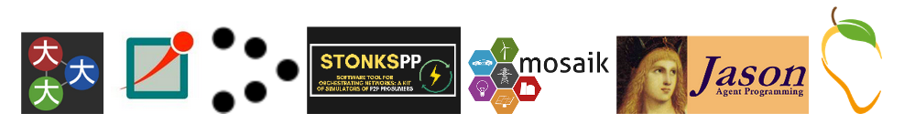
Mango framework in STONKSpp?
 | PROS | CONS
Python-agentspeak | Simplicity, 1:1 with Jason, strict BDI syntax, FIPA standard | Less powerful, not fully leverage python, no codecs/TCP/MQTT support
Mango | Codecs & TCP/MQTT support, power and features, FIPA standard | Complexity, not directly comparable with agentspeak

Slide 13
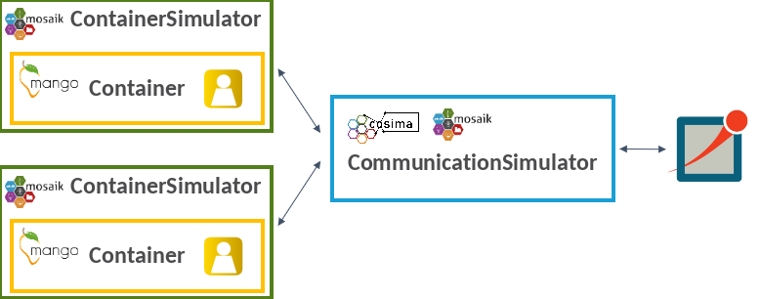
How to use Mango?
The general procedure implies implementing the code into a new kind of simulator, namely Mango Container, wrapping it into the Mosaik’s ContainerSimulator. The latter will exchange messages thanks to Cosima CommunicationSimulator, as it’s currently happening with basic Cosima Simulators.

Slide 14
Why is it hard?
At first glance, to implement Mango in the current code, an easy procedure can be followed. However, the problem lies in how Prosumers are implemented.
Original setup
Collectors trick
ADMM trick

Slide 15
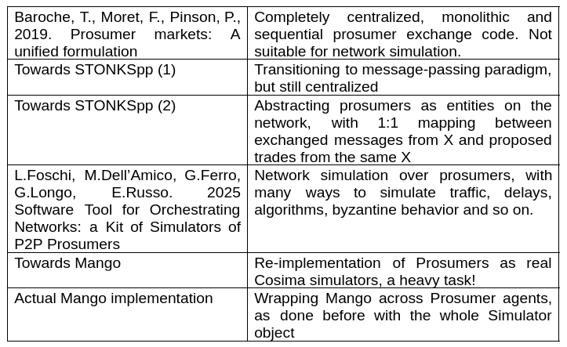
Further steps and extensibility

Slide 16
References
L.Foschi, M.Dell’Amico, G.Ferro, G.Longo, E.Russo. 2025 Software Tool for Orchestrating Networks: a Kit of Simulators of P2P Prosumers – near the review process
Baroche, T., Moret, F., Pinson, P., 2019. Prosumer markets: A unified formulation, in: 2019 IEEE Milan PowerTech, pp. 1–6. doi:10.1109/PTC. 2019.8810474.
Bukar, A.L., Hamza, M.F., Ayub, S., Abobaker, A.K., Modu, B., Mohseni, S., Brent, A.C., Ogbonnaya, C., Mustapha, K., Idakwo, H.O., 2023. Peer-to-peer electricity trading: A systematic review on current developments and perspectives. Renewable Energy Focus 44, 317–333. URL:https://www.sciencedirect.com/science/article/pii/S1755008423000091, doi:10.1016/j.ref.2023.01.008.
Viviana Mascardi, Unige, May 3 2024, Seminars on Research in AI for the Energy and Infrastructure Sector (CETINA)
Oest, F., Frost, E., Radtke, M., Lehnhoff, S., 2022. Coupling omnet++ and mosaik for integrated co-simulation of ict-reliant smart grids. arXiv preprint arXiv:2209.12550 doi:10.48550/arXiv.2209.12550.
Ofenloch, A., et al., 2022. Mosaik 3.0: Combining time-stepped and discrete event simulation, in: 2022 Open Source Modelling and Simulation of Energy Systems (OSMSES), pp. 1–5. doi:10.1109/OSMSES54027.2022.9769116.
Varga, A., Hornig, R., 2008. An overview of the omnet++ simulation environment, in: Proceedings of the 1st International Conference on Simulation Tools and Techniques for Communications, Networks and Systems & Workshops (Simutools), p. 60. doi:10.1145/1416222.1416290.
Nair, A.S., Hossen, T., Campion, M. et al. Multi-Agent Systems for Resource Allocation and Scheduling in a Smart Grid. Technol Econ Smart Grids Sustain Energy 3, 15 (2018). https://doi.org/10.1007/s40866-018-0052-y
Deng, Y., An, B. Utility distribution matters: enabling fast belief propagation for multi-agent optimization with dense local utility function. Auton Agent Multi-Agent Syst 35, 24 (2021).https://doi.org/10.1007/s10458-021-09511-z
Inês F.G. Reis, Ivo Gonçalves, Marta A.R. Lopes, Carlos Henggeler Antunes, (2022) Towards inclusive community-based energy markets: A multiagent framework

