Slide 1


Slide 2

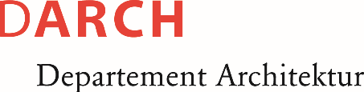



MAS Digital Fabrication
Python and Rhino
Interfacing geometries in Rhino using GH Python

Slide 3
But first, what is Rhino?🦏

Slide 4
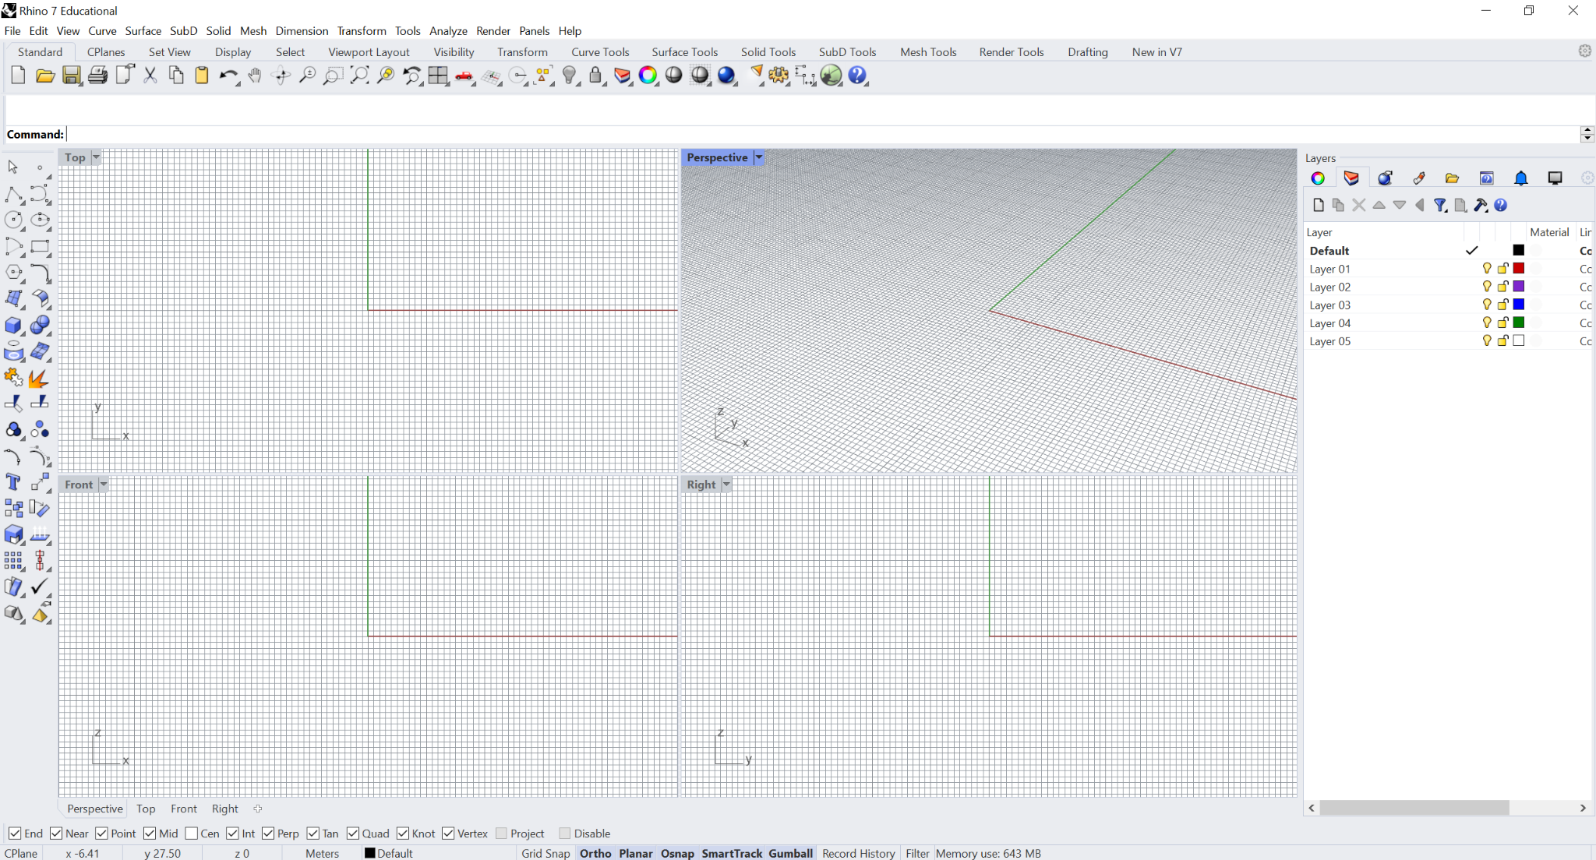
https://docs.mcneel.com/rhino/5/help/en-us/user_interface/rhino_window.htm
Notes:
Around 1985, many of McNeels' clients were asking for help with AutoCAD, which began the shift to McNeel becoming an AutoCAD reseller, providing related support and training. In May 1992, Applied Geometry (AG) approached McNeel for assistance with integrating their NURBS geometry library into AutoCAD. By June of that year, a prototype had been produced, and November saw McNeel and AG agree to develop a tool for NURBS modelling in AutoCAD - AccuModel. 1993 released first version called Sculptura. 1998 Rhino 1.0

Slide 5
“..to make complex calculations, store and retrieve data, analyze that data and make conditional decisions, or reach deep into the inner workings of Rhino; for this, one needs a real programming tool. The simplest and most accessible of these is Python..”

Slide 6
Why Python?

Slide 7
Python is interpreted, meaning it is executed one line at a time. This makes the program flow easy to understand. Also it is semantically dynamic which allows the syntax to be less restrictive and less formal when using declarations and variables types. These characteristics add to Python’s ease-of-use for basic programming tasks.

Slide 8


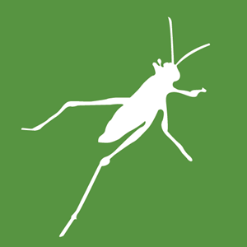
Rhinoceros 3D
Python IDE
Grasshopper 3D
Notes:
BASIC stands for Beginner’s All-purpose Symbolic Instruction Code…The first version of Grasshopper, then called Explicit History, was released in September 2007.

Slide 9

+
=

Slide 10
However old, IronPython 2.7 can allow for a lot of functionalities within Rhino/GH environment and build foundations for scripting. Later we will look into how to interface with scripts outside Rhino and how to write CAD-agnostic code.

Slide 11
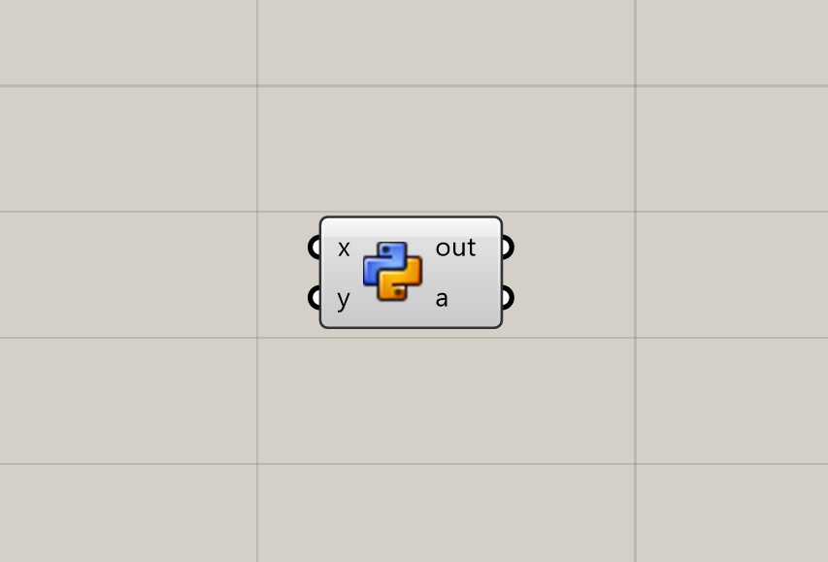

Slide 12
Our first GHPython program!

Slide 13
What is RhinoCommon?
an SDK that can be used across Rhino platforms

Slide 14
Software Development Kit
Rhinocommon is a low-level powerful SDK for all Rhino platforms used mainly by more experienced developers. Python scripts can use Rhinocommon, to have full access to the .NET framework including access to Rhino’s RhinoCommon SDK.

Slide 15
Rhino Application
RhinoCommon.dll
RhinoCommon.xml
rhcommon_c.dll and monomanager.rhp
Notes:
RhinoCommon.dll - This is a pure .NET DLL that plugins can reference and use to work with Rhino.

Slide 16
RhinoCommon SDK
Rhino Application
Point3d
Rhino.Geometry
RhinoCommon.dll
NurbsCurve
Rhino.DocObjects
Surface
RhinoCommon.xml
…
rhcommon_c.dll and monomanager.rhp
Mesh
…
All .NET plugins that ship with Rhino for Windows and Rhino for Mac, including the Python interpreter, reference RhinoCommon.
https://developer.rhino3d.com/guides/rhinocommon/what-is-rhinocommon/

Slide 17
RhinoCommon SDK
Rhino Application
Namespaces
Classes
Point3d
Rhino.Geometry
RhinoCommon.dll
NurbsCurve
Rhino.DocObjects
Surface
RhinoCommon.xml
…
rhcommon_c.dll and monomanager.rhp
Mesh
…

Slide 18
Point3d
Constructors
Point3d(double x, double y, double z)
NurbsCurve
Properties/Attributes
Point3d.X
Surface
Methods
Point3d.DistanceTo(Point3d Other)
Mesh
…
*data types
*classes(self)

Slide 19
https://developer.rhino3d.com/api/rhinocommon/

Slide 20
assignment time!

Slide 21
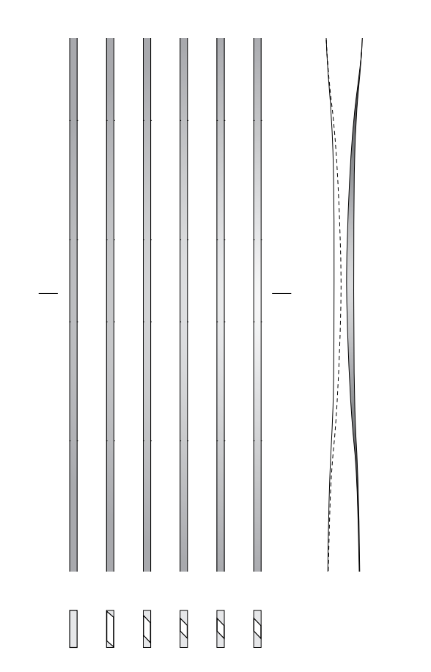

Slide 22
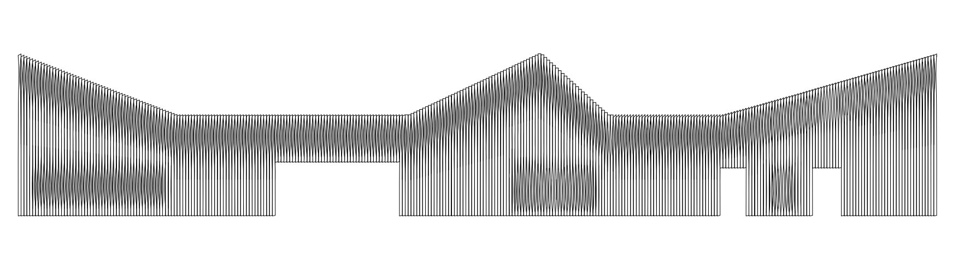

Slide 23
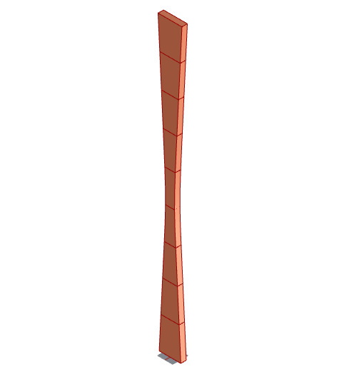

Slide 24
Rules:
Use as much Python as possible. Only use GH Components for visualize or other non-logical roles
Help from internet/and or tutors is welcome :); However this is a learning exercise so come up with your own logic - nothing is more beautiful than something you thought of and wrote yourself!

Slide 25
Tips
https://youtu.be/t3CB1Xk0prI?si=3ACJ3SlUx1elhLIH (Grasshopper solution) - Use for computational thinking
Rhino.Geometry: Rectangle3d
Loft function
Value remapping

