Slide 1


Slide 2


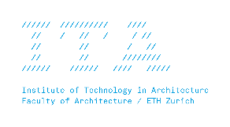


MAS Digital Fabrication
Basics of Geometry Transformations
What is the purpose of digital tools in design?

Slide 3
What is a Transformation?

Slide 4
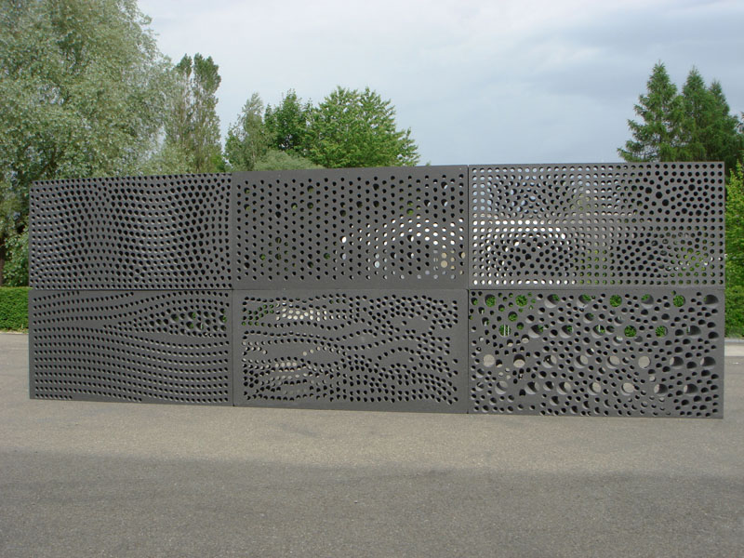
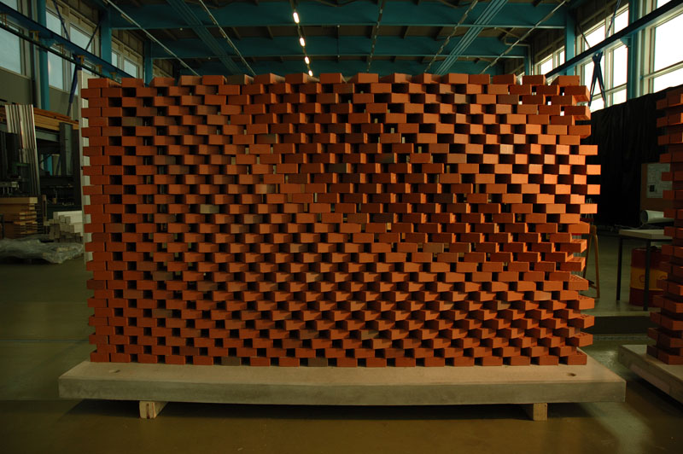
The perforated Wall, ETH Zürich, 2006
The programmed Wall, ETH Zürich, 2006

Slide 5
Algorithmic Thinking, Automation, Generative Design, Complex Geometry, Parametric Design, Data-Driven Design, Customization and Personalization, Iterative Design Process

Slide 6
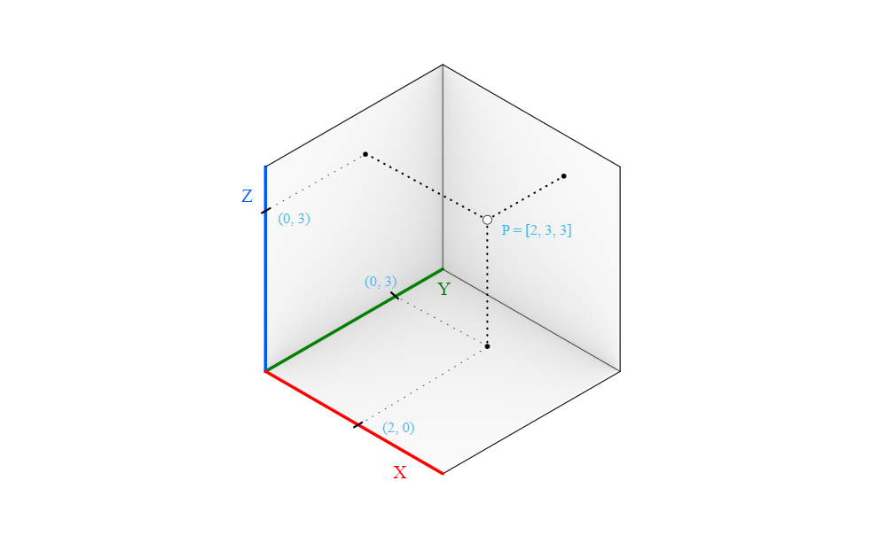
3D Point
2
P = 3
3

Slide 7
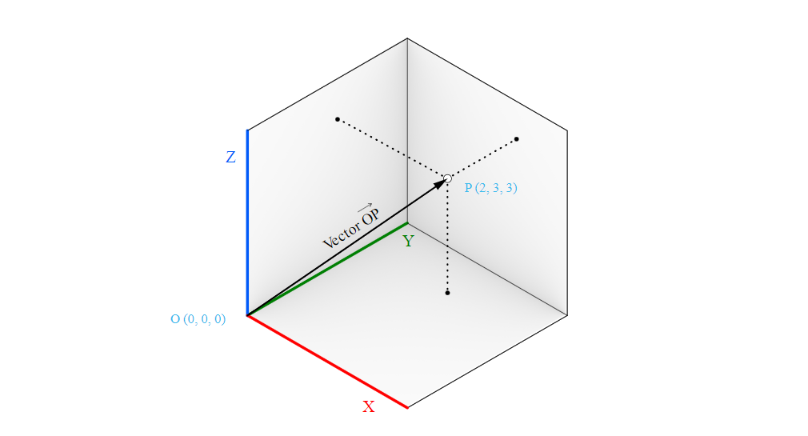
3D Vector
2
V = 3
3

Slide 8
What is the difference?
2
P = 3
3
2
V = 3
3

Slide 9
Unit Vector
→
a
→
unit a
A unit vector is a vector whose length is equal to one unit.

Slide 10
Vector addition
→
→
a
+
b
→
b
→
a

Slide 11
Vector addition
→
→
a
+
b
→
b
→
a
vector addition logic can be used to move a point

Slide 12
Vector subtraction
→
b
→
→
a
-
b
→
a

Slide 13
Vector subtraction
→
b
→
→
a
-
b
→
a
vector subtraction can be used to get a vector between two points

Slide 14
Dot product
a ⋅ b = |a| |b| cos(θ)
→
b
→
|a| cos(θ)
a
|a| |b| cos(θ)

Slide 15
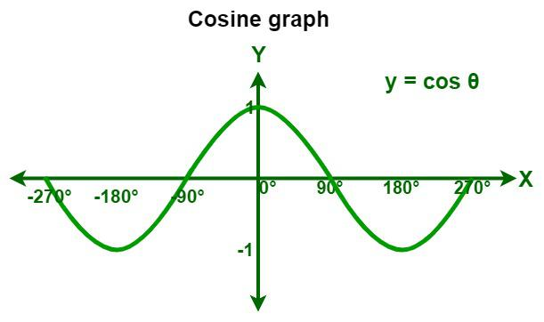
Dot product
a ⋅ b = |a| |b| cos(θ)

Slide 16
Dot product
a ⋅ b = |a| |b| cos(θ)
a ⋅ b = 1
a ⋅ b = -1
a ⋅ b = 0

Slide 17
Cross product
a × b
The cross product takes two vectors and produces a third vector that is orthogonal to both.

Slide 18
Cross product
a × b
1) The smaller the angle (smaller sine); the shorter the cross product vector will be.
2) The order of operands is important in vectors cross product. For example:
a = <1, 0, 0>
b = <0, 1, 0>
a × b = <0, 0, 1>
b × a = <0, 0, -1>

Slide 19
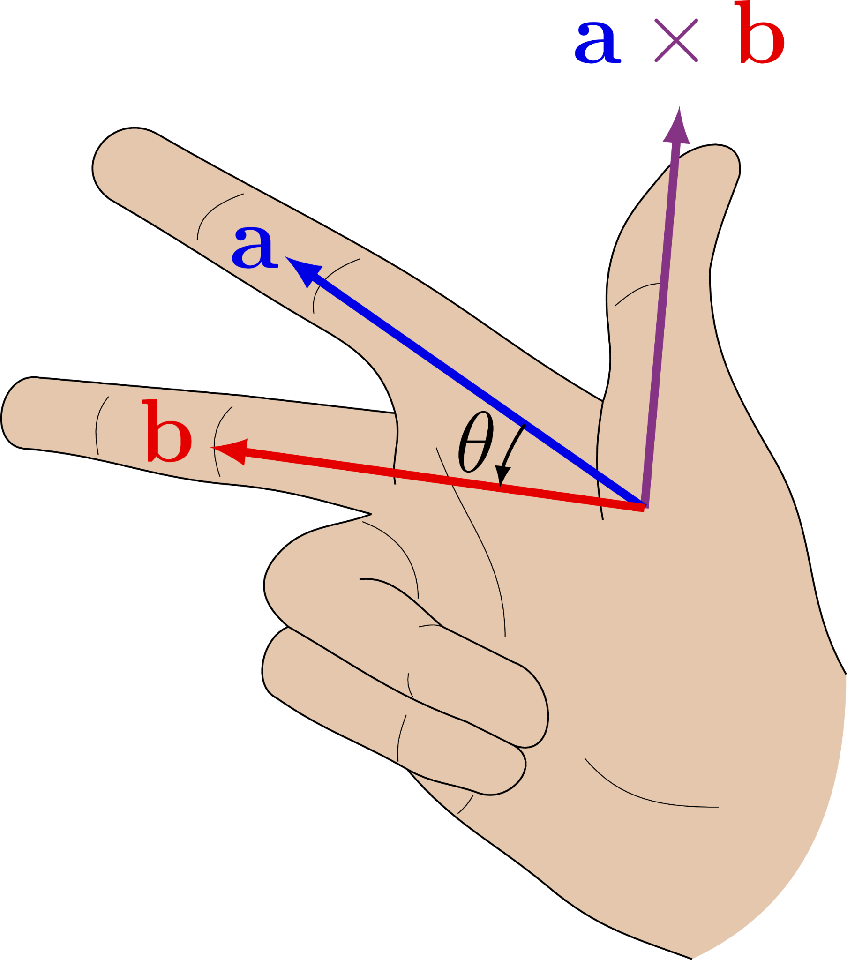
Cross product

Slide 20
What is a Geometric Transformation?

Slide 21
Transformations refer to operations such as moving (also called translating), rotating, and scaling objects. They are stored in 3D programming using matrices, which are nothing but rectangular arrays of numbers. Multiple transformations can be performed very quickly using matrices. It turns out that a [4x4] matrix can represent all transformations. Having a unified matrix dimension for all transformations saves calculation time.

Slide 22
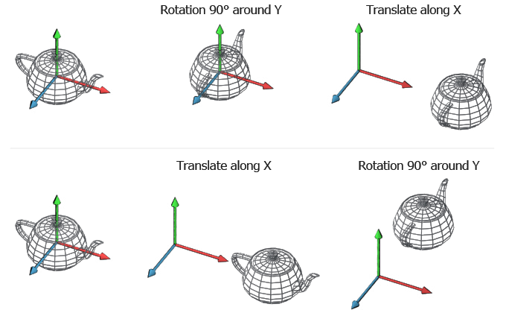

Slide 23
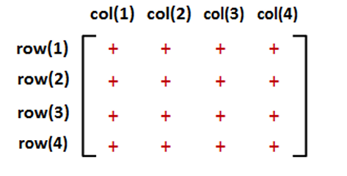
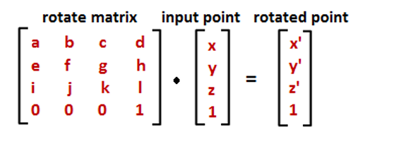

Slide 24
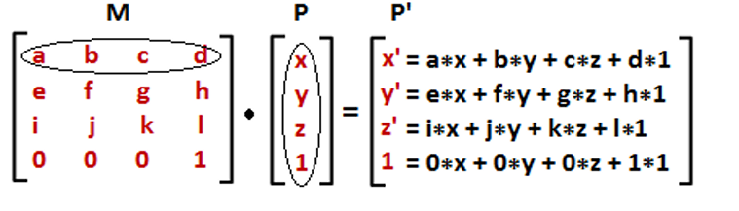

Slide 25
Translation transformation
1 0 0 translate_x
0 1 0 translate_y
0 0 1 translate_z
0 0 0 1

Slide 26
Scaling transformation
scale_x 0 0 0
0 scale_y 0 0
0 0 scale_z 0
0 0 0 1

Slide 27
Rotation transformation
1 0 0 0
0 cos(θ) -sin(θ) 0
0 sin(θ) cos(θ) 0
0 0 0 1
cos(θ) 0 sin(θ) 0
0 1 0 0
-sin(θ) 0 cos(θ) 0
0 0 0 1
cos(θ) -sin(θ) 0 0
-sin(θ) cos(θ) 0 0
0 0 1 0
0 0 0 1
R_{xaxis}
R_{yaxis}
R_{zaxis}

Slide 28
projection, shear, mirror, …

Slide 29
Combining multiple transformations
T = T₃ × T₂ × T₁
Order of transformations

Slide 30
At the core stands the question of how to use digital architectural design methods in a creative, purposeful and manner.

