Slide 1


Slide 2


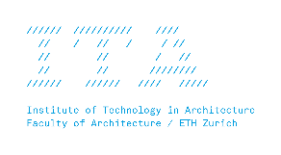


MAS Digital Fabrication
Robotic Drawing
What makes a Robot Move?

Slide 3
What is a robotic movement?

Slide 4
A robot is a programmable machine, any movement(in the literal meaning of the word) that is programmed and executed by the robot can be referred to as a “robotive move”

Slide 5
control, freedom, variability
how can we go from teaching the robot to programming it?
automation, repetition

Slide 6
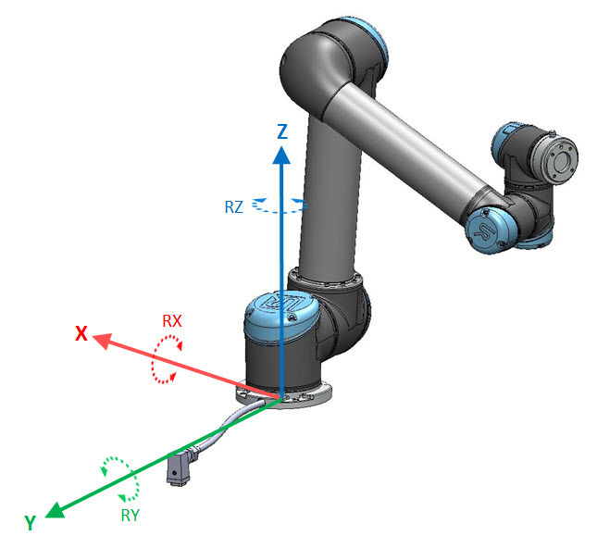
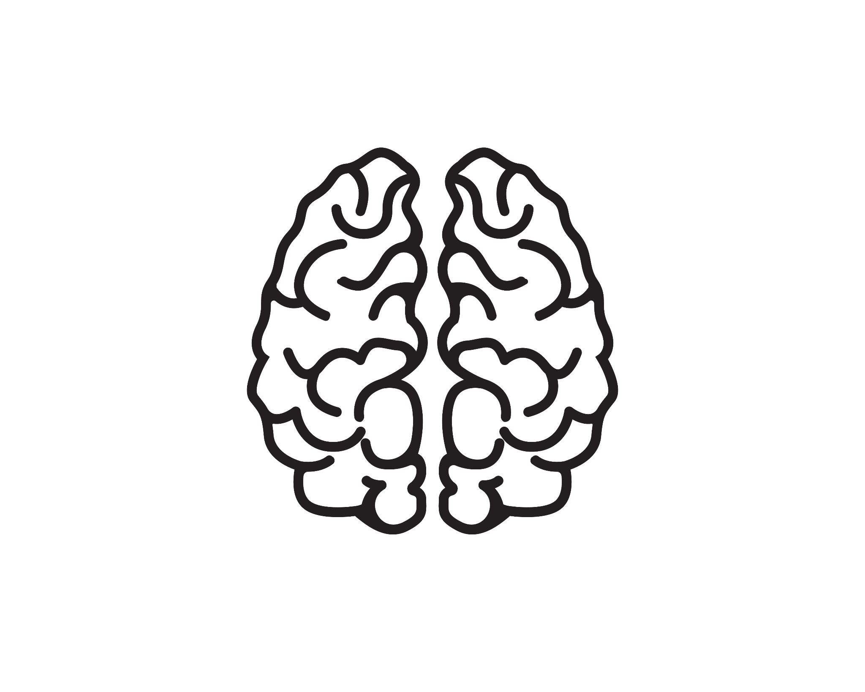
input
=
movement

Slide 7
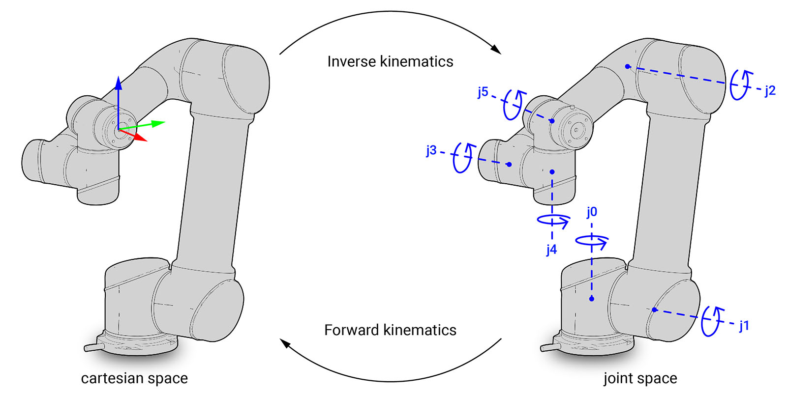

Slide 8
Cartesian movements-
moveL, moveP
Joint movements-
moveJ

Slide 9
URScript is a python like language that is used to control universal robots. It has like any other programming language - variables, functions and flow control.

Slide 10
URScript API Reference

Slide 11
def my_program():
# Move to the home position
movej(p[-1.5708, -1.5708, 1.5708, -1.5708, -1.5708, 0], a=1.0, v=0.1)
# Pick up an object
movel(p[0.5, 0.2, 0.1, 0.00, 0.00, 0.00], a=0.5, v=0.1)
end

Slide 12
how could we draw this simple rhombus?

Slide 13
(0,10,0)
(-5,5,0)
(5,5,0)
(0,0,0)
how could we draw this simple rhombus?

Slide 14
(0,10,0)
(-5,5,0)
(5,5,0)
(0,0,0)
how could we draw this simple rhombus?

Slide 15
but wait, what is a plane?
In mathematics, a plane is a two-dimensional space or flat surface that extends indefinitely. A plane is the two-dimensional analogue of a point (zero dimensions), a line (one dimension) and three-dimensional space.

Slide 16
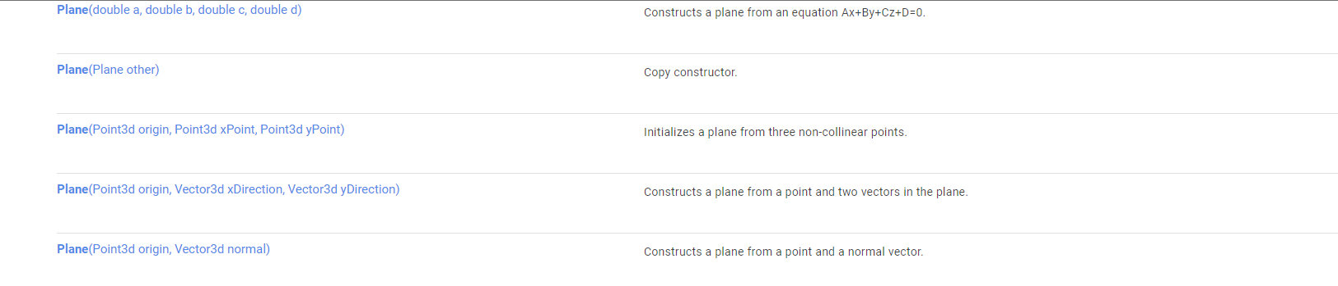
Plane in RhinoCommon

Slide 17
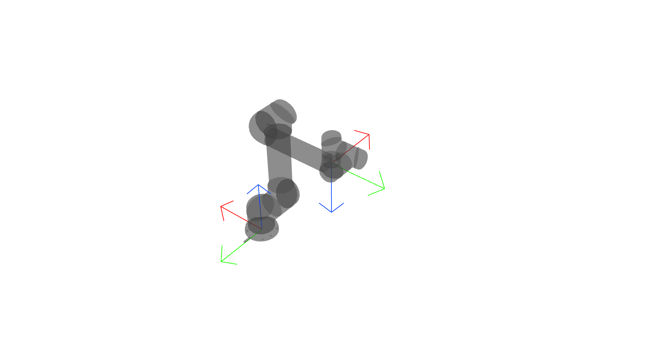
movel(p[0.3, 0.11, 0.43, 2.221, -2.221, -0.000], a=0.5, v=0.1)
x
y
z
axis angle representation
3D Rotation Converter

Slide 18
def my_program():
#Move to corner 1 ...
movel(p[0.5, 0.5, 0.5, 2.221, -2.221, -0.000], a=0.5, v=0.1)
#Move to corner 2 ...
movel...
...
end

Slide 19


