Slide 1


Slide 2





MAS Digital Fabrication
Robotic Drawing
The Robot Workspace

Slide 3
How does a robot know where to move?

Slide 4
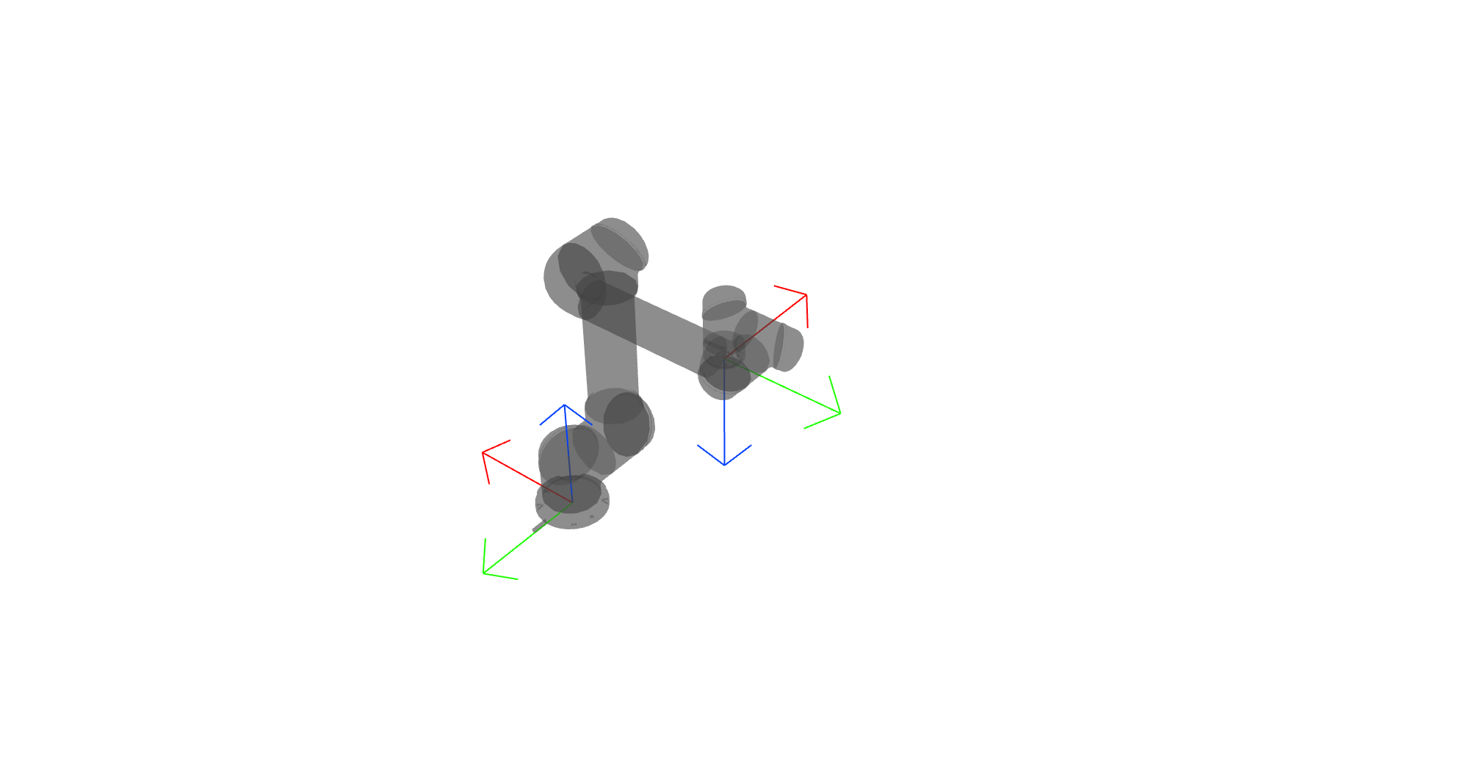
Robot Base Coordinate System
movel(p[0.3, 0.11, 0.43, 2.221, -2.221, -0.000], a=0.5, v=0.1)
x
y
z
axis angle representation
3D Rotation Converter

Slide 5
how to(and why) measure our robotic workspace?

Slide 6
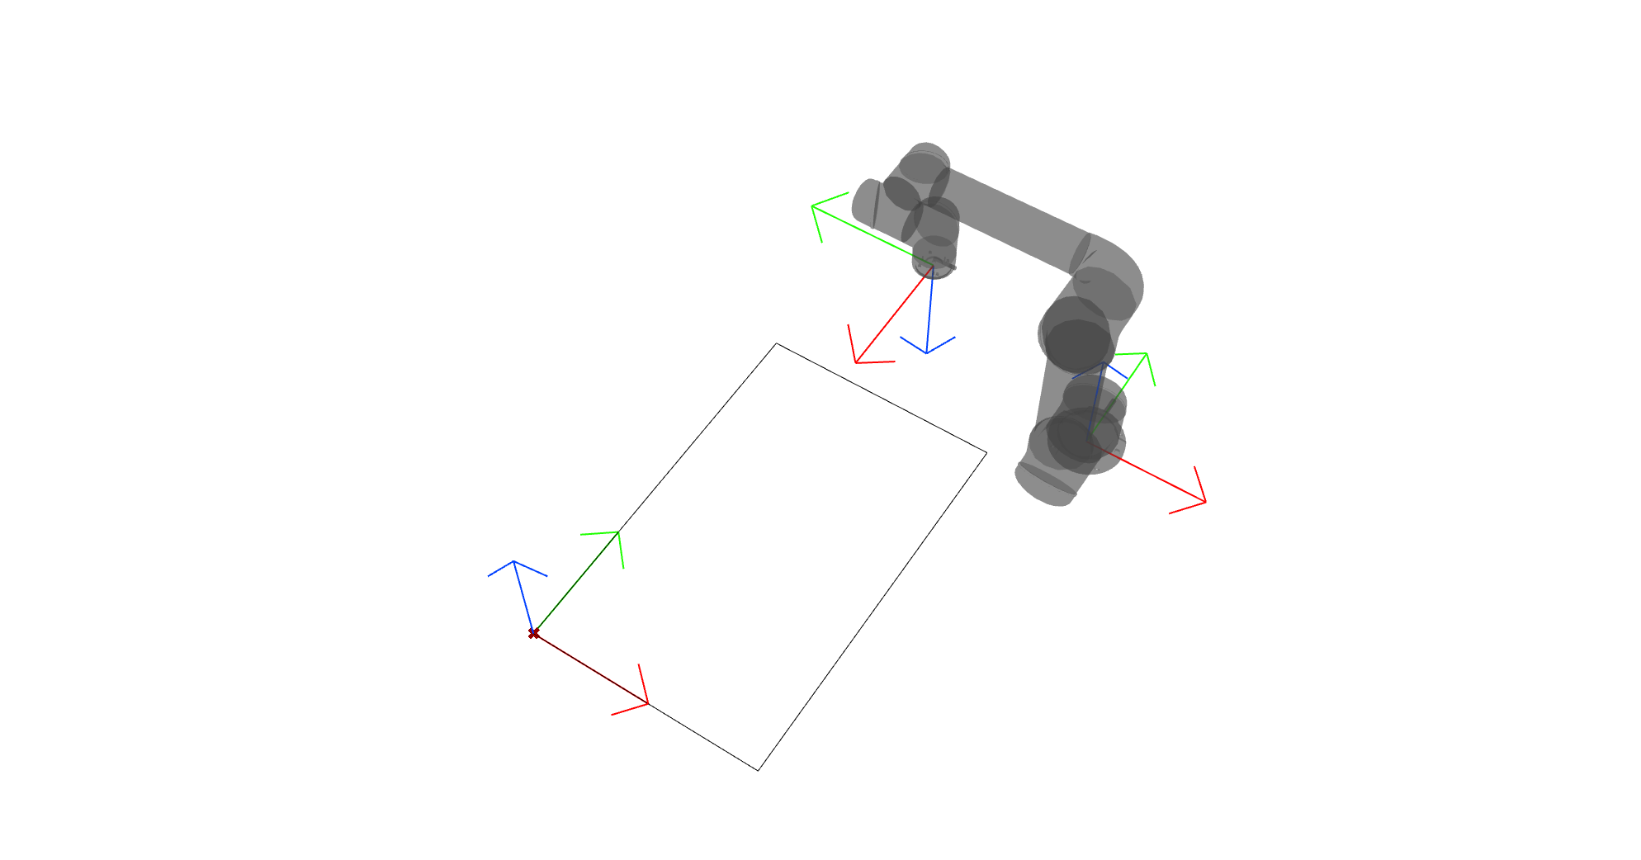
Robot Base Origin
Workspace origin
Notes:
If we want to place our work area precisely we want to place our origin to a point we know physically(measurable)

Slide 7
Since a robot knows it’s tip position in its base coordinate system, we can measure the relative position of (any) point in space within the robot reach using this information.

Slide 8
By knowing the precise position and orientation of our desired physical origin relative to our robot base, we can precisely position our operations in our design space(Rhino) and transform it to the coordinate system the robot understand.

Slide 9
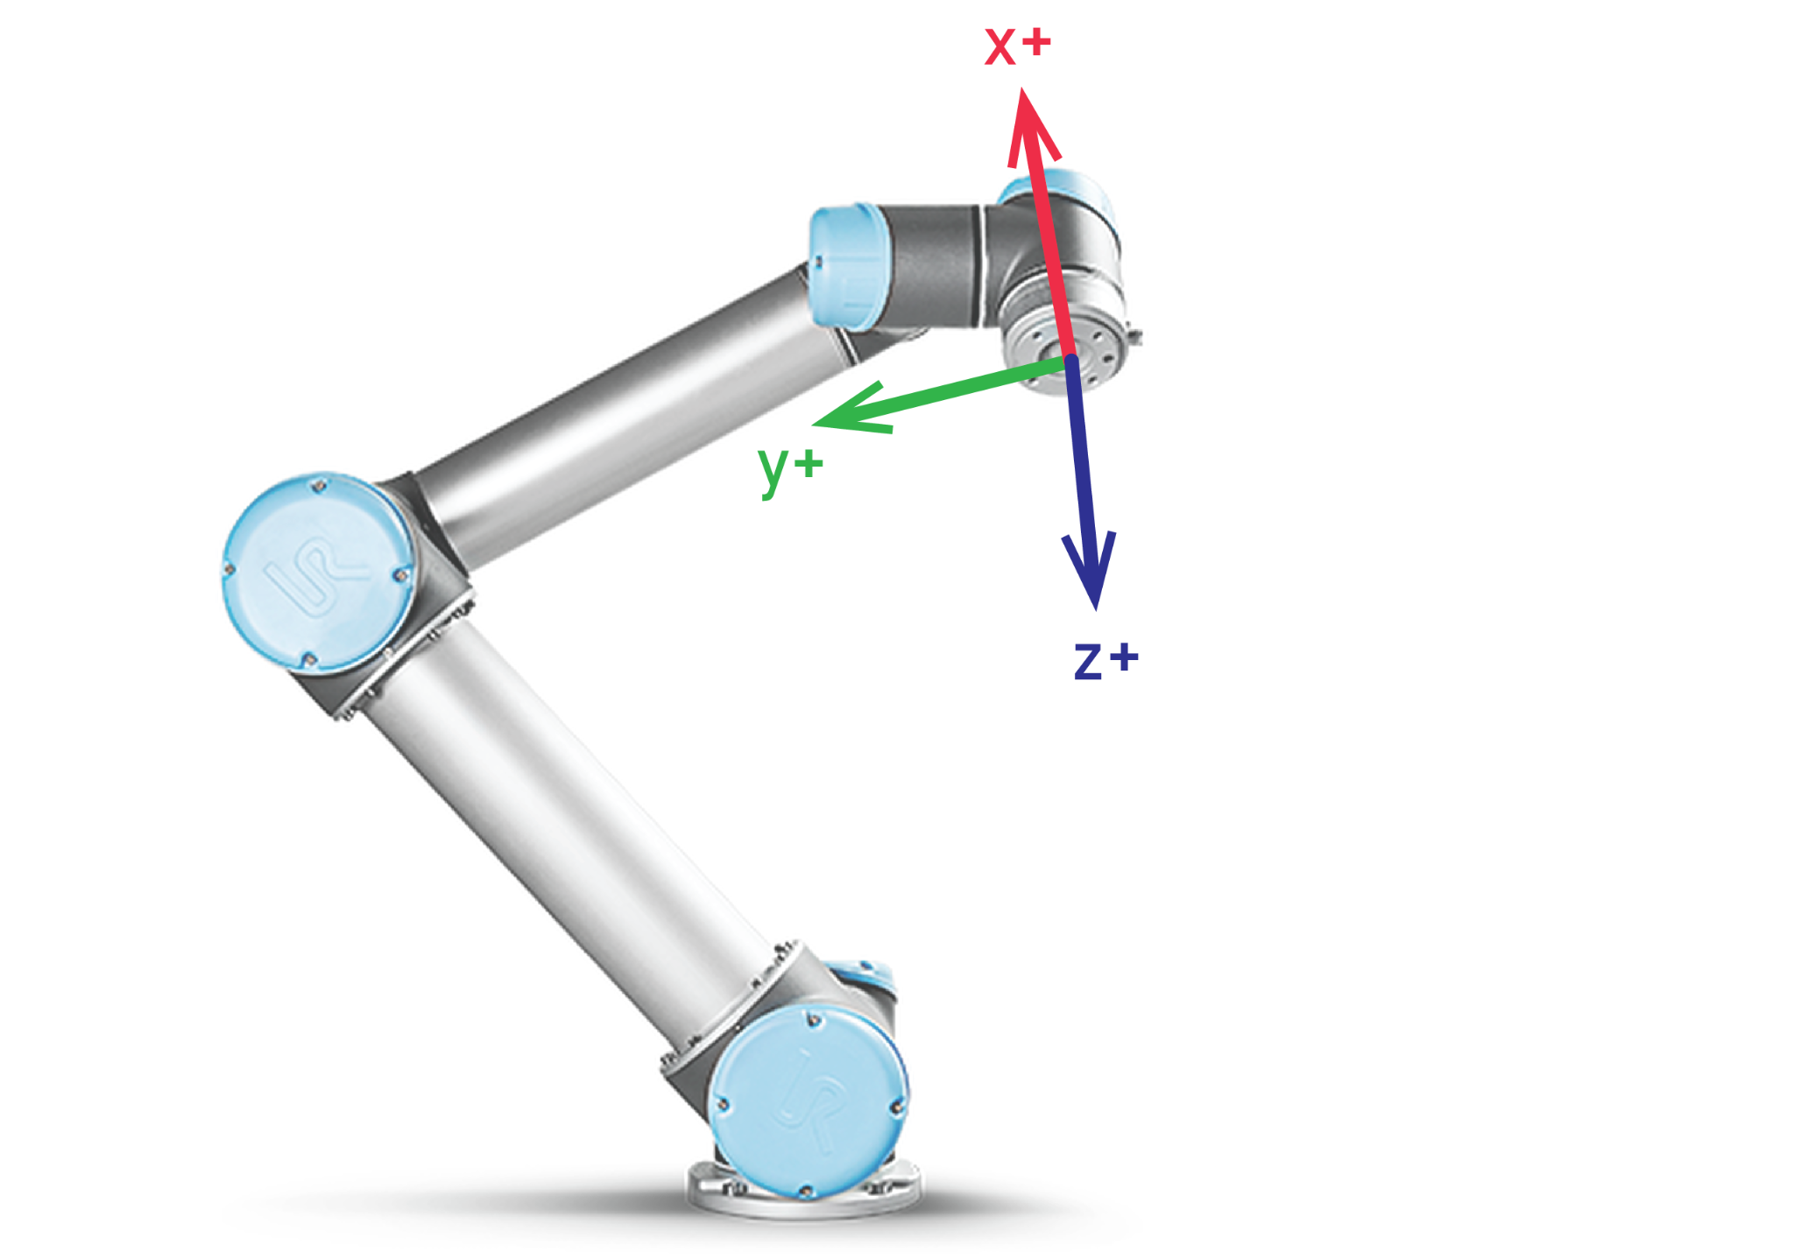
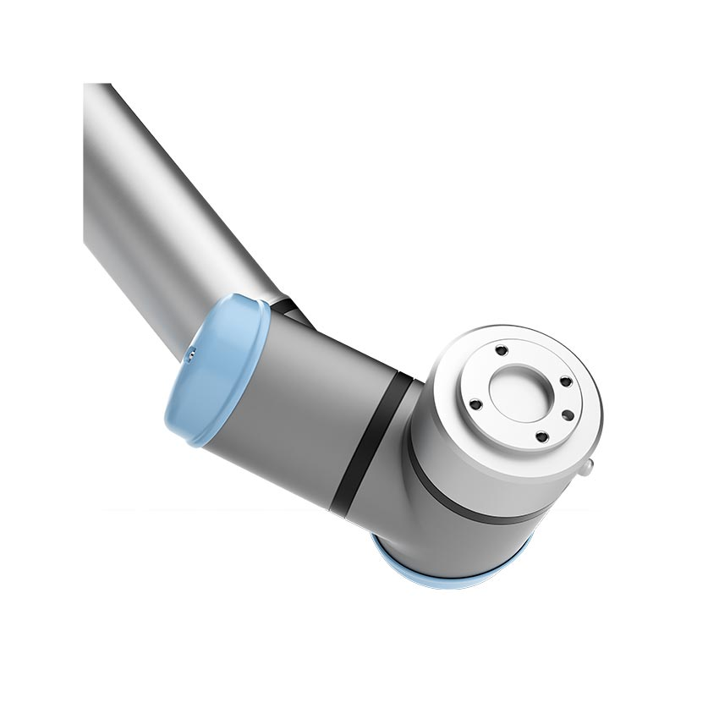

Slide 10
To precisely measure our workspace, we need to have a precise tool(end effector) on our robot; so first, let’s mount our measuring tool and measure our tool itself. Ideally, we only have to do it once.

Slide 11
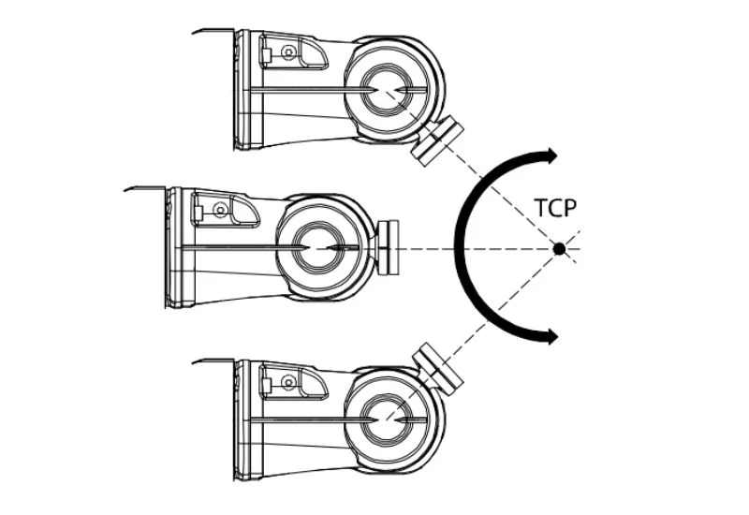

Slide 12
how can we convert our drawings to this weird code?

Slide 13
A wrapper is a data structure or software that contains ("wraps around") other data or software, so that the contained elements can exist in the newer system.

Slide 14


Slide 15
drawing our first lines with a robot

