Slide 1
Salinity coef
Sigma = sqrt(4)
Eta = 4.5 / 400
Tau = sqrt(0.3)
Threshold = 23

Slide 2
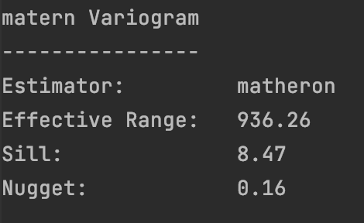
Depth 0.5m

Slide 3
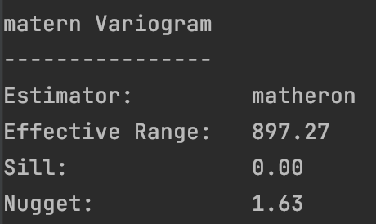
Depth 1.0m

Slide 4
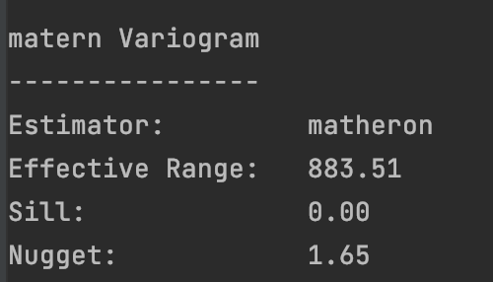
Depth 1.5m

Slide 5
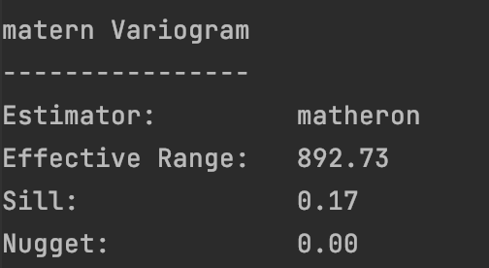
Depth 2.0m

Slide 6
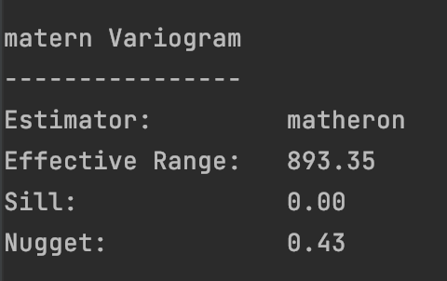
Depth 2.5m

Slide 7
Temperature coef
Sigma = sqrt(0.5)
Eta = 4.5 / 400
Tau = sqrt(0.1)
Threshold = 10.5

Slide 8
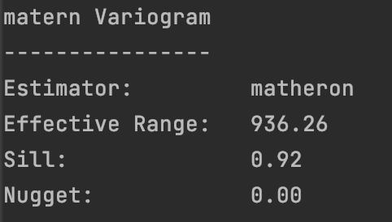
Depth 0.5m

Slide 9
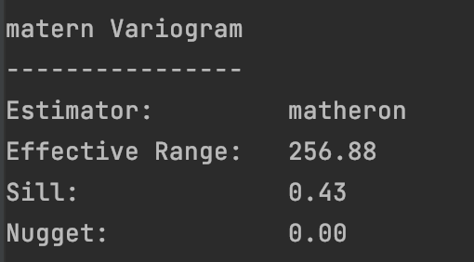
Depth 1.0m

Slide 10
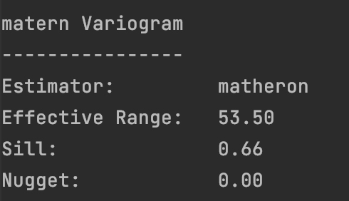
Depth 1.5m

Slide 11
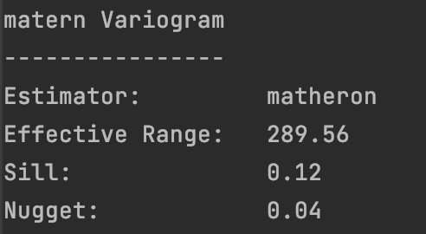
Depth 2.0m

Slide 12
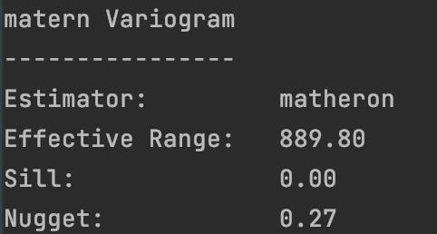
Depth 2.5m

Slide 13
Salinity-Temperaure coef
Sigma = 0.74

Slide 15
Depth-correlated coef
\Ksi^2 = (1000 / 24) ^ 2 / (2.5 / 5) ^ 2 = 6944.43

Slide 16
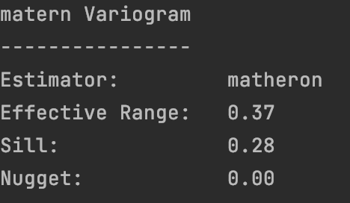
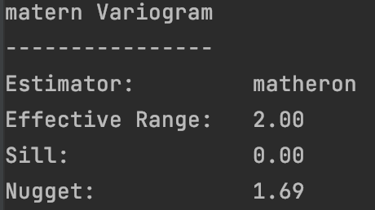
Temperature residual variogram along depth direction
Salinity residual variogram along depth direction

Slide 17
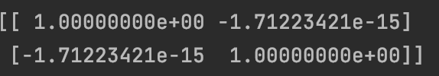
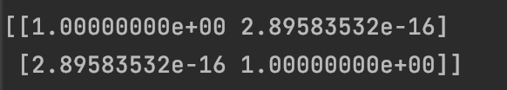
It does seem clear that the residual has a strong correlation with depth. Or maybe I used the wrong data. Each
Correlation matrix for temperature residual and depth
Correlation matrix for salinity residual and depth

