Slide 1
Salinity coef
Sigma = sqrt(30)
Eta = sqrt(3) / 500
Tau = 0.3
Threshold = 23

Slide 2
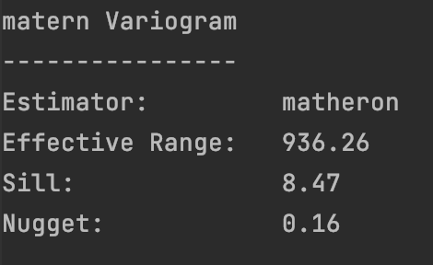
Depth 0.5m

Slide 3
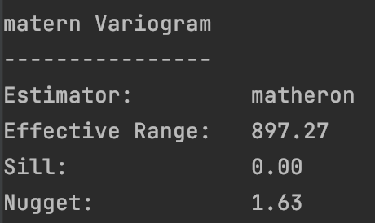
Depth 1.0m

Slide 4
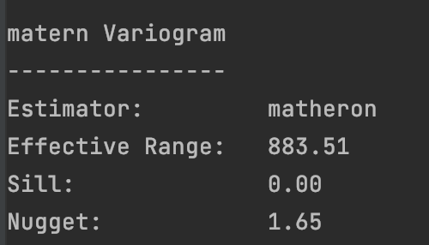
Depth 1.5m

Slide 5
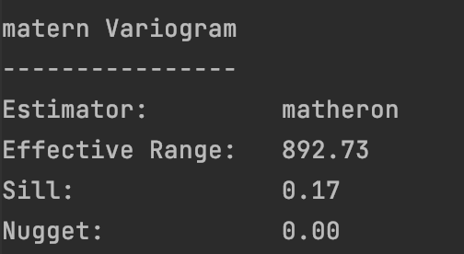
Depth 2.0m

Slide 6
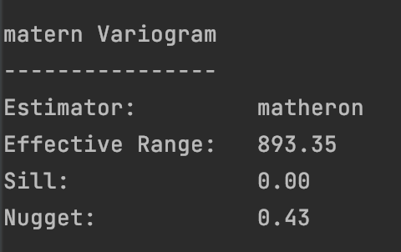
Depth 2.5m

Slide 7
Temperature coef
Sigma = sqrt(30)
Eta = sqrt(3) / 500
Tau = 0.3
Threshold = 10.5

Slide 8
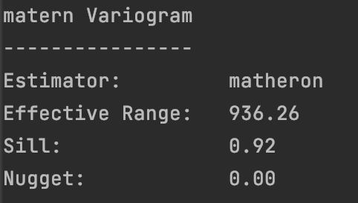
Depth 0.5m

Slide 9
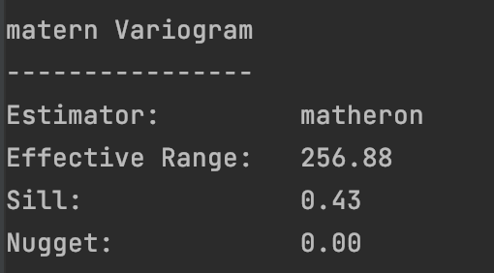
Depth 1.0m

Slide 10
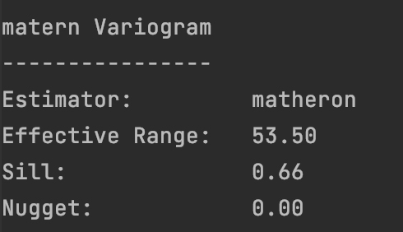
Depth 1.5m

Slide 11
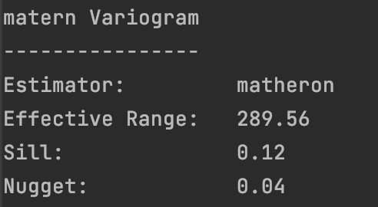
Depth 2.0m

Slide 12
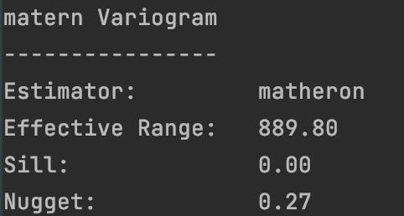
Depth 2.5m

Slide 13
Salinity-Temperaure coef
Sigma = 0.74

