Slide 1
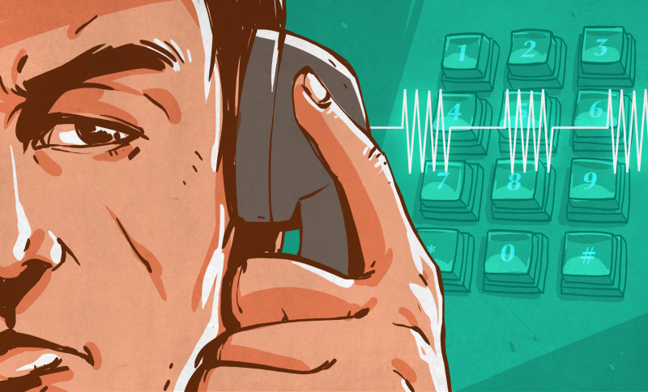
DTMF
Using
MATLAB

Slide 2
Hello!
I am Muhammad Asif Ayub
Assad Ullah Khan
Arbab Shujaat Ahmad
2

Slide 3
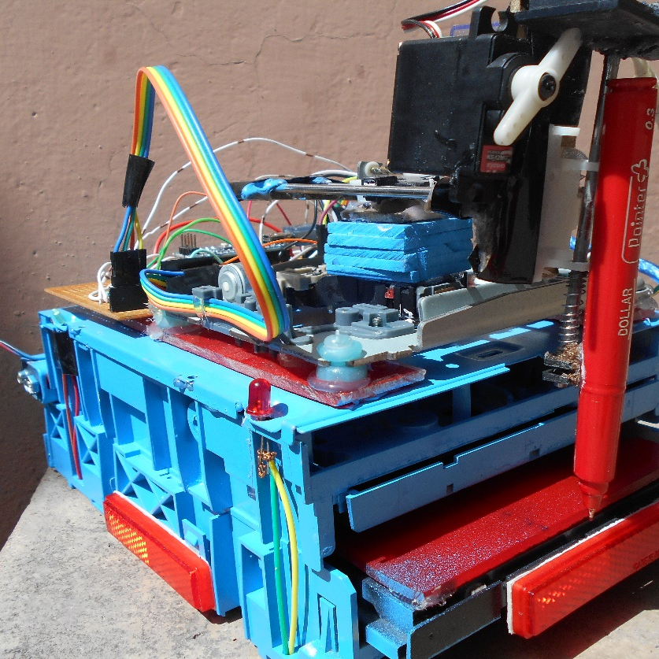
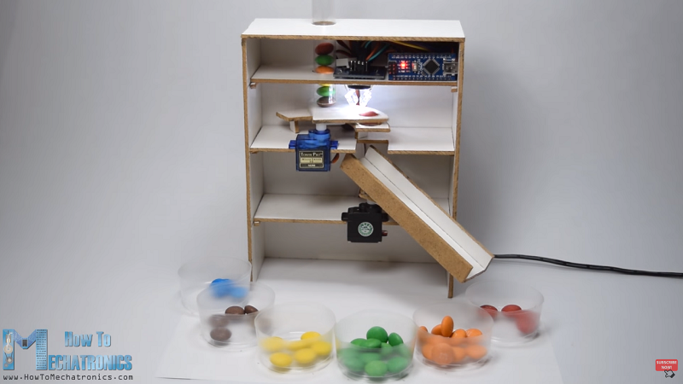
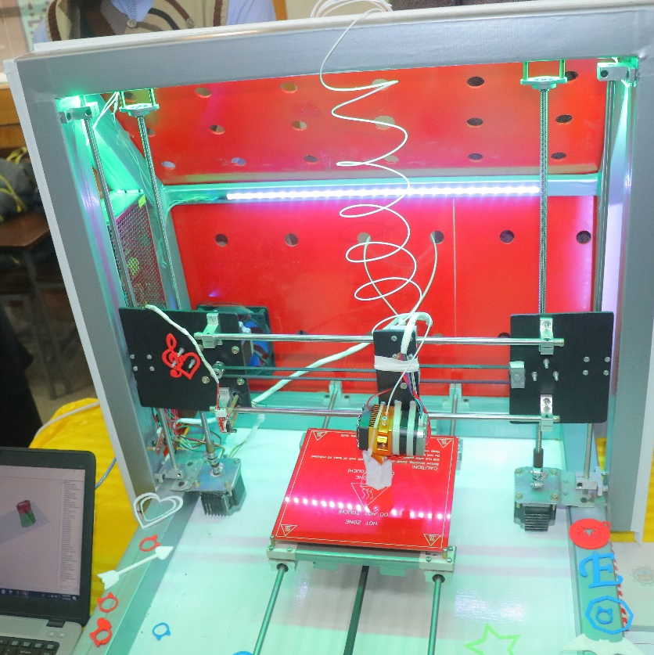
Circuit & System 1
Circuit & System 2
Digital Logic Design
CNC Drawing Machine
Color Sorter
CNC 3D Printer
It can Draw and Design simple Model which using Arduino Nano and L293D IC with servo Motor, Using 2 DVD Drives.
Color Sorter is actually a machine which can sort or differentiate between different colors of different shaped object using Arduino UNO and Color Sensor.
CNC 3D Printer is a huge Project based on 3D modelling and Manufacturing Process using a lot of components including Arduino Mega, Ramps Shield, Stepper Drivers Etc.
3

Slide 4
Contents
01
Introduction
History & DTMF Signal
02
DTMF Generate & Receive
Tone Generation & Receiver
03
Algorithm & Working
Design & Procedure
04
Application & Conclusion
Uses, Outcome, Q&A
4

Slide 5
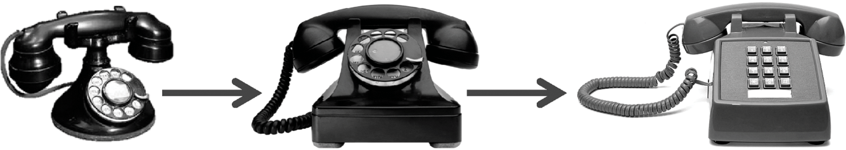
HISTORY
Before DTMF was created, telephone networks used a system called “Decadic”. This system was used extensively in telephone networks to dial numbers, it was very useful system, but limited to the local exchange connections requiring an operator to connect long distance calls. In the late years of 1950, DTMF was being developed for the purpose of allowing tone signals to dial long distance numbers, which could be potentially be dialed not only via standard wire networks, but also via radio links . The version of DTMF used for telephone tone dialing is known by the trademarked term “Touch-Tone”.
5

Slide 6
DTMF Signal Processing
The DTMF is a popular signaling method between telephones and switching centers
FFT is used to detect the DTMF tones.
1
4
2
DTMF signals are the superposition of 2 sine waves with different frequencies.
5
DTMF has enabled the long distance signaling of dialed numbers in voice frequency range over telephone lines.
3
DTMF tone generation and detection with the help of MATLAB.
6
IVR System, Security, Call Centers.
6

Slide 7
Algorithm
1
Generate a DTMF signal with 8 different combinations of frequency.
4
Comparing the FFT signal with look up tables.
2
5
Get the information of which button is pressed.
DTMF signal is applied to the decoder
3
6
Connect the Dialer to the Receiver address obtained through decoder.
FFT is applied to each signal.
7

Slide 8
Working Procedure
1
When a key is pressed the tone of the column and the tone of the row are generated.
4
At the receiver the tone frequencies are detected and the number is decoded.
2
5
The DTF algorithm can be used to detect the frequencies .
There are 16 different tones.
3
Uses 2 tones to represent each key on touch pad.
6
Since there are only 8 frequency components a more efficient method is GOERTZEL algorithm.
8

Slide 9
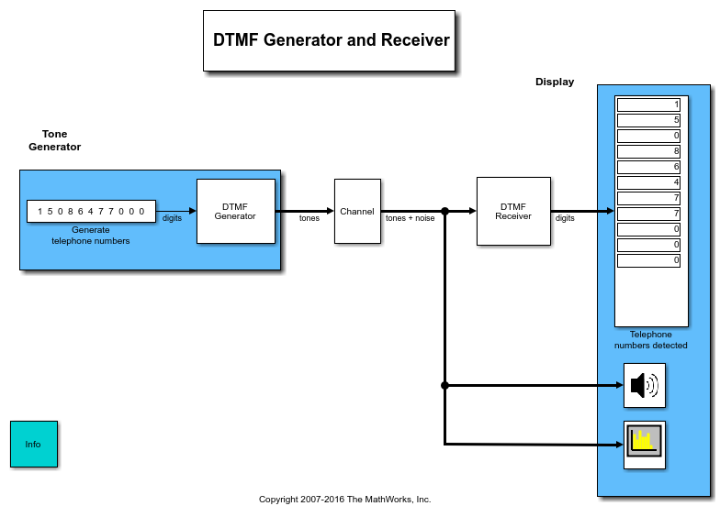

Slide 10
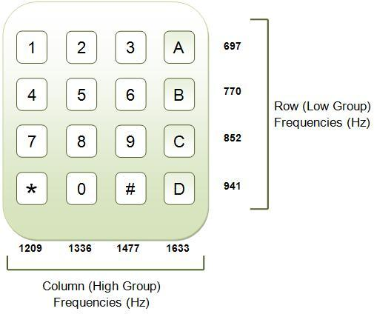

Slide 11

Re-Dial Numbers

Slide 12
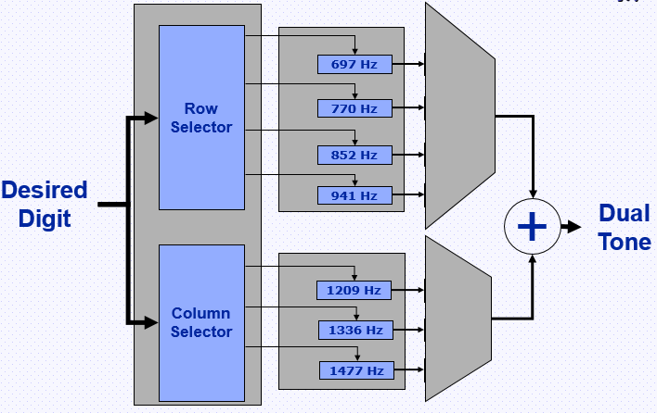
DTMF Generation

Slide 13
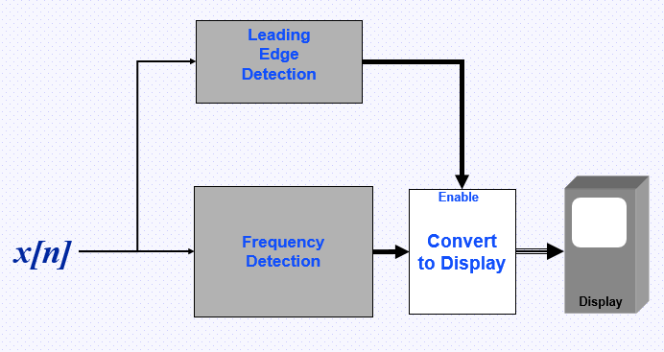
DTMF Detection

Slide 14
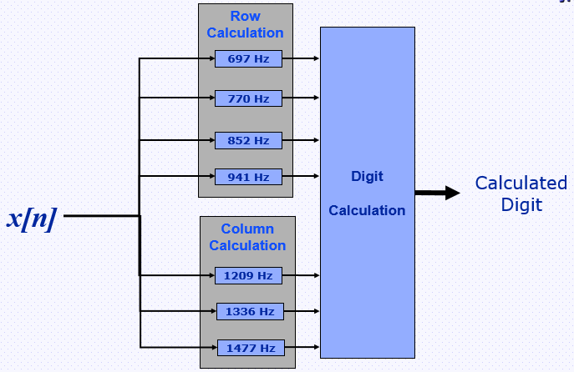
Frequency Detection

Slide 15
Applications
01
Home Automation System
02
Cell Phone Controlled Vehicles
03
Auto Emergency Call (Security)
15

Slide 16
Results & Conclusion
FFT (Fast Fourier Transform) is the mathematical tool that can be used to calculate the frequency component in the given signal.
DTMF technology was first introduced in telephone system in 1963 but nowadays it is used in different field of life.
It reduces the waiting time, response time and increases the efficiency.
The Dialer is now connected with the Receiver without the involvement of the third party (Telephone Exchange).
We can Reduce or Finish the theft rate, burglary and use DTMF in security Places (Military, Banks etc.), and can also use this technology in home automation systems.

Slide 17
Further Improvements
1
Automatic calling to Security institute by watching burglary or guns or any inappropriate scene in camera using Artificial Intelligence.
2
Develop a smartphone application and interface the robotic vehicles to control it with phone.
3
Self Driving Vehicles contains DTMF Decoder to performs different Tasks.
17

Slide 18
Thanks!
Any Questions?

