Slide 1
Linux introduction
2018-9-17 https://github.com/Travis-MA/Artinx-ROS-tutorial

Slide 2

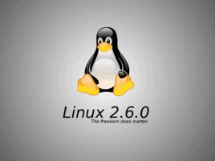
Linux Kernel
Linux is a family of free and open-source software operating systems built around the Linux kernel.

Slide 3
Ubuntu & Linux
Ubuntu is a free and open-source operating system and Linux distribution based on Debian.
Desktop environment : GNOME or Unity
Windowing System : X Server ( X Window)
X Window provides the basic framework for a GUI environment: drawing and moving windows on the display device and interacting with a mouse and keyboard. X does not mandate the user interface this is handled by individual programs.
Ubuntu system structure:
Linux Kernel
X Server
Unity or GNOME

Slide 4
Linux survival skill
Operating System
·Terminal usage
·Directory structure
·Shell and Shell script
Useful Tools
·Git / Github
·Vim / Editor
·SSH

Slide 5
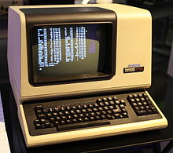
What is Terminal
- Long Long ago . We use Terminal to send instruction to our operating system.
- Today, terminal is still a important tools in Linux, since it is more efficient than
graphical interfaces
- Ubuntu use GNOME Terminal
- The Terminal in Ubuntu is actually a Terminal emulator.
Serious definition：
A computer terminal is an electronic or electromechanical hardware device that is used for entering data into, and displaying
or printing data from, a computer or a computing system
←The DEC VT100, a widely emulated computer terminal

Slide 6
Terminal instructions
Terminal instructions structure:
$ + Instruction’s name + [ parameters ] + ( filename / directory path / …)
Commonly used instructions:
mkdir , rmdir Create a new file/Delete file mkdir -p filename
cd , cd ~ , cd .. Directory operations
pwd Get now directory
ls Show sub directory ls -a
cp Copy file / directory cp –a filename , cp –r test / newtest
find , locate Fine file / directory
http://www.runoob.com/linux/linux-command-manual.html

Slide 7
Directory structure

Slide 8
Shell and Shell script

