Slide 1


HACKATHON 2024
LNRS HACKATHON 2024

Slide 2

ABOUT ME
Name: Masrita Mangalarapu
Email Id:masrita.mangalarapu053@nmims.in
Contact No:8779862422
Github Account:MASRITA19
Topic: Handwritten Text Recognition
College: Mukesh Patel School of Engineering and Technology
Student Id:70612300053
Repo Link:https://github.com/MASRITA19/LNRS_HACKATHON_MasritaMangalarapu.git

Slide 3
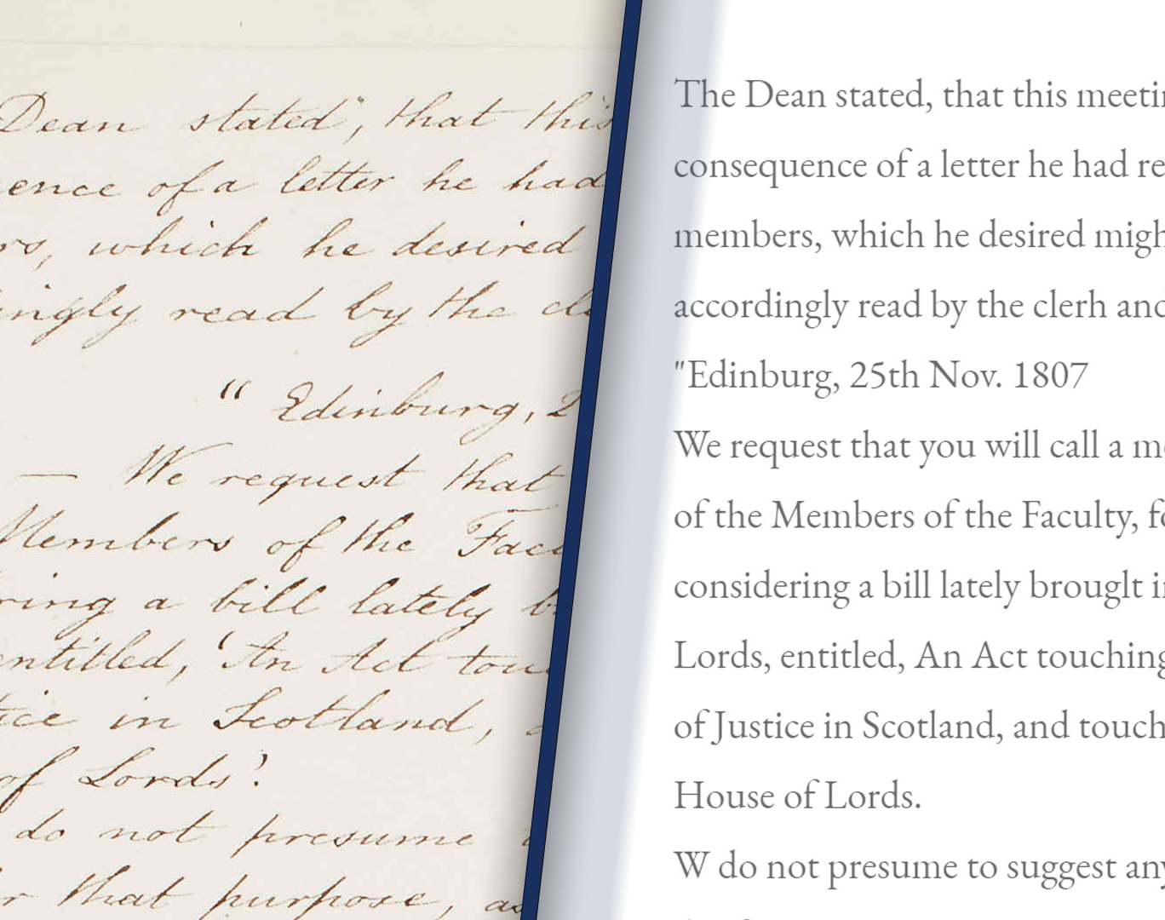
Handwritten Text Recognition Project
Using Tesseract-OCR and OpenCV
Develop a robust and efficient system for recognizing handwritten text
Improve the accuracy of handwritten text recognition
Provide a robust and efficient system for recognizing handwritten text

Slide 4
Challenges in Handwritten Text Recognition
Variations in Writing Styles and Fonts: Difficulty in recognizing handwritten
Limited Accuracy of Existing OCR Systems: Existing OCR systems have limited accuracy
Need for a Robust and Efficient Solution: Need for a robust and efficient solution
Importance of Handwritten Text Recognition: Crucial in various applications, including:
Document scanning and digitization
Form recognition and processing
Handwritten note-taking and transcription
Historical document analysis and preservation

Slide 5
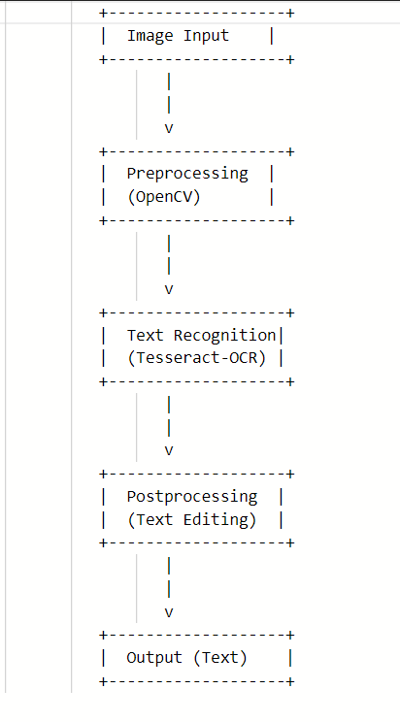
Solution Overview
Use of Tesseract-OCR for handwritten text recognition
Preprocessing of images using OpenCV
Integration of Tesseract-OCR and OpenCV for robust text recognition
Overview of the system architecture and implementation

Slide 6
Tesseract-OCR
OpenCV
High accuracy in recognizing handwritten text
Support for multiple languages
Open-source and widely used
Advantages of using Tesseract-OCR
Limitations of Tesseract-OCR
Powerful computer vision library
Support for image processing and manipulation
Widely used in various applications
Advantages of using OpenCV
Limitations of OpenCV

Slide 7
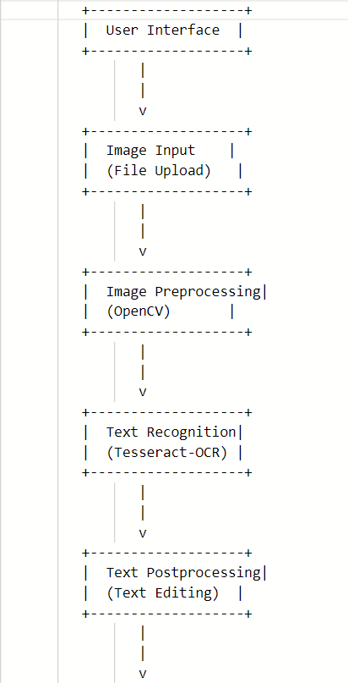
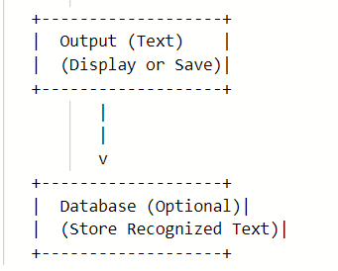
System Architecture
Image input and preprocessing
Text recognition using Tesseract-OCR
Output and post-processing
Integration of Tesseract-OCR and OpenCV
Overview of the system architecture

Slide 8
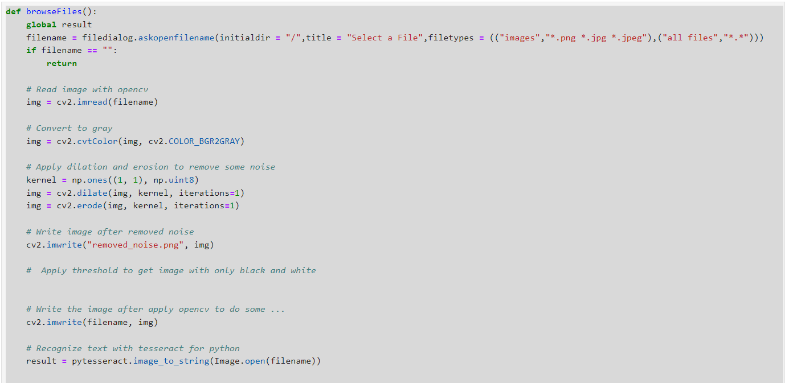
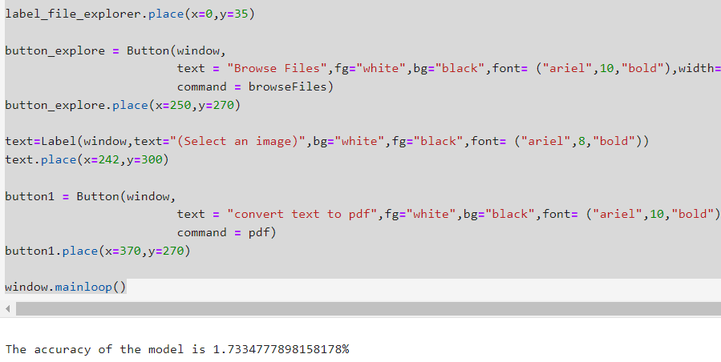
Implementation

Slide 9
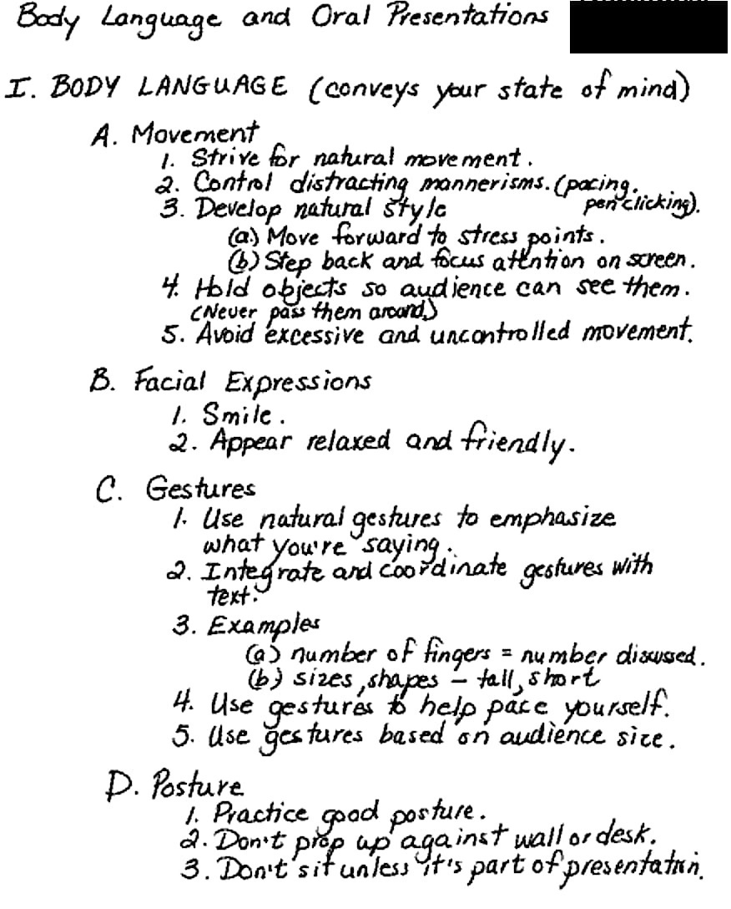
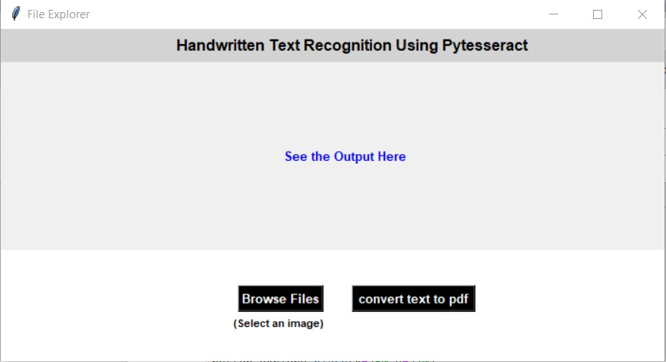
Results

Slide 10
