Slide 1
VIEN THE VIRTUAL CONTROLLER
BATCH - 09
GNANASEKARAN B 510620205011
GOKUL M 510620205012
YUVARAJ A D 510620205052
Internal Guide:
Dr. S . UMAMAHESWARI Phd,
HOD

Slide 2




ABSTRACT
VIEN -THE VIRTUAL CONTROLLER
Waving our hand in front of our computer/laptop allows us to manage certain of its functionalities.
The Virtual Mouse provides an infrastructure between the user and the system using only a camera.
This study presents a method for controlling the cursor’s position without the need of any electronic equipment.
The suggested system will require the use of OpenCV and Python as well as other tools. The camera’s output will be presented on the system’s screen so that the user can further calibrate it.

Slide 3
Introduction
A gesture control system using a camera allows computer vision to interpret and respond to human gestures captured by the camera.
This innovative technology enables users to interact with devices through natural movements, eliminating the need for physical touch or traditional input methods.
By analyzing the video feed, the system recognizes predefined gestures, enhancing user experience in diverse applications such as presentations, and hands-free device control.

Slide 4
Literature survey :
S.NO | TITLE | YEAR | AUTHOR | TECHNOLOGY
1 | Real-time hand gesture recognition | 2018 | Thakare, V., & Thool, R | Computer Vision
2 | Hand gesture recognition based on finger-orientation using depth sensor | 2020 | Kim, J., & Park, J | Depth Sensing
3 | Hand gesture recognition system using convolutional neural networks | 2022 | Sharma, N., & Singh, S. | Deep Learning

Slide 5
Existing System
The existing system utilizes gesture recognition technology to control various functions across different software applications. Specifically, it allows users to control a media player (presumably for playing music or videos), zoom in and out in maps (likely referring to the web-based version of Google Maps), and play and pause video clips in YouTube. The system likely employs a camera, such as the Creative Intel RealSense SR300, to capture and interpret hand gestures, which are then translated into corresponding commands for the targeted software applications.
Description

Slide 6
Advantages
Hands-Free Operation without any actual contact with the system
Enhanced Accessibility(Additional ways to access a single functionality)
Flexibility can be achieved by the diversity of available functions

Slide 7
Disadvantages
Unavailability of system functions
Only Limited Gesture Vocabulary is available
Privacy Concerns may occur to the user

Slide 8
Proposed System
Vien is a software application that allows users to control their computer cursor and interact with digital interfaces without physically moving a physical mouse. Virtual PPT control using gestures offers a hands-free and intuitive way to interact with presentations, making it especially useful in situations where traditional input devices like keyboards or mice are not feasible. Switching between modules using audio in Python typically involves using speech recognition libraries to detect specific commands spoken by the user and then executing actions to switch between modules accordingly.
Description:

Slide 9
Advantages
Provides hands free experience
Substitutes for some additional hardware devices(Mouse)
Can be adapted for natural movements
Convenient with quick and real-time responses
New functions can be easily added and existing functions can be easily altered or customized(With adequate programming skill)

Slide 10
Disadvantages
Accuracy of the virtual mouse is comparatively less
User is required to have a stable hand
Accuracy is dependent on the quality of the webcam
Too many similar hand gestures can cause in malfunctioning

Slide 11
Existing VS Proposed System :
Existing:
Controls media player, zoom in and out in maps, play and pause clips in YouTube
Proposed:
Virtual mouse, screen brightness control, audio control, presentation control

Slide 12
System Requirements:
HARDWARE REQUIREMENTS :
Basic Laptop or Computer With a Webcam
SOFTWARE REQUIREMENTS :
Window OS
Python interpreter
Required pip files(libraries)

Slide 13



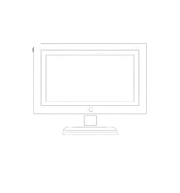
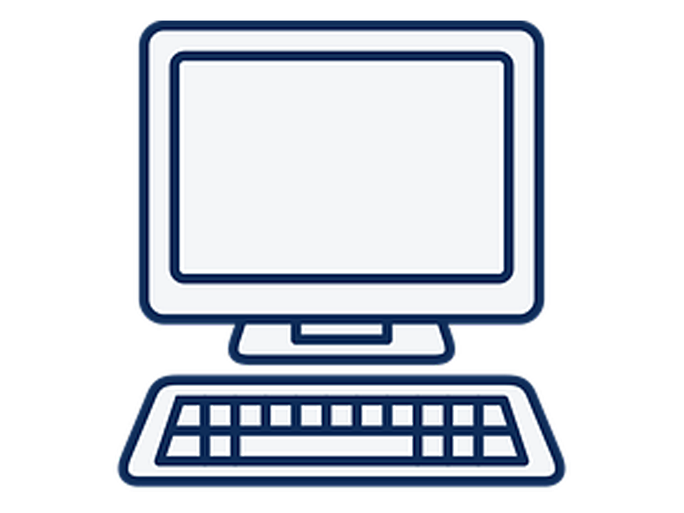
SYSTEM ARCHITECTURE
User body and hand gestures
Webcam
Visual real-time response
PyautoGUI
Real-time hand tracking and image preprocessing
Testing and recognition using Mediapipe models
Screen brightness
PC audio
Cursor access
PPT control
Mapping of hand and body plots and tracking

Slide 14
MODULES [DATA FLOW DIAGRAM]
Camera
The Vien system captures live video feeds from a connected webcam, providing frames for gesture recognition. It processes video data with specific resolutions, frame rates, and color spaces to ensure accurate hand gesture detection.
Visual real-time response
It controls screen brightness, audio playback, and mouse actions based on gestures.
Mike
Mediapipe models
The "Microphone Input Module" in the Vien system captures audio input from a connected microphone, enabling voice commands and interactions.
MediaPipe includes models for full-body or upper-body pose detection and analysis, utilizing landmark keypoints to understand the spatial configuration and movements of the human body in real-time.

Slide 15
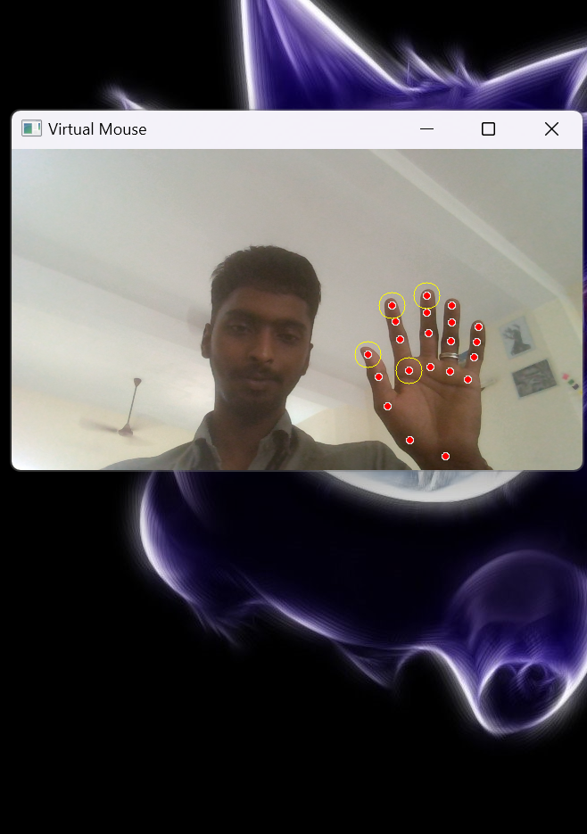
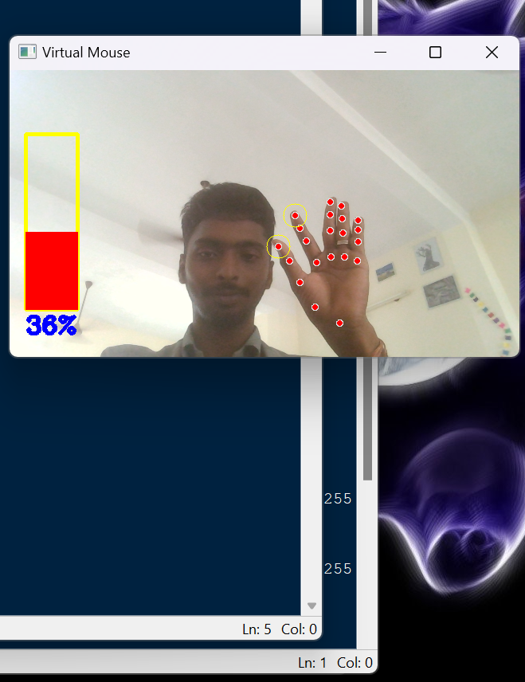
SCREENSHOT :

Slide 16
Conclusion:
Concluding our project, it’s evident that they offer significant advantages in terms of accessibility. Their versatility extends to various applications and everyday computer use. However challenges remain in perfecting this technology

Slide 17
FUTURE ENHANCEMENT
An AI assistant can be added with the existing features to enhance its efficiency
Gestures dedicated to control camera can be included
Sensors may be used to increase accuracy of gesture
Other required features like keyboard control can be added

Slide 18
REFERENCE
SNO | JOURNALS PAPERS
[1] | Prathyakshini, Prathwini (2023). Hand Gesture Controlled Video Player Application. DOI:10.1109/ICECA58529.2023.10395578
[2] | Kirti Aggarwal, Anuja Arora. (2022). An Approach to Control the PC with Hand Gesture Recognition using Computer Vision Technique. DOI: 10.23919/INDIACom54597.2022.973282
[3] | Minu P Abraham, Gaurav Murdeshwar, Divya Jennifer Dsouza. (2022). Gesture Based Hand Control System for Power Point Presentation. DOI: 10.1109/ICAEECI58247.2023.10370775
[4] | Wang Hongpeng, Tan Dianxiong, Wang Jue. (2022). A real-time hand gesture recognition algorithm for an embedded system. DOI: 10.1109/ICMA.2014.6885817
[5] | Ishwarlal Rathod, Kunal Rathod, Neha Gupta. (2023). Use of IOT in Computer Control Using Hand Gesture Using AT Mega 328 over the Cloud. DOI: 10.1109/ICTBIG59752.2023.10456351

Slide 19
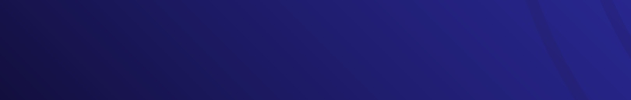
Thank you!
ANY QURIES ?

