Slide 1

AI-POWERED RESUME AUTOMATION SYSTEM
by:
Utkarsh Shah (241B278)
Utsav Kothari (241B279)
Yashasv Pandey (241B295)
Under the supervision of:
Ms. Sarita Sahni
Jaypee University of Engineering & Technology, Guna

Slide 2
Table of Contents
2
1. Introduction
Project overview, core objectives & target users
6. Work Done So Far
System architecture, behavioral workflow & UI
2. Problem Statement
Key challenges in entry-level job applications
7. Work to be Done
Browser extension, portal adapters & evaluation
3. Literature Review
Existing solutions, comparison matrix & gaps
8. Conclusion
Progress summary & expected outcomes
4. Work Plan
10-week milestones & current progress log
9. References
Academic citations in official IEEE format
5. Individual Contribution
Role allocation & modular ownership

Slide 3
1. Introduction
3
Project Overview
• AI-assisted career copilot designed specifically for college students and freshers.
• Solves the fragmented job hunting journey by uniting discovery, evaluation, document tailoring, and tracking.
• Extracts normalized candidate profiles from unstructured resumes to eliminate redundant parsing.
• Combines LLM language comprehension with deterministic scoring and safety rules.
Project Objectives
• Reduce repetitive effort in searching, customizing, and applying across multiple job boards.
• Deliver multi-factor job compatibility ranking (semantic similarity, skills match, preferences).
• Generate ATS-compliant, tailored resumes and targeted cover letters without fabrications.
• Establish Human-In-The-Loop approval gates: automation assists, but user retains final authorization.
End-to-End Application Workflow Pipeline:
Resume Upload ➜ Profile Structuring ➜ Job Discovery ➜ Multi-Factor Match ➜ ATS Tailoring ➜ Reviewer Check ➜ User Approval ➜ Extension Autofill ➜ Status Tracking

Slide 4
2. Problem Statement
4
Challenges Faced by Students
• Fragmented Portals: Students spend endless hours navigating company websites, LinkedIn, and internship boards.
• Generic Resumes: Submitting a single static resume leads to immediate rejection by ATS filters.
• Repetitive Tailoring: Manually customizing resumes and cover letters for dozens of roles causes severe burnout.
• Lost Applications: Tracking status, versions, and application dates in spreadsheets is tedious and error-prone.
Flaws in Current Automation
• Uncontrolled Scripts: Existing bot appliers submit without user oversight, risking bans and wrong applications.
• Hallucinated Claims: Naive LLM resume builders frequently invent fake experience or stuffed keywords.
• No Session Reusability: Cloud automation tools require storing credentials, risking security leaks.
• Disconnected Tooling: Resume builders, job alerts, and tracker boards operate in isolated silos.
Core Problem Addressed:
“How can an intelligent, multi-agent system eliminate repetitive job application effort while preserving ATS relevance, document truthfulness, and guaranteed user approval at every critical step?”

Slide 5
3. Literature Review & Research Gap
5
System / Approach | Job Discovery | Resume Tailoring | Auto Apply | Tracking | User Approval
Traditional Job Boards (LinkedIn, Indeed) | Yes | Limited | No | Limited | N/A
Auto-Apply Bots (AIHawk, Scripts) | Limited | Basic / None | Yes (Aggressive) | Limited | No (Risk of Bans)
AI Resume Builders (Novoresume, etc.) | No | Yes (Manual) | No | No | N/A
Proposed System | Yes (Hybrid Adapters) | Yes (ATS Verified) | Supported Portals | Yes (Real-time) | Yes (Mandatory Gate)
Identified Research Gaps
• Fragmented Tooling: Job search, document drafting, and application tracking are isolated.
• Unverified AI Output: Generic LLM resumes suffer from keyword stuffing and inaccurate claims.
• Safety Neglect: Autonomous scripts submit without user review, risking irrelevance and bans.
Proposed Improvements & Innovation
• Unified Multi-Agent Architecture: Orchestrates parsing, matching, tailoring, and tracking.
• Drafter ➜ Reviewer ➜ Verification Loop: Deterministic scoring and PDF verification eliminate hallucinated claims.
• Browser Extension Architecture: Executes actions within the user's active session without exposing credentials.

Slide 6
4. Work Plan
6
Week | Planned Work | Status
Week 1 | Problem identification, student user interviews, and requirement analysis | Completed
Week 2 | Literature review, existing system benchmarking (AIHawk, LoopCV, LinkedIn bots) | Completed
Week 3 | Frontend architecture, Design & component mockup | Completed
Week 4 | Backend event-driven multi-agent architecture and FastAPI service design | Completed
Week 5 | Multi-user database schema, relational domain modeling, and FAISS vector design | Completed
Week 6 | Resume upload, structured candidate profile parsing, and profile data models | Completed

Slide 7
5. Individual Contribution
7
Member Name | Enrollment No. | Core Contribution & System Ownership
Utkarsh Shah | 241B278 | System Architecture, Event-Driven Backend (FastAPI, Redis event queue), Multi-Agent Orchestration & Model Router (GLM, Qwen, Groq).
Utsav Kothari | 241B279 | Frontend Architecture, Clyde Dark Editorial UI/UX implementation, Agent Dashboard, Resume Center, and WebSocket state management.
Yashasv Pandey | 241B295 | Resume Parsing Engine, Structured Profile Extraction, FAISS Vector Embedding Store, and Multi-Factor Job Matching Algorithm.
Collaborative Team Responsibilities
• Joint requirement engineering and analysis of college student job-application friction points.
• Collaborative system design, behavioral sequence modeling, and end-to-end data pipeline validation.
• Unified testing, ATS scoring benchmark evaluation, documentation, and department presentation.

Slide 8
6. Work Done So Far: System Architecture
8
1. PRESENTATION & CLIENT LAYER (React 18, TypeScript, UI)
Agent Dashboard
Natural language chat, task activity & telemetry
Resume Center
PDF upload, structured profile & ATS versioning
Job Discovery
Semantic match scores, filters & role cards
Browser Extension
DOM inspection, form mapper & session autofill
2. EVENT-DRIVEN MULTI-AGENT BACKEND LAYER (FastAPI Gateway + Redis Event Bus)
Orchestrator Agent
Workflow planner
Resume Agent
Parser & tailor
Job Discovery Agent
Source adapters
ATS Agent
Scoring & verifier
Cover Letter Agent
Targeted drafting
Reviewer Agent
Quality & audit
Application Agent
Submission logic
Tracking Agent
Telemetry & logs
Central Model Router: GLM (Drafting/Writing) | Qwen (Reasoning) | Groq (Fast Inference) | Ollama (Local Fallback)
3. DATA PERSISTENCE & VECTOR INTELLIGENCE LAYER
PostgreSQL (Relational Store)
Multi-user tables: Users, Resumes, Jobs, Applications, Events
FAISS (Vector Store)
High-performance embedding indices for resume & job vectors
Redis (Cache & Event Queue)
Decoupled pub/sub event bus, transient states, rate limiting

Slide 9
6. Work Done So Far: Behavioral Workflow & Data
9
End-to-End Behavioral Workflow
1. Ingestion: Candidate uploads resume PDF to Resume Center.
2. Structuring: Resume Agent extracts skills, education, projects.
3. Profile Persistence: Normalized profile saved in PostgreSQL.
4. Job Discovery: Hybrid adapters query API/boards/career pages.
5. Multi-Factor Match: FAISS vector similarity + deterministic scoring.
6. Resume Tailoring: Resume Agent tailors bullet points to JD.
7. Quality Review: Reviewer Agent checks claims & keyword density.
8. PDF Verification: Text extracted from rendered PDF for check.
9. Cover Letter: Tailored company letter drafted & verified.
10. Safety Gate: Mandatory user approval prompt on UI.
11. Dispatch: Application Agent transmits action plan to extension.
12. Submission: Browser extension autofills & submits in session.
13. Tracking: Tracking Agent logs timestamp & status in DB.
Multi-User Database Schema Domains
• Candidate Domain: users, resumes, resume_versions, candidate_profiles, extracted_skills, education, projects.
• Job Domain: companies, job_sources, jobs, job_matches.
• Application Domain: cover_letters, applications (Status: Saved, Ready, Applied, Interview, Rejected), events.
• Agent Domain: workflows, agent_runs, provider_health.
AI Quality Pipeline & Safety Model
• Drafter ➜ Reviewer ➜ Revision Loop: Independent Reviewer Agent audits drafts against strict rules before finalizing.
• Anti-Hallucination: Rejects unsupported experience claims.
• Keyword Verification: Prevents spammy keyword stuffing.
• Hybrid Approval Policy: Low-risk tasks (search, match, ATS scoring) run autonomously; Critical actions (version commit, application submission) require explicit user click.

Slide 10
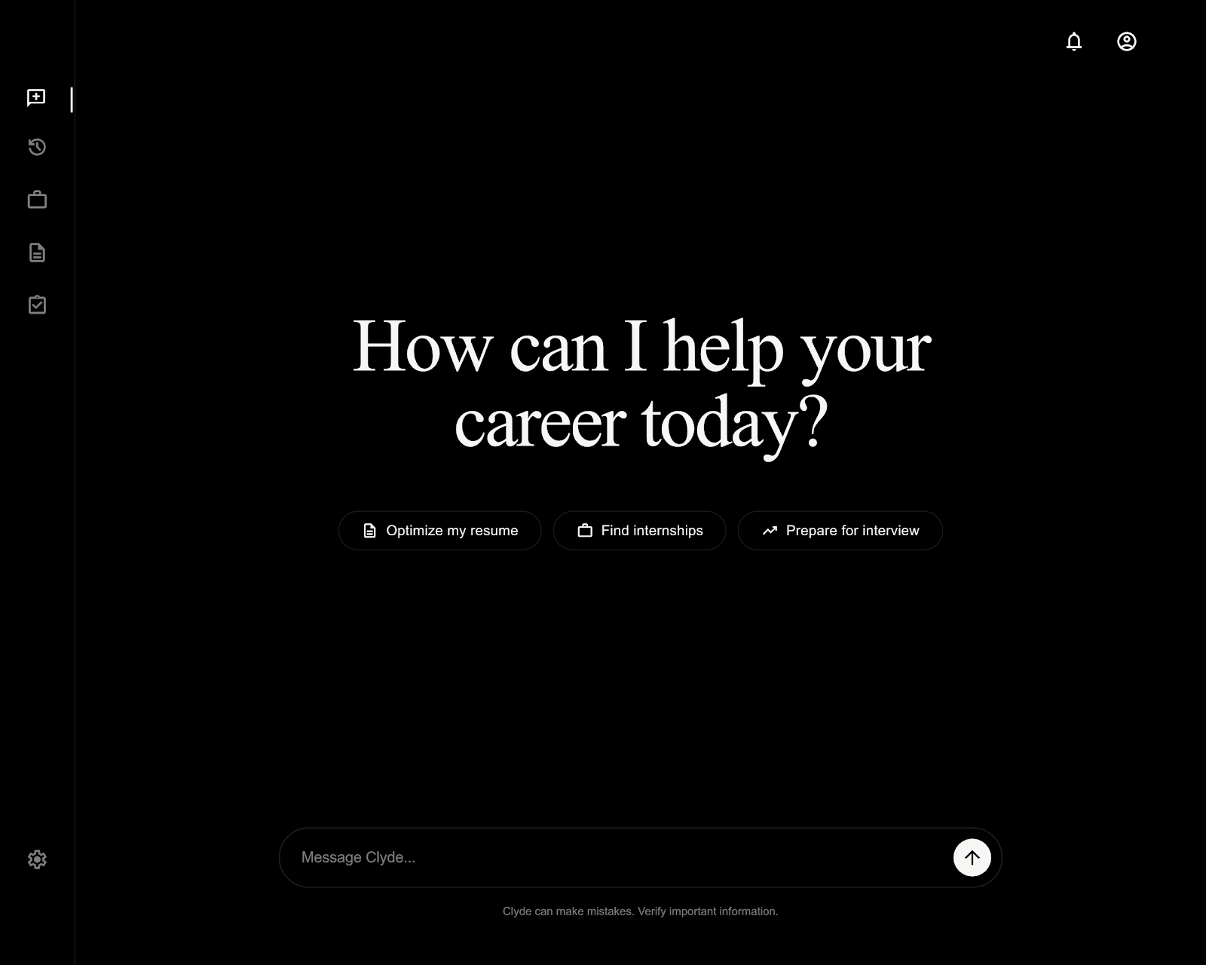
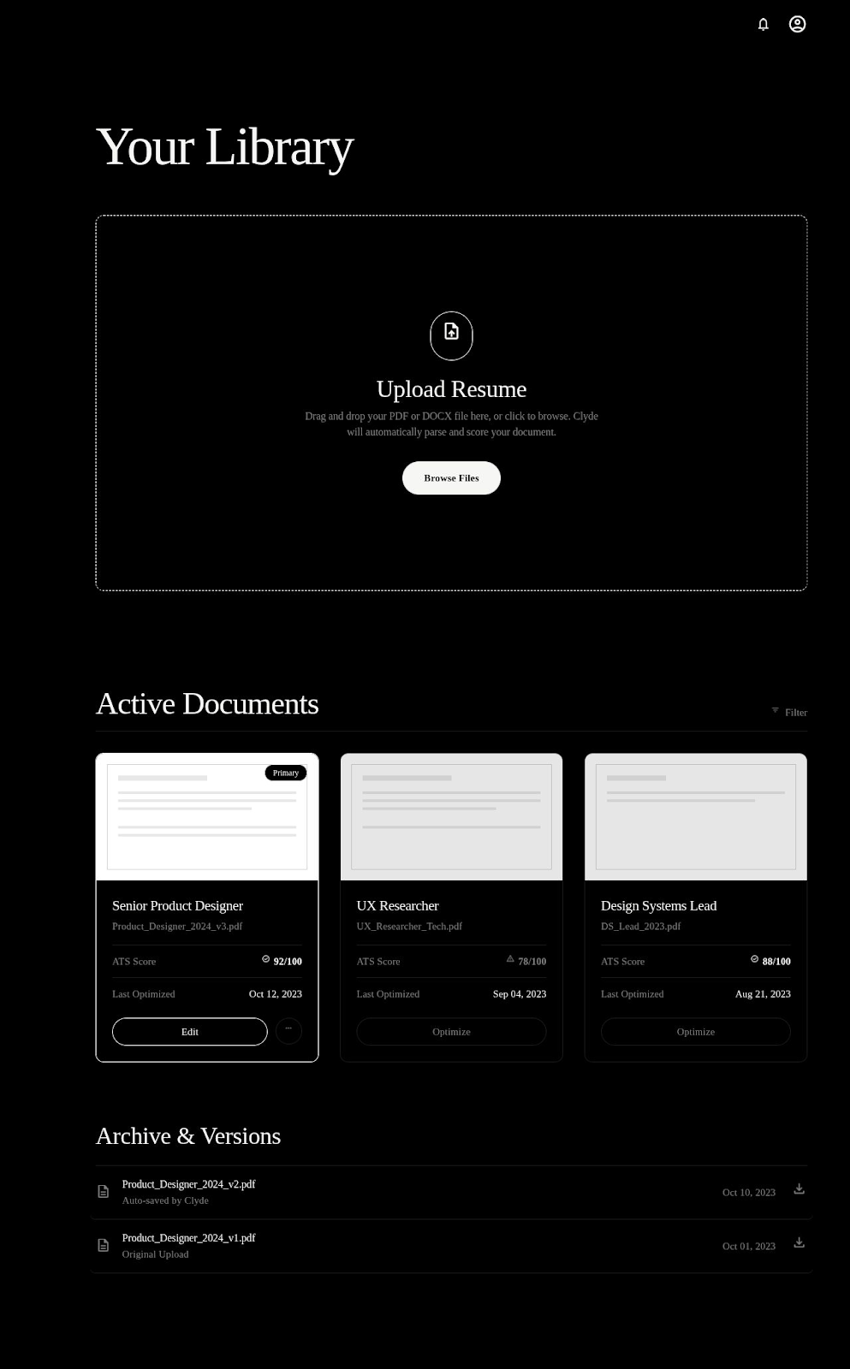
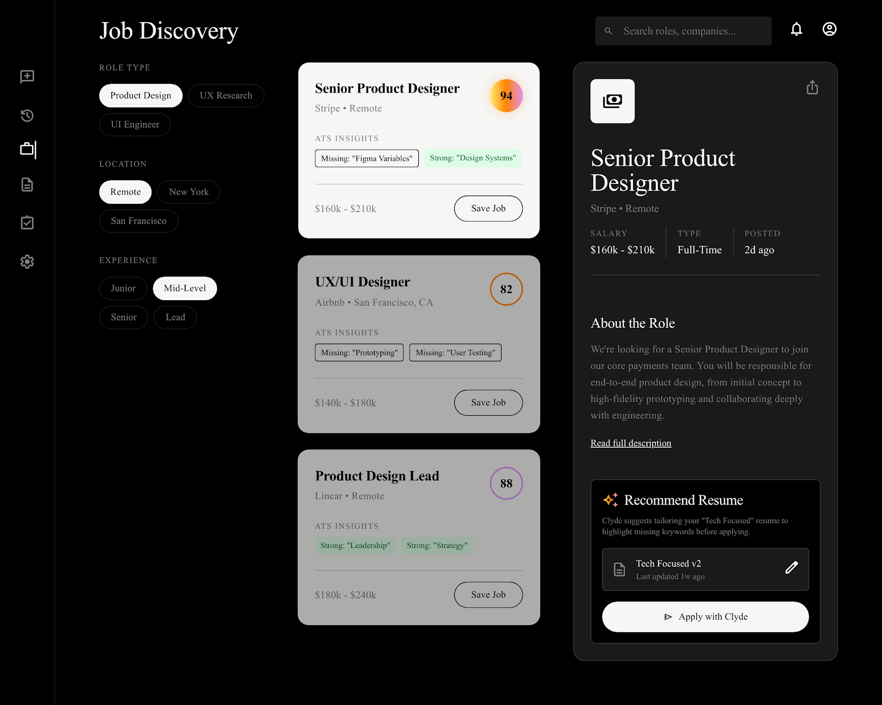
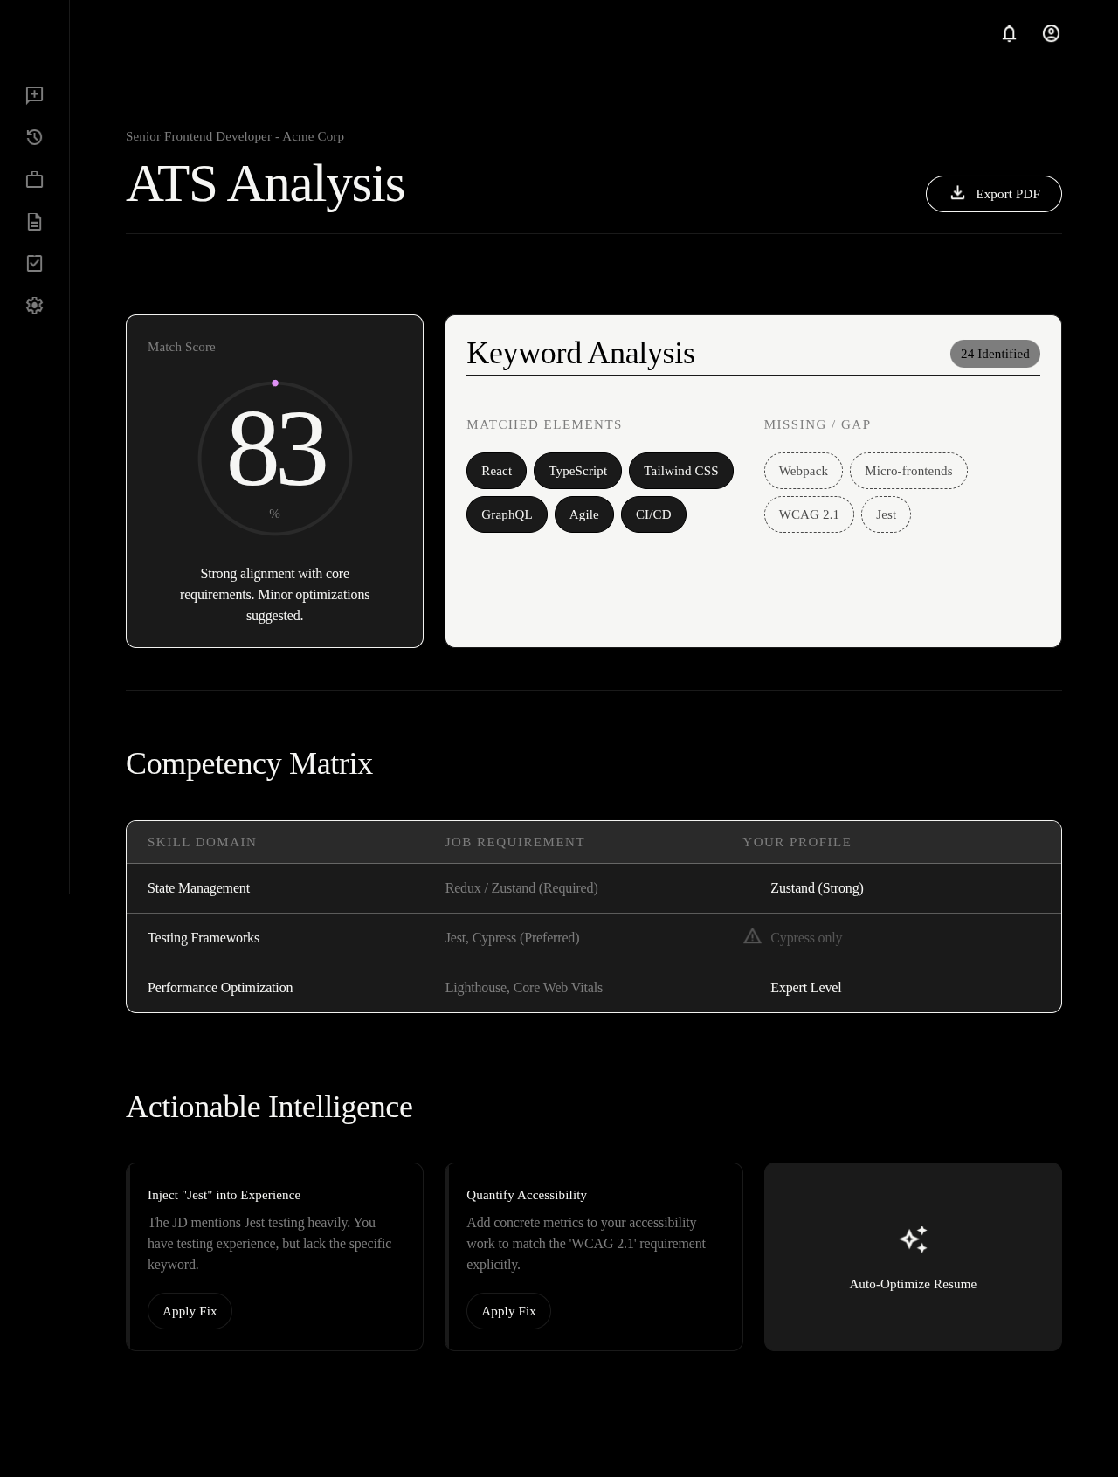
6. Work Done So Far: Application UI
10
1.Dashboard (Chat & Telemetry)
2. Resume Optimization Center (Profiles & Versions)
3. Job Discovery & Match Ranking (FAISS Similarity)
4. ATS Keyword & Gap Analysis (Deterministic Scoring)

Slide 11
7. Work to be Done
11
Implementation Tasks Ahead
• Browser Extension Completion: Implement content scripts and form autofill engine for Workday, Greenhouse, and LinkedIn.
• Model Router Integration: Finalize automatic provider failover (GLM ➜ Qwen ➜ Groq ➜ Ollama fallback).
• PDF Verification Pipeline: Deploy deterministic text-extraction verification to ensure rendered PDF matches approved structured resume.
• Full Multi-User Migration: Finalize database migrations for production multi-user session management.
Testing, Evaluation & Benchmarking
• ATS Pass Rate Benchmark: Measure keyword match improvements on 50+ real software and AI internship descriptions.
• Submission Accuracy Testing: Test form autofill precision on complex multi-step application forms.
• Latency & Reliability Audits: Benchmark end-to-end processing times across Redis queue and multi-agent pipelines.
• User Evaluation Study: Run pilot trials with JUET students to collect feedback on approval UX and match relevance.

Slide 12
8. Conclusion & Expected Outcomes
12
Summary of Progress So Far
• Completed rigorous requirement engineering and literature benchmark.
• Finalized full event-driven multi-agent architecture and database schema.
• Developed frontend dashboard.
• Functional working modules: Resume PDF parsing, structured candidate profiles, AI agent chat,
Expected Project Outcomes
• A complete, student-centric career copilot reducing application fatigue by >80%.
• Significantly higher ATS shortlisting rates through tailored, truthful resumes.
• 100% user safety with zero credential storage and mandatory human approval.
• A robust, extensible architectural benchmark for event-driven academic multi-agent systems.
Core Takeaway:
“The system does not replace the student’s judgment—it eliminates repetitive manual toil, unlocks deep opportunity visibility, and guarantees that every submitted application is relevant, verified, and user-approved.”

Slide 13
9. References
13
Academic & Technical References (IEEE Format)
[1] M. Lorentzen, “AI Job Search,” GitHub repository, 2026. [Online]. Available: https://github.com/MadsLorentzen/ai-job-search.
[2] feder-cr, “Jobs Applier AI Agent AIHawk,” GitHub repository, 2026. [Online]. Available: https://github.com/feder-cr/Jobs_Applier_AI_Agent_AIHawk.
[3] jomacs, “LinkedIn Auto Jobs Applier with AI,” GitHub repository, 2026. [Online]. Available: https://github.com/jomacs/linkedIn_auto_jobs_applier_with_AI.
[4] S. Fer, “Career Ops,” GitHub repository, 2026. [Online]. Available: https://github.com/santifer/career-ops.
[5] LoopCV, “LoopCV: Job Search Automation Platform,” 2026. [Online]. Available: https://www.loopcv.pro/.

Slide 14
14
Thank You
Questions & Discussion
Utkarsh Shah (241B278) | Utsav Kothari (241B279) | Yashasv Pandey (241B295)
Under the supervision of: Ms. Sarita Sahni
Jaypee University of Engineering & Technology, Guna

