Slide 1
Building SSIS Packages with C#

Slide 2

Tomasz Kostyrka
Senior BI Developer @tieto
Assistant @wsei
tomek.kostyrka@gmail.com
https://github.com/TKostyrkaWSEI/SSISPGen

Slide 3
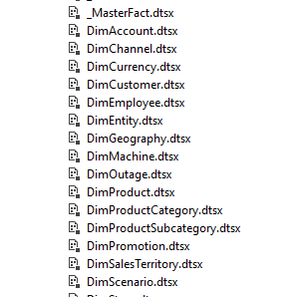
PROBLEM
Create N SSIS packages…

Slide 4


Slide 5
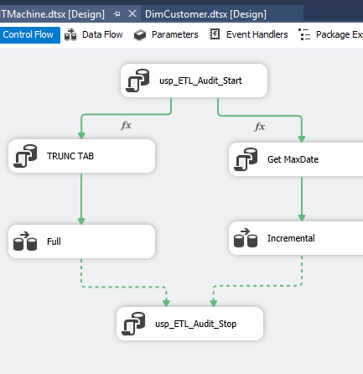
PROBLEM CHALLENGE
… with similar Control Flow …

Slide 6
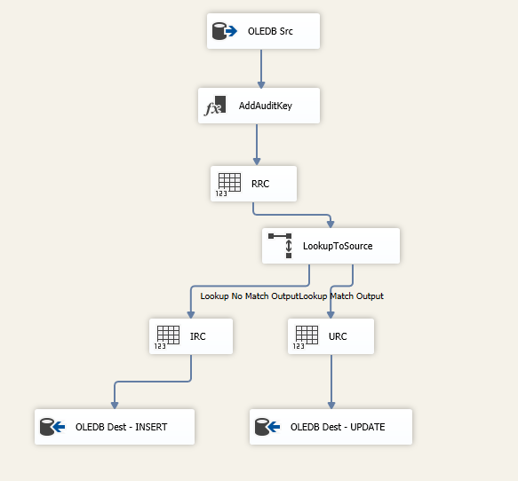
CHALLENGE
… and similar Data Flow.

Slide 7
SOLUTIONS
BIML (https://en.wikipedia.org/wiki/Business_Intelligence_Markup_Language)
SSIS Automation API
EzAPI (https://blogs.msdn.microsoft.com/mattm/2008/12/30/ezapi-alternative-package-creation-api/)
FluentSSIS (https://github.com/johnwelch/FluentSsis/)
or …

Slide 8
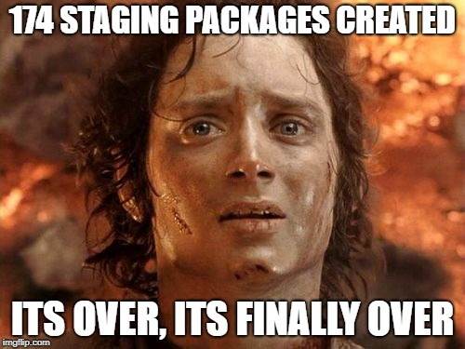
… the project is billed T&M. Do it manually.

Slide 9
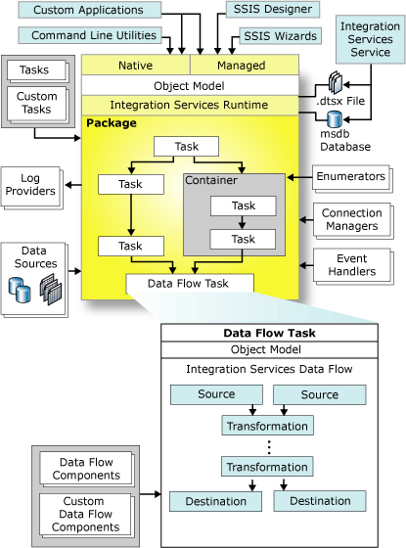
Integration Services Programming Overview
https://docs.microsoft.com/en-us/sql/integration-services/integration-services-programming-overview?view=sql-server-2017

Slide 10
The Integration Services run-time engine controls the management and execution of packages, by implementing the infrastructure that enables execution order, logging, variables, and event handling. Programming the Integration Services run-time engine lets developers automate the creation, configuration, and execution of packages and create custom tasks and other extensions.
The data flow engine manages the data flow task, which is a specialized, high performance task dedicated to moving and transforming data from disparate sources. Unlike other tasks, the data flow task contains additional objects called data flow components, which can be sources, transformations, or destinations. These components are the core moving parts of the task. They define the movement and transformation of data. Programming the data flow engine lets developers automate the creation and configuration of the components in a data flow task, and create custom components.

Slide 11
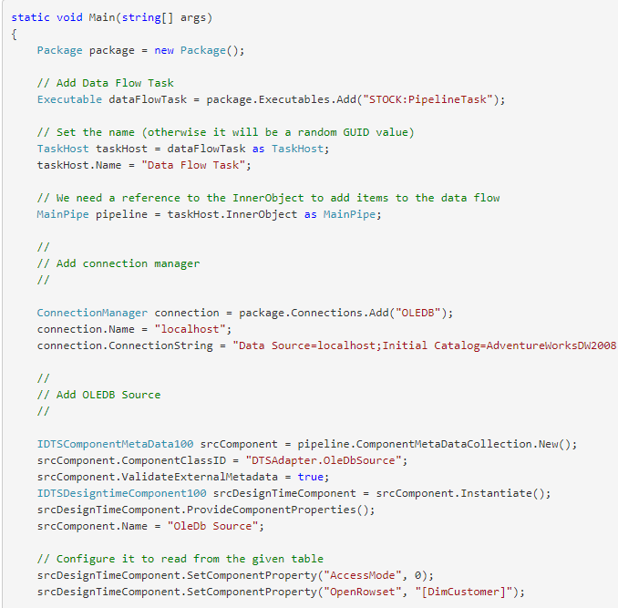
SSIS Automation API
https://docs.microsoft.com/en-us/sql/integration-services/building-packages-programmatically/creating-a-package-programmatically?view=sql-server-2017
https://blogs.msdn.microsoft.com/mattm/2008/12/30/samples-for-creating-ssis-packages-programmatically/

Slide 12
Commonly Used Assemblies
Microsoft.SqlServer.ManagedDTS.dll | Contains the managed run-time engine.
Microsoft.SqlServer.RuntimeWrapper.dll | Contains the primary interop assembly (PIA), or wrapper, for the native run-time engine.
Microsoft.SqlServer.PipelineHost.dll | Contains the managed data flow engine.
Microsoft.SqlServer.PipelineWrapper.dll | Contains the primary interop assembly (PIA), or wrapper, for the native data flow engine.
https://msdn.microsoft.com/en-us/library/aa302338.aspx

Slide 13
Microsoft.SqlServer.Dts.Runtime
Application
ConnectionManager
Executable
ForLoop
Package
Parameters
Project
Sequence
The Microsoft.SqlServer.Dts.Runtime namespace contains the classes and interfaces to create packages, custom tasks, and other package control flow elements.

Slide 14
Microsoft.SqlServer.Dts.Runtime.Wrapper
ConnectionManagerOleDbClass
PackageClass
ParameterClass
PrecedenceConstraintClass
SequenceClass
VariableClass
The Runtime.Wrapper namespace provides the classes and interfaces used to create Control Flow components in the runtime.
This assembly is a Primary Interop Assembly (PIA) for the namespace Dts.Runtime.
The classes in this namespace should not be instantiated. Instead, use the classes found in the Microsoft.SqlServer.Dts.Runtime.

Slide 15
Microsoft.SqlServer.Dts.Pipeline
PipelineBuffer
Provides an in-memory data store containing rows and columns of data.
PipelineComponent
Defines the base class that is used when developing managed data flow components.
The Microsoft.SqlServer.Dts.Pipeline namespace contains managed classes that are used to develop managed data flow components.
It contains the PipelineComponent class, which is the base class for managed data flow components, and the PipelineBuffer class, which is the managed implementation of the IDTSBuffer100 interface.
The PipelineBuffer class marshals data flow buffers between the COM data flow engine and managed data flow components.

Slide 16
Microsoft.SqlServer.Dts. Pipeline.Wrapper
IDTSCustomProperty100
IDTSCustomPropertyCollection100
IDTSInput100
IDTSInputCollection100
IDTSInputColumn100
IDTSInputColumnCollection100
IDTSOutput100
IDTSOutputCollection100
IDTSOutputColumn100
IDTSOutputColumnCollection10
IDTSPath100
IDTSPathCollection100
Dts.Pipeline.Wrapper namespace provides the classes and interfaces used to create custom Data Flow components and to automate the Data Flow task.

Slide 17

DEMO #1

Slide 18
Back to the Challenge
C# dll’s
create the SSIS project from scratch
create CF/DF using C# code, no templates
standarization, reusability
create destination structures (source platform independent)
create master packages

Slide 19
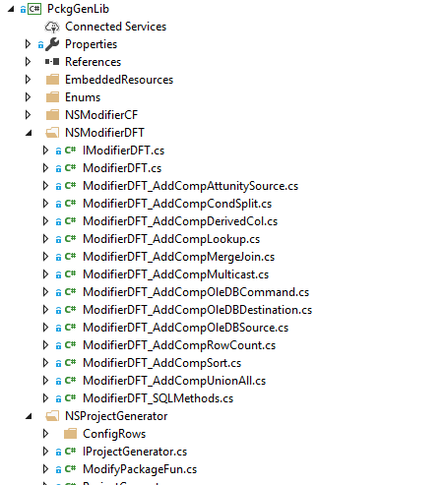
PckgGenLib

Slide 20
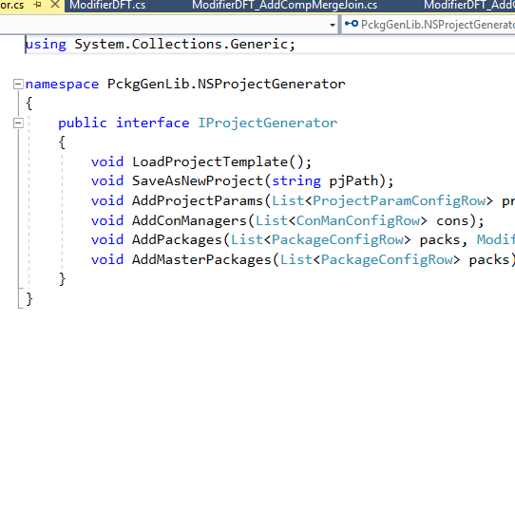
IProjectGenerator

Slide 21
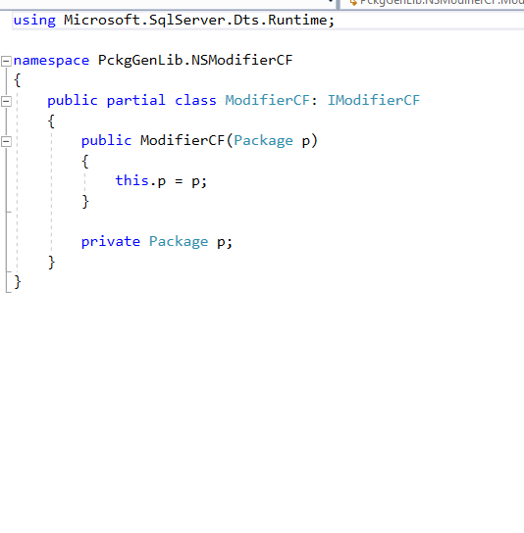
IModifierCF

Slide 22
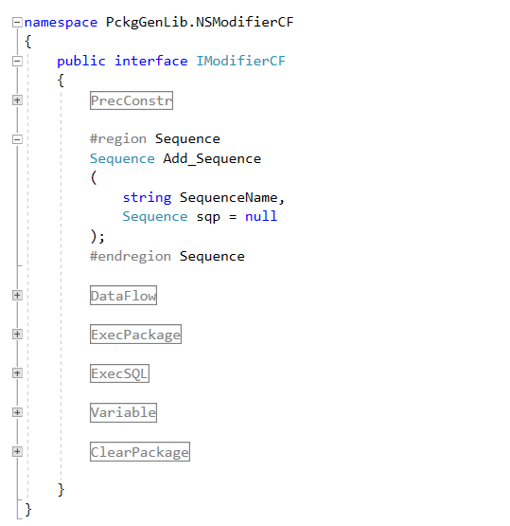
IModifierCF

Slide 23
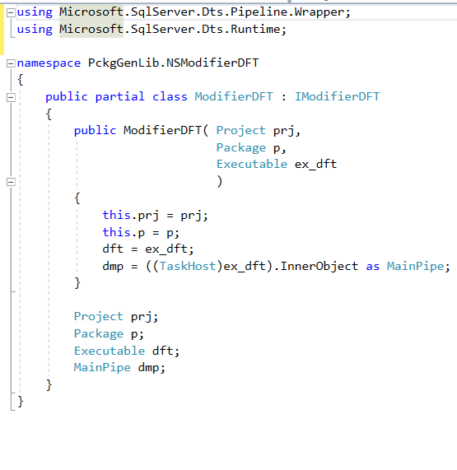
IModifierDF

Slide 24
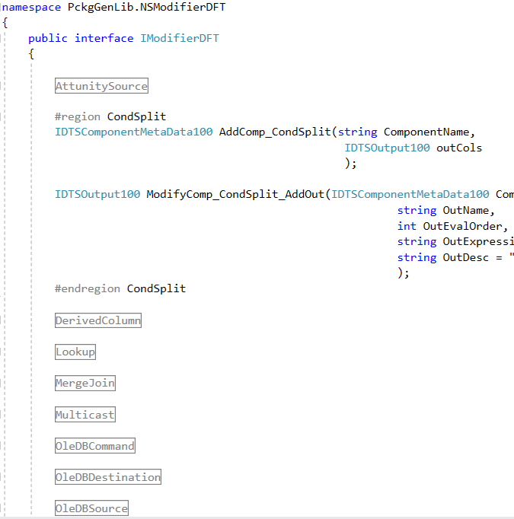
IModifierDF

Slide 25
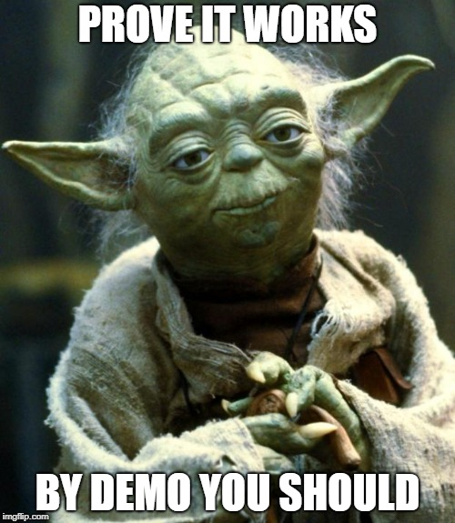
DEMO #2

Slide 26
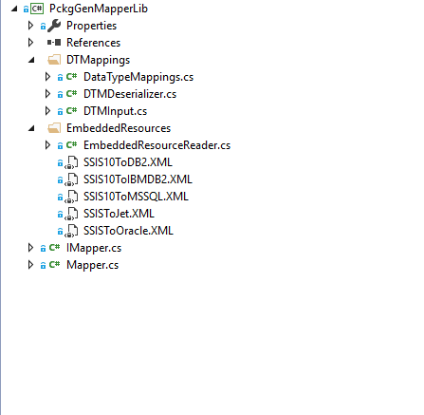
PckgGenMapperLib

Slide 27
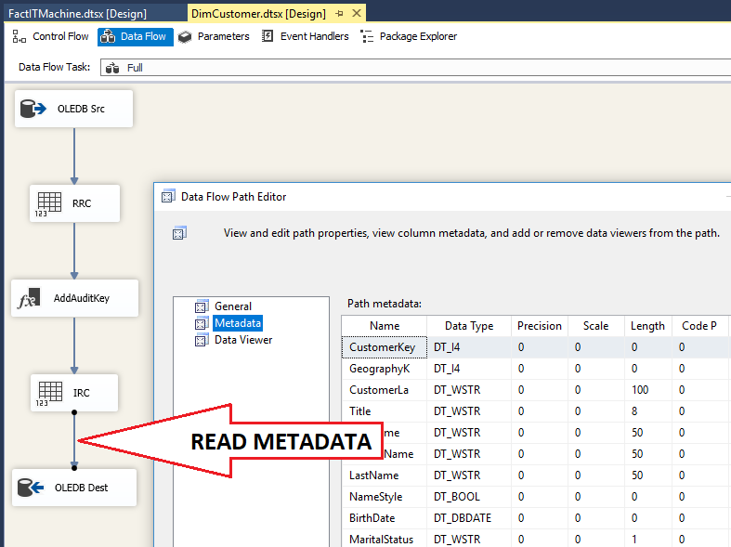
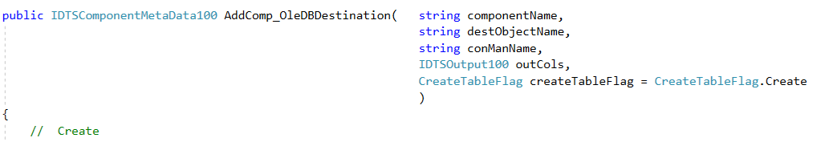
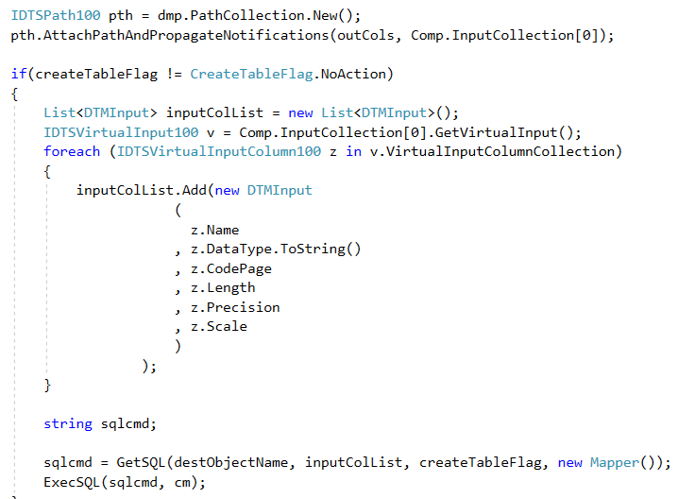

Slide 28

DEMO #3 (last one)

Slide 29
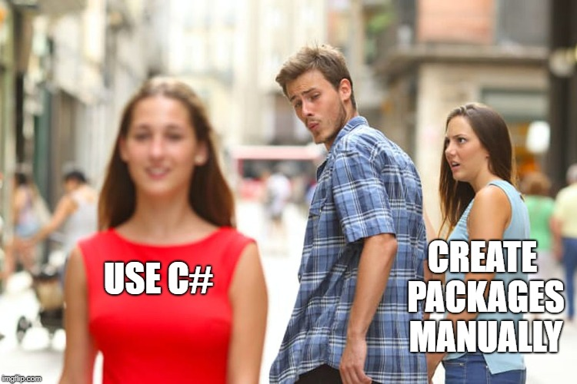
Thanks!

