Slide 1
Customer Personality Analysis
Stefan Mitrovic
mi20350@alas.matf.bg.ac.rs

Slide 2
ATRIBUTI
People
ID: Customer's unique identifier
Year_Birth: Customer's birth year
Education: Customer's education level
Marital_Status: Customer's marital status
Income: Customer's yearly household income
Kidhome: Number of children in customer's household
Teenhome: Number of teenagers in customer's household
Dt_Customer: Date of customer's enrollment with the company
Recency: Number of days since customer's last purchase
Complain: 1 if the customer complained in the last 2 years, 0 otherwise
Products
MntWines: Amount spent on wine in last 2 years
MntFruits: Amount spent on fruits in last 2 years
MntMeatProducts: Amount spent on meat in last 2 years
MntFishProducts: Amount spent on fish in last 2 years
MntSweetProducts: Amount spent on sweets in last 2 years
MntGoldProds: Amount spent on gold in last 2 years
Promotion
NumDealsPurchases: Number of purchases made with a discount
AcceptedCmp1: 1 if customer accepted the offer in the 1st campaign, 0 otherwise
AcceptedCmp2: 1 if customer accepted the offer in the 2nd campaign, 0 otherwise
Response: 1 if customer accepted the offer in the last campaign, 0 otherwise
Place
NumWebPurchases: Number of purchases made through the company’s website
NumCatalogPurchases: Number of purchases made using a catalogue
NumStorePurchases: Number of purchases made directly in stores
NumWebVisitsMonth: Number of visits to company’s website in the last month

Slide 3
PRETprocesiranje
Obrada NULL vrednosti
Uklanjanje elemenata van granica
Pravljenje pogodnih atributa
Brisanje atributa koji nam vise nece biti potrebni
Podela podataka na ulazne I na ciljne atribute
Enkodiranje kategorickih atributa
Normalizaciju podataka
Podela podataka na trening I test skupove
Cuvanje podataka za dalju obradu

Slide 4
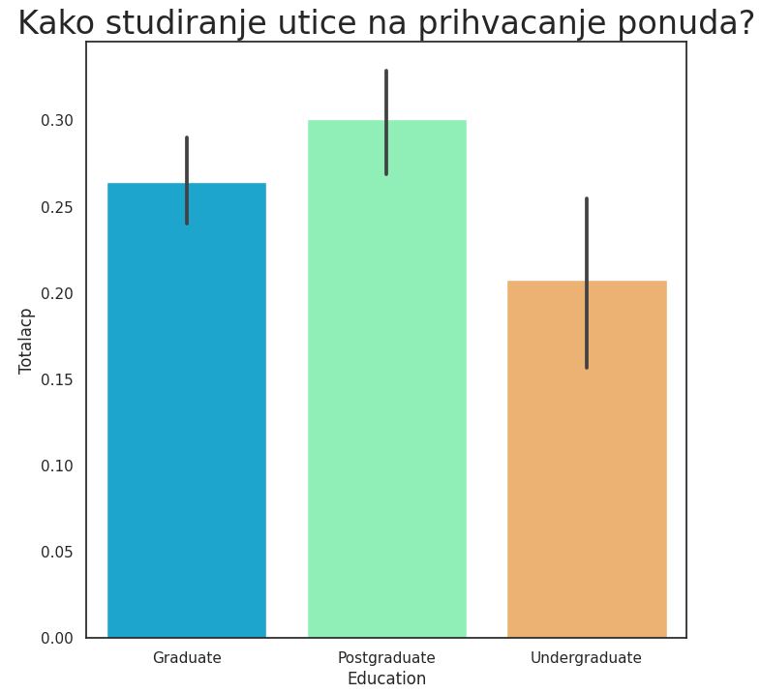
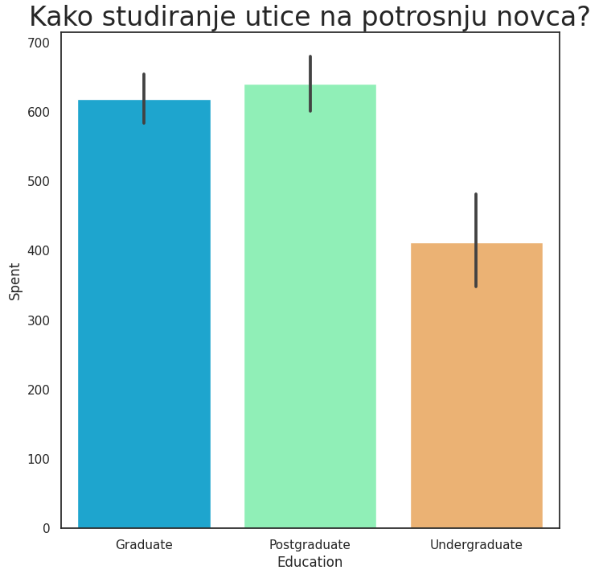
Analiza podataka

Slide 5
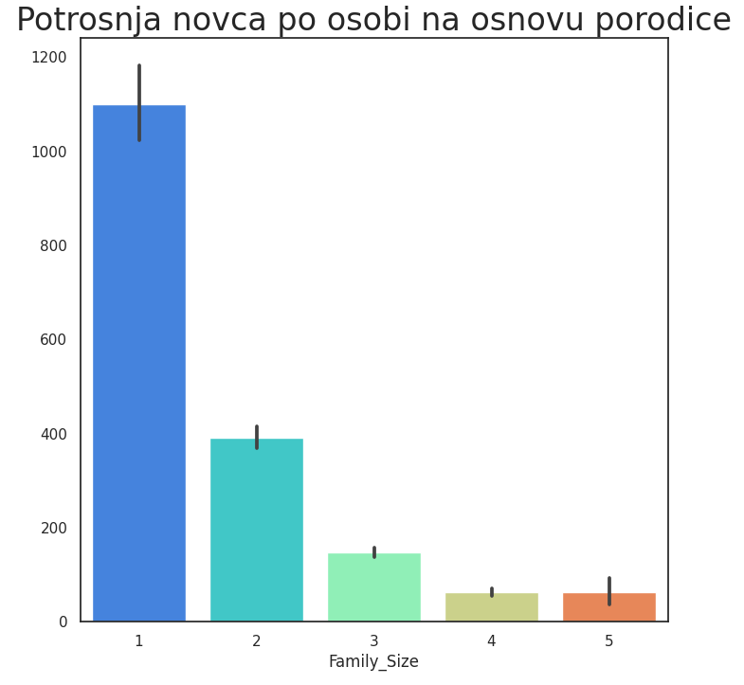
Analiza podataka

Slide 6
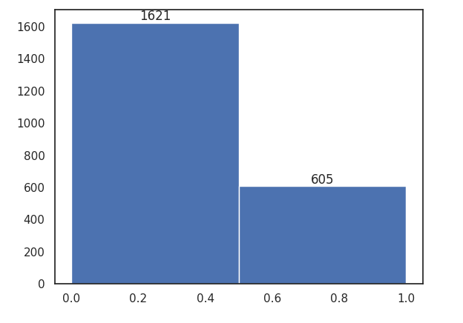
ANALIZA PODATAKA
Broj ljudi koji nikada nisu prihvatili neku ponudu I broj koji su prihvatili

Slide 7
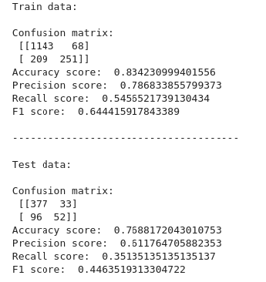
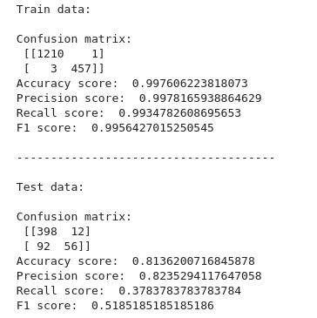
KLASIFIKACIJA
KNN | KNN CV

Slide 8
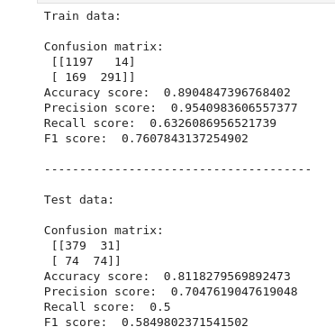
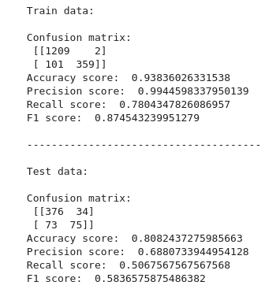
KLASIFIKACIJA
GradientBoosting | GradientBoostingCV

Slide 9
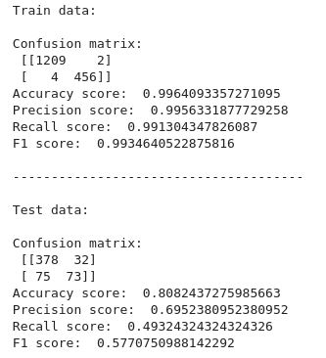
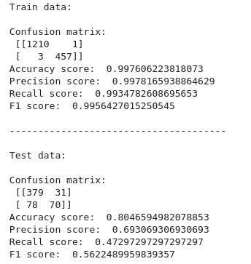
KLASIFIKACIJA
RandomForest | RandomForest CV

Slide 10
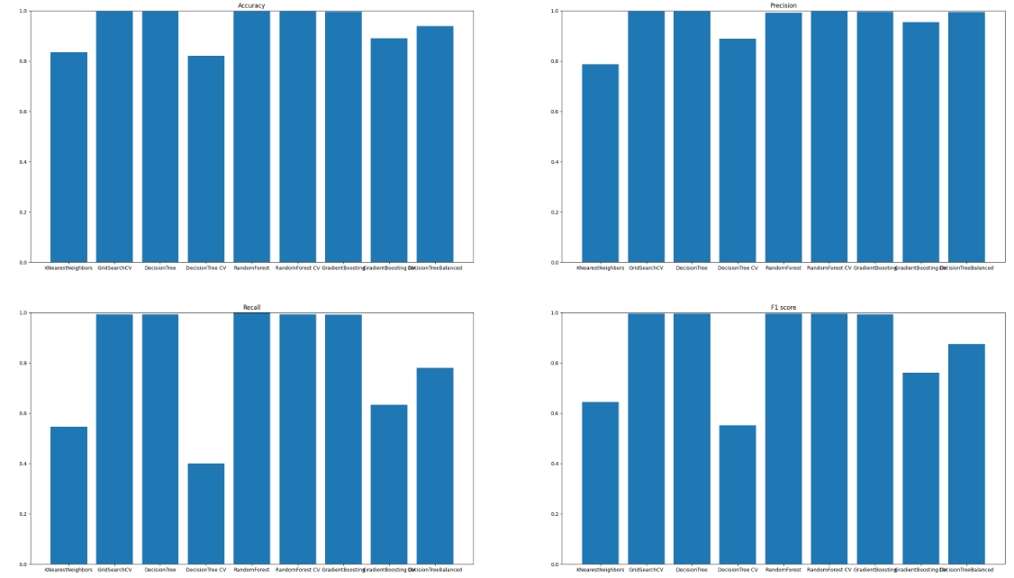
KLASIFIKACIJA (trening skup)

Slide 11
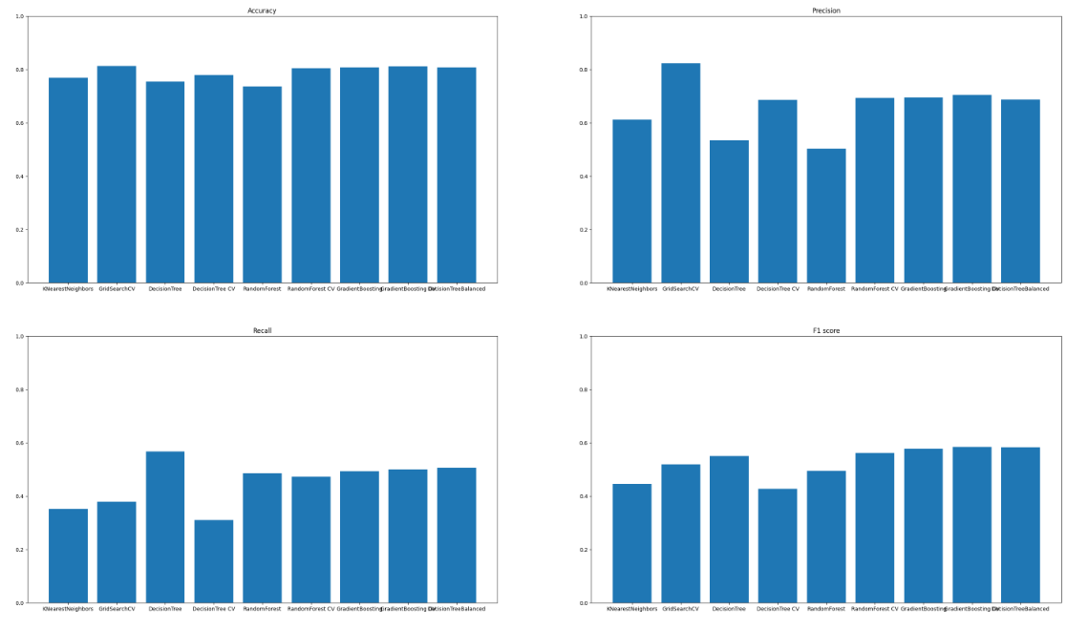
KLASIFIKACIJA (TEST skup)

Slide 12
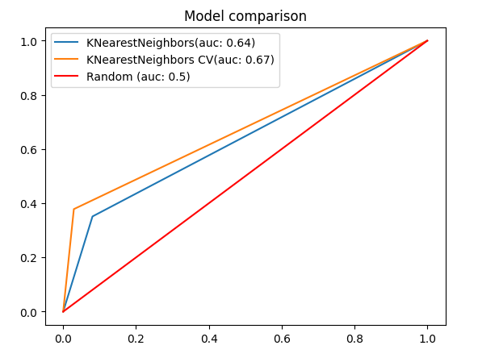
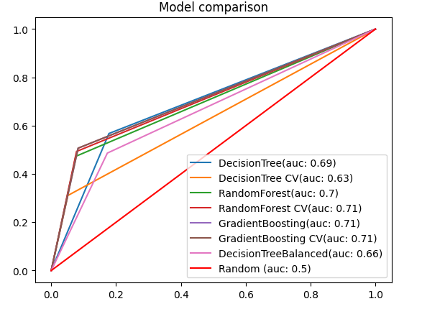
ROC krive

Slide 13
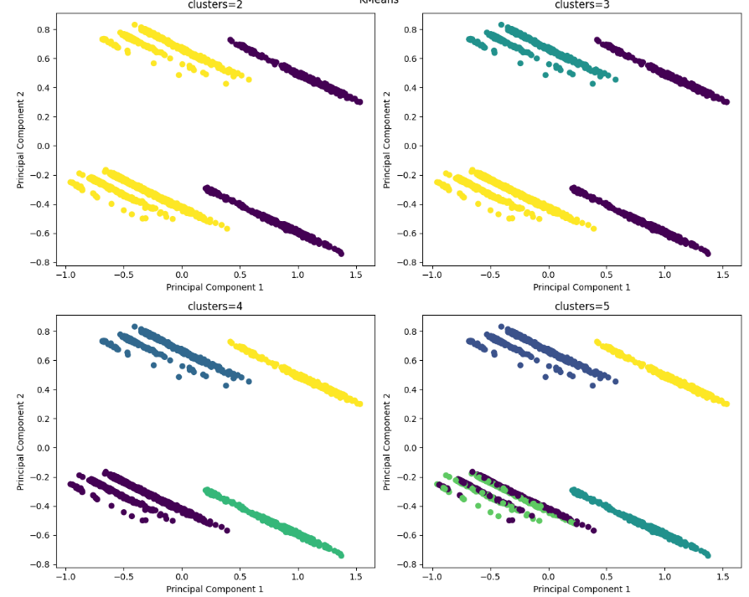
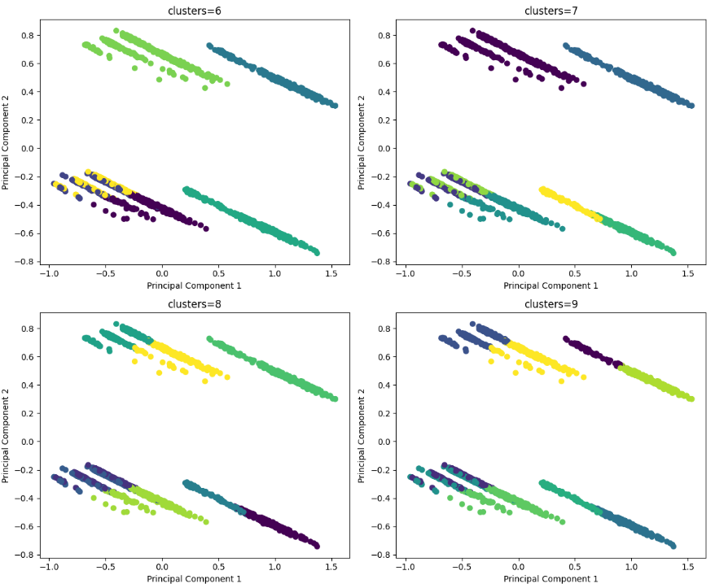
kmeans

Slide 14
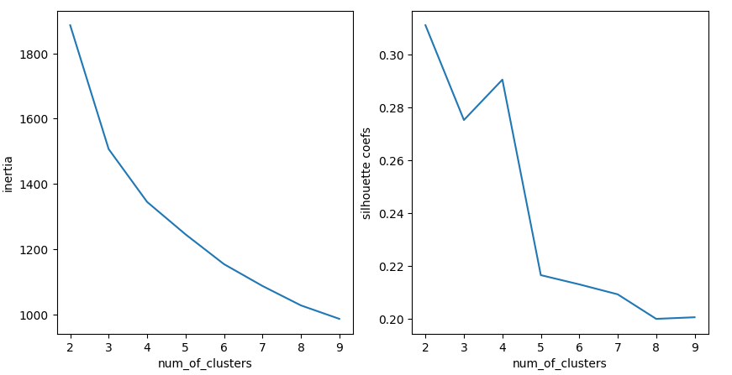
kmeans

Slide 15
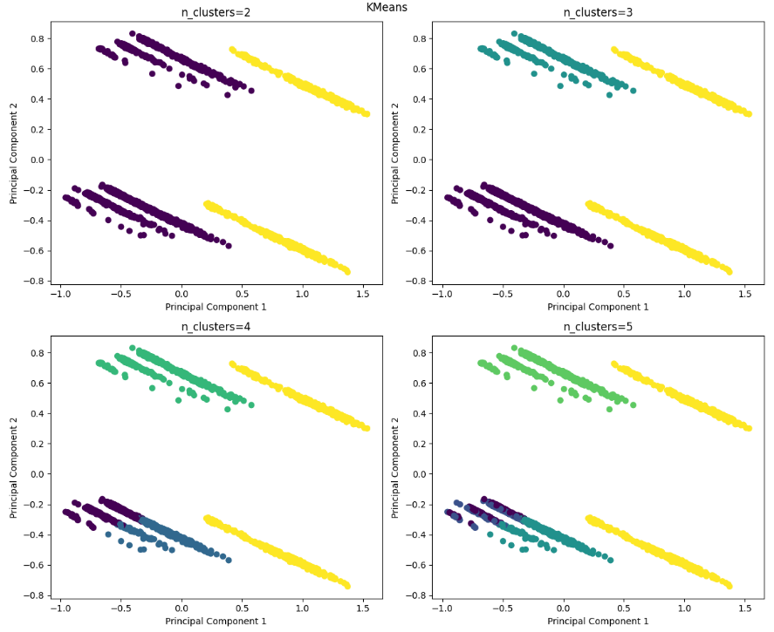
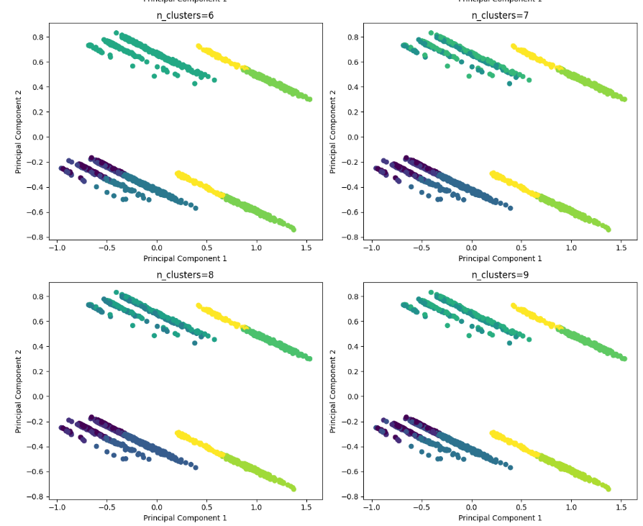
Bkmeans

Slide 16
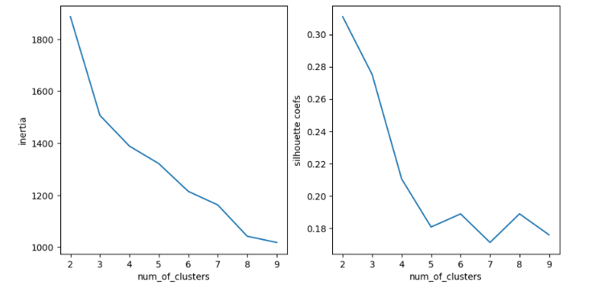
Bkmeans

Slide 17
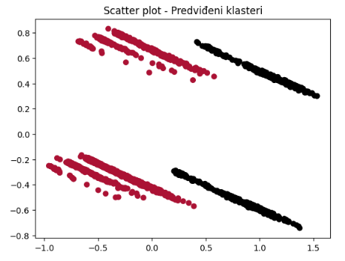
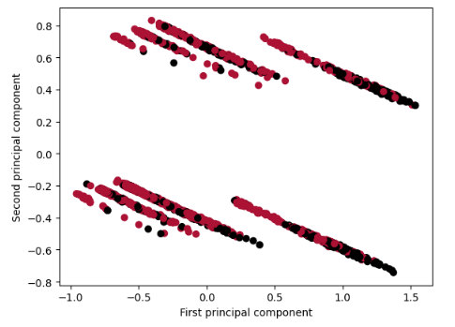
Kmeans I bkmeans
Kmeans | Test model | Bkmeans

Slide 18
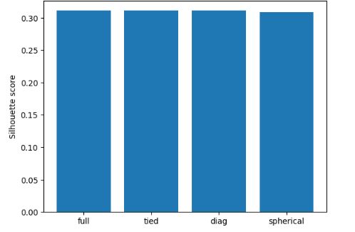
GAUS

Slide 19
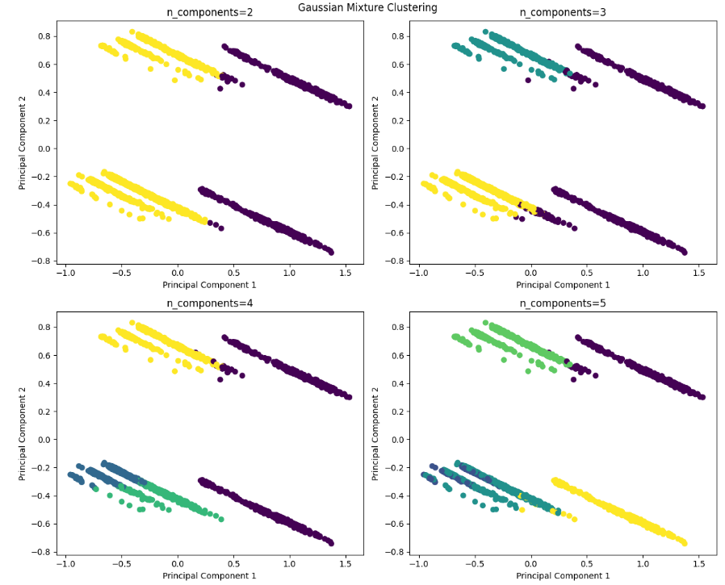
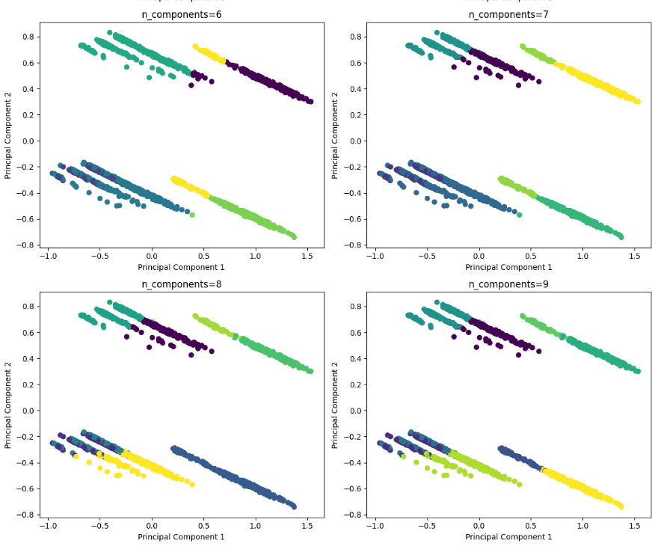
GAUS(Spherical)

Slide 20
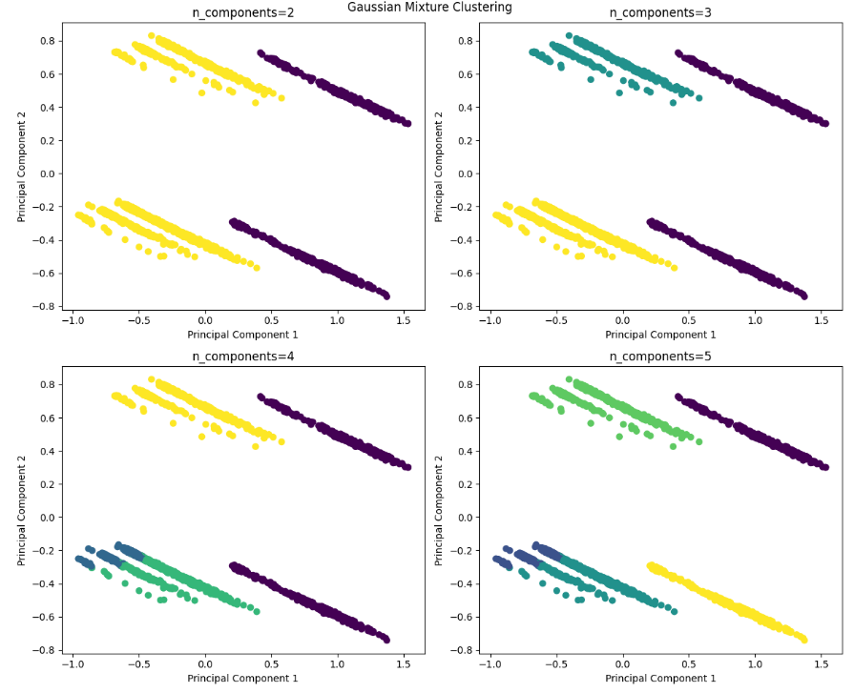
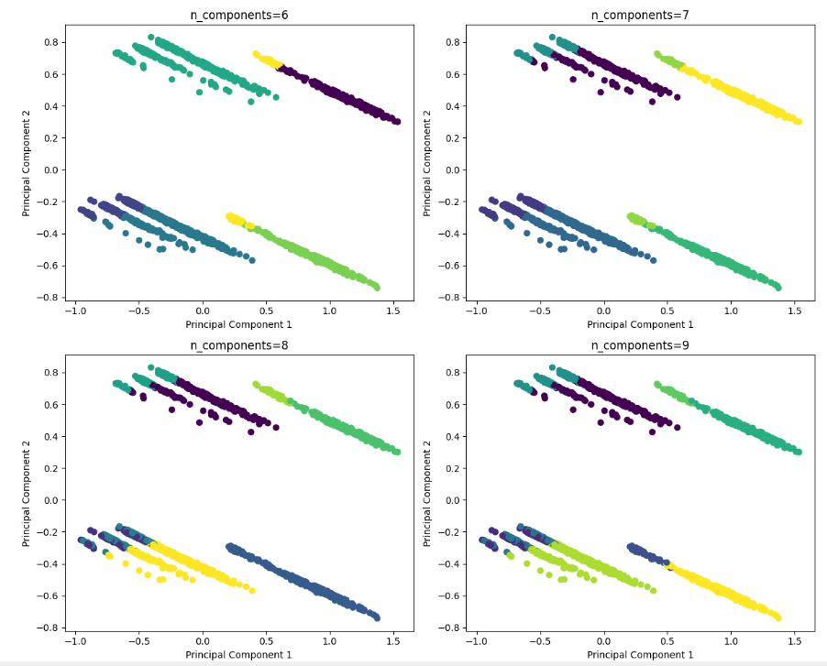
GAUS(TIED,FULL,DIAG)

Slide 21
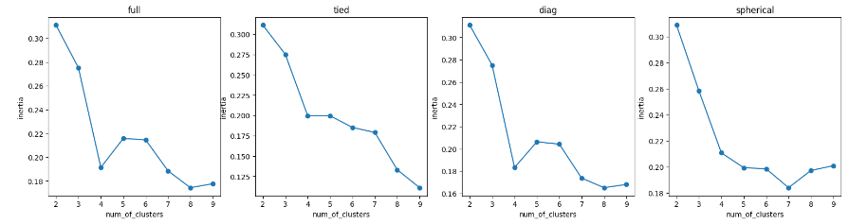
GAUS

Slide 22
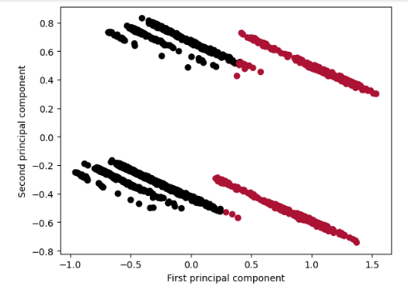
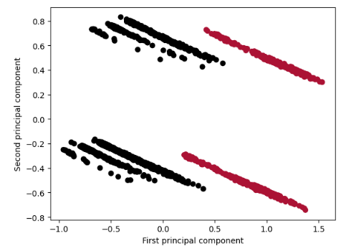
GAUS
Spherical | Test model | Svi ostali

Slide 23
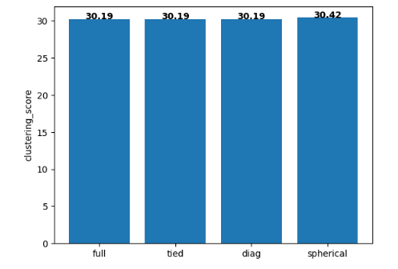
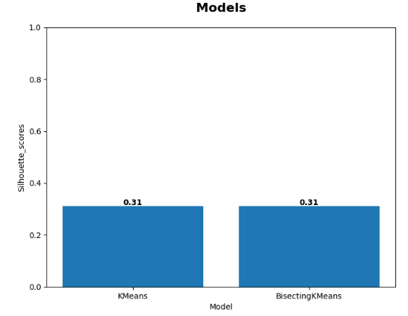
GAUS I kmeans I bkmeans

Slide 24
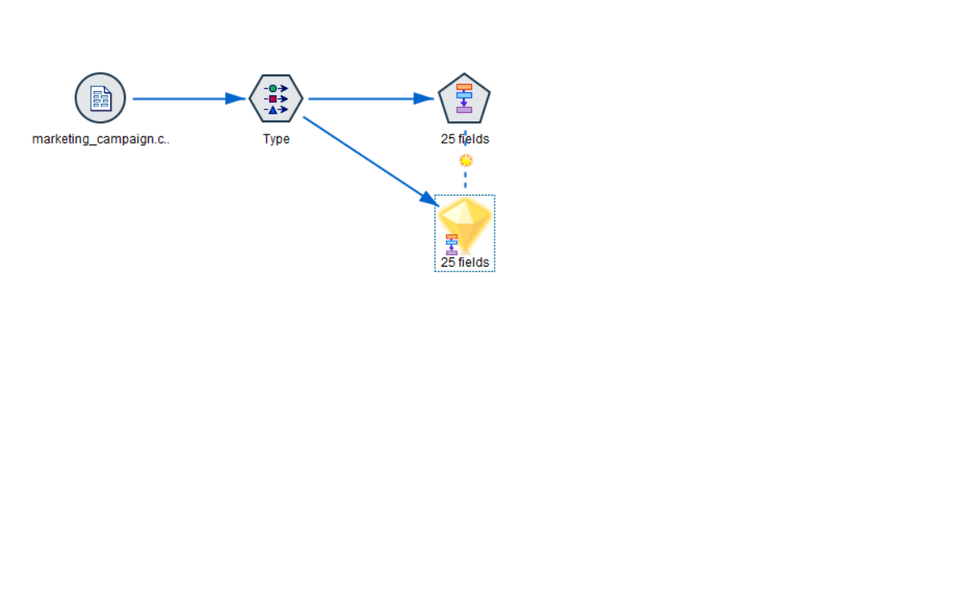
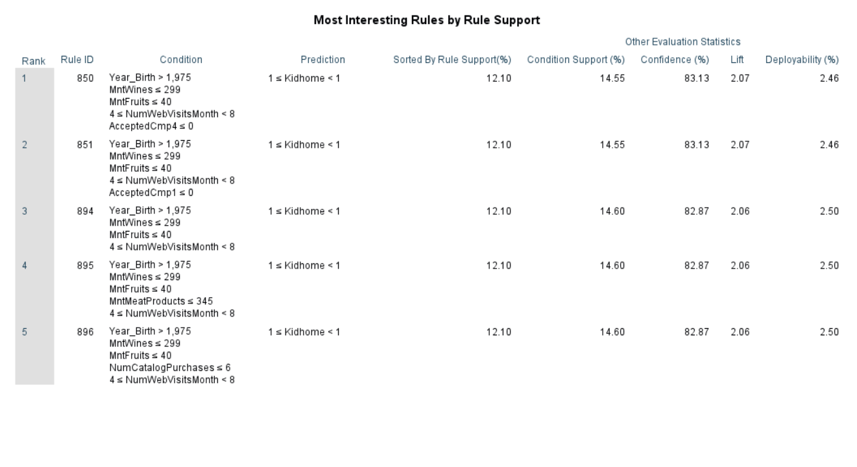
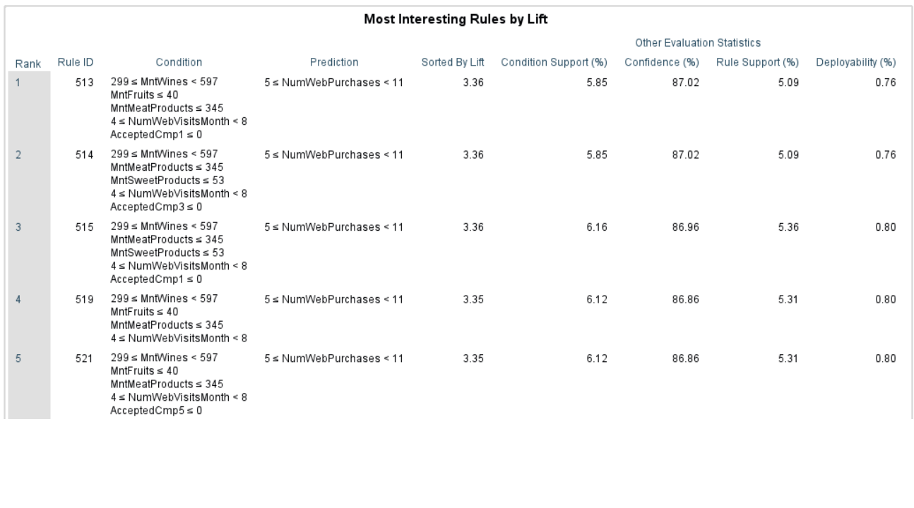
Pravila pridruzivanja

Slide 25
Hvala na paznji Sportski pozdrav <3

