Slide 1


K.RAMAKRISHNAN COLLEGE OF TECHNOLOGY
(AUTONOMOUS), TRICHY
ONLINE BOOKSTORE
PRESENTED BY SUPERVISOR
MATHAN M Mrs.K.Valli Priyadharshini M.E., (PhD),
2303811710421092 AP/CSE.

Slide 2
PRESENTATION OVERVIEW
Objective
Project Introduction
Problem Statement
Methodologies (Programming concepts relevant to problem statement)
Architecture of the proposed system
List of Modules
7. Merits
8. Results and Discussion
9. Queries

Slide 3
OBJECTIVE
The objective of this project is to develop an interactive and user-friendly online bookstore application that manages book sales, tracks inventory, and provides an efficient shopping experience for users.

Slide 4
PROJECT INTRODUCTION
The Online Book Store offers features for browsing, purchasing books, and real-time stock tracking. It ensures secure transactions, tracks deliveries, and provides a platform for both users and administrators to manage their respective needs.

Slide 5
PROBLEM STATEMENT
Traditional bookstores face challenges like limited reach, inefficient inventory management, and lack of real-time data. This project addresses these issues by implementing a digital platform to streamline book sales and inventory management.

Slide 6
METHODOLOGY
1.Classes and objects: For modeling entities such as books, users, and inventory.
2.Swing Framework: To create a graphical user interface for interaction.
3.Java Collections Framework: For managing dynamic lists of books and user data.
4.Event Handling: For managing actions like registration, login, and cart updates.

Slide 7
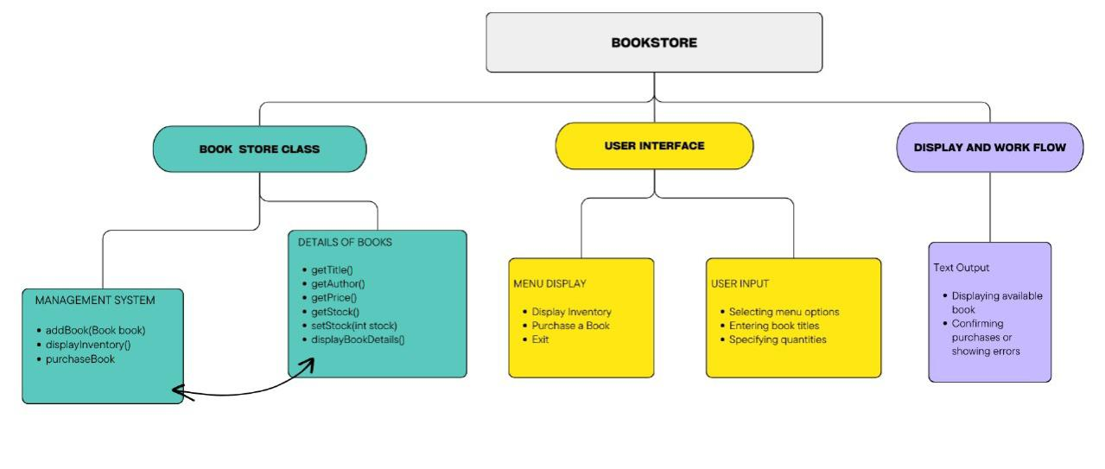
ARCHITECTURE DIAGRAM

Slide 8
LIST OF MODULES
User Registration and Login Module: For secure account creation and authentication.
Bookstore Module: Displays inventory and supports adding books to the cart.
Cart and Checkout Module: Tracks selected books, calculates totals, and processes orders.
Book Tracker Module: Displays shipping and delivery status.
Admin Module (Future Scope): For inventory management and sales reporting.

Slide 9
MERITS
1.User-Friendly Interface: Easy navigation and operations.
2.Real-Time Updates: Inventory changes dynamically based on purchases.
3.Scalable: Can handle large inventories and multiple users.
4.Security: Ensures strong password creation and user authentication.

Slide 10
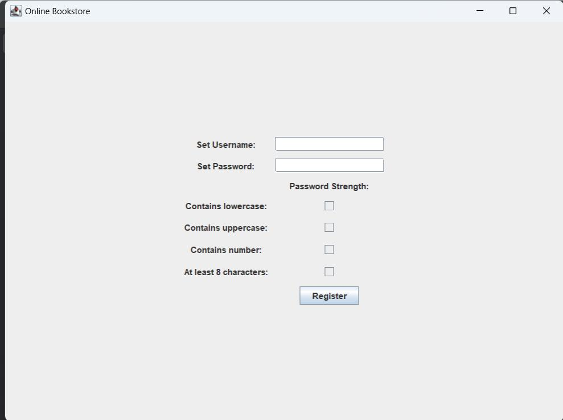
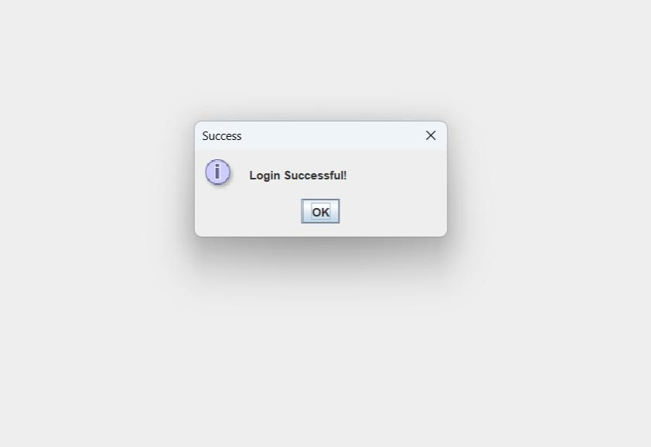
RESULTS AND DISCUSSION

Slide 11
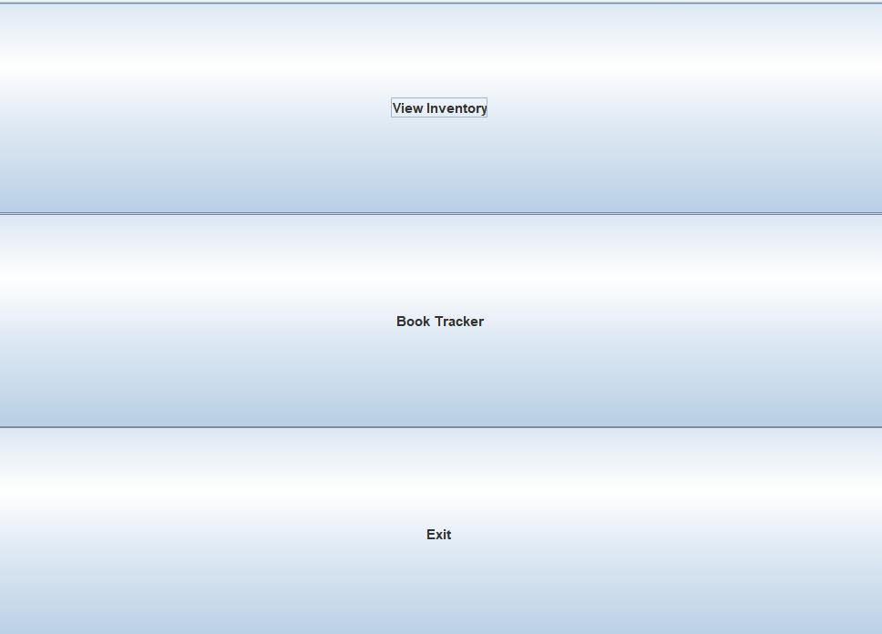
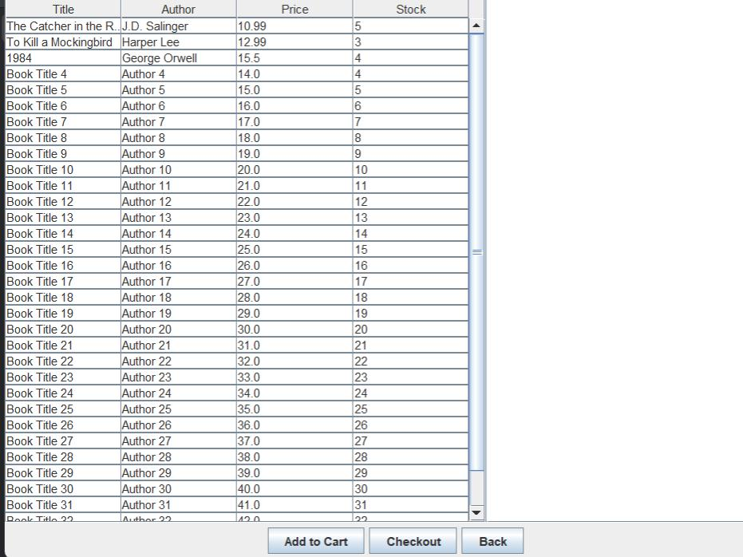

Slide 12
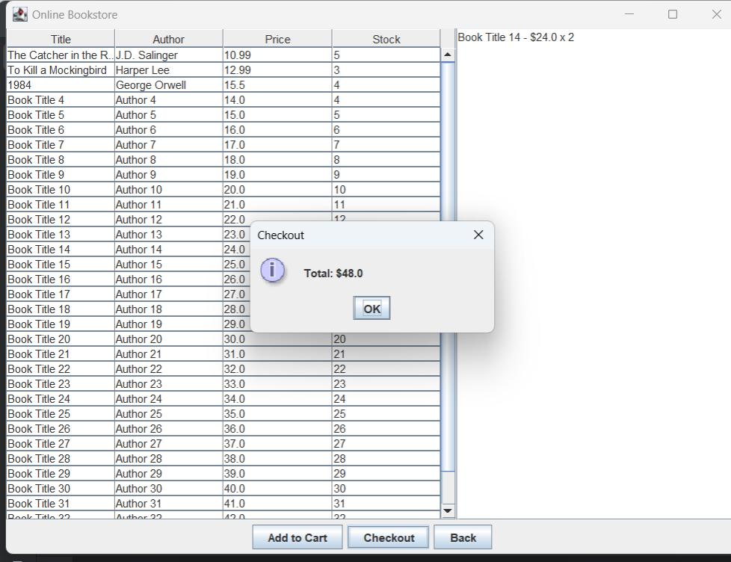
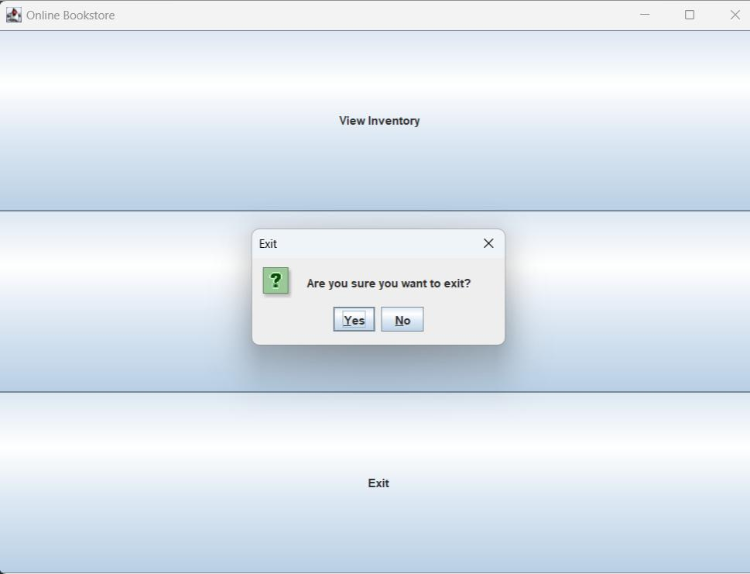

Slide 13
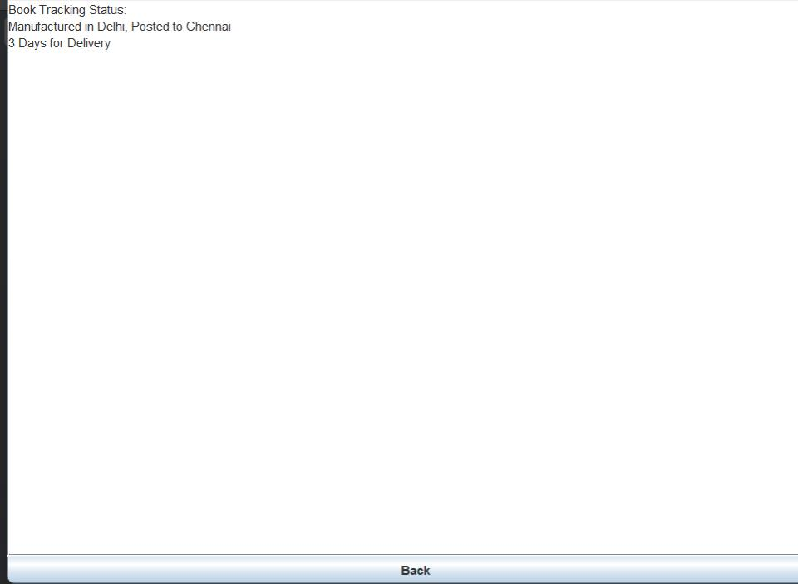

Slide 14
QUERIES

Slide 15
THANK YOU

