Slide 1
Life Expectancy Data Analysis
Exploratory Data Analysis and Machine Learning
Dataset Source: WHO

Slide 2
Dataset Overview
The dataset contains 2,938 records with 22 columns.
- Features include demographics, health, economic indicators.
- Target Variable: Life Expectancy
- Includes both Developed and Developing countries (2000–2015)

Slide 3
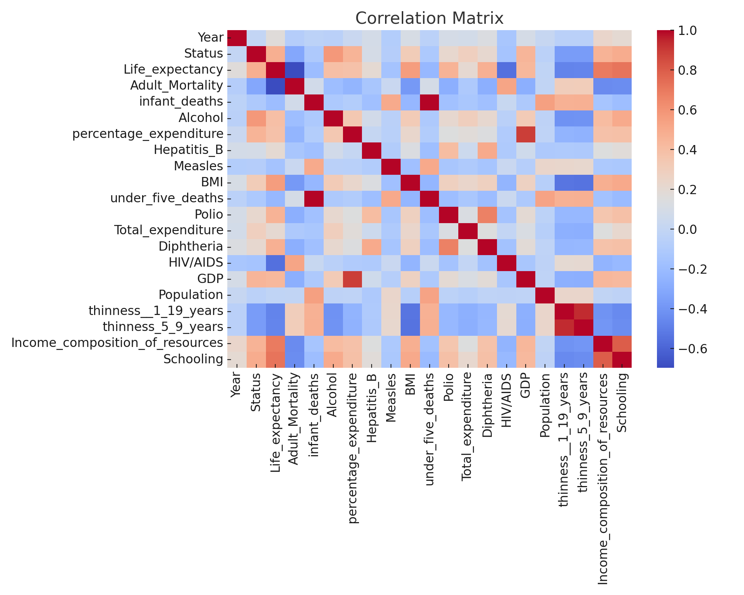
Correlation Matrix

Slide 4
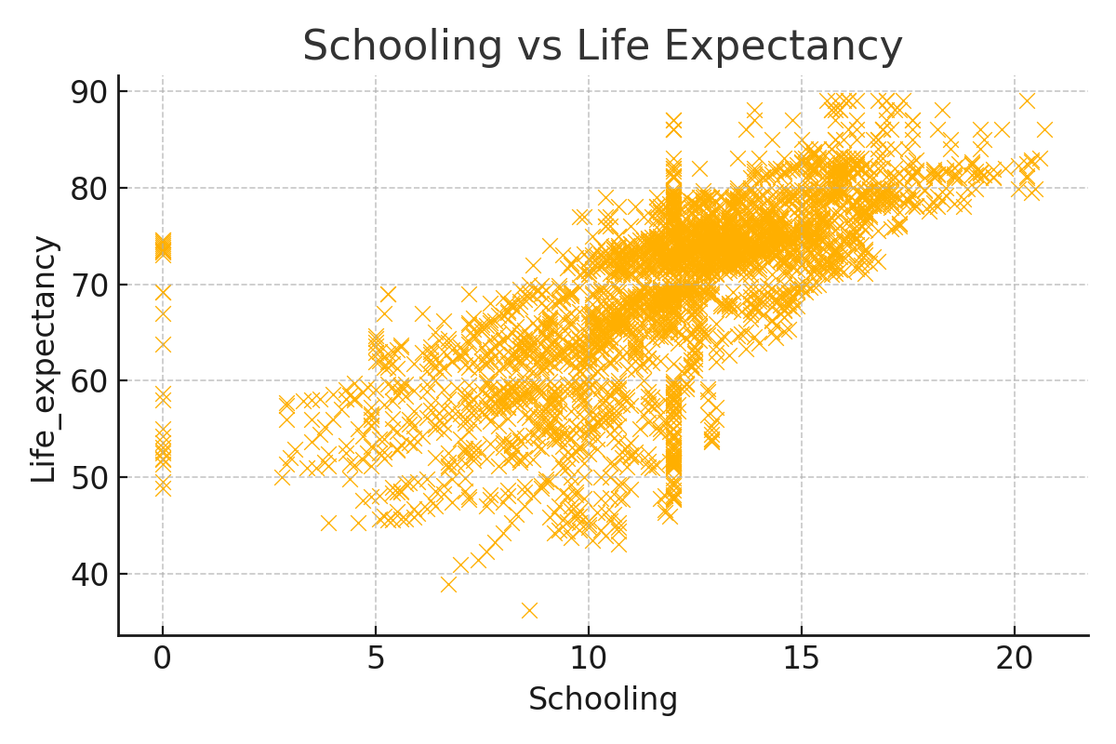
Schooling vs Life Expectancy

Slide 5
Model & Performance
Linear Regression Model was used to predict Life Expectancy.
- Input Features: Health, economic, and demographic variables
- R² Score: ~0.83
- RMSE: ~2.6
The model captures general trends well but has limitations due to data variance.

