Slide 1
MEDICARE
BY:
MOTHIKA G (20ISR028)
PREMA J (20ISR037)
RAGAVI A (20ISR038)

Slide 2
PROBLEM STATEMENT
Many people in India live in extreme poverty.
So, it becomes difficult for those people to pay for their health care and medication.
As a result, they live with several diseases and the number of deaths increases daily.
Apart from that, there are various people who are overdosing on drugs even after they have stopped their medication.

Slide 3
SOLUTION - OUR WEBSITE
We have set up a website for donating medicines to the people who need that.
We act as a intermediate between the recipient and the foundations.
This site will help in reducing the cost of health services by making better use of unused drugs as well as helping poor people to get better healthcare.

Slide 4
FEATURES
The people who in need of medicine will receive the medicine in correct time.
We can save lots of lives.

Slide 5
HAVE A GLANCE OF OUR WEBSITE

Slide 6


Slide 7
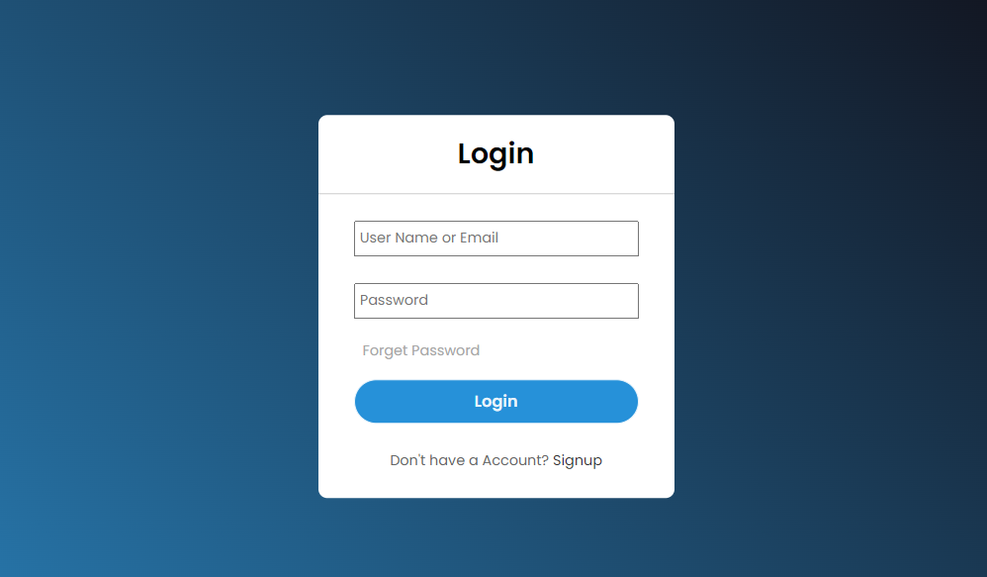

Slide 8
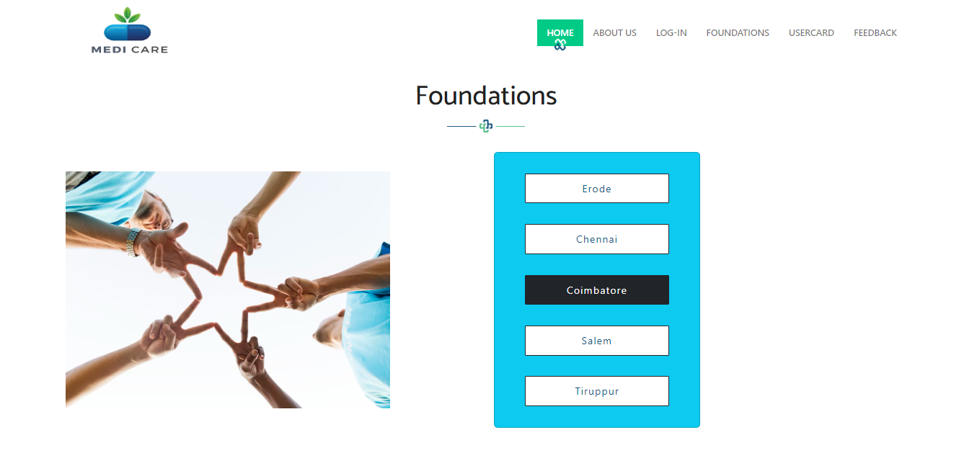

Slide 9
THANK YOU

