Slide 1

Multi Flop Synchronizer & Asynchronous Reset Synchronizer
Prepared and Presented by
M.Mathy Bala
Intern
Smart IOPS

Slide 2
Synchronizer
A synchronizer is a digital circuit that converts an asynchronous signal/a signal from a different clock domain into the recipient clock domain so that it can be captured without introducing any metastability failure.
The purpose of synchronizer is to prevent the downstream logic from metastable state of first flip-flop in new clock domain.
The synchronizer is used to avoid metastability.
It is a digital circuit which is used to convert asynchronous or signals from different clock domains into the receiver's clock domain so that capturing would not cause any metastability issue.

Slide 3
Types of Synchronizers
Multi-flop Synchroniser
Asynchronous Reset Synchroniser
Asynchronous Reset Synchronised De-assertion
Pulse/Toggle Synchroniser
Data Synchroniser

Slide 4
Multi Flop Synchronizer
It is also known as Three Flip Flop Synchronizer
A commonly used synchronizer is a multi-flop synchronizer
This structure is mainly used for single and multi-bit control signals and single bit data signals in the design
It consists of multiple flip-flops connected in a chain, with the input signal being fed into the first flip-flop, and the output of each flip-flop being fed into the next one in the chain.
Each flip-flop in the chain introduces a delay, which allows the signal to settle down and stabilize before being passed on to the next stage.

Slide 5
Description of Multi Flop Synchronizer
The output of the final flip-flop in the chain provides the synchronized signal that can be safely used in the clock domain of the circuit.
The number of flip-flops in the chain can be adjusted to achieve a desired level of synchronization and delay.
Multi-flop synchronizers are often used for critical signals that require high reliability, such as asynchronous resets, and clock enables.
They are also used in high-speed circuits where timing violations can lead to significant errors or malfunction.

Slide 6
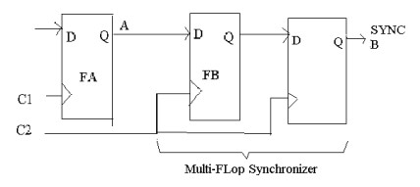
Signals used in Multi Flipflop Synchronizer
The signals used in the Multi Flip Flop Synchronizer are
Clock
Reset
Asynchronous Signal Input
Synchronous Signal Output
There are three flip flops ; One of three flipflops uses one Clock Domain and the other two uses other clock domain

Slide 7
Block Diagram of Multi Flop Synchronizer
Input
Qb 0
Qb 1
Qb
1st Flipflop
2nd Flipflop
3rd Flipflop
Clock 1
Clock 2

Slide 8
Working of Multi Flop Synchronizer
The Synchronizer consists of three flipflops
Input is fed into the 1st Flipflop along with Clock 1which is of short duration
The other two flipflops are clocked with the help of same clock Clock 2
The output from the 1st flipflop is connected to the next flipflop
At this time, the clock used here in the flipflop 2 and 3 slows down and make the signal settle down and wait for the Meta-Stability to pass through
So the output signal from the 3rd flipflop will be free from any glitches and thus the glitches is avoided in Multi Flop Synchronizer

Slide 9
Timing Diagram in Multi Flipflop Synchronizer
Input
Clock 1
META STABILITY
Clock 2
Qb 0 & 1
But prevented in the final output
Qb

Slide 10
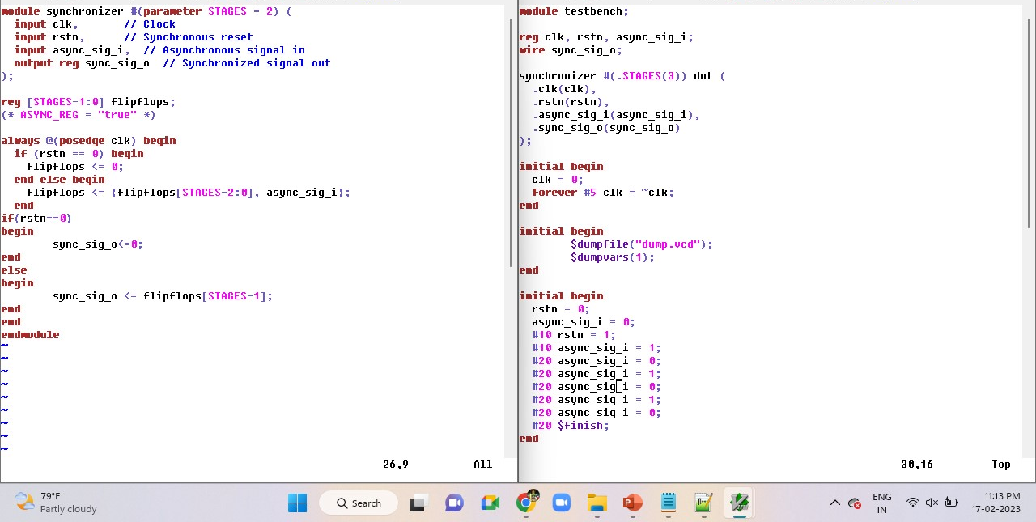
Equivalent Verilog code for Multi flop Synchronizer

Slide 11
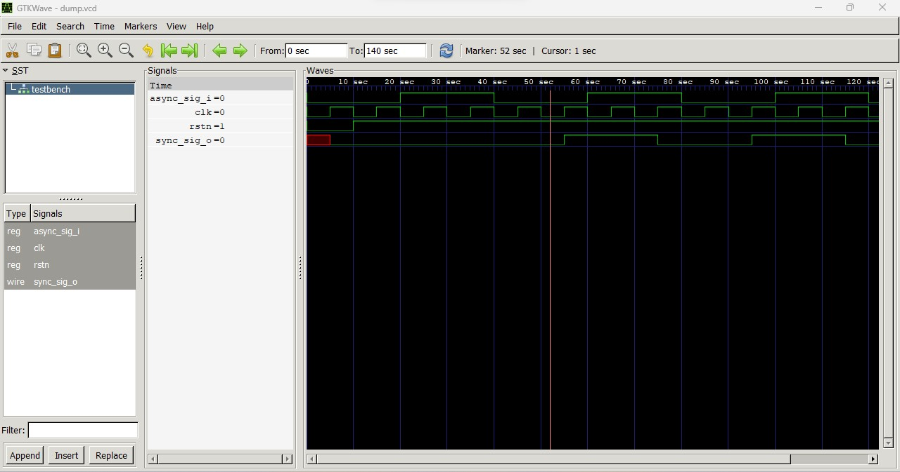
Waveform

Slide 12
Asynchronous Reset Synchronizer
An asynchronous reset synchronizer is a circuit used in digital electronics to synchronize an asynchronous reset signal to a clock domain.
Asynchronous resets are commonly used to reset digital circuits to a known state.
However, asynchronous reset signals can cause timing problems when they are used across different clock domains.
This is because the reset signal may be affected by clock skew, which can cause it to arrive at different times in different parts of the circuit.
To solve this problem, an asynchronous reset synchronizer is used.
The purpose of the synchronizer is to delay the reset signal so that it is synchronized to the clock domain of the circuit.

Slide 13
Description of Asynchronous Reset Synchronizer
Asynchronous Reset Synchronizer consists of two flip-flops :
Reset signal fed into the first flip-flop.
The output of the first flip-flop fed into the second flip-flop.
The clock signal is used to clock both flip-flops.
The first flip-flop captures the asynchronous reset signal, and the second flip-flop serves as a buffer to provide a clean and synchronized reset signal to the circuit.
The synchronizer ensures that the reset signal is stable for at least one clock cycle before it is applied to the circuit.
Overall, the asynchronous reset synchronizer is an important tool for ensuring reliable and predictable behavior of digital circuits that use asynchronous resets.

Slide 14
Signals used in Asynchronous Reset Synchronizer
The signals used in the Multi Flip Flop Synchronizer are
Clock
Asynchronous Reset Input
Synchronous Reset Output
There are two flip flops ; Both Flipflops are clocked by the Same clock

Slide 15
Block Diagram of Asynchronous Reset Synchronizer
Async reset
Synchronized reset
Flip flop 1
Flip flop 2
AND gate

Slide 16
Working of Asynchronous Reset Synchronizer
The asynchronous reset signal is fed into the first flip-flop.
The output of the first flip-flop is then connected to the input of the second flip-flop.
The output of the second flip-flop is connected to an AND gate, along with the original asynchronous reset signal.
The output of the AND gate provides the synchronized reset signal, which can be used to reset the rest of the circuit.
The purpose of the asynchronous reset synchronizer is to delay the asynchronous reset signal so that it is synchronized to the clock domain of the circuit, and to ensure that the reset signal is stable for at least one clock cycle before it is applied to the circuit.

Slide 17
Timing Diagram in Asynchronous Reset Synchronizer
Async_reset
Clock
Flipflop 1
Flipflop 2
AND
Synchronized_reset

Slide 18
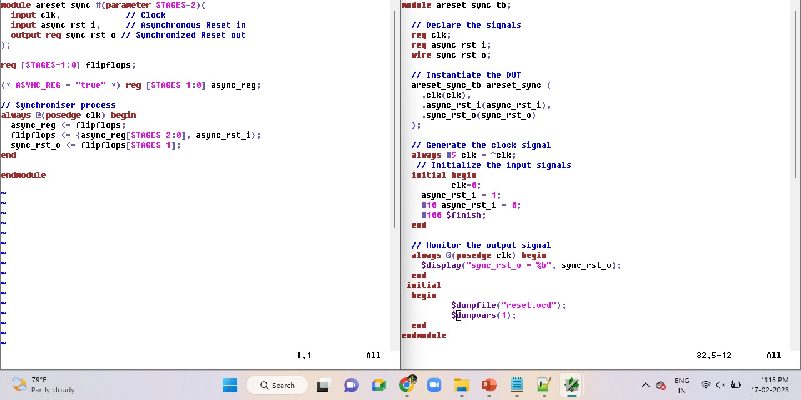
Equivalent Verilog code for Asynchronous Reset Synchronizer

Slide 19
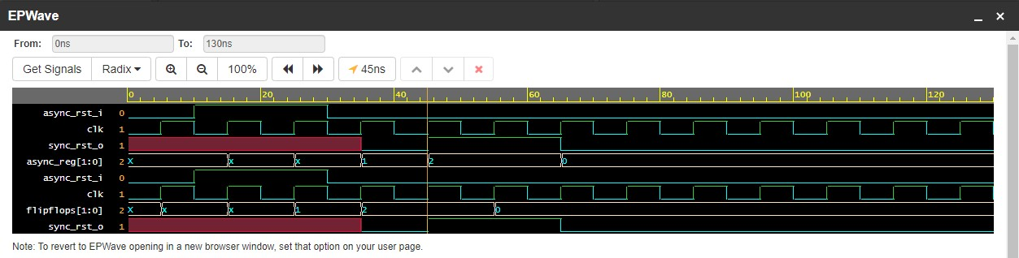
Waveform

Slide 20
Thank You…!

