Slide 1


Slide 2
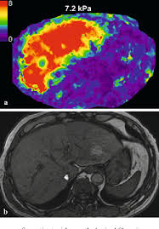
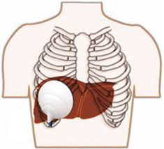
Project 5: CONTEXT
MR Elastogtraphy: Imaging technique sensitive to tissue mechanical properties
Mechanical excitation (at given frequency)
Phase-contrast MRI (encodes tissue response)
Physical model of tissue (linear elastic, viscoelastic, poroelastic)
Inversion method (direct/least–squares, iterative/finite element, …)

Slide 3
PROJECT IDEA
Phase Images
Elastogram

Slide 4
PROJECT IDEA
Phase Images
Elastogram
Phase Images
Smoothing
Umwrapping
FFT
Direct Inversion
Elastogram

Slide 5
PROJECT IDEA
Phase Images
Elastogram
Phase Images
Smoothing
Umwrapping
FFT
Direct Inversion
Elastogram
Finite-Volume inversion
Tissue modeling (biphasic)
Numerical simulation

Slide 6
GOALS
Build an interdisciplinary pipeline from data to physical parameters
Enable the simple validation and testing of different approaches
Facilitate the communication/collaboration between different disciplines

Slide 7
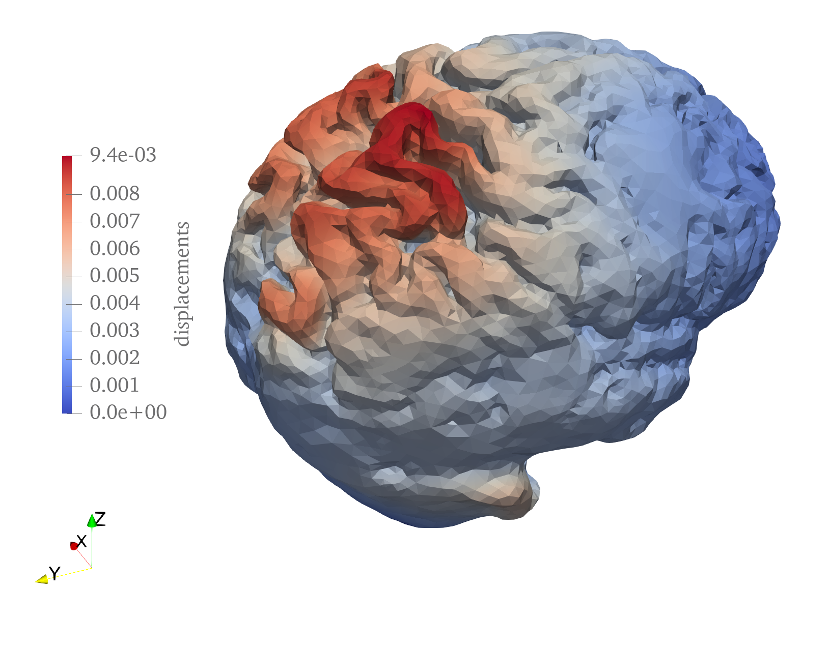
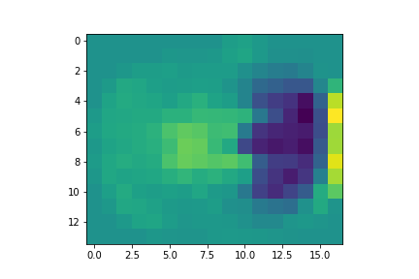
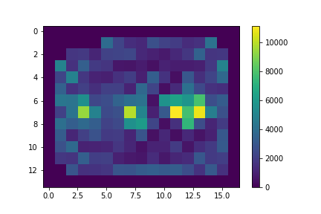
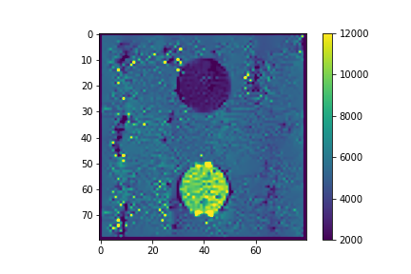
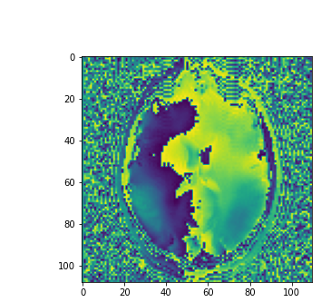
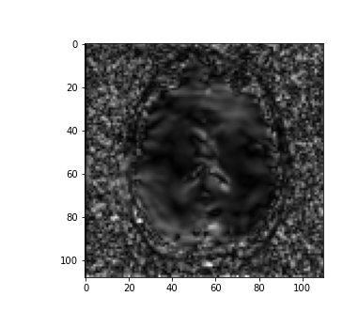
RESULTS
Shear modulus for simulated brain
Shear modulus for simulated phantom
In vivo images

