Slide 1
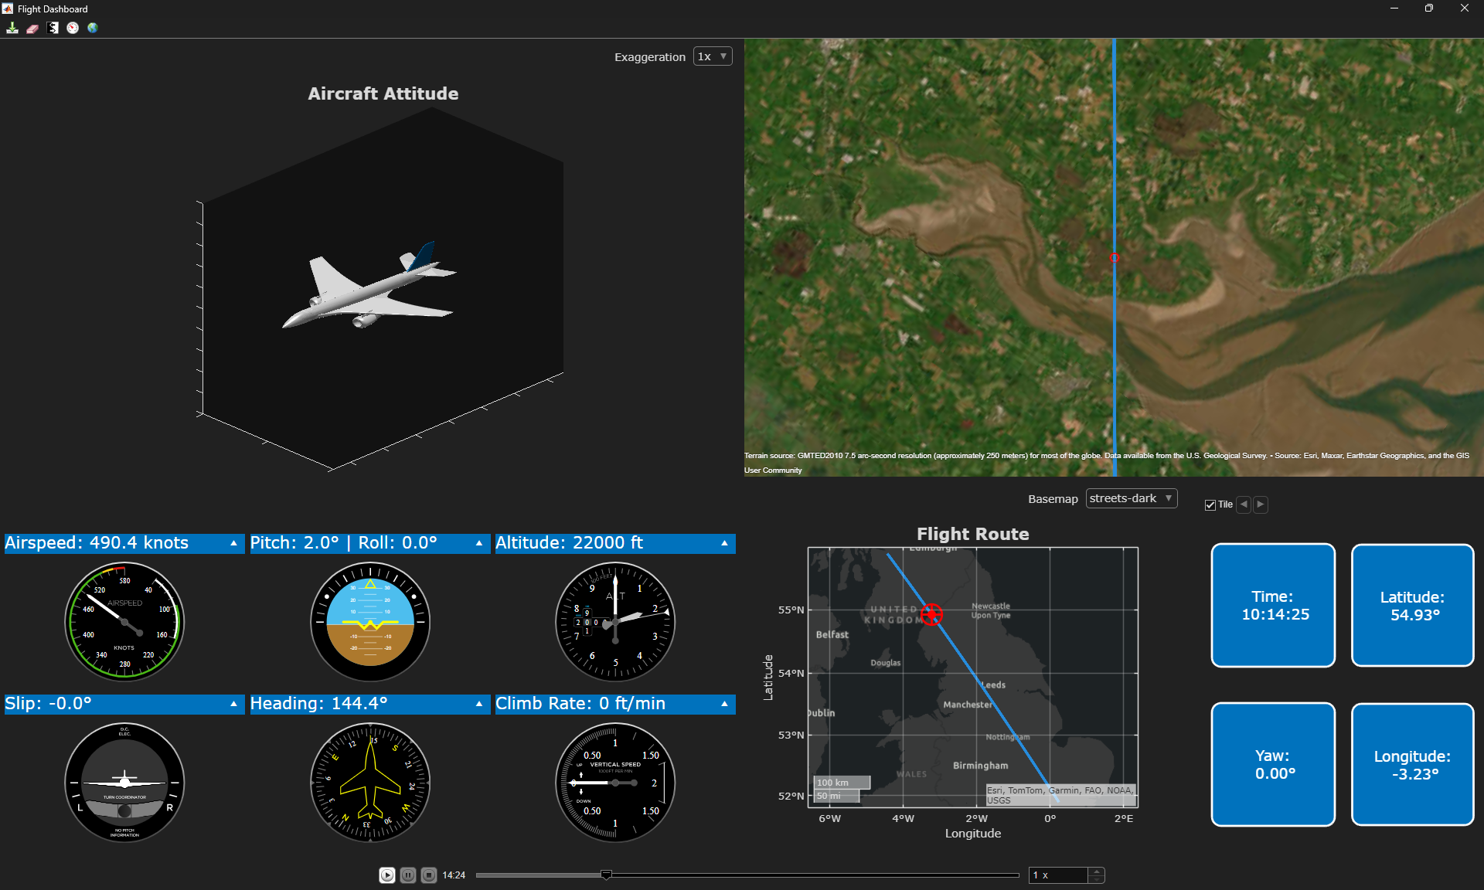
Dashboard configuration
Charts
Flight data
Flight instruments

