Slide 1
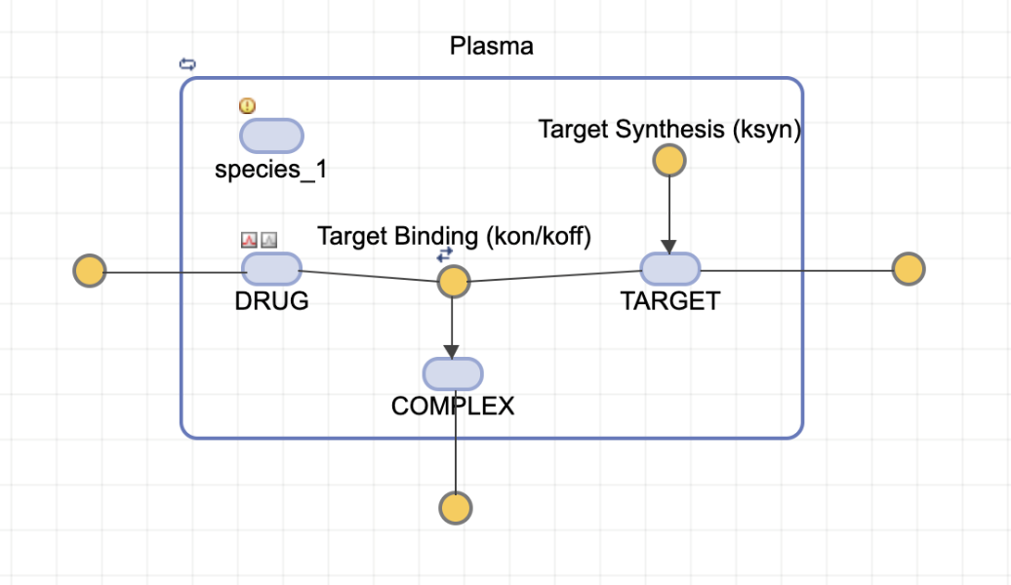
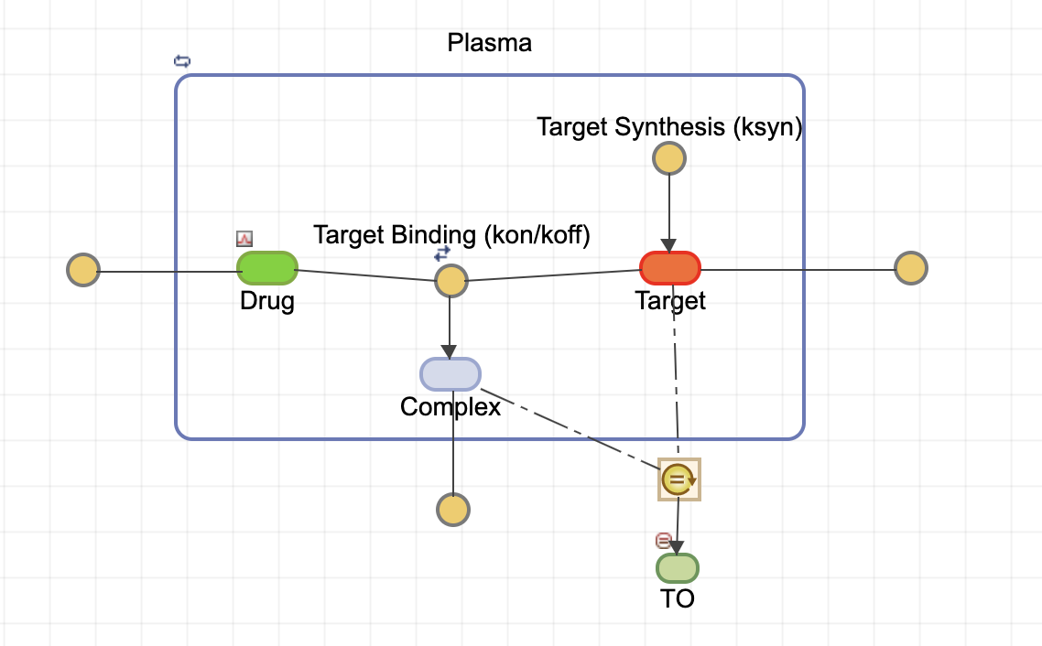
Model Comparison
One model, two versions
Find the differences
tmdd_v1.sbproj
tmdd_final.sbproj

Slide 2
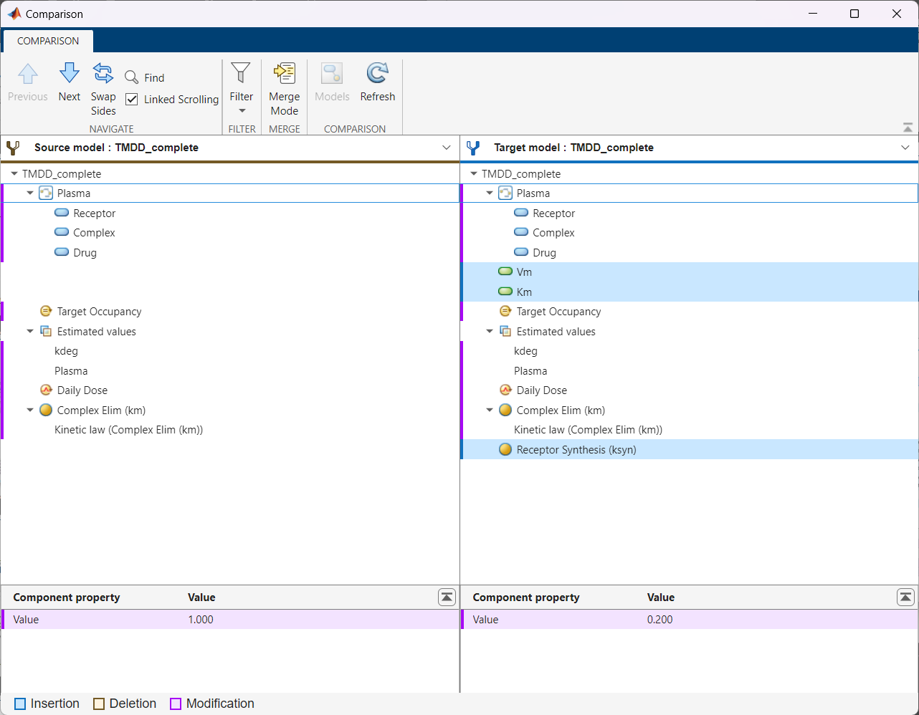
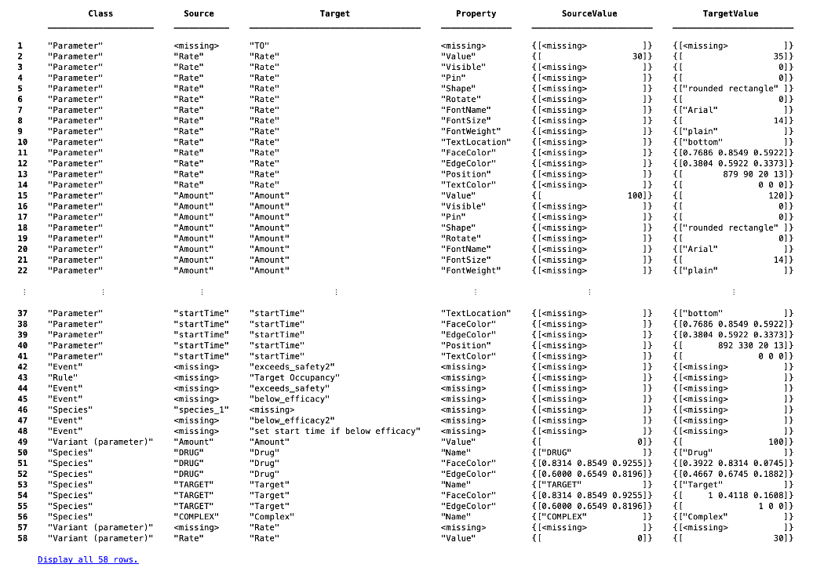
Two ways to view model differences
command line feature and graphical user interface
diffResults = sbiodiff(model1, model2);

Slide 3
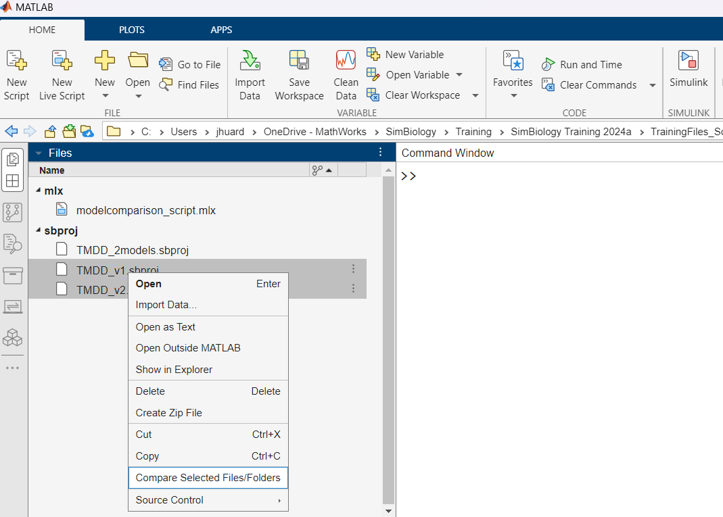
Model Comparison
Start GUI for model comparison

Slide 4
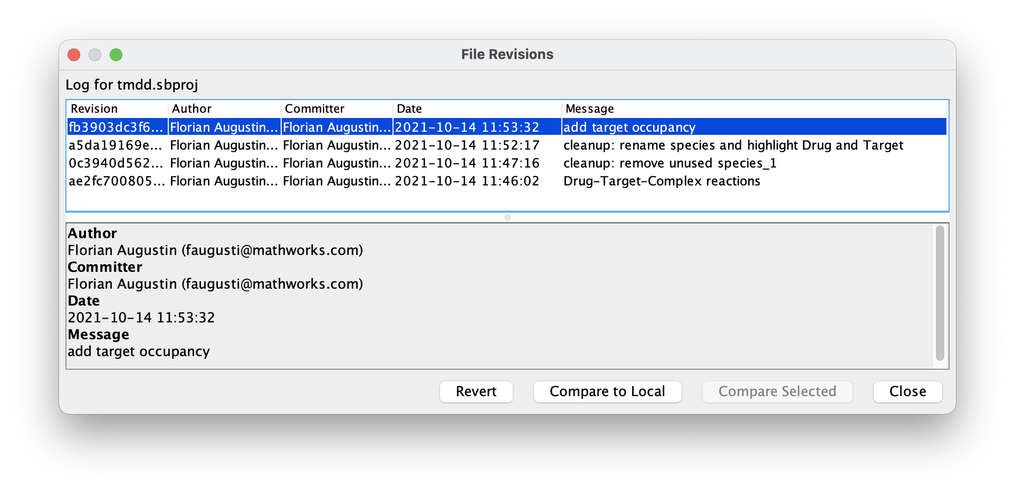
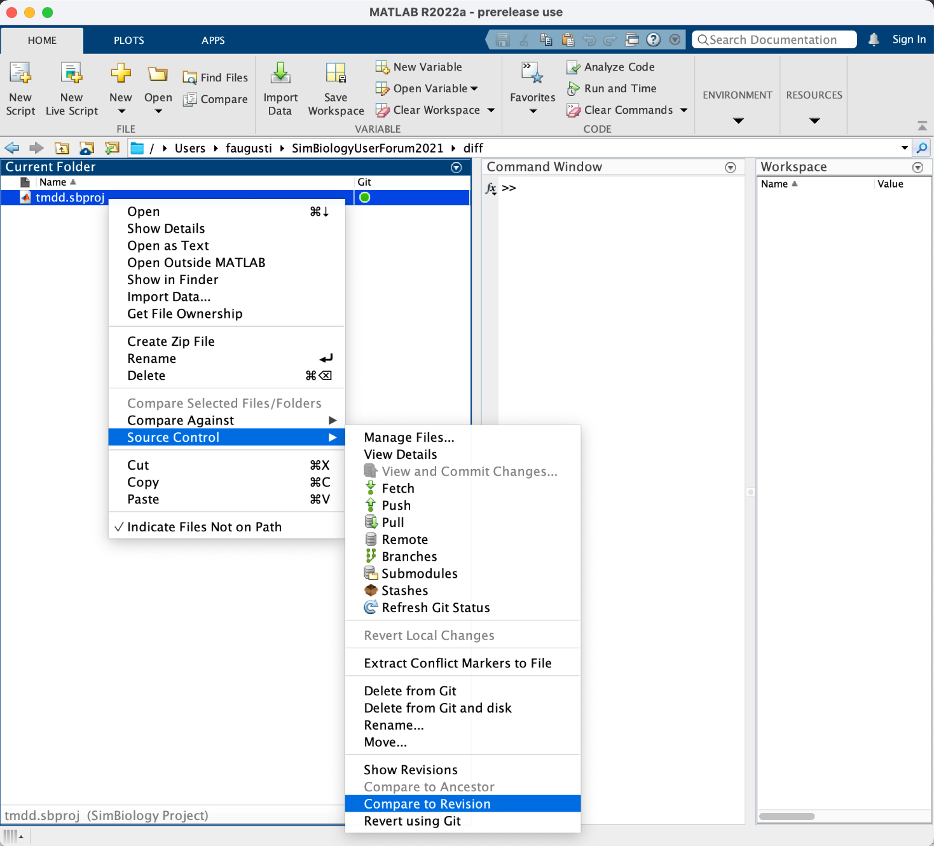
Model Comparison
Git integration within MATLAB

Slide 5
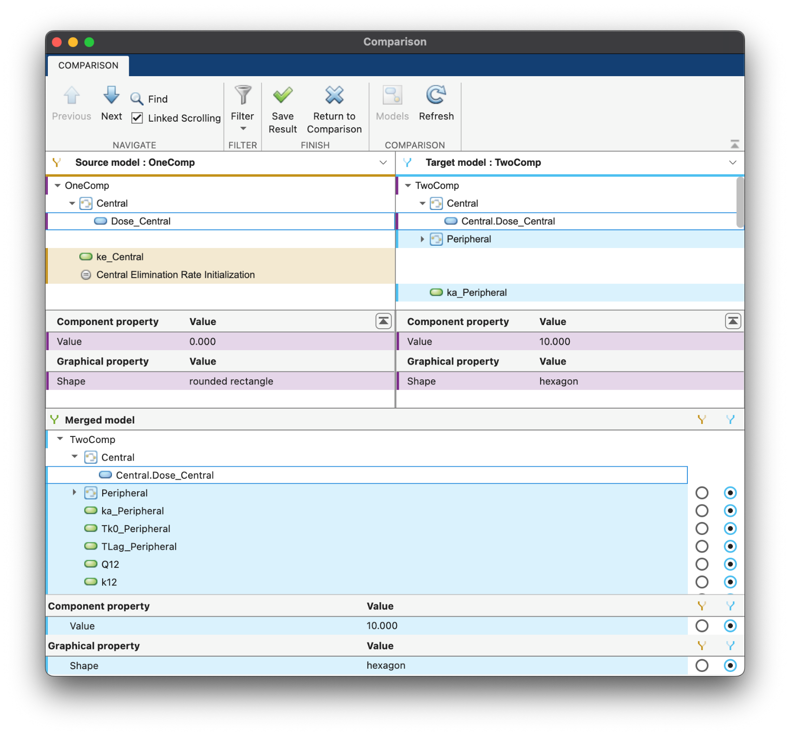

Model Comparison & Merge Merging new in
Merge Tool
Comparison of model hierarchy
Comparison of properties
Merged model hierarchy
Property value selection

Slide 6
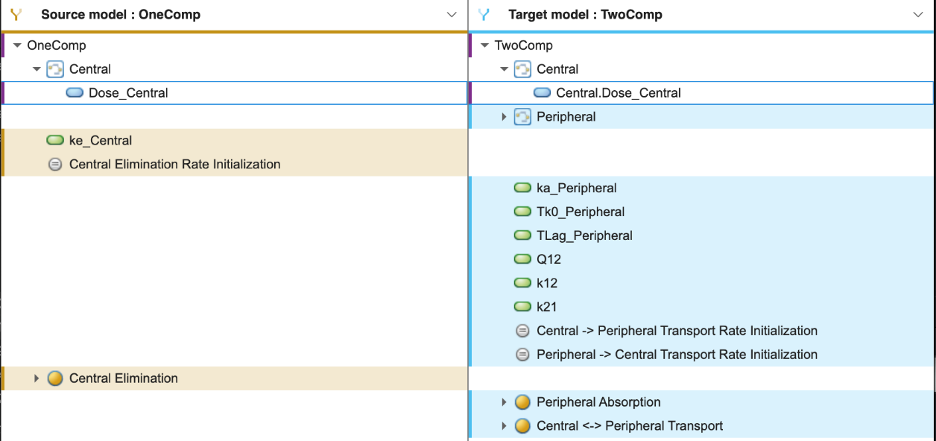
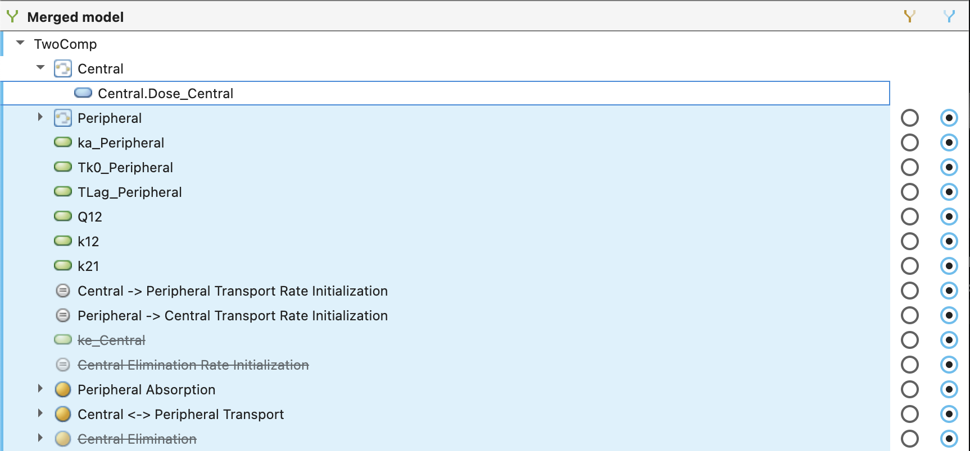

Model Comparison & Merge Merging new in
Merge Tool
Merged model hierarchy
choice of left / right side

Slide 7
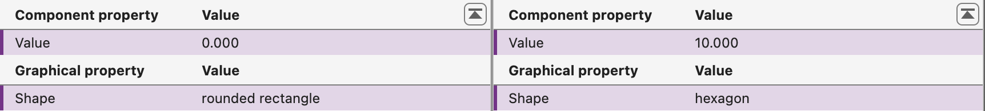
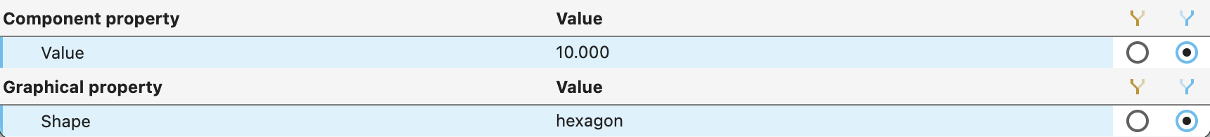
Model Comparison & Merge Merging new in
Merge Tool
Property value selection
choice of left / right side

Slide 8
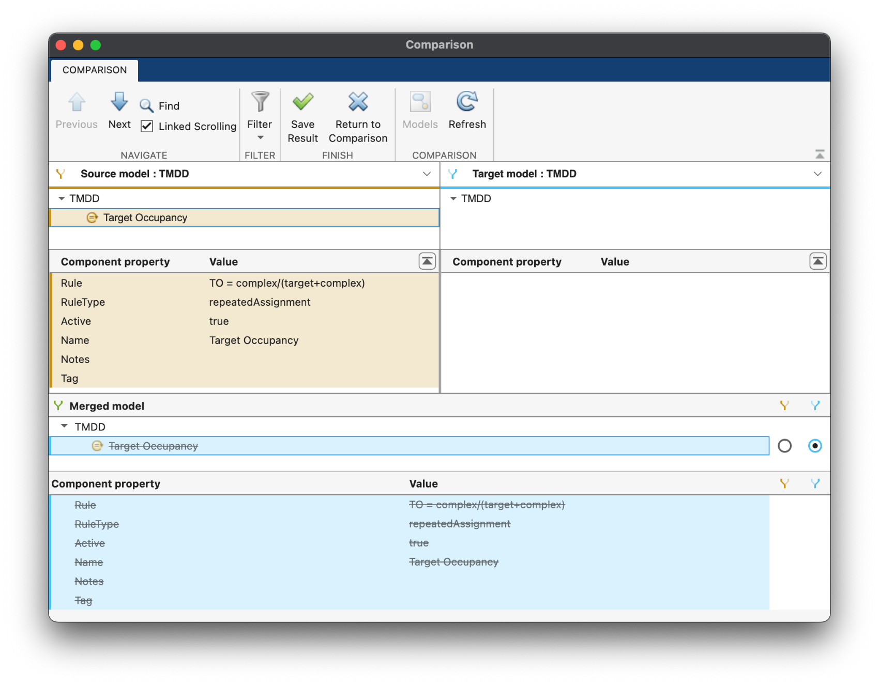
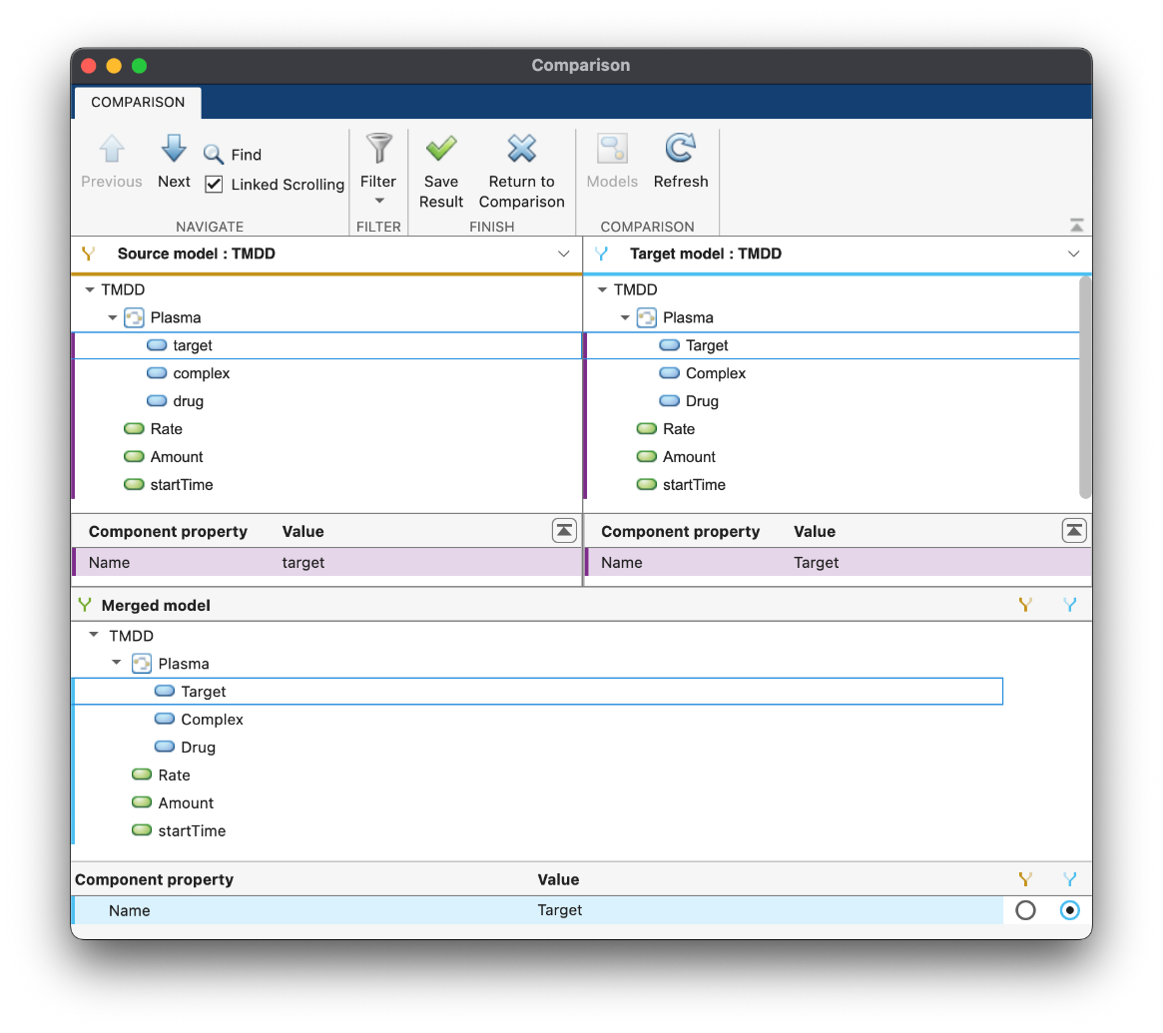

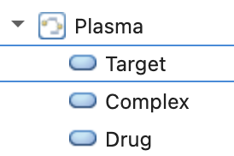
Model Comparison & Merge Merging new in
Merge Tool
Component references in reactions, …, doses, variants are updated automatically

Slide 9
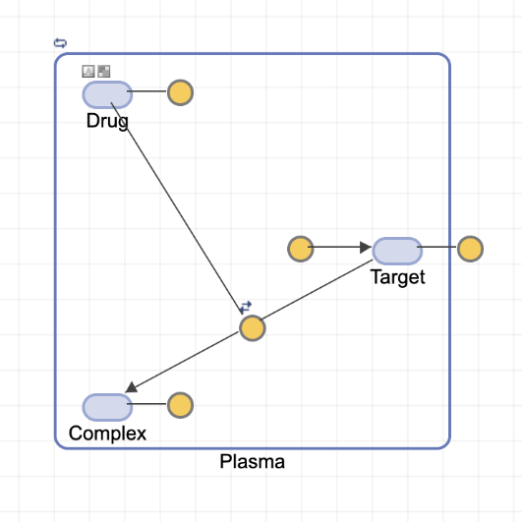
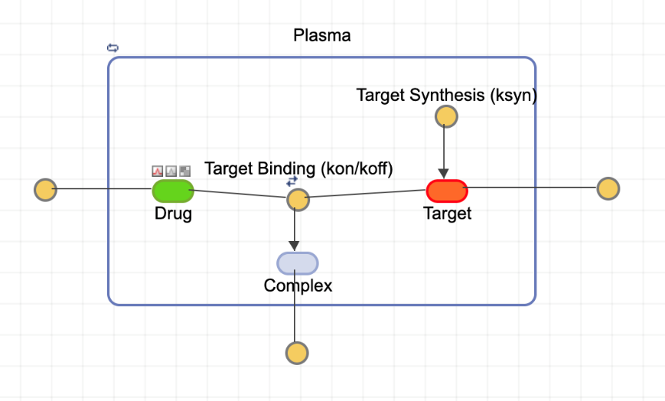
Model Comparison & Merge Merging new in
Merge Tool
Diagram is automatically created if
left-side model has a diagram
right-side model does not have a diagram
Example:
>> modelObj = sbmlimport("tmdd.sbml");
>> simbiology(modelObj)
>> simbiology("tmdd.sbproj")

Slide 10

Model Comparison & Merge Merging new in
Merge Tool
Diagram is automatically created if
left-side model has a diagram
right-side model does not have a diagram
Example:
Diagram of merged model
>> modelObj = sbmlimport("tmdd.sbml");
>> visdiff(sbiodiff(("tmdd.sbproj”, modelObj))

Slide 11
Model Comparison & Merge Merging new in
Limitations
Merging models and diagrams
Programs, results, and data are not merged
Annotation blocks are not merged
Workaround: use copy/paste to bring them over
Clones are not (yet) supported
Clones are joined into a single block in the merged model

