Slide 1
IBM Data Analyst Capstone Project Technology Trends Analysis
Prepared by:
ANNAH MOKOO
Date:
23 July 2026

Slide 2




OUTLINE
Executive Summary
Introduction
Methodology
Results
Programming Language Trends
Programming Language Trends – Findings and Implications
Database Trends
Database Trends – Findings and Implications
Job Postings
Popular Languages
Dashboard Tab1 – Current Technology Usage Dashboard
Dashboard Tab2 – Future Technology Trends Dashboard
Dashboard Tab3 – Demographics Dashboard
Discussion
Overall Findings and Implications
Conclusion
Appendix

Slide 3

EXECUTIVE SUMMARY
This project analyzes data to identify current and emerging technology trends in the software industry.
This analysis focuses on understanding demographics, technology usage, future technology preferences, and employment demand through visualizations and dashboards.
Cleaned and analyzed data
Created visualizations and interactive dashboards
Collected data through APIs and Web scraping
Key findings- Python, JavaScript, SQL, Cloud platforms, and modern databases are the most in-demand and preferred technologies.
Insights- The dashboards highlight developer demographics, current technology usage, future technology trends and job market demand.
Impact- The findings support career planning, workforce development and informed technology adoption decisions.

Slide 4

INTRODUCTION
Purpose:
To analyzes Stack Overflow Developer Survey data together with job market data to identify Current and emerging technology trends.
Target Audience:
Developers, employers, educators, students and organizations interested in technology workforce trends.
Project Scope:
The analysis focuses on developer demographics, current technology usage, future technology preferences, and employment trends.
Value:
The findings support informed decisions on career development, recruitment, technology adoption, workforce planning, and curriculum design.

Slide 5

METHODOLOGY
Data Sources
Stack Overflow Developer Survey
job posting APIs
web scraping sources.
Data Collection
API
Web Scraping
Survey Dataset
Data Wrangling
Cleaning
Filtering
Transformation
Tools
Python
SQL
IBM Cognos

Slide 6
RESULTS
The analysis produced several key findings:
Python, JavaScript, and SQL were among the most commonly used programming languages.
PostgreSQL and MongoDB showed strong growth as preferred future databases.
Cloud platforms such as AWS and Azure remain widely used.
Developers expressed growing interest in modern web frameworks including React and Node.js.
Most survey respondents were between 25 and 34 years old and held at least bachelor's degree.
The most widely used and most in-demand programming languages, databases, platforms, and web frameworks while highlighting future technology trends.

Slide 7
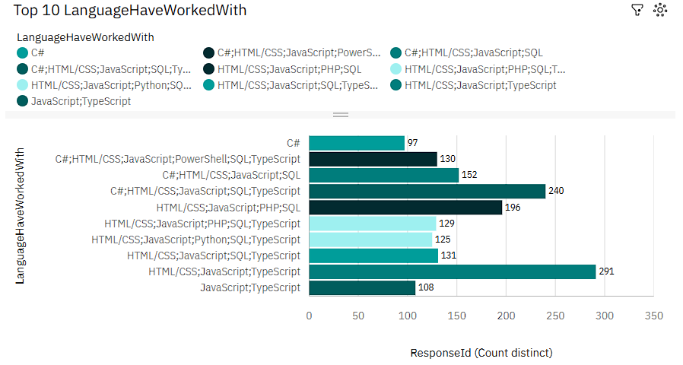
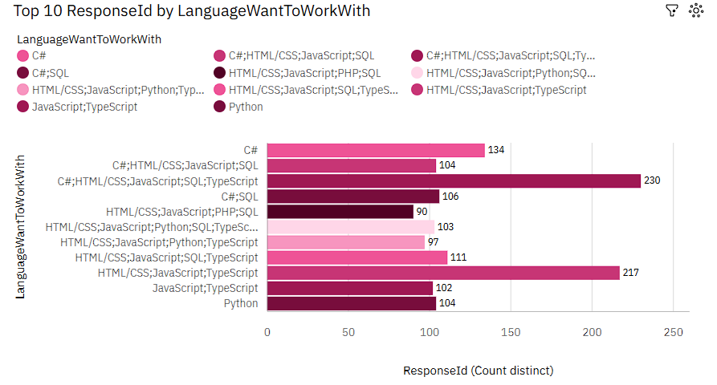
PROGRAMMING LANGUAGE TRENDS
Figure 1.
Bar Chart – Top 10 Programming Languages(Current Year)
Figure 2.
Bar Chart – Top 10 Programming Languages(Next Year)
Key Observation
Python and JavaScript remain the most widely used and highly desired programming languages.

Slide 8
PROGRAMMING LANGUAGE TRENDS - FINDINGS & IMPLICATIONS
Implications
Developers should prioritize learning Python, JavaScript, SQL and cloud technologies.
Organizations should prioritize these languages when planning recruitment , software development, and employee training.
Educational institutions can update curricula to reflect current industry demands.
Findings
Python and JavaScript remain highly demanded programming languages.
SQL continues to be an essential skill across industries.
Cloud computing platforms continue to dominate the technology landscape.
Overall findings
Python, JavaScript, and SQL remain essential skills across industries.

Slide 9
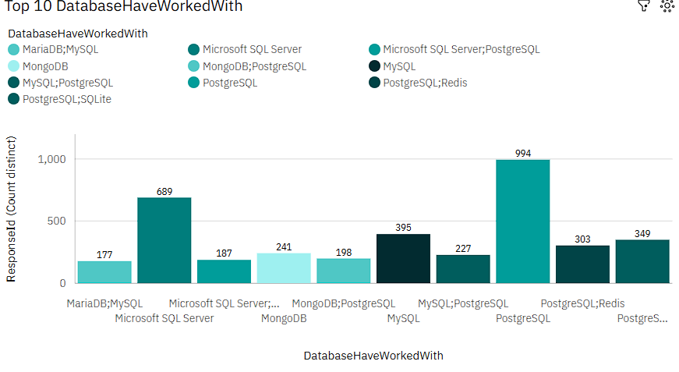
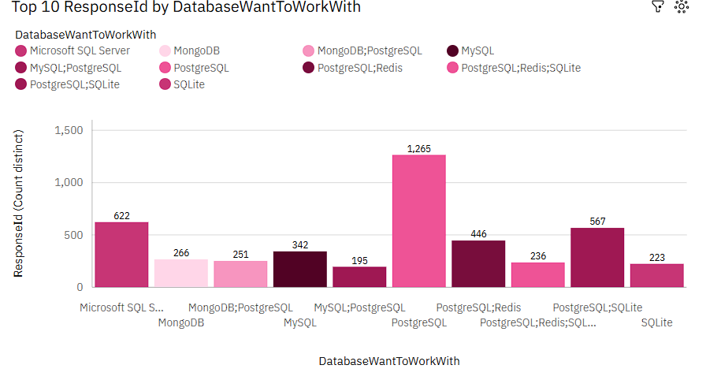
DATABASE TRENDS
Figure 3.
Bar Chart – Database Trends(Current Year)
Figure 4.
Bar Chart – Database Trends(Next Year)
Key observation
PostgreSQL and MongoDB show increasing future demand.

Slide 10
DATABASE TRENDS - FINDINGS & IMPLICATIONS
Findings
PostgreSQL, MongoDB, and MySQL are among the most popular and preferred databases.
Developers show increasing interest in modern, open-source databases for future projects.
Traditional Relational databases remain important, while NoSQL databases continue to grow in adoption.
Overall Finding
Modern databases continue to gain popularity while relational databases remain important.
Implications
Developers should build expertise in both SQL and NoSQL databases to remain competitive.
Organizations should consider adopting modern database technologies to improve scalability and performance.
Training programs and educational institutions should include both relational and NoSQL database technologies to meet industry demand.

Slide 11
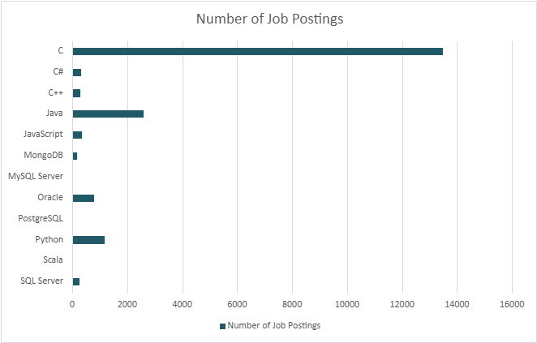
JOB POSTINGS
Figure 5.
Bar Chart – Job Postings
Observation
Python has the highest number of job postings followed by JavaScript and SQL.

Slide 12
POPULAR LANGUAGES
Figure 6.
Bar Chart – Popular Languages
Observation
Python offers one of the highest average salaries among the selected programming languages.

Slide 13
DASHBOARD
https://us1.ca.analytics.ibm.com/bi/?perspective=dashboard&pathRef=.my_folders%2FDemographics&action=view&mode=dashboard&subView=model0000019f7f3c4741_00000000&nav_filter=true

Slide 14
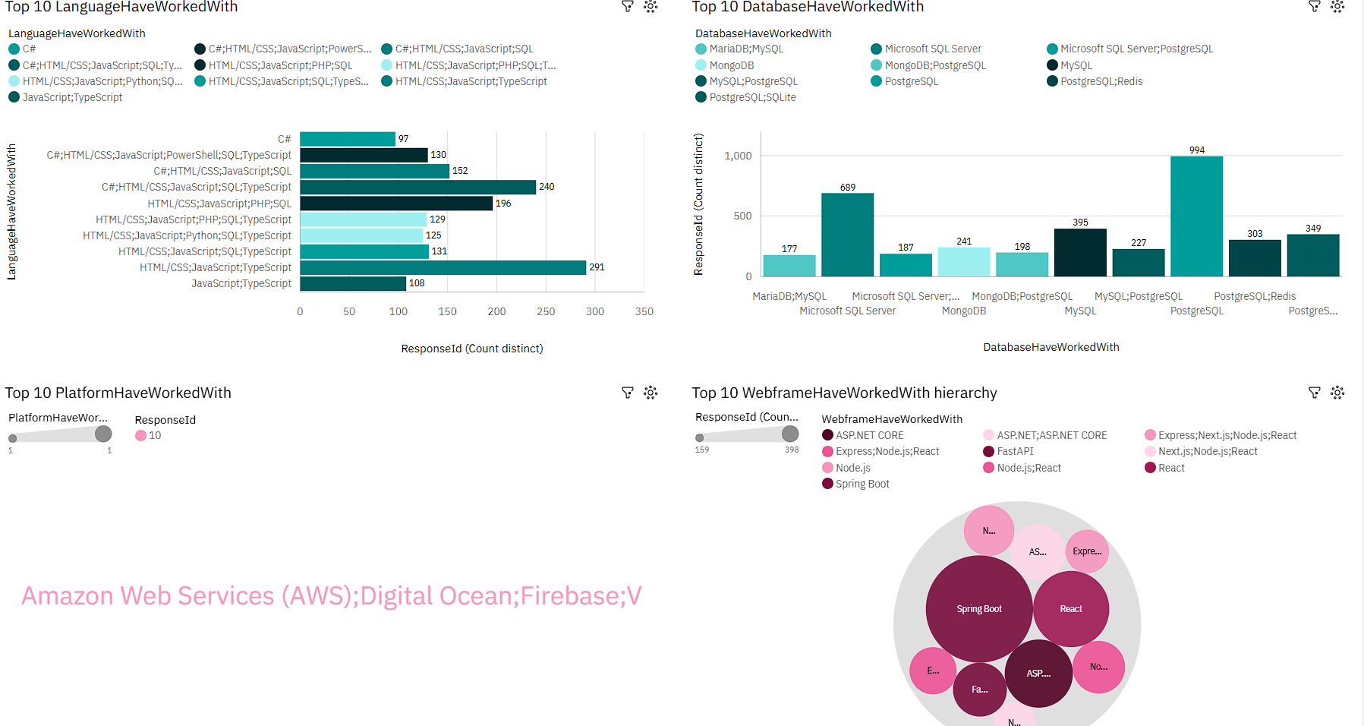
Dashboard Tab1- Current Technology Usage
Top 10 Programming Languages
Top 10 Databases
Top 10 Platforms
Top 10 Web Frameworks

Slide 15
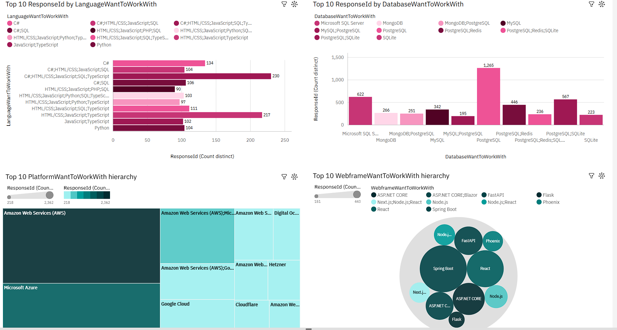
Dashboard Tab2- Future Technology Trends
Future Programming Languages
Future Databases
Future Platforms
Future Web Frameworks

Slide 16
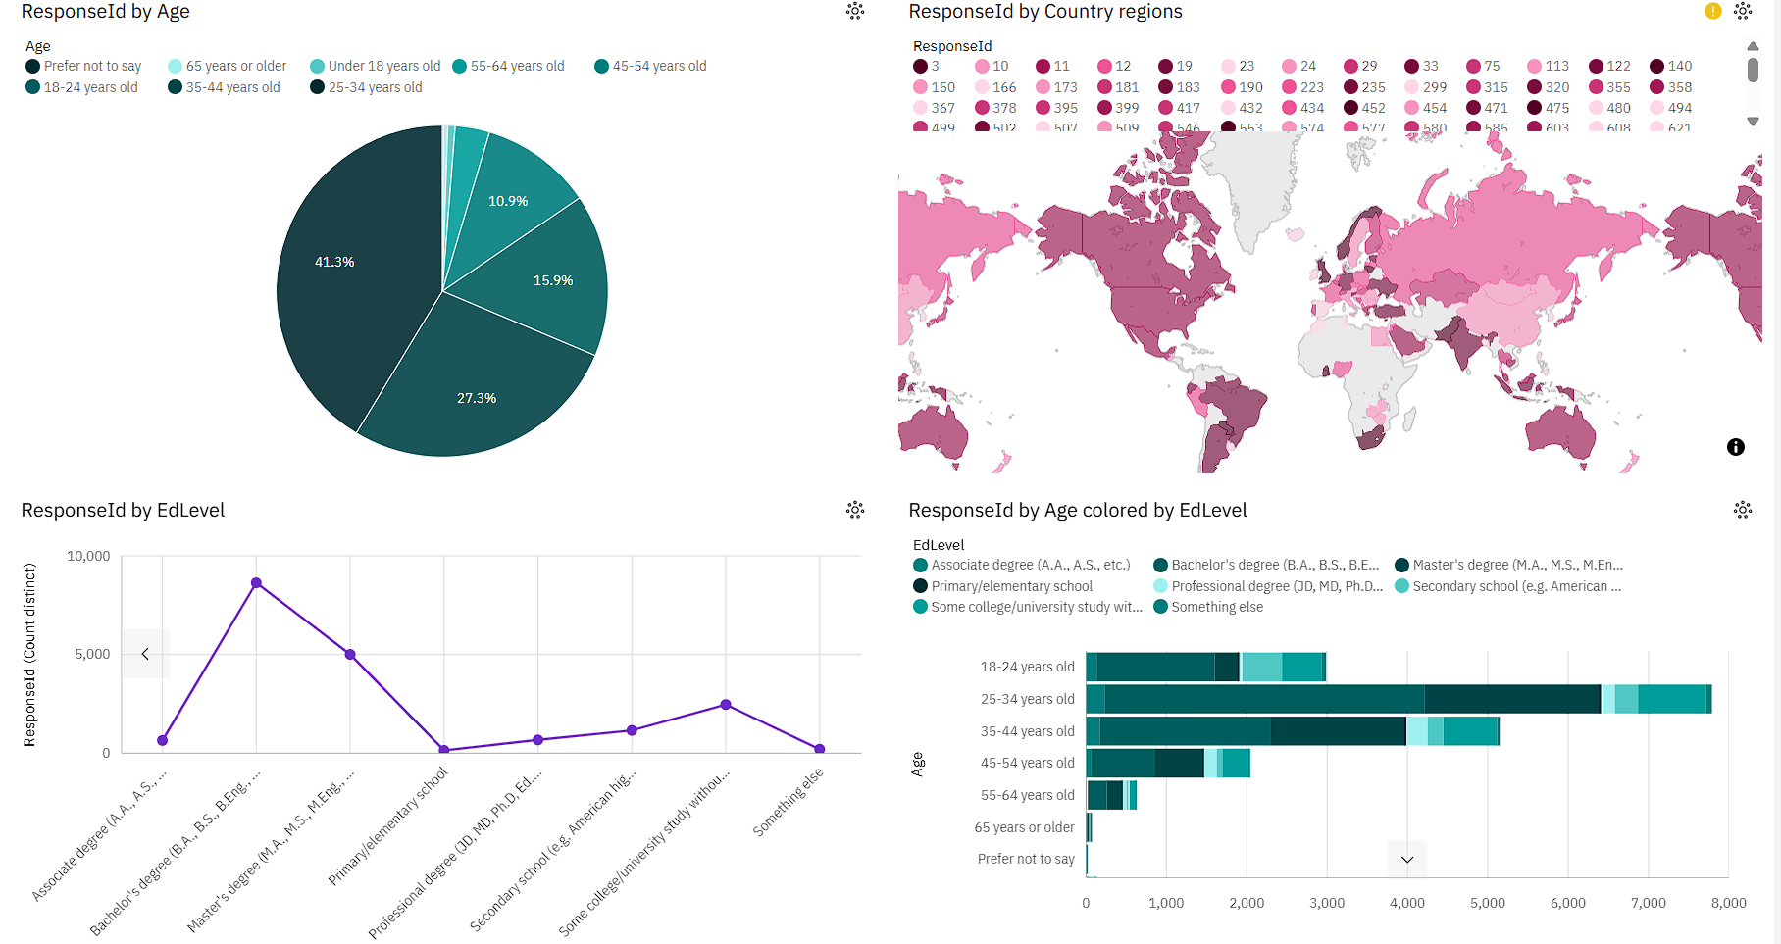
Dashboard Tab3- Demographics Dashboard
Respondent Age
Respondent Country
Educational Level
Age by Educational Level

Slide 17
DISCUSSION
The analysis demonstrates that while established technologies such as JavaScript, Python, SQL and cloud platforms continue to dominate the industry, developers increasingly prefer modern technologies like PostgreSQL, MongoDB, React, and cloud-native platforms. The comparison between current usage and future preferences suggests a gradual shift toward newer technologies while maintaining demand for widely adopted programming languages.
Overall, the analysis shows that established technologies remain relevant while modern technologies continue to gain adoption.

Slide 18
OVERALL FINDINGS & IMPLICATIONS
Findings
Python, JavaScript, SQL, and cloud technologies remain the most widely used and in-demand skills.
Developers are increasingly interested in modern databases, web frameworks, and cloud platforms for future work.
The analysis highlights changing technology preferences, reflecting the industry's shift toward modern and scalable technologies.
Implications
Developers should continuously update their skills to stay aligned with current and emerging technology trends.
Organizations can use these insights to guide hiring, workforce planning , and technology investment decisions.
Educational institutions should align curricula with industry demands to better prepare learners for technology careers.
Overall Conclusion
Technology trends indicate continuous growth in cloud computing, modern databases, and python-based development.

Slide 19

CONCLUSION
Successfully analyzed developer survey and job market data to identify current and future technology trends.
Developed visualizations and dashboards that clearly present technology adoption, developer preferences, and employment demand.
Identified key technologies and skills that are in demand and expected to remain relevant in the future.
The insights can support career planning, organizational decision-making, and curriculum development for the technology industry.
Project Outcome
The project successfully met its objective of identifying current and future technology trends using survey and job market data

Slide 20
APPENDIX
https://us1.ca.analytics.ibm.com/bi/?perspective=dashboard&pathRef=.my_folders%2FDemographics&action=view&mode=dashboard&subView=model0000019f7f3c4741_00000000&nav_filter=true
Data sources
Stack Overflow Developer Survey
Job posting API dataset
Programming languages salary dataset
Tools & Technologies
Python(Pandas, Matplotlib, BeautifulSoup, Requests)
SQL(SQlite)
IBM Cognos Dashboard Embedded
Jupyter Notebook
Microsoft PowerPoint
Analysis Performed
Data cleaning and preprocessing
API data collection
Web scraping
Exploratory Data Analysis
Data visualization
References
Stack Overflow Developer Survey
IBM Skills Network Labs
Software Used
IBM Cognos Dashboard Embedded
Python
SQL
Microsoft PowerPoint
Jupyter Notebook

