Slide 1


Student Details
NAME: CHAUHAN MAULIK BHAVYKETU
EMAIL ID: maulikchauhan124@gmail.com
COLLEGE NAME: LDRP - ITR
COLLEGE STATE: GUJARAT
DOMAIN: ARTIFICIAL INTELLIGENCE
START DATE & END DATE: 18 AUG 2023 TO 30 AUG 2023

Slide 2

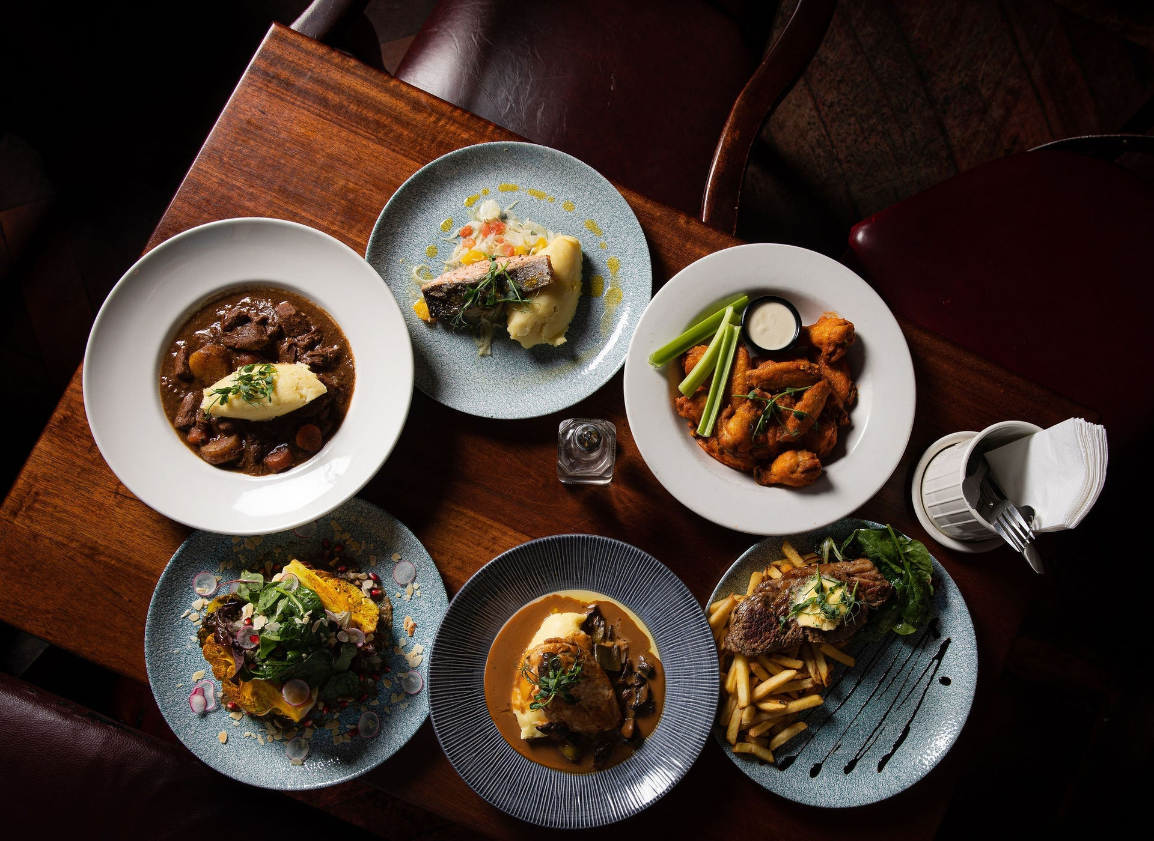

sentiment analysis of Restaurant reviews
Restaurant review sentiment analysis involves using machine learning or natural language processing techniques to analyze text-based reviews of restaurants. The goal is to determine the sentiment expressed in each review, classifying it as positive, negative, or neutral. This analysis helps restaurants and review platforms gauge customer satisfaction, identify areas for improvement, and make data-driven decisions. The process includes data collection, text preprocessing (cleaning, tokenization, and more), feature extraction to convert text into numerical data, model selection and training, sentiment prediction, evaluation, and continuous improvement. Effective sentiment analysis can provide valuable insights into customer opinions, helping restaurants enhance their services and reputation in a highly competitive industry.

Slide 3




AGENDA
Project Kickoff: Define goals and roles.
Data Collection: Gather restaurant reviews.
Data Preprocessing: Clean and tokenize text.
Feature Engineering: Convert text to numerical data.
Model Selection: Choose sentiment analysis model.
Model Training: Train and evaluate models.
Deployment: Integrate into restaurant platforms.
Monitoring: Continuously assess model performance.
Feedback Loop: Gather user feedback for improvements.
Conclusion: Present insights and future recommendations.

Slide 4

Project Overview
This project aims to analyze sentiments expressed in restaurant reviews using natural language processing and machine learning techniques. We will collect and preprocess textual data from various review sources, transforming it into numerical features. Our selected sentiment analysis model will classify reviews as positive, negative, or neutral, providing valuable insights for restaurant owners and platforms. The project will encompass data preparation, model development, deployment, continuous monitoring, and feedback integration to enhance customer satisfaction and restaurant operations. Also This project has the potential to benefit both restaurant owners and customers. Restaurant owner use this to identify the areas where they can improve their service and customers can use this to search restaurant as per their taste.
Data Preprocessing
Model Training
Model Evaluation

Slide 5


users
The users of the sentiment analysis of restaurant reviews project are:
Restaurant owners: Restaurant owners can use the model to identify areas where they can improve their service or food quality. For example, if the model identifies that they have less customers in the different areas so that, the restaurant owner can take steps to improve the speed of service.
Customers: Customers can use the model to quickly and easily find restaurants that are suitable for them and their family. For example, if a customer is looking for a restaurant with good food and less budget so that they can use the model to find restaurants that have mostly positive reviews.
Sentiment analysis helps restaurant owners and managers gauge customer satisfaction and identify areas needing improvement based on customer reviews. And also analyzing sentiments in competitor reviews can provide insights into their strengths and weaknesses.
Sentiment analysis assists customers in making informed choices by providing summarized sentiments in reviews. Also it is use to encourages customers to express their opinions and experiences, leading to better service quality.

Slide 6





Solution & value proposition
Solution: The restaurant review sentiment analysis solution involves leveraging natural language processing (NLP) and machine learning techniques to automatically analyze and categorize customer reviews of restaurants into positive, negative, or neutral sentiments.
Value Proposition: Restaurant Review Sentiment Analysis provides a multifaceted value proposition by empowering restaurants and various stakeholders in the industry to make data-driven decisions, enhance customer satisfaction, and stay competitive in a dynamic market.
Positive
Review
Model
Negative

Slide 7

Wow in system
Data Collection
Scalable
Automated preprocessing
Real time analysis
Feedback loop
Marketing integration
Flexible
Higher accuracy

Slide 8
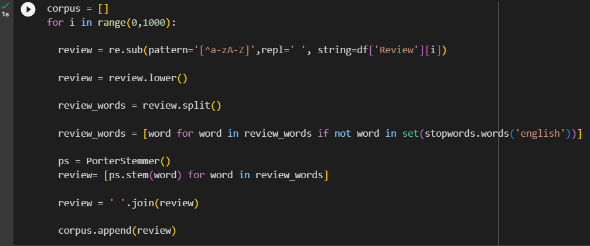
Modelling
The algorithm was developed in four stages
Data Cleaning : Before using data for model training its essential to clean the data. Identifying and eliminating duplicate reviews to ensure data accuracy. Stripping HTML tags and formatting to extract only the textual content. Eliminating punctuation marks, symbols, and special characters that don't contribute to sentiment analysis. And also remove the stopwords.

Slide 9
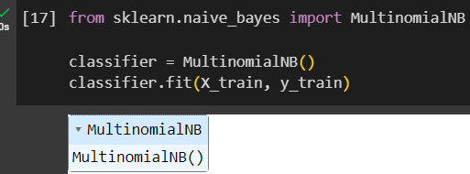
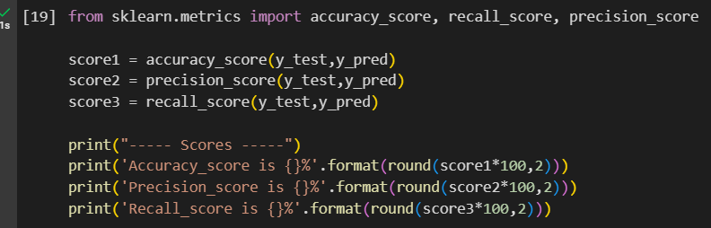
MODELLING
Model Training & Evaluation : After the training of model is done the model is evaluated using three performance testing parameters accuracy, precision and recall. during model training for sentiment analysis, accuracy provides a holistic view of performance, precision emphasizes the correctness of positive predictions, and recall focuses on the model's ability to capture positive sentiments accurately. Balancing these parameters is essential for a well-rounded sentiment analysis model.

Slide 10
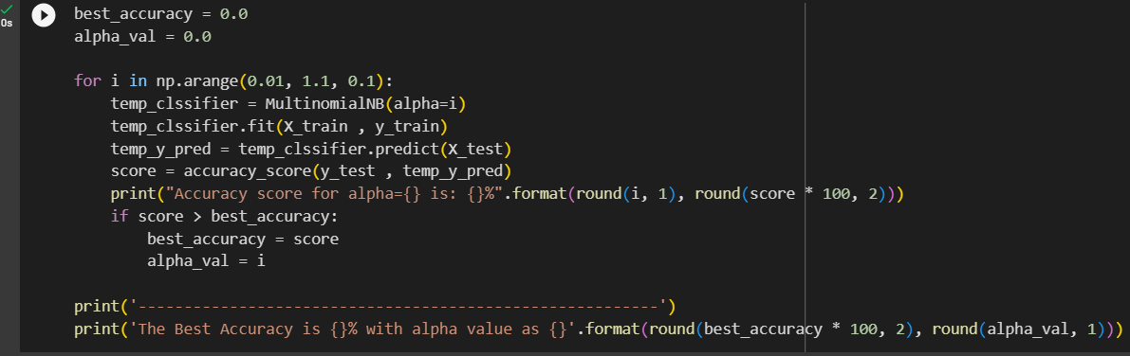
MODELLING
Hyperparameter Tuning: Hyperparameter tuning is a critical step in improving the accuracy and effectiveness of restaurant reviews sentiment analysis models, enabling them to capture better restaurant reviews and provide more valuable insights.

Slide 11
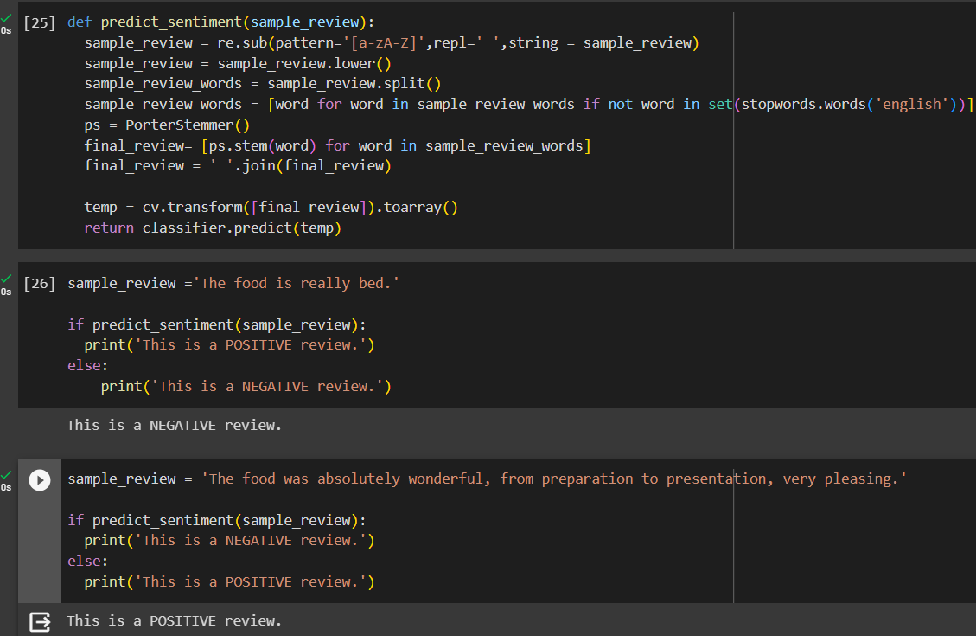
MODELLING
4. Model Testing : Testing the model with different inputs.

Slide 12
Results
The result of Restaurant Review Sentiment Analysis serves as a valuable tool for both restaurant owners and customers.
The model was accurate to predict the results for different inputs.
It allows businesses to assess customer satisfaction, make data-driven improvements, and adapt to changing customer preferences.
Customers, in turn, can benefit from summarized insights to choose the best dining experiences.

Slide 13


links
Google colab link : https://colab.research.google.com/drive/1mGeFij_0yUxSD1BUPszsp8CVyviBU18G?usp=sharing
Github link:
https://github.com/MAULIK-24/resturant_review_sentiment_analysis

Slide 14
THANK YOU

