Slide 1




Odoo 20 ERP
Implementation Project
Project Presentation
PROJECT TEAM
Rawan Tamer Gouda Mohamed Gad · Project Leader
Hager Amin Abdel Bary
Mariam Mohamed Mahmoud Amin
Amira Abdo Sayed Abdo
Habiba Waleed
Fictional company – all data is illustrative
Notes:
Welcome and introduce the project: Maven Furniture is a fictional Egyptian office-furniture manufacturer and retailer used as an Odoo 20 ERP implementation project. Introduce the five team members. Make clear that all company data is fictional and that this is a proposed implementation, not a live go-live. Suggested time: 1 minute.

Slide 2





One integrator, four functional owners
PROJECT TEAM & RESPONSIBILITIES
PROJECT LEADER
Rawan Tamer Gouda Mohamed Gad
Project Management & Accounting
COORDINATION & INTEGRATION
Project plan, milestones and cross-team coordination
Company setup and integration review across modules
Access rights, approvals and UAT coordination
Accounting ownership: COA, journals, taxes, reports
FUNCTIONAL RESPONSIBILITIES
Hager Amin Abdel Bary
Mariam Mohamed Mahmoud Amin
Amira Abdo Sayed Abdo
Habiba Waleed
Inventory & Warehousing
Procurement & Purchasing
Manufacturing & Quality
Sales & Customer Management
Warehouses, locations and UoM
Receipts, transfers, deliveries
Replenishment and stock counts
Vendors, RFQs and purchase orders
Vendor terms and follow-up
Vendor-bill handoff to Finance
BOMs and work centers
Manufacturing and work orders
Quality checks and maintenance
CRM and customer records
Quotations, orders and POS
Price lists and after-sales
Notes:
Introduce each team member and their functional area. Rawan acts as Project Leader and also owns Accounting; her role is coordination and integration: planning, company setup, access and approvals, and the cross-module integration review. Hager, Mariam, Amira and Habiba each own the processes and Odoo modules of their function from configuration through UAT and training.

Slide 3

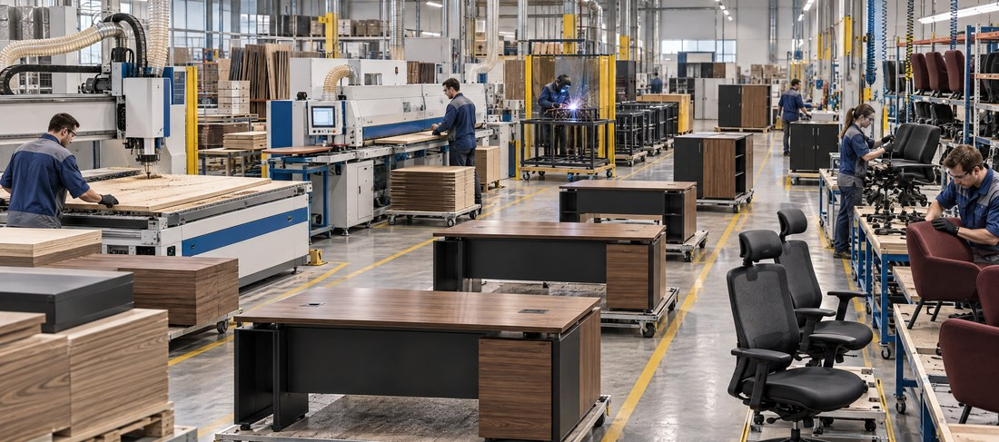

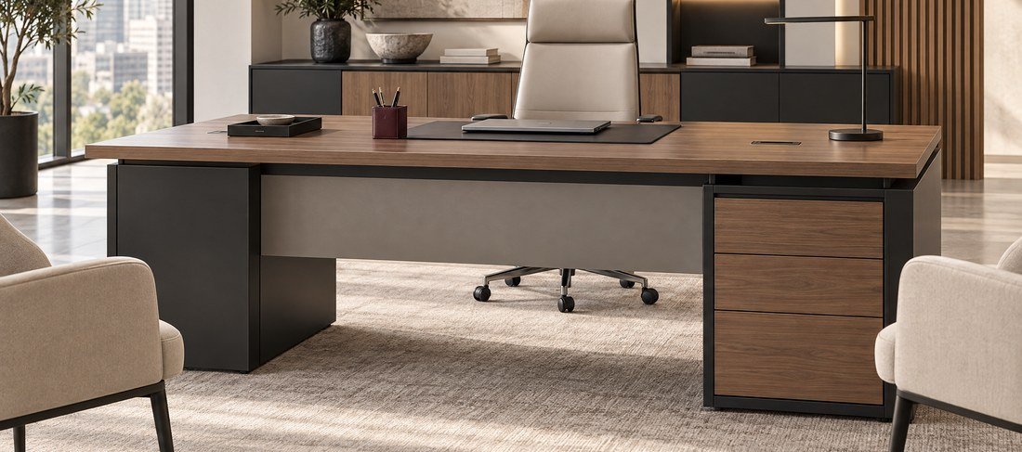

Factory-to-showroom office furniture
COMPANY PROFILE
1
Factory
1
Central warehouse
5
Showrooms
Office-furniture manufacturing, 10th of Ramadan City
Main stock hub, next to the factory
Retail network, locations to be confirmed
Business model
Customer segments
Manufacture-to-stock for standard products
Make-to-order for selected customized products
Manufacturing + retail under one operation
Installation and after-sales service
B2B corporate customers
Project and corporate orders via CRM and Sales
B2C showroom customers
Walk-in retail sales through Point of Sale
Notes:
Give the audience the business picture: one factory and a central warehouse in 10th of Ramadan City, plus five showrooms. Maven manufactures for stock and, for selected products, to order. Two customer segments: B2B corporate/project buyers and B2C walk-in showroom customers. Note that showroom locations are placeholders to be confirmed by the team. Photos of the factory, warehouse and showrooms will be added manually.

Slide 4



Five challenges, five ERP objectives
BUSINESS CHALLENGES & PROJECT OBJECTIVES
BUSINESS CHALLENGE
ERP OBJECTIVE
Inventory across multiple locations
Stock split between warehouse, factory zones and showrooms
Real-time stock by warehouse and location, with traceable internal transfers
Procurement and supplier coordination
Requests and vendor terms handled informally
Controlled RFQ-to-PO flow with vendor comparison and approvals
Production planning and cost tracking
Material use and production status tracked manually
BOM-driven manufacturing orders with consumption and cost visibility
Sales and delivery coordination
Quotes, orders and deliveries not linked end to end
One flow from CRM lead to delivery and invoice, for B2B and POS
Financial visibility and reporting
Entries recorded after the operational event
Operations post to Accounting; reports come from one source of data
Challenges describe the assumed baseline, not verified company facts.
Notes:
Walk through the five operational challenges and map each to an ERP objective. Stress that the current-state description is an assumed baseline taken from the gap analysis, not verified company facts. This slide sets up the whole solution: every later workflow answers one of these objectives.

Slide 5








Ten Odoo 20 modules in scope
PROJECT SCOPE
CRM
Sales
Purchase
Inventory
Manufacturing (MRP)
Capture and qualify B2B leads and opportunities
Quotations, price lists, sales orders and delivery triggers
RFQs, vendor comparison and purchase orders
Multi-location stock, receipts, transfers, deliveries
BOMs, work centers, manufacturing and work orders
Quality
Maintenance
Point of Sale
Accounting
Approvals
Inspection checkpoints, alerts and corrective actions
Equipment upkeep and maintenance requests
Showroom walk-in sales with cash and card sessions
Chart of accounts, journals, invoices, payments, reports
Management approval for POs, discounts and payments
Later phase / out of scope: full HR and payroll, website / eCommerce, advanced PLM, custom code and external integrations.
Notes:
These are the ten Odoo 20 modules included in the project. Describe each in one phrase. Emphasize that Approvals provides the control layer and that Accounting receives postings from all operational modules. HR/payroll, eCommerce, advanced PLM and custom development are explicitly outside this scope.

Slide 6
Odoo 20 as one integrated platform
ODOO 20 MODULES ARCHITECTURE
ODOO 20 · one database · shared master data
1
CRM → Sales
Won opportunities become quotations.
CRM
1
Sales
Point of Sale
Approvals
Sales → Inventory
Confirmed orders create deliveries and reserve stock.
2
2
3
Purchase → Inventory
PO receipts increase on-hand stock.
Purchase
3
Inventory
4
Manufacturing (MRP)
5
Quality
4
Inventory ↔ Manufacturing
Components consumed; finished goods received.
Maintenance
5
Manufacturing → Quality
Checks at work-order and final stages.
6
Accounting
Journals · receivables · payables · valuation · reports
All modules → Accounting
Invoices, bills, valuation and POS post to journals.
6
Notes:
Odoo 20 is the single integrated platform: every module shares one database and the same master data for contacts, products and warehouses. Follow the numbered connections: (1) CRM opportunities become quotations in Sales; (2) confirmed sales orders trigger deliveries and stock reservation in Inventory; (3) purchase receipts update stock; (4) Inventory and Manufacturing exchange components and finished goods; (5) Manufacturing triggers quality checks; (6) all operational modules post to Accounting. Approvals sits as a control layer over purchases, discounts and payments.

Slide 7







Controlled path from request to payment
PROCUREMENT CYCLE · PROCURE TO PAY
Purchase Request
RFQ
Vendor Comparison
Purchase Order
Goods Receipt
Vendor Bill
Payment
Purchase
Purchase
Purchase
Purchase
Inventory
Accounting
Accounting
Main controls
Module interaction
Approval threshold: POs above EGP 25,000 need management approval (proposed value)
Three-way match: PO, receipt and vendor bill checked together
Vendor comparison: price, lead time, terms and quality
Segregation of duties: Finance prepares payment, authorized approver releases
Purchase
Creates the PO and sets the expected receipt date
Inventory
Validates the receipt and updates stock by location
Accounting
Matches the bill, posts the payable and registers payment
Notes:
Procure to Pay starts from an approved purchase need or replenishment signal. Mariam runs RFQ and vendor comparison; purchase orders above the proposed EGP 25,000 threshold require management approval. Hager validates the goods receipt, which updates stock by location. Rawan's accounting side matches the vendor bill with PO and receipt (three-way match), then registers payment and reconciles. Thresholds are illustrative values.

Slide 8






From bill of materials to finished goods
MANUFACTURING CYCLE
Bill of Materials
Material Availability
Manufacturing Order
Work Orders
Production
Quality Inspection
Finished Goods
Manufacturing
Inventory
Manufacturing
Work centers
Manufacturing
Quality
Inventory
Work centers
Component consumption
Production tracking
Quality control
Capacity and routing per operation
Work orders scheduled by work center
Time recorded per operation
Components reserved on MO confirmation
Consumed as work orders progress
Scrap and variances recorded
MO and work-order status
Planned vs. produced quantities
Production cost and lead-time review
Checkpoints in-process and final
Failed check creates alert and action
Passed units move to finished stock
Notes:
Amira owns this cycle. An approved BOM defines components; Inventory confirms material availability; a manufacturing order is created and split into work orders at work centers. Components are reserved and consumed as work progresses, and production quantities and time are tracked. Quality checks run at configured checkpoints; failed checks raise an alert with a documented disposition, and finished goods are received into stock.

Slide 9


B2B projects and B2C showroom sales
SALES CYCLE · ORDER TO CASH
B2B · CORPORATE / PROJECT SALES
CRM Lead
Quotation
Sales Order
Delivery
Customer Invoice
Payment
B2C · SHOWROOM SALES THROUGH POS
POS Session Open
Showroom Sale
Cash / Card Payment
Session Close
Both lanes post to Accounting: receivable or cash/bank, revenue, tax and stock valuation.
Sales ↔ Inventory
POS ↔ Inventory
Sales / POS → Accounting
Confirmed B2B orders reserve stock or trigger replenishment, then the delivery from the correct warehouse is validated.
Each showroom sells from its own warehouse stock, which reduces on-hand quantity at session close.
Invoices create receivables; POS sessions reconcile by payment method; payments are matched to open items.
Notes:
Two sales lanes share one stock and accounting backbone. B2B: a CRM lead becomes a quotation, then a confirmed sales order, delivery, customer invoice and payment. B2C: showroom staff open a POS session, sell, take cash or card, and close the session. Habiba owns the front-office flow; Hager covers deliveries; Rawan covers invoicing, receipts and reconciliation. Approval is required for discounts above 5% and credit-limit overrides (proposed thresholds).

Slide 10
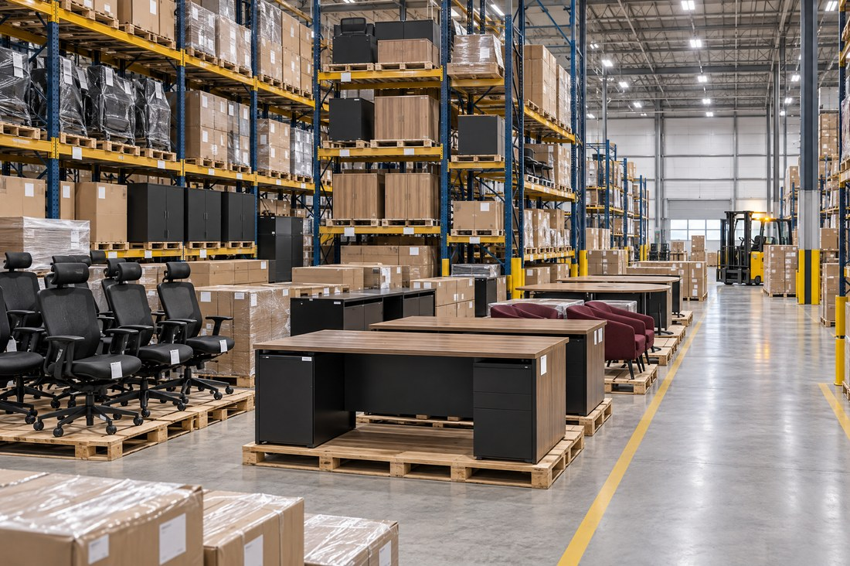
One central hub, five showroom warehouses
WAREHOUSE STRUCTURE
Suppliers
Raw materials
Central Warehouse
WH-CENTRAL · 10th of Ramadan City
Factory zones
Raw material · WIP · Finished goods · Scrap
Receipts
Internal transfers · replenishment
Showroom 1
WH-SHOW-01
Location to confirm
Showroom 2
WH-SHOW-02
Location to confirm
Showroom 3
WH-SHOW-03
Location to confirm
Showroom 4
WH-SHOW-04
Location to confirm
Showroom 5
WH-SHOW-05
Location to confirm
Warehouse operations
Receipts and putaway at the hub
Transfers to showrooms
Replenishment rules
Cycle counts with approved adjustments
Stock visibility by location
On hand
Reserved
Forecast
Reviewed per warehouse and location in Inventory. Showrooms are replenished from the central warehouse against approved need.
Notes:
Hager owns this design. The central warehouse in 10th of Ramadan City is the receiving, storage and dispatch hub, with factory zones (raw material, WIP, finished goods, scrap) modelled as locations inside it unless separate operational ownership is required. Five showroom warehouses are fed by internal transfers. Showroom cities are placeholders to be confirmed. Inventory reports show on-hand, reserved and forecast quantities by location.

Slide 11





Every operation posts to the books
ACCOUNTING STRUCTURE & FINANCIAL CONTROL
FROM OPERATION TO ACCOUNTING ENTRY
Chart of Accounts
Journals
Operational event | Typical entry (Dr / Cr)
Goods receipt · Inventory | Dr Stock valuation / Cr Stock interim (received)
Vendor bill · Purchase | Dr Stock interim or expense / Cr Accounts payable
Delivery · Inventory | Dr Cost of goods sold / Cr Stock valuation
Customer invoice · Sales | Dr Accounts receivable / Cr Revenue and tax payable
POS session close | Dr Cash or bank / Cr Revenue and tax payable
Manufacturing order | Dr Finished goods / Cr Raw materials
Localized COA reviewed before opening balances
Sales, purchase, bank, cash and stock journals
Taxes
Bank & Cash
Classified per product; validated with current law
Statement import and reconciliation, cash safes
Accounts Receivable
Accounts Payable
Customer invoices, receipts, aged receivables
Vendor bills, payments, aged payables
Inventory Valuation
Financial Reporting
Illustrative entries. Accounts, taxes and valuation method to be validated against Egyptian localization before posting.
Costing method to be approved (AVCO vs. FIFO)
Trial Balance, P&L and Balance Sheet
Notes:
Accounting is configured by Rawan and acts as the destination of every operational event. Walk through the table: receipts and deliveries drive stock valuation and cost of goods sold; vendor bills and customer invoices create payables and receivables; POS closing posts cash or bank and revenue; manufacturing orders move value from raw materials to finished goods. The entries are illustrative; account mappings, taxes and the valuation method must be validated against Egyptian localization before posting real transactions.

Slide 12
Six weeks from discovery to hypercare
IMPLEMENTATION ROADMAP
W1
W2
W3
W4
W5
W6
Discovery, requirements & process analysis
System configuration & company foundation
Procurement & inventory workflows
Manufacturing & sales workflows
Testing, UAT & user training
Cutover, go-live prep & hypercare
DELIVERABLES
DELIVERABLES
DELIVERABLES
DELIVERABLES
DELIVERABLES
DELIVERABLES
Approved scope and BRD
Process maps, data inventory
Company, COA, journals
Warehouses, products, access design
Vendor, PO and receipt flows
Opening data prepared
BOMs, work centers, quality
Sales, CRM and POS setup
UAT evidence, defect log
Role-based training
Cutover rehearsal
Go-live simulation, handover
MILESTONE
Scope & BRD approved
MILESTONE
Design signed off
MILESTONE
P2P and stock flows ready
MILESTONE
Core modules configured
MILESTONE
UAT completed
MILESTONE
Go-live acceptance, handover
Lead: Rawan + all
Lead: Rawan + Hager
Lead: Mariam, Hager, Habiba
Lead: Amira + Habiba
Lead: All; Rawan coordinates
Lead: Rawan + all
Notes:
This is the proposed six-week implementation plan. Week 1 covers discovery and scope; week 2 configuration and company foundation; week 3 procurement and inventory; week 4 manufacturing and sales; week 5 integration testing, UAT and training; week 6 cutover rehearsal, go-live simulation, hypercare and handover. The plan is a proposal: it is adjusted to team availability and scope, and no go-live has taken place.

Slide 13





Proving the system and preparing users
TESTING, TRAINING & CHANGE MANAGEMENT
Functional testing
Integrated cycle testing
User Acceptance Testing
Go-live readiness
Each module and configuration tested by its process owner
Procure-to-pay, manufacturing and order-to-cash run end to end with accounting checks
13 scenarios (UAT-01 to 13) run by business users with evidence and defect log
Cutover rehearsal, no open critical defects, formal sign-off
Department-based training
Access rights & approvals
Adoption & change
Sales: CRM, quotations, POS
Procurement: RFQ, PO, bill handoff
Warehouse: receipts, transfers, counts
Production: BOM, MO, quality
Finance: journals, reconciliation
Approvers: approval inbox
Role-based named users, least privilege
Restricted actions tested per role (UAT-11)
Over-threshold transactions need approval (UAT-12)
No shared administrator credentials
Attendance recorded for every participant
Each user completes a practical transaction
Defects logged with owner and due date
Materials stored in the project repository
Notes:
Testing moves from narrow to broad: functional tests per module, integrated business-cycle tests, then User Acceptance Testing with thirteen defined scenarios. Training is delivered by department, using scenario exercises. Access rights and approval rules are validated by deliberately attempting restricted actions and over-threshold transactions. Go-live readiness requires no open critical defects, completed training and reconciled reports. All of this describes the plan, not completed activity.

Slide 14






Expected benefits, to be measured
EXPECTED OUTCOMES
Integrated operations
Better inventory visibility
Procurement and production coordination
More accurate financial information
One database linking sales, stock, production and finance
On-hand, reserved and forecast stock by location
Material needs and replenishment visible to both teams
Operational events post to accounting with an audit trail
EXPECTED ≠ MEASURED
These are targets, not results. They will be validated through UAT evidence and a KPI review after go-live.
Better customer experience
Stronger management reporting
Scalable operational structure
Reliable delivery promises and faster order handling
Standard reports and agreed KPIs from one source
Add showrooms, products and users without redesign
Notes:
Present the seven expected benefits as targets of the design, not achieved results. Odoo has not gone live in this simulation. Explain that each benefit will be verified through UAT evidence (for example stock-by-location reports and reconciled financial statements) and through a KPI review after go-live.

Slide 15

Thank You
Maven Furniture
Odoo 20 ERP Implementation Project
Questions and discussion
Rawan Tamer Gouda Mohamed Gad · Hager Amin Abdel Bary · Mariam Mohamed Mahmoud Amin · Amira Abdo Sayed Abdo · Habiba Waleed
Notes:
Thank the audience and invite questions. Remind them that all company data is fictional and that results are expected benefits to be measured, not achieved outcomes.

