Slide 1
Software Development Life Cycle (SDLC)
Presented By-Himanshu Uniyal
Date-10/06/24

Slide 2
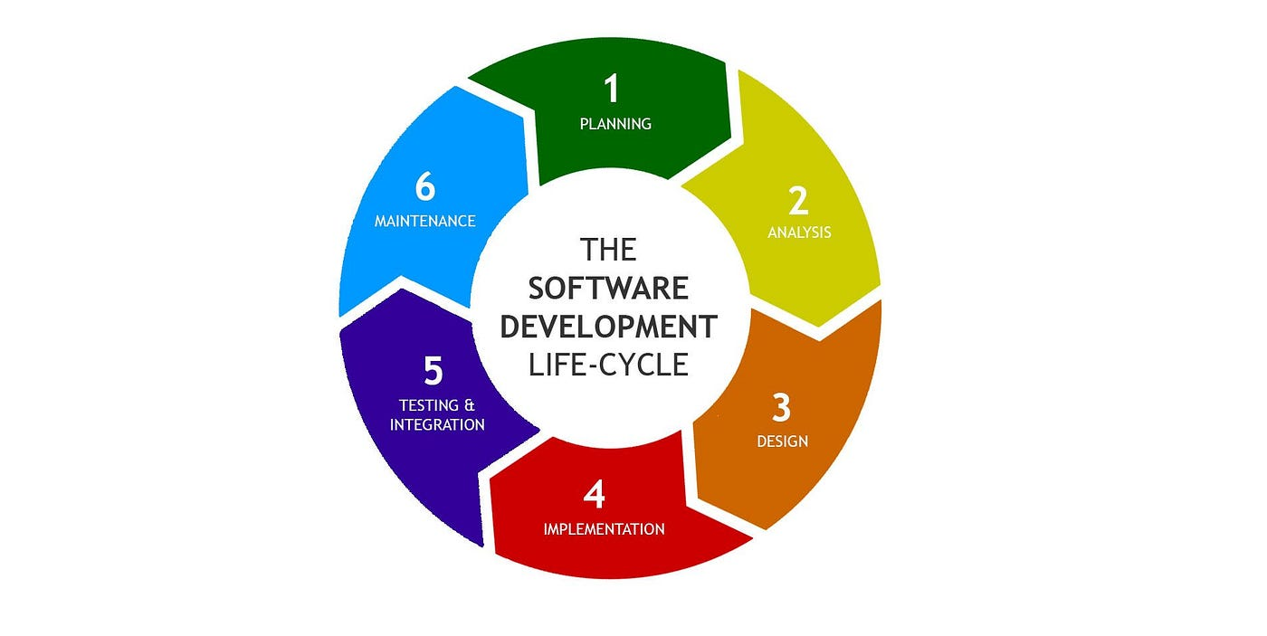
SDLC Model
A framework that describes the activities performed at each stage of a software development project.

Slide 3
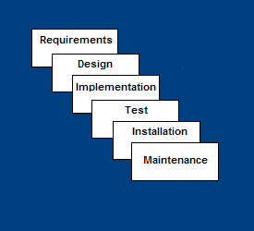
Waterfall Model
Requirements – defines needed information, function, behavior, performance and interfaces.
Design – data structures, software architecture, interface representations, algorithmic details.
Implementation – source code, database, user documentation, testing.

Slide 4
Waterfall Strengths
Easy to understand, easy to use
Provides structure to inexperienced staff
Milestones are well understood
Sets requirements stability
Good for management control (plan, staff, track)
Works well when quality is more important than cost or schedule

Slide 5
Waterfall Deficiencies
All requirements must be known upfront
Deliverables created for each phase are considered frozen – inhibits flexibility
Can give a false impression of progress
Does not reflect problem-solving nature of software development – iterations of phases
Integration is one big bang at the end
Little opportunity for customer to preview the system (until it may be too late)

Slide 6
When to use the Waterfall Model
Requirements are very well known
Product definition is stable
Technology is understood
New version of an existing product
Porting an existing product to a new platform.

Slide 7
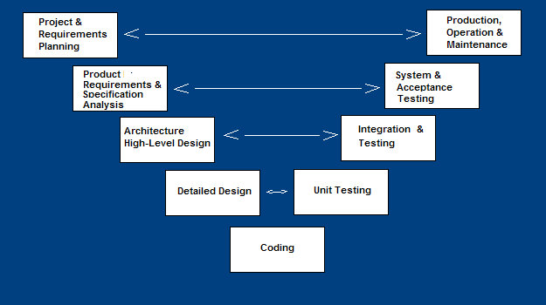
V-Shaped SDLC Model
A variant of the Waterfall that emphasizes the verification and validation of the product.
Testing of the product is planned in parallel with a corresponding phase of development

Slide 8
V-Shaped Strengths
Emphasize planning for verification and validation of the product in early stages of product development
Each deliverable must be testable
Project management can track progress by milestones
Easy to use

Slide 9
V-Shaped Weaknesses
Does not easily handle concurrent events
Does not handle iterations or phases
Does not easily handle dynamic changes in requirements
Does not contain risk analysis activities

Slide 10
When to use the V-Shaped Model
Excellent choice for systems requiring high reliability – hospital patient control applications
All requirements are known up-front
When it can be modified to handle changing requirements beyond analysis phase
Solution and technology are known

Slide 11
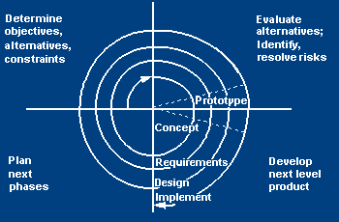
Spiral SDLC Model
Adds risk analysis, and 4gl RAD prototyping to the waterfall model
Each cycle involves the same sequence of steps as the waterfall process model

Slide 12
Spiral Model Strengths
Provides early indication of insurmountable risks, without much cost
Users see the system early because of rapid prototyping tools
Critical high-risk functions are developed first
The design does not have to be perfect
Users can be closely tied to all lifecycle steps
Early and frequent feedback from users
Cumulative costs assessed frequently

Slide 13
Spiral Model Weaknesses
Time spent for evaluating risks too large for small or low-risk projects
Time spent planning, resetting objectives, doing risk analysis and prototyping may be excessive
The model is complex
Risk assessment expertise is required
Spiral may continue indefinitely
Developers must be reassigned during non-development phase activities
May be hard to define objective, verifiable milestones that indicate readiness to proceed through the next iteration

Slide 14
When to use Spiral Model
When creation of a prototype is appropriate
When costs and risk evaluation is important
For medium to high-risk projects
Long-term project commitment unwise because of potential changes to economic priorities
Users are unsure of their needs
Requirements are complex
New product line
Significant changes are expected (research and exploration)

Slide 15
Agile SDLC’s
Speed up or bypass one or more life cycle phases
Usually less formal and reduced scope
Used for time-critical applications
Used in organizations that employ disciplined methods

Slide 16
Strengths
Adaptability: Agile allows for flexibility in responding to change. As requirements evolve, Agile teams can adjust their processes and deliverables accordingly, ensuring that the final product meets the customer's needs effectively.
Customer Satisfaction: Continuous delivery of working software and regular feedback loops ensure that the product meets customer expectations. This customer-centric approach increases satisfaction and reduces the risk of delivering an unwanted product.
Iterative Development: Agile breaks down the project into smaller iterations or sprints, allowing teams to focus on delivering small, manageable increments of functionality. This iterative approach enables quick delivery of value and early identification of issues.
Collaborative Environment: Agile fosters collaboration among cross-functional teams, including developers, testers, designers, and business stakeholders. Regular meetings such as daily stand-ups, sprint planning, and retrospectives promote communication and teamwork.
Quality Focus: Agile emphasizes continuous integration, testing, and delivery, leading to higher quality software. By addressing defects early in the development process and incorporating feedback from stakeholders, teams can produce a more reliable product.

Slide 17
Weaknesses
Uncertainty in Requirements: Agile works well in environments where requirements are likely to change. However, if the requirements are unclear or constantly changing, it can lead to scope creep and project delays.
Dependency on Team Collaboration: Agile relies heavily on collaboration and self-organizing teams. If team members lack communication skills or if there are conflicts within the team, it can hinder progress and affect the quality of the deliverables.
Documentation Challenges: Agile prioritizes working software over comprehensive documentation. While this approach promotes flexibility, it can be challenging to maintain documentation, especially in regulated industries where documentation is essential for compliance.
Resource Intensive: Agile requires active participation from stakeholders throughout the project lifecycle. Meetings, feedback sessions, and continuous communication demand significant time and resources, which may not be feasible for all organizations.

Slide 18


THANK YOU

