Slide 1

Control an Elevator
A C# Project
Name: Mayank Agarwal
University Roll No. : 2210038

Slide 2
Table of Contents
~ Introduction C#
~ Introduction .NET
~ Introduction MS Access Database
~ About Elevator Control
~ Aims and Objectives
~ Requirements
~ Working Specifications
~ Graphical User Interface
~ Experience

Slide 3
Introduction C#
C# (pronounced "See Sharp") is a modern, object-oriented programming language.
Makes Secured and robust applications that run in “.NET”
C# has its roots in the C family of languages and will be immediately familiar to C, C++, Java, and JavaScript programmers.

Slide 4
Introduction .NET
.NET is a free, open source cross-platform, platform for building many different types of applications.
You can design .NET apps in C#, F#, or Visual Basic.
With .NET, you can build for web, mobile, desktop, games, IoT, and more.

Slide 5
Introduction MS Access Database
Database Management System (DBMS) designed by Microsoft
Combines the relational Microsoft Jet Database Engine with a graphical user interface and software-development tools

Slide 6


—About Elevator control
“Designed under the assignment-01 of CIS016-2 “OBJECT ORIENTED PROGRAMMING AND SOFTWARE ENGINEERING”, it displays working of a elevator system for two floors using C# .NET Framework designed under visual studio 2022”

Slide 7
Aim and Objectives
To check the knowledge of OOPs concept and C# programming
Designing an attractive and working lift system with its controller

Slide 8
Requirements
Hardware
Software
Functional
Minimum 2 Gb RAM
Storage capacity
Visual Studio
Database
.NET Framework specifications
Functioning control panel
Database connectivity

Slide 9
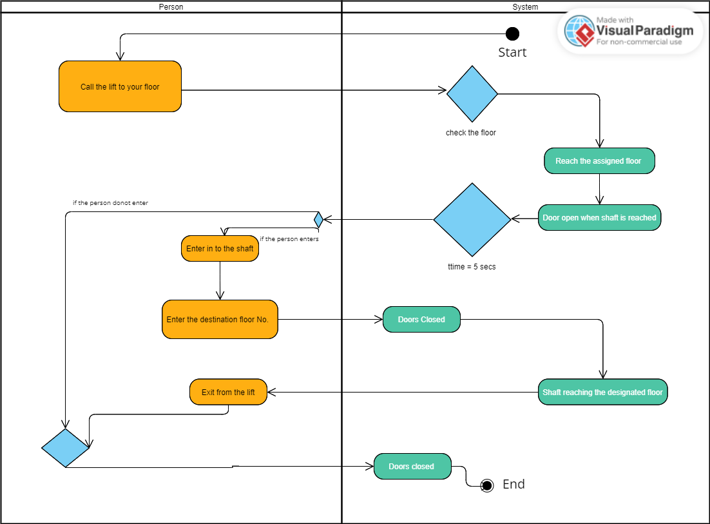
Working Specifications

Slide 10
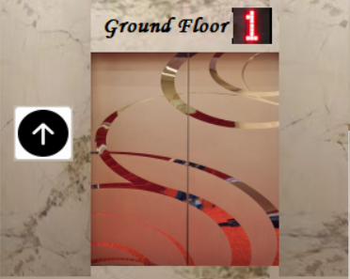
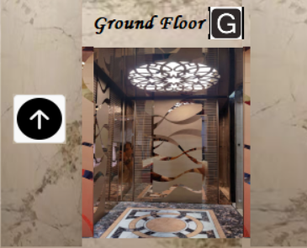
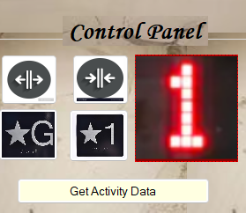
Graphical User Interface
Showcase of ground floor when door is closed and lift is currently at first floor
Showcase when the shaft reaches ground floor and door is open
Control panel consisting of buttons to provide command to the system

Slide 11

Experience
This has been wonderful experience working in C# .NET Framework using visual studio and MS Access Database, clearing my concepts for OOPs and would like to work more with similar concept in future also. I will be looking to take more projects like Elevator controller and many more under C# Programming Language.

Slide 12

THANK YOU!!

